Slide 1




The session will start in a few moments and will be recorded
Please turn off your microphone and camera
To ask a question, please use the chat
If there is not enough time to answer all your questions, feel free to send them by email after the session (valerie.durieux@ulb.be)
You are at the Zotero session

Slide 2

Zotero 6.0
Open-source reference management software
Valérie DURIEUX - valerie.durieux@ulb.be
Spécialiste de l’information documentaire en Sciences de la Santé
Dép. des bibliothèques et de l’information scientifique

Slide 3
Zotero
Open source bibliographic management software (free)
Since version 6.0, only standalone version compatible with Safari, Chrome, Firefox and Edge
Collects bibliographic references on the web
Stores and manages bibliographic information but also document captures, reading notes, ....
Generates citations and formatted bibliographies
Other software :
  Endnote (licence at ULB), Citavi (paying)
  Mendeley (free)
Notes:
Citavi : 120€ pour une licence individuelle

Slide 4

Installation & set-up

Slide 5
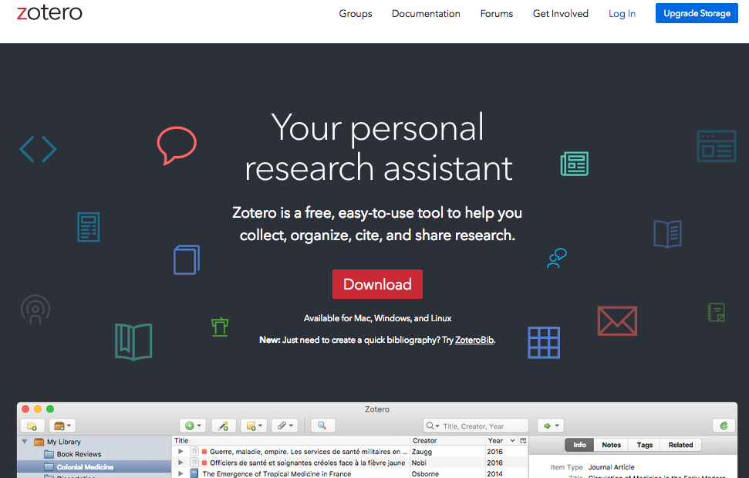
Install
Zotero
http://www.zotero.org

Slide 6
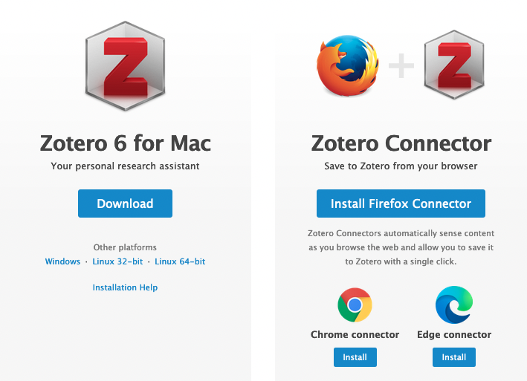
Install
Zotero :
2 steps
❶
❷

Slide 7
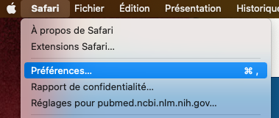
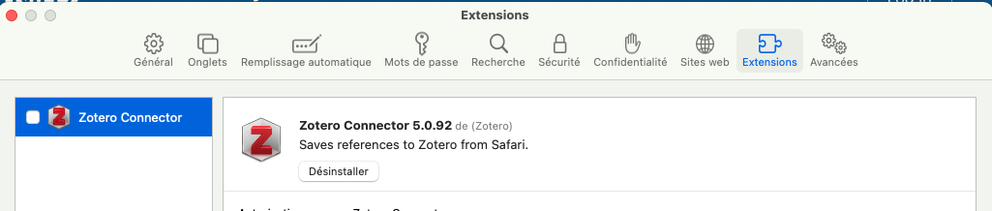
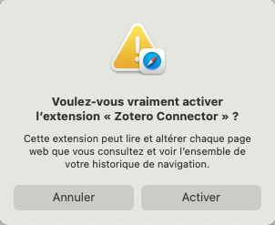
Special feature of the Safari connector
N.B. : the extension is installed by default but must be activated
select

Slide 8
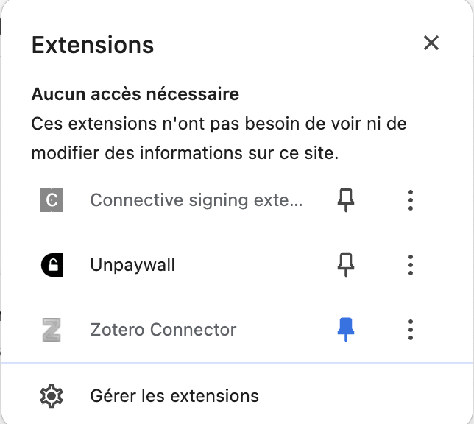
Dysplay extension in Chrome
If the extension does not appear to the right of the URL bar

Slide 9
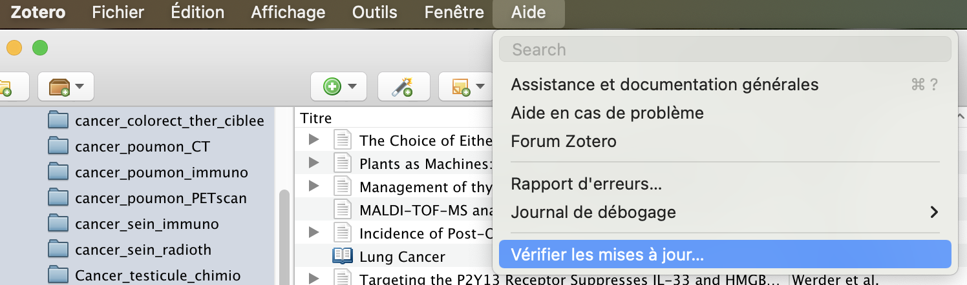
Update Zotero
N.B. : Zotero should automatically install the latest update when the application starts. However, it is possible to force the installation manually.

Slide 10
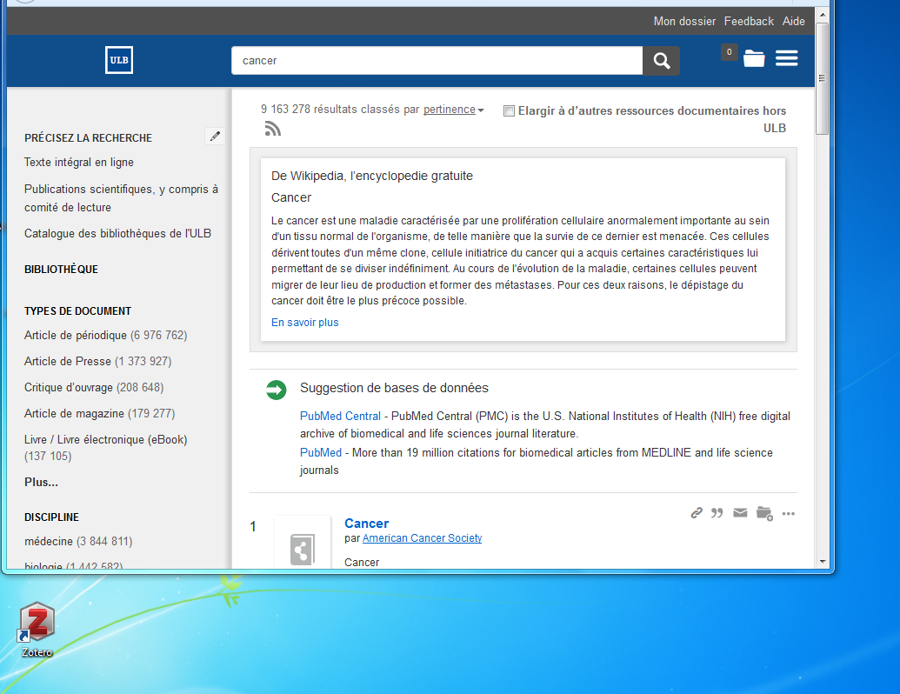
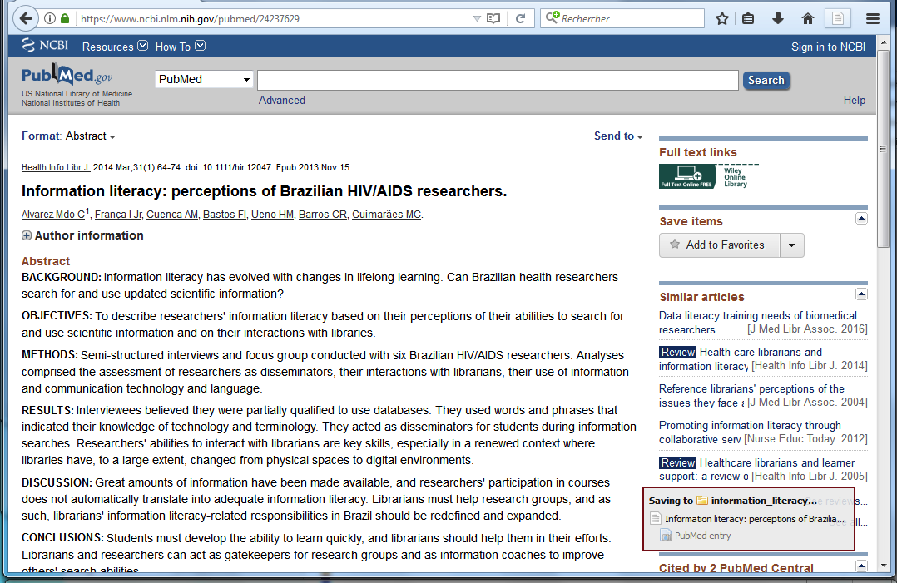
On Windows

Slide 11
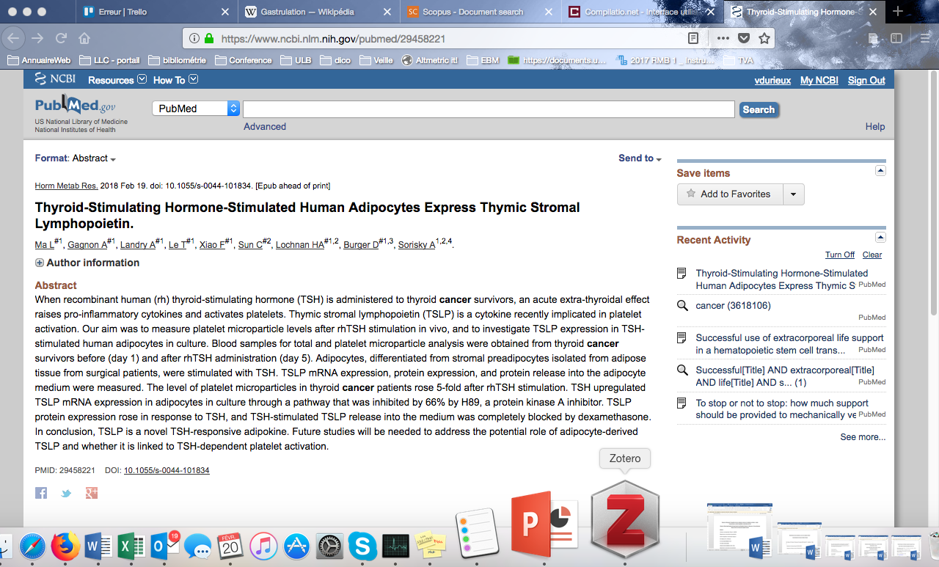
On Mac

Slide 12
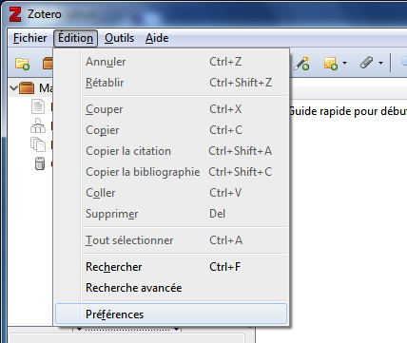
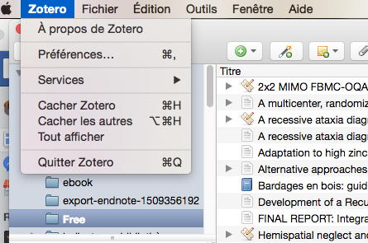
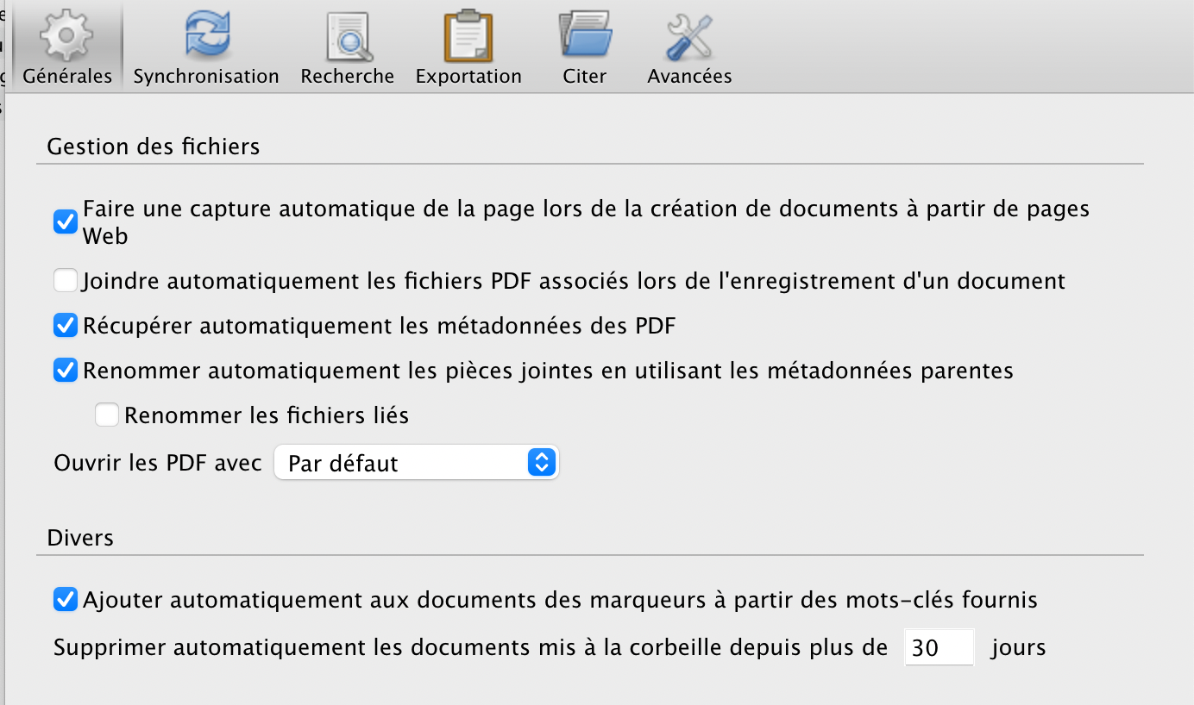
On Windows
On Mac
❶
❶
Set-up Zotero
❷

Slide 13
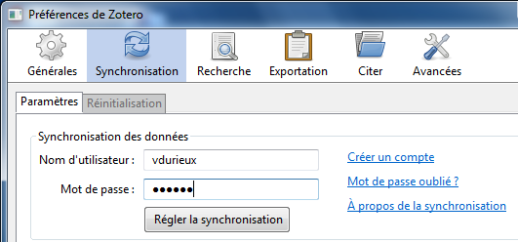
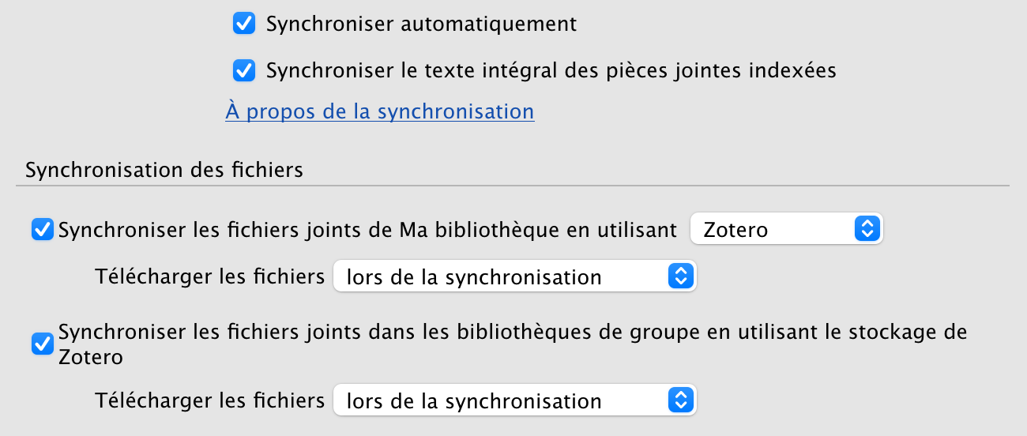
On Windows
On Mac
❶
❶
Synchronize data
❷

Slide 14
Importing & encoding bibliographic references

Slide 15
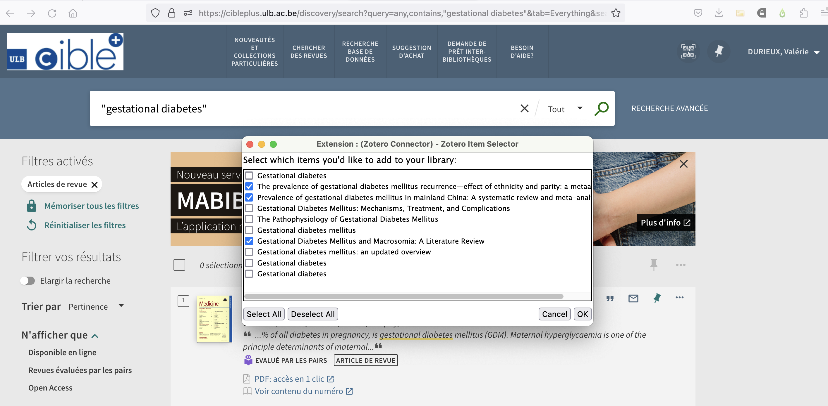
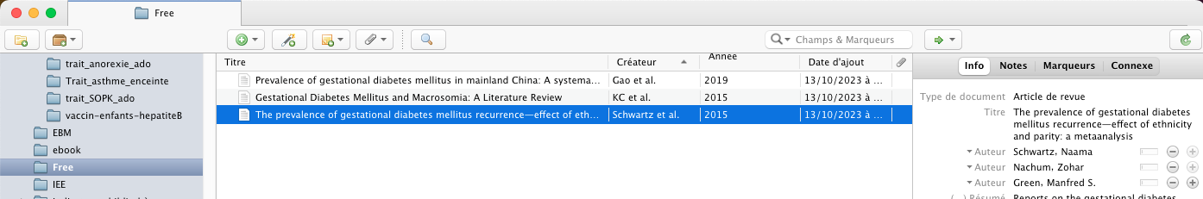
❶
❷
Collect from Cible+
❸

Slide 16
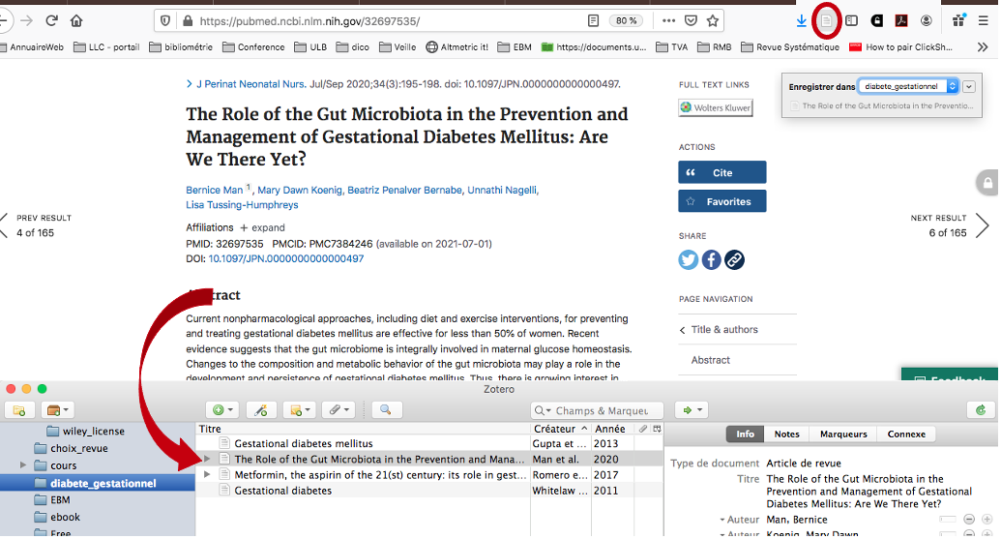
Collect from a bibliographic database

Slide 17
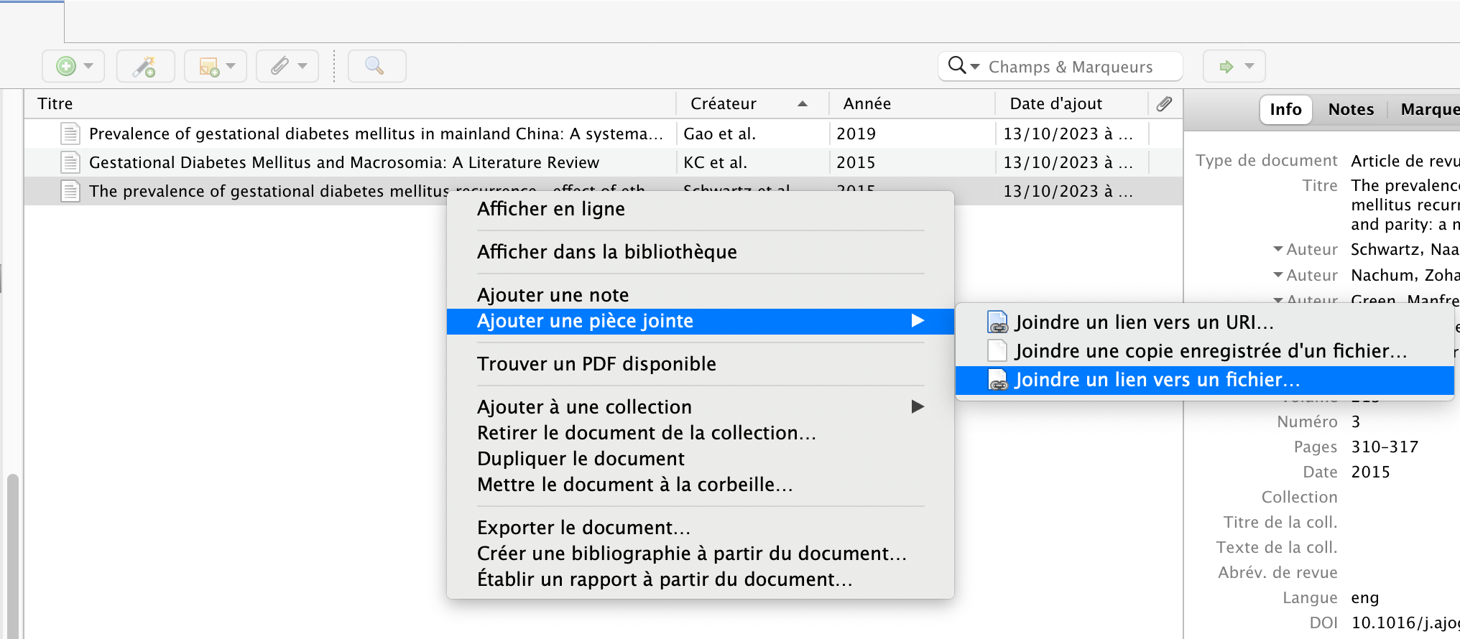
Make a link to the PDF on your computer
❶
Clic droit
❷
❸

Slide 18



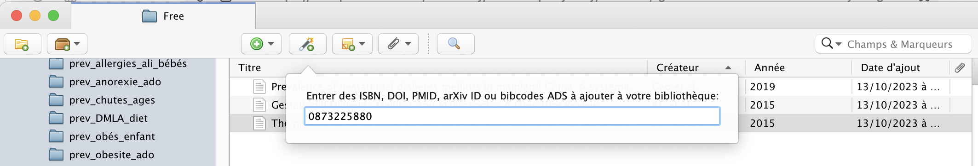
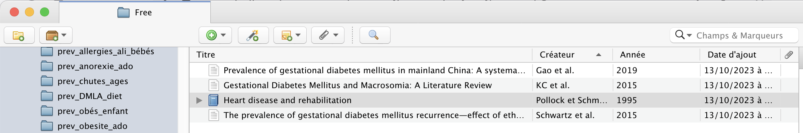
Collect with an identifier

Slide 19
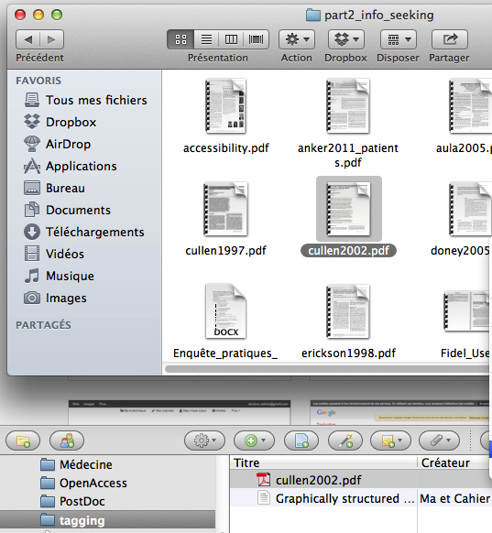

Collect from a PDF

Slide 20
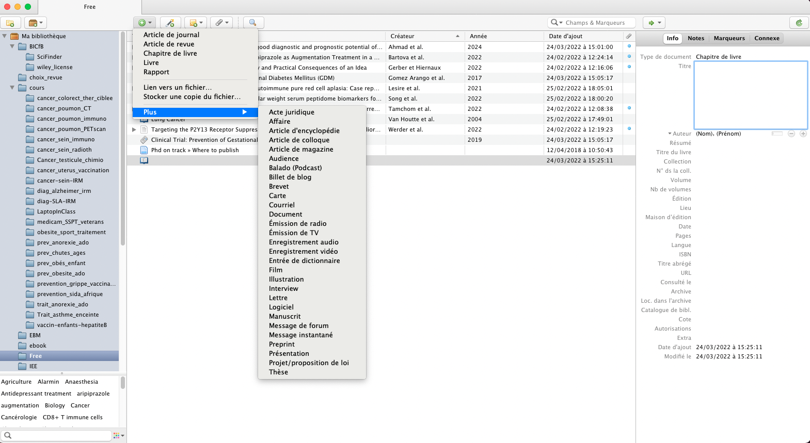
❶
❷
Create a record manually
Select
❸
Encode

Slide 21
Managing bibliographic references

Slide 22
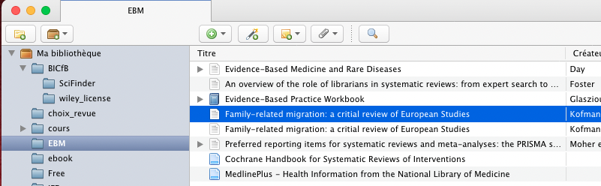

❶ Create a new collection
❷ Create/rename/delete a collection/sub-collection
❸ Add to a collection/sub-collection (drag & drop)
Manage your library
❶
❸
❷
Clic droit

Slide 23
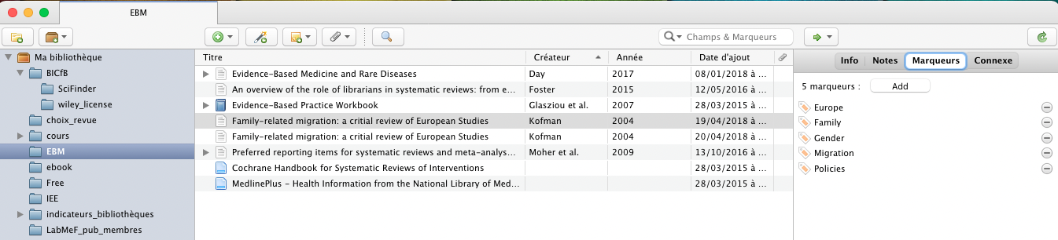
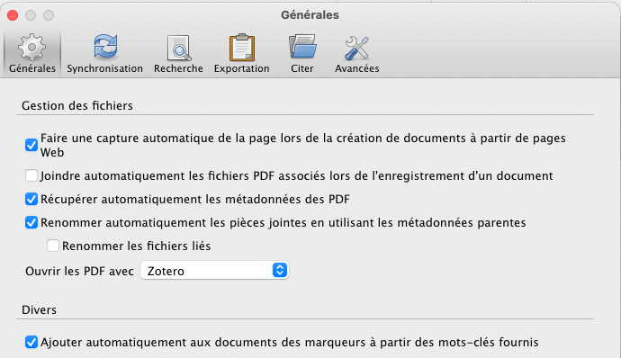
❷
❶
Tag your references
N.B. : Automatically retrieved if set in Preferences

Slide 24
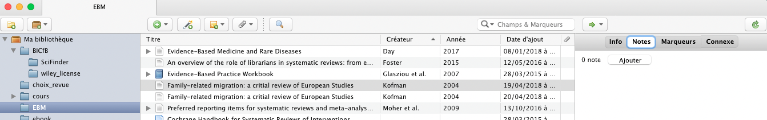
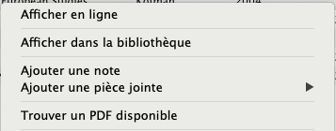
❷
❶
❸
or
Annotate your references
❶
❷
Right click

Slide 25
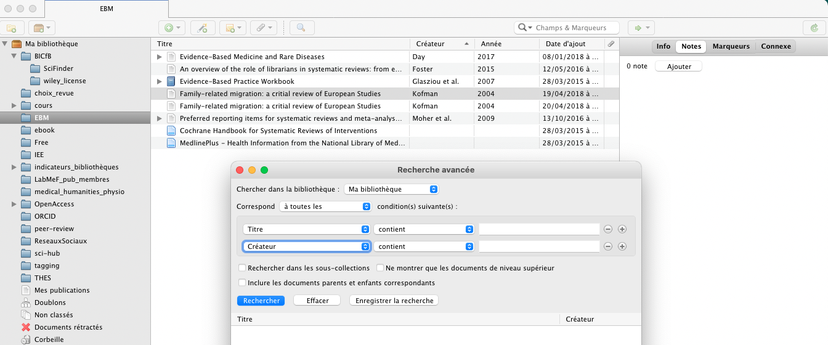
Advanced
Basic
Search your library

Slide 26
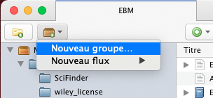
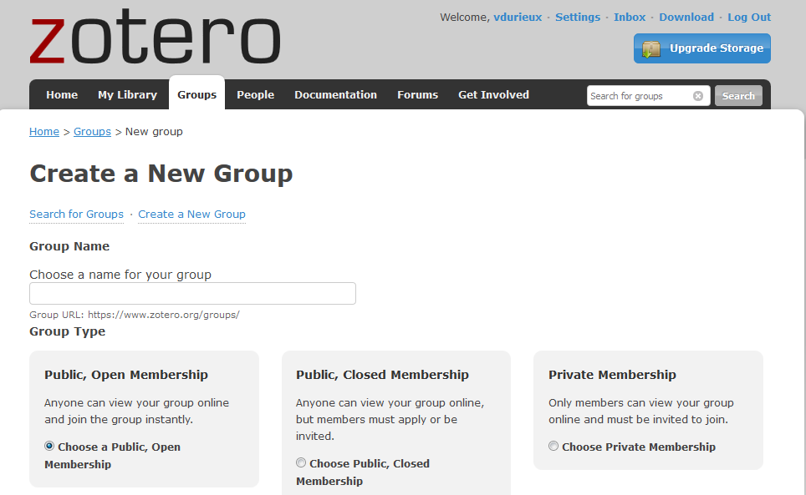
Share your references

Slide 27
Exporting/inserting bibliographic references

Slide 28
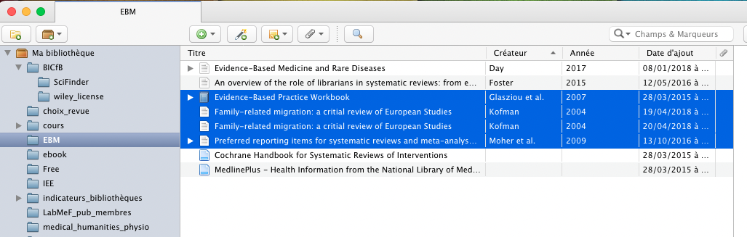
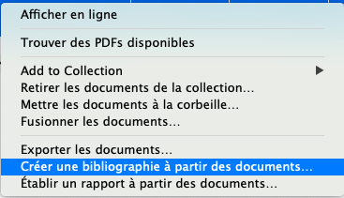
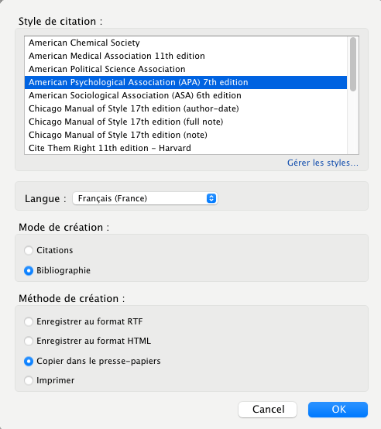
Sélectionner
❶
Export formatted bibliography
❷
Clic droit
❹
❸
Glasziou, P.P., Mar, C.D., Salisbury, J., 2007. Evidence-Based Practice Workbook, 2 edition. ed. BMJ Books, Oxford.
Kofman, E., 2004a. Family‐related migration: a critial review of European Studies. Journal of Ethnic and Migration Studies 30, 243–262. https://doi.org/10.1080/1369183042000200687
Kofman, E., 2004b. Family‐related migration: a critial review of European Studies. Journal of Ethnic and Migration Studies 30, 243–262. https://doi.org/10.1080/1369183042000200687
Moher, D., Liberati, A., Tetzlaff, J., Altman, D.G., 2009. Preferred reporting items for systematic reviews and meta-analyses: the PRISMA statement. BMJ 339. https://doi.org/10.1136/bmj.b2535

Slide 29
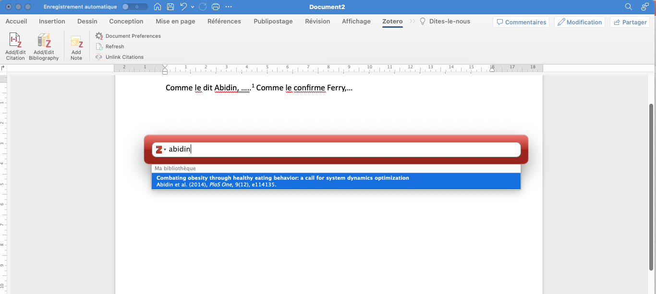
Insert citation in Word

Slide 30
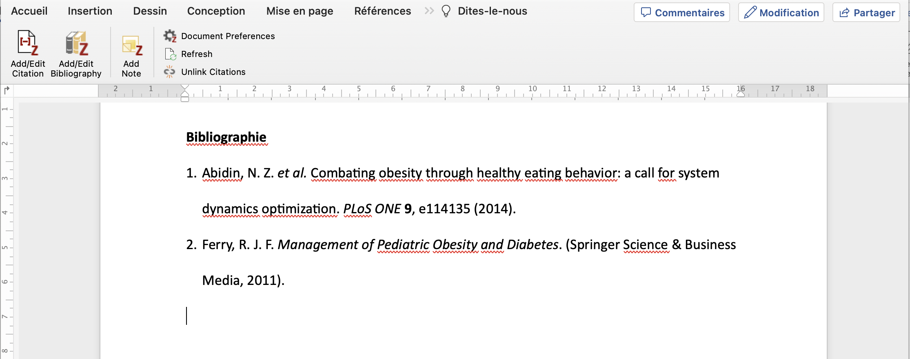
Generate a bibliography

Slide 31
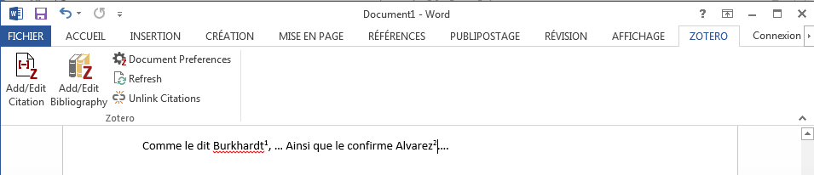


Delete a citation
To delete the entire citation, select the citation(s) in the text and press Delete.
To delete some (not all) references in a citation
❷
❶ Select the citation
❸
Delete the reference
N.B. : If the bibliography does not change, click on

Slide 32
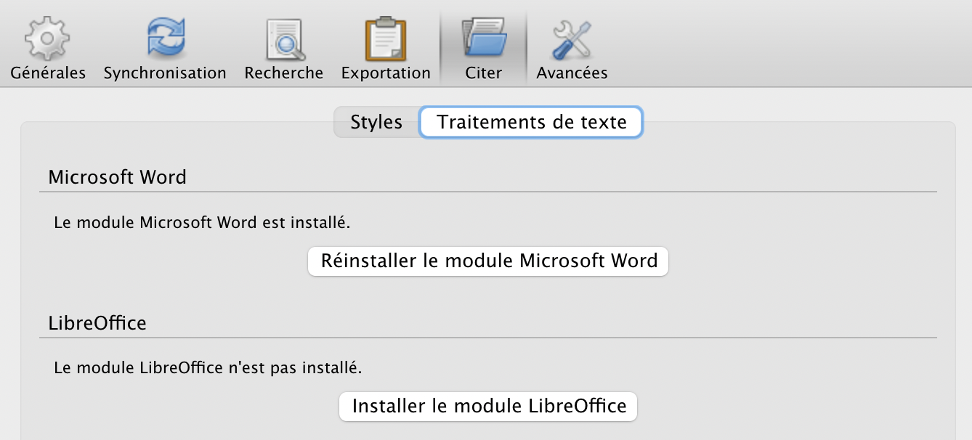
Force the plug-In installation
In case it did not install automatically
On Windows
On Mac
❶
❶
❷
❸

Slide 33
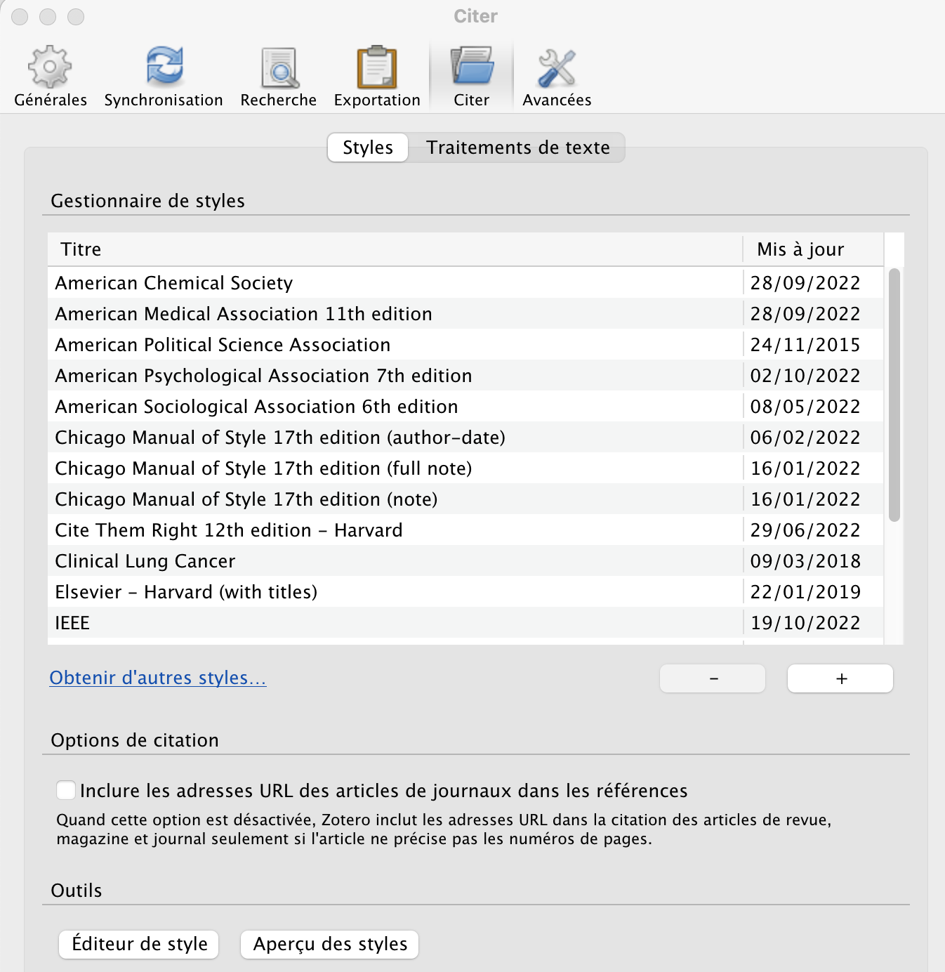
Add/edit styles
On Windows
On Mac
❶
❶
❷
Add
Edit

Slide 34
Zotero
EndNote
Cost
Open Source / free
Proprietary / paid
Structure
Single library
Multiple libraries
Zotero VS EndNote
Import of references
In 1 click via the extension
or via an import file
Via an import file only
Deduplication
On the entire library
Reference by reference
On a set of references
Mass deletion
Share
By creating group libraries
1 single library at a time
Notes:
https://www.zotero.org/support/kb/transferring_a_library
Utiliser Zotero avec Latex : https://zotero.hypotheses.org/762
Notero (plug-in to connect Zotero & Notion) : https://www.youtube.com/watch?v=1RVAZHgicd0

