Slide 1
The scientific publication process
Doctoral training session in science and engineering
Françoise Vandooren
Departement of libraries and scientific information
Université libre de Bruxelles
27 April 2018

Slide 2
The scientific journal publishing process
Functions of publishing
Roles in scientific journal publishing
Peer review process
Ethics

Slide 3
The scientific journal publishing process

Slide 4
pdf-pubprint
journal
editing
Publisher
dissemination
sale
Library
Consortium
postprint
Journal
Scientific Editor
payment
access
preprint
Library
writing
Author
Reader
access
Peer
review
Funding
by universities
Expert
Scientific Community
Notes:
What is specific to the scientific publishing system : the author is not remunerated by the publisher for his article, contrary to the literature publication, where the author is remunerated according to the books sold.
Moreover, the system is funded mainly by research institutions and universities which pay the author who writes the article, the researcher who reviews it, and provide libraries with the budget to buy access to the journals.
Thus research institutions pay, sometimes a very high price, to have access to the articles of their own researchers.

Slide 5
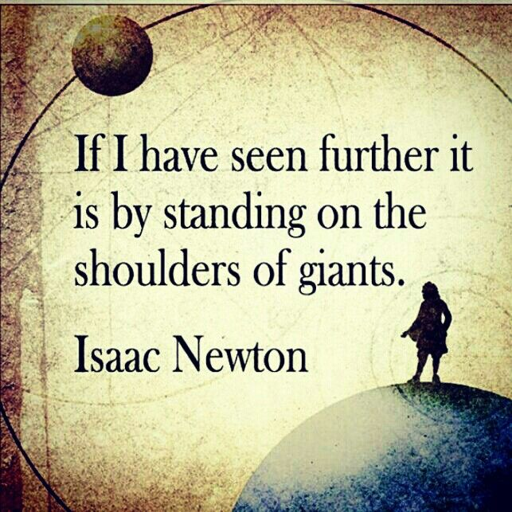
https://www.pinterest.com/pin/544865254892377944/
Notes:
Why do you have to publish your research results?
To disseminate them and provide access to them to other researchers since scientific research is built on previous research results.
It is thus crucial to disseminate your research results, as it is part of the research cycle.
Dissemination is the original function of scientific publication, but not the only one.

Slide 6
The functions of scientific publication
RECORD
Establish intellectual
priority
VALIDATE
Certify the
quality/validity
of the research
DISSEMINATE
Ensure
accessibility of
research results
ARCHIVE
Preserve
research results
for future use
+ Researcher’s evaluation…
Notes:
Validate: peer review remains the main mechanism for evaluating the scientific quality of research results
Disseùination: journals used to be the main scientific communication channel but since the internet many others are available and used such as open archives, preprint servers, blogs etc.
Archivage: also an important function of the journals was to ensure future access to research results. But publishers have never been responsible for long term preservation, this was the role of libraries at least when they held paper journals. The responsibility for electronic journals is not as clear, and publishers are working with third parties to ensure long term preservation (Jstor, LOCCKS, Portico…)
An additional related function of scientific publication is the evaluation of the researcher
You may have heard the phrase « publish or perish »

Slide 7

Publish or Perish
Notes:
"Publish or perish" refers to the pressure on the researchers to rapidly and continually publish their work to sustain or further one's career.
It also points to the fact that researchers are mainly evaluated on the basis of their publications, not taking into account other academic activities such as teaching, thesis supervision, etc. Moreover the value of published work is often determined by the prestige of the academic journal it is published in.
And we’ll see in the session on bibliometrics how bibliometric indicators based on publications are used to evaluate the researcher himself.
Source : https://en.wikipedia.org/wiki/Publish_or_perish

Slide 8
Roles in scientific journal publishing
Editor in chief:
editorial policy, decision to publish or not
Editorial board, reviewers
evaluating manuscripts
Publisher:
editing, disseminating, selling the journal
+ infrastructure for submitting manuscripts, managing peer review, search and access journals

Slide 9
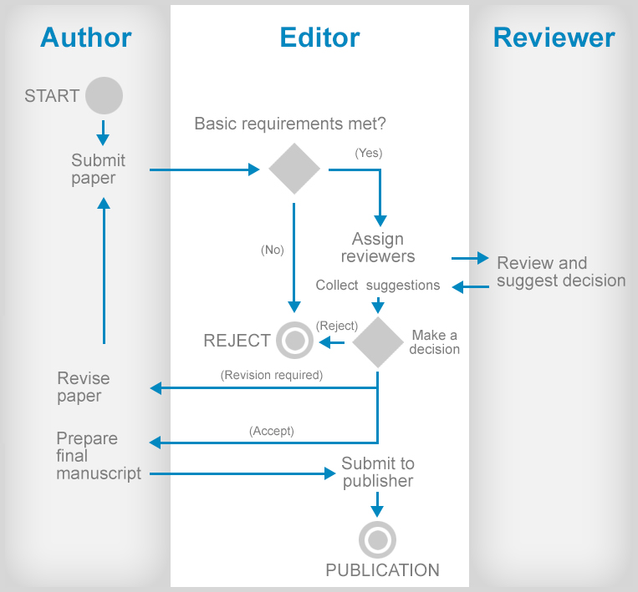
Peer review process
PREPRINT
POSTPRINT
PUBPRINT
Notes:
Submit paper = PREPRINT
Basic requirements = -> see instructions to authors
Eg: format, language, lenght, relevance wrt the editorial policy…
Assign reviewers: usually to 3 expert inthe domain of the manuscript
Review and suggest decision:
The reviewers assess the validity or the research results, their originality (not yet published), their importance.
They examine the methodology, the ethical approach, the references to prior works on the subject.
They indicate to the editor whether the manuscript should be accepted or rejected and provide comments and recommendations for the author.
Collect suggestions: and makes the decision to publish or not the article.
Three possibilities:
Rejected
Accepted with minor or major revisions: then the author is invited to review his manuscript according to the comments and recommendations of the reviewers and to submit it again.
The manuscript is accepted without modification
Prepare final manuscript: = POSTPRINT
Submit to publisher:
Publication: = PUBPRINT

Slide 10
Types of peer review
Blind:
the author does not know the identity of the reviewers
Double blind:
the author does not know the identity of the reviewers and the reviewers do not know the identity of the author(s)
Open:
identity of authors and reviewers is known from both parties
  Even more open:
  public access to the reviews,
  interactive public peer review (ex: Copernicus Interactive Public Peer Review)
Notes:
Open Peer review:
Open access to the reviews
Interactive public peer review: reviews are public and the scienctific community can contribute to the review but not anonymously
Advantages: work of the reviewers can be valued, visiblity of their expertise, quality of the comments
Drawbacks: risks taken by the reviewers, difficulty in recruiting reviewers who accept to take the risks

Slide 11
Ethics of publication
Code of conduct in scientific publication
Conflict of interest and funding sources:
to be declared
Paternity : contributors (only) to be mentioned
Originality : research not yet published
Multiple submissions: forbidden
« Salami slicing »: to be avoided
Plagiarism : proscribed
Scientific integrity: no scientific fraud
Copyright: to be respected
See also Code d’éthique de la recherche scientifique en Belgique FNRS
Notes:
Conflict of interest and funding sources: you have to declare to the editor any conflict of interest and the funding sources which could biase the independence and impartiality of your research
Paternity : all the authors mentioned msut have contributed to a significant part of the scientific work, and reversely any contributor msut be mentioned.
Multiple submissions: do not submit your manuscript to several journal à the same time
« Salami slicing »: do not slice your research work into several pieces to make several articles out of it
Plagiarism : do not pass on the ideas of others for your own, always cite the source http://www.bib.ulb.ac.be/fr/aide/eviter-le-plagiat/index.html
Scientific fraud: do not create data or falsify your data (manipulate data, tables, graphs…)

