Slide 1

Corporate Governance
LL.M. International Business Law
Dr. Nick Hallemeesch

Slide 2

Slides will be on after each session

Slide 3
Introduction

Slide 4
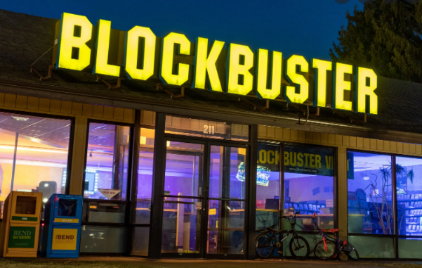
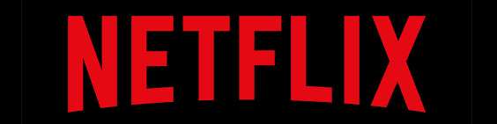

Why corporate governance?
Corporate governance affects firm performance.
Firm performance affects investors, creditors, employees, customers, environment, … thus, society as a whole.
Society has an interest in firm performance, and thus in corporate governance.
Example:
  2004: Blockbuster: USD 5,900,000,000 annual revenue, especially “late fees”
  2000: Blockbuster turns down offer to acquire Netflix at USD 50,000,000
  2010: Blockbuster filed for bankruptcy
  2021: Netflix: USD 29,700,000,000 annual revenue

Slide 5


Slide 6

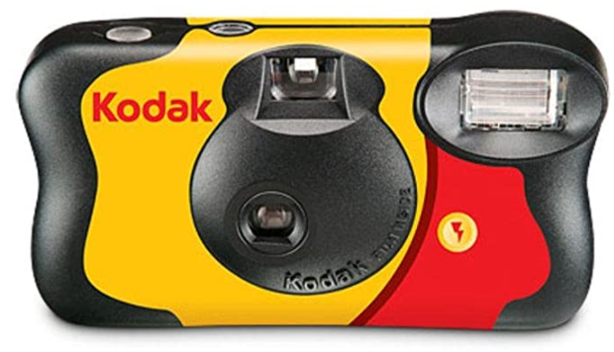

Why corporate governance?
Other examples

Slide 7
Subject-matter of corporate governance
Two type of questions:
  who decides? The “means” of corporate governance
  whose interest prevails? The “ends” of corporate governance
Investors
Managers
Firm
Creditors
Employees

Slide 8
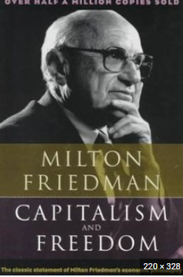
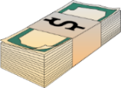
Subject-matter of corporate governance
Two type of questions:
  who decides? The “means” of corporate governance
  whose interest prevails? The “ends” of corporate governance
Shareholders
Directors
Creditors

Slide 9
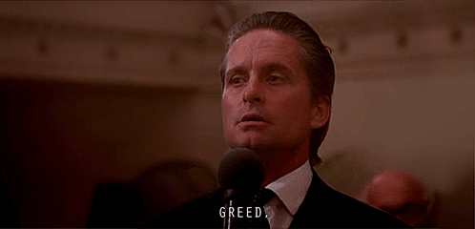
Subject-matter of corporate governance
Two type of questions:
  who decides? The “means” of corporate governance
  whose interest prevails? The “ends” of corporate governance

Slide 10
Subject-matter of corporate governance
Two type of questions:
  who decides? The “means” of corporate governance:
    shareholder primacy versus director primacy;
    role of employees and creditors in decision-making;
  whose interest prevails? The “ends” of corporate governance:
    shareholderism versus stakeholderism
    attention to inequality and environment

Slide 11
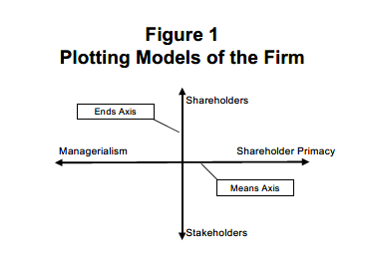
Subject-matter of corporate governance
Source: Brainbridge, “Director Primacy: The Means and Ends of Corporate Governance” (2002)

Slide 12
Gameplan for next sessions
Part I: Determinants of corporate governance
Chapter II: Means of corporate governance
Chapter III: Ends of corporate governance

Slide 13
I. Determinants of corporate governance

Slide 14
1.1. Ownership and control

Slide 15


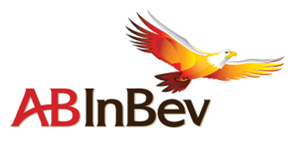



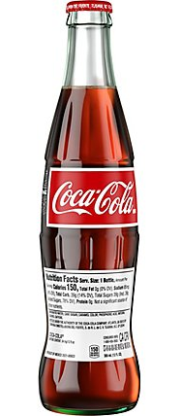





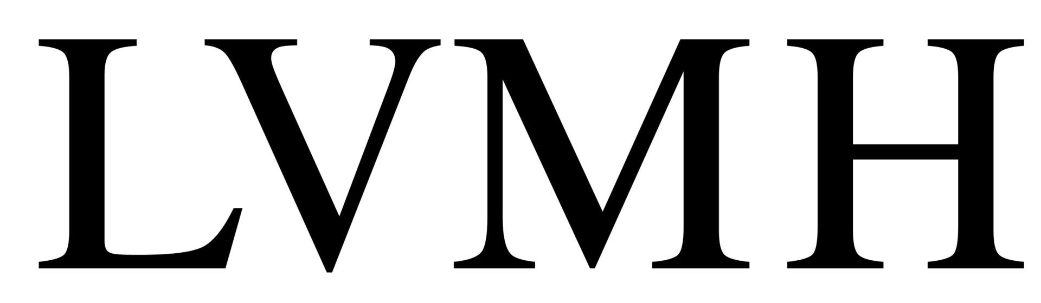
Ownership structures – Overview
Three ownership structures (simplified):

Slide 16
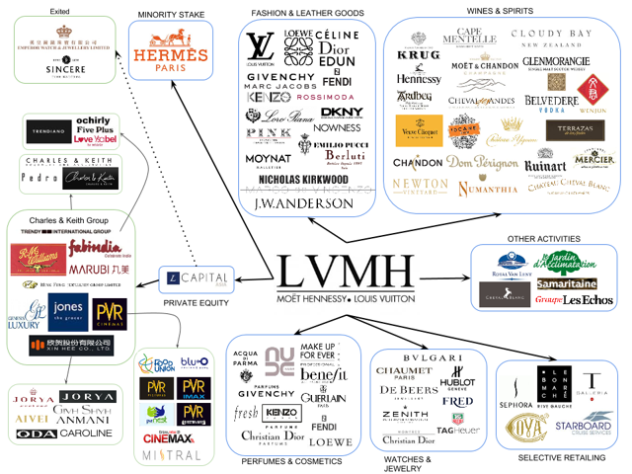
Ownership structures – Overview

Slide 17
Ownership structures – Overview
Terminology
“Closed firm”
“Controlled public firm”
“Widely-held public company”
“Public firm”
= firm
= shareholders (physical persons / legal entities)

Slide 18
Ownership structures – Overview
How does ownership change?

Slide 19



Ownership structures – Overview
How does ownership change?
Investments

Slide 20
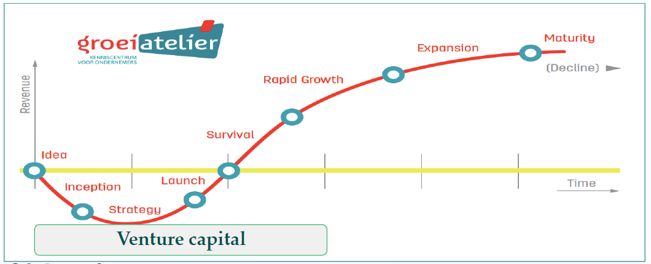
Ownership structures – Overview
First stages: venture capital

Slide 21
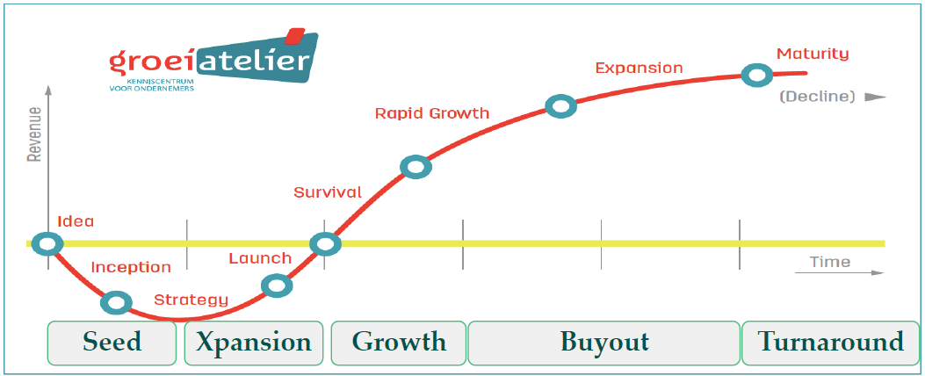
Ownership structures – Overview
Further growth

Slide 22


Ownership structures – Overview
Why raise additional funds?
- Need for additional operational funds
- “Liquidity” for founders
- Combination of both
Equity versus debt
Minority versus majority investments
Private investors versus public
→ Two options

Slide 23



Ownership structures – Overview
Option 1: Private investors: “private equity”
Minority investment
Buy-out

Slide 24

Ownership structures – Overview
Private investors: “private equity”
“Leveraged buy-out”
Buy-out

Slide 25
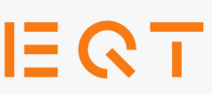
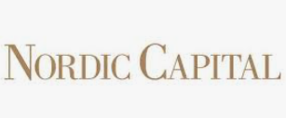
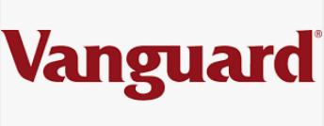
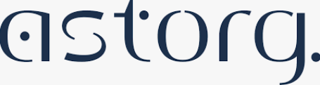


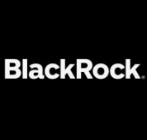
Ownership structures – Overview
Option 1: Private investors: “private equity”
=

Slide 26
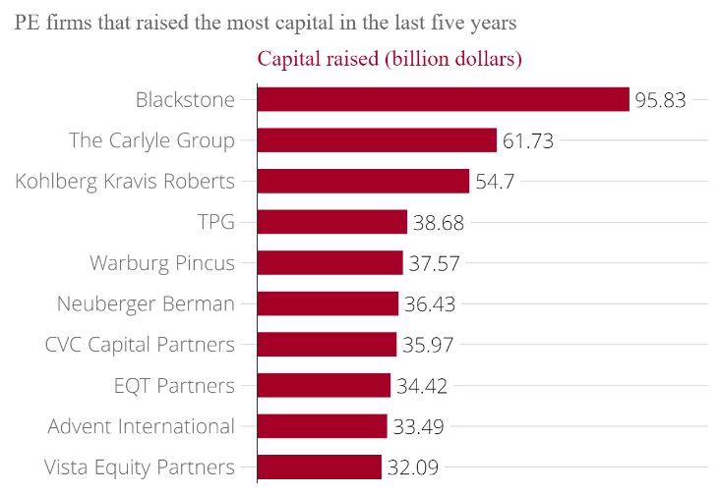
Ownership structures – Overview
Private investors: “private equity”

Slide 27
Ownership structures – Overview
Private investors: “private equity”
Asset manager (“Sponsor”)
GP
LP
LP
LP
LP
Fund
Portfolio
Portfolio
Portfolio

Slide 28
Ownership structures – Overview
GP/Manager
Fund Workstream
LPs
Fund
Equity Workstream
Managers
Ordinary Equity
Ordinary Equity
Shareholder debt (loan notes/preference shares)
Shareholder debt?
Equityco
Holdco
Bank Security Group
Midco
Bidco
Bank Debt
Acquisition Workstream
Target
Debt Workstream
Group

Slide 29
Ownership structures – Overview
Option 2: Public investors

Slide 30
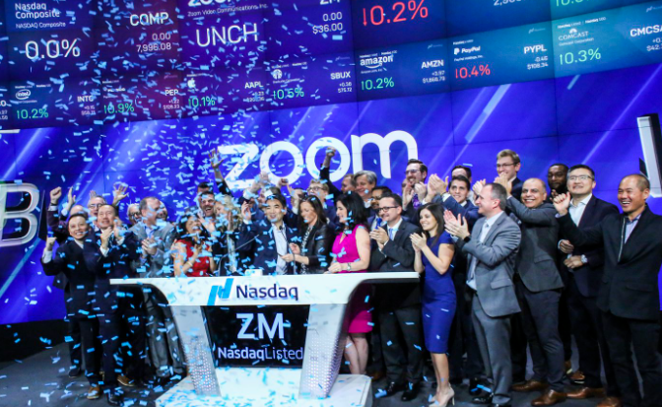
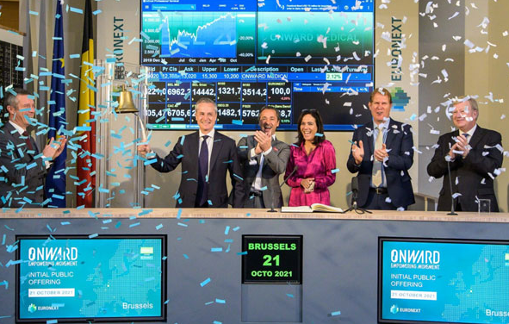

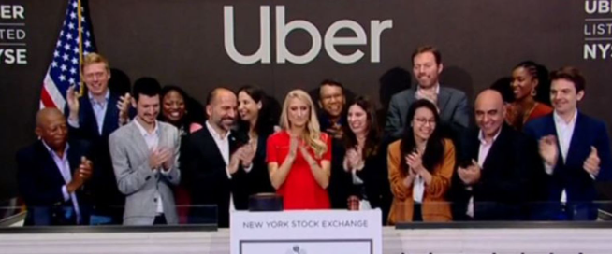
Ownership structures – Overview
How?
Initial Public Offering (“IPO”)

Slide 31
Ownership structures – Overview
How does ownership change?
Sale of existing shares
Initial Public Offering (“IPO”)
Issuance of new shares
Secondary offerings and block sales

Slide 32
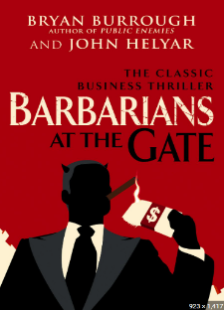
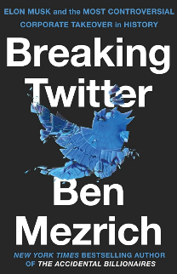
Ownership structures – Overview
How does ownership change?
Public takeover (tender offer) without delisting
Public takeover (tender offer) with de-listing (“P2P / Public to private”)
((leveraged) buy-out)

Slide 33
Ownership structures – Benefits
Why does ownership change?
Efficiency gains (e.g., economies of scale)

Slide 34
Ownership structures – Benefits
Why does ownership change?
How much capital does a firm need to be efficient?

Slide 35
Ownership structures – Benefits
Optimal firm expansion may require capital; however, enterpreneurs are not necessarily rich:
  as capital requirement increases, it becomes less likely that such capital can be provided by the entrepreneur, and that outside capital shall be required, and vice versa;
  as capital requirement increases, it becomes more likely that the optimal ownership structure responds to that of a public firm, and vice versa,
  in each case, all else being equal.

Slide 36
1.2. Agency cost

Slide 37
Ownership structures – Costs
Who manages the firm?
General structure (simplified – reality may vary) – Static view:
Shareholders
Key decisions
Firm
Board
Business decisions
Management
= Hiring / dismissal
= Accoun-tability

Slide 38
Ownership structures – Costs
Who manages the firm?
General structure (simplified – reality may vary) – Dynamic view:
Board
Board
Board
Management
Management
Management

Slide 39
Ownership structures – Costs
Ownership dispersion results in a separation of ownership and control
Separation of ownership and control creates an “agency problem”, resulting in cost (agency cost) off-setting potential efficiency gains:
  an agency relationship is “a contract under which one or more persons (the principal(s)) engage another person (the agent) to perform some services on their behalf which incolves delegating some decisions making authority to the agent.”¹
  agency problems arise “whenever one party, termed the “principal” , relies upon actions taken by another party, termed the “agent”, which will affect the principal’s welfare. The problem lies in motivating the agent to act in the principal’s interest rather than in the agent’s own interest.”²
  firms face vertical and horizontal agency problems.
¹ Jensen & Meckling, “Theory of the Firm” (1976).
² Armour, Hansmann, Kraakman, “Agency Problems and Legal Strategies” in The Anatomy of Corporate Law (2017).

Slide 40
Vertical agency problem
Shareholders
Board
Management

Slide 41

Vertical agency problem
Smith, An Inquiry Into the Nature of Causes of the Wealth of Nations (1776):
“The directors of such companies, however, being the managers rather of other people’s money than of their own, it cannot well be expected, that they should watch over it with the same anxious vigilance with which the partners in a private copartnery frequently watch over their own… Negligence and profusion, therefore, must always prevail, more or less, in the management of the affairs of such a company. It is upon this account that joint stock companies for foreign trade have seldom been able to maintain the competition against private adventurers. They have, accordingly, very seldom succeeded without an exclusive privilege, and frequently have not succeeded with one. Without an exclusive privilege they have commonly mismanaged the trade. With an exclusive privilege they have both mismanaged and confined it.”

Slide 42
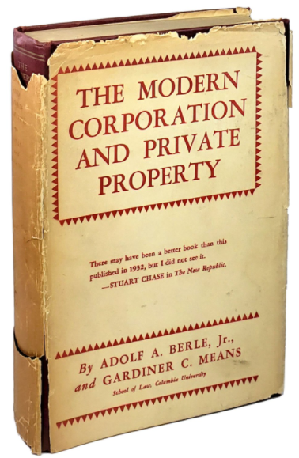
Vertical agency problem
Berle & Means, The Modern Corporation & Private Property (1932):
“The separation of ownership from control produces a condition where the interests of owner and ultimate manager may, and often do, diverge, and where many of the checks which formerly operated to limit the use of power disappear. […] Those who control the destinies of the typical modern corporation own so insignificant a fraction of the company’s stock that the returns from running the corporation profitably accrue to them in only a very minor degree. The stockholders, on the other hand, to whom the profits of the corporation go, cannot be motivated by those profits to a more efficient use of the property, since they have surrendered all disposition of it to those in control of the enterprise. ”

Slide 43
Vertical agency problem
Agency problem between shareholders (principal) and board/management (agent)
Nature of the vertical agency problem:
  management/board is expected to maximize firm value in the interest of the owners;
  management/board is rational, and seeks to maximize its personal wealth;
  since management/board does not receive all gains resulting from its actions, nor incur all costs of their actions, it may act opportunistically, and trade off firm value to increase own utility.

Slide 44
Vertical agency problem
Varieties of the vertical agency problem:
  “Shirking”: slacking on the job (resulting in incompetence as well)
  “Stealing”: value diversion (e.g., related party transactions, on-the-job consumption, excessive compensation and other benefits, appropriate corporate opportunities, …) and, more generally, self-interested actions (e.g., nepotism, pet projects, empire building, block takeovers, …), e.g.:
    “hubris hypothesis”: management acquires firms for its self-interest and economic advancement to the acquiring firm is not the dominant motive for the acquisition;
    “free cash flow hypothesis”: managers endowed with free cash flow will invest it in negative net present value projects rather than pay it out to shareholders.
    City Capital Associates Partnership v Interco, 551 A2d 787 (Del.Ch. 1988):“human nature may incline even one acting in subjective faith to rationalize as right that which is merely personally beneficial”

Slide 45
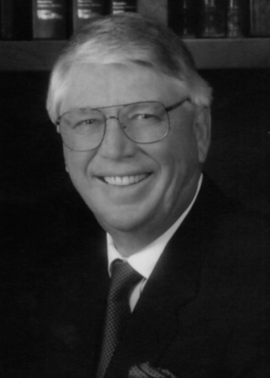

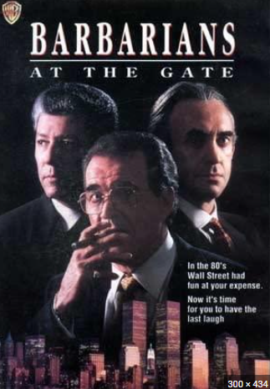
Vertical agency problem

Slide 46
Vertical agency problem
Agency problem imposes a cost on the firm, i.e., agency cost:
  Jensen & Meckling, “Theory of the Firm” (1976): Vertical agency problem creates three types of (agency) cost:
    monitoring cost;
    bonding cost;
    residual loss.

Slide 47
Vertical agency problem
Intensification of vertical agency problem:
  shareholders can, through voting rights (including on (re-)appointments and dismissals), mitigate the vertical agency problem;
  however, rational shareholders shall only vote if benefits of doing so exceeds cost (resulting from, among other things, information assymetries);
  for an individual investor, the cost of voting may exceed the benefits, resulting in “rational apathy”;
    Easterbrook & Fischel, The Economic Structure of Corporate Law (1991): “Investors are rationally uninterested in votes, not only because no investor’s vote will change the outcome of the election but also because the information necessary to cast an informed vote is not readily available.”
  general meetings of shareholders are therefore, to a greater or lesser extent, affected by the collective action problem, whereby management/board are not monitored by the shareholders;
  shareholders may “vote with the feet” – however, capital markets do not deter management perfectly (infra).

Slide 48
Vertical agency problem
Vertical agency problem in controlled public firms:
  if a shareholders’ stake increases, the benefits of monitoring management/boards increases as well;
  for controlling shareholders, the benefits of monitoring management/board may exceed the cost; in such case, management/boards shall steal and shirk less, and vertical agency cost shall be lower, all else being equal;
  Gilson, “Controlling Shareholders and Corporate Governance: Complicating the Comparative Taxonomy” (2006):“[A] controlling shareholder may police the management of public corporations better than the standard panoply of market-oriented techniques employed when shareholdings are widely held.”

Slide 49
Vertical agency problem
Conclusions:
  all firms face vertical agency cost;
  vertical agency cost shall be higher as ownership is more dispersed and vice versa;
  vertical agency cost shall be higher in the widely held firm and lower in the controlled firm, all else being equal.

Slide 50
Agency cost: trade-off
Why does ownership change?
IPO
Efficiency gains (e.g., economies of scale)
Agency cost
Buy-out

Slide 51
Horizontal agency problem
Shareholders
Board
Management

Slide 52
Horizontal agency problem
Agency problem between controlling shareholder (principal) and entire class of shareholders, including minority/outside shareholders (agents)
Nature of the problem:
  controlling shareholders act rationally, and maximize personal wealth;
  since controlling shareholders do not receive all gains resulting from their actions, nor incur all costs of their actions, they may act opportunistically, and trade off firm value to increase own welfare;
  by doing so, controlling shareholders enrich themselves at the expense of minority shareholders (outside investors)
  in sum, control over the firm confers “private benefits of control” on controlling shareholders (hereafter: “PBC”).

Slide 53
Horizontal agency problem
Examples of PBC:
  possibility of value diversion through self-dealing (tunneling), usurpation of corporate opportunities, freeze and squeeze-outs, tender offers, dividend policies, executive compensation;
  possibility of value diversion through suboptimal actions favoring other group companies;
  non-pecuniary benefits of control (infra), resulting in inefficiencies.

Slide 54
Horizontal agency problem
Example
Outsiders
A1
40%
60%
100%
B
A2
Sale of x
Market value x = $150
Price paid for x = $100
Transfer from outsiders to A1 of $20 (i.e., $50*0.4)

Slide 55
Horizontal agency problem
Illustration: Sinclair Oil v. Levien, 280 A.2d 717 (Del. 1971)
Sinclair Oil
Levien
97%
100%
3%
Venezuelan Oil Company (Sinven)
International
“from 1960 through 1966, Sinclair caused Sinven to pay out such excessive dividends that the industrial development of Sinven was effectively prevented, and it became in reality a corporation in dissolution.”
“[f]rom 1960 to 1966 Sinclair purchased or developed oil fields in Alaska, Canada, Paraguay, and other places around the world. The plaintiff contends that these were all opportunities which could have been taken by Sinven.”
“On September 28, 1961, Sinclair caused Sinven to contract with International whereby Sinven agreed to sell all of its crude oil and refined products to International at specified prices. […] The plaintiff contends that Sinclair caused this contract to be breached in two respects.”

Slide 56
Horizontal agency problem
Illustration: Weinberger v. UOP, 457 A.2d 701 (Del. 1983)
Free float
Signal
51%
49%
100%
UOP
Cash-out merger
WoS
“Arledge and Chitiea concluded that it would be a good investment for Signal to acquire the remaining 49.5% of UOP shares at any price up to $24 each. […] It was ultimately agreed that a meeting of Signal's executive committee would be called to propose that Signal acquire the remaining outstanding stock of UOP through a cash-out merger in the range of $20 to $21 per share.”

Slide 57
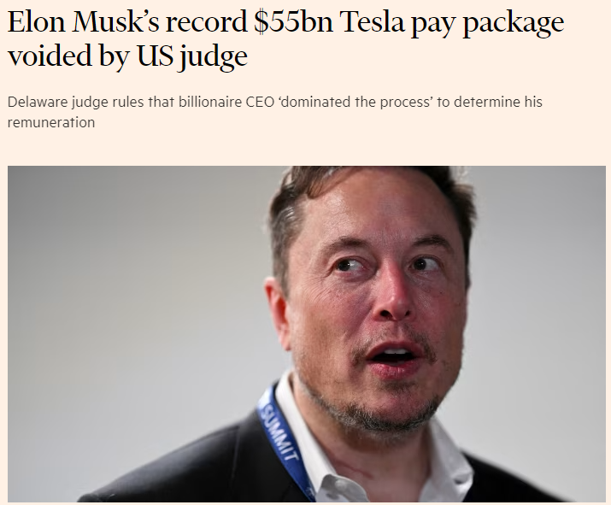

Slide 58
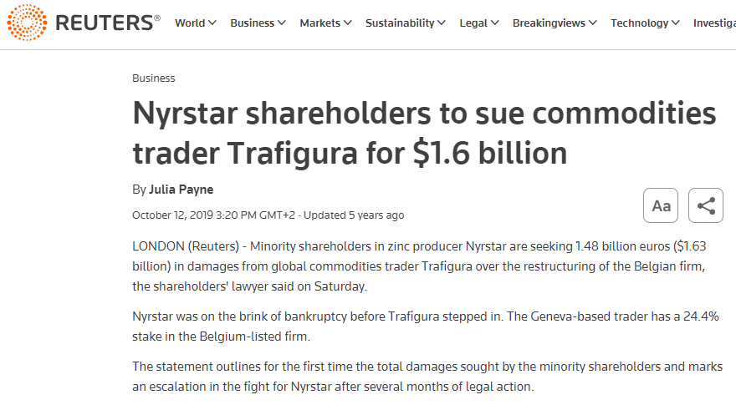

Slide 59
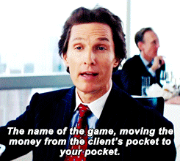
Put differently

Slide 60
Horizontal agency problem
Intensification of horizontal agency problem:
  PBC exist where cash-flow rights (ownership) are disproportionate to control rights;
  if controlling shareholders decrease cash-flow rights but maintain control, PBC increase;
  controlling shareholders may decrease cash-flow rights through stock pyramids, cross-ownership and dual class equity.
  Bebchuk, Kraakman & Triantis, “Stock Pyramids, Cross-Ownership and Dual Class Equity” (2000):
  “We demonstrate that the agency cost imposed by controlling shareholders who have a small minority of the cash-flow rights in their companies can be an order of magnitude larger than those imposed by controlling shareholders who hold a majority of the cash-flow rights. This is because, as the size of cash-flow rights held decreases, the size of agency costs increases, not linearly, but rather at a sharply increasing rate.”

Slide 61
Horizontal agency problem
A
Outsiders
A
Outsiders
A
100%
100%
30%
70%
100%
70%
30%
100%
B
A bis
B
A bis
B
A bis
100
100
100

Slide 62
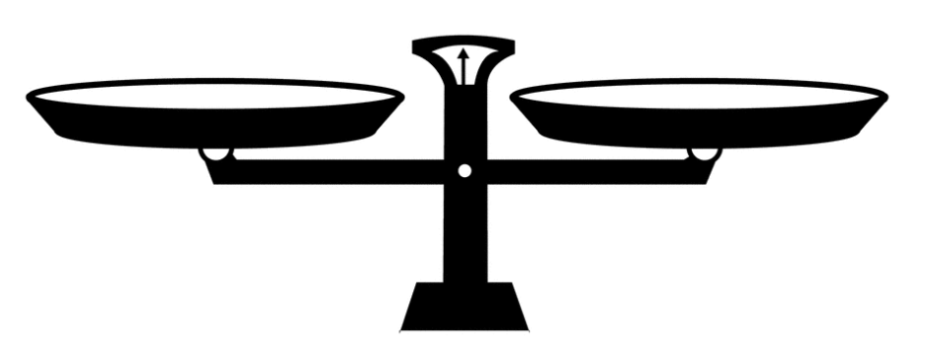
Agency cost: trade-off
Agency cost associated with a certain ownership structure set-offs potential efficiency gains resulting from it.
Agency cost therefore impacts optimal ownership structure: e.g.
  if agency cost of public firm exceeds efficiency gains, a firm is better off with a closed structure;
  if increase in agency cost of widely held firm exceeds efficiency gainst (as opposed to controlled firm), a firm is better off which a controlled ownership structure.
Agency cost
Efficiency gains

Slide 63
Agency cost: trade-off
Why does ownership change?
IPO
Efficiency gains (e.g., economies of scale)
Agency cost
Buy-out

Slide 64
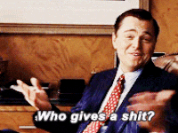
Question

Slide 65
Impact of agency cost
Two types of consequences:
  direct: agency costs results in value-decreasing decisions ex post:
    on company level, agency cost harms all stakeholders (shareholders, creditors, employees, …);
    on country level, agency cost results in weaker (product) markets and a competitive disadvantage of domestic firms compared to foreign firms where agency cost is lower;
  indirect: ex post agency cost will be taken into account ex ante, and thus increase cost of capital.

Slide 66
Impact of agency cost
Ex post agency cost will be taken into account ex ante.
Expected agency cost will therefore negatively impact the cost of capital, an thus a firm’s possibility to raise capital and/or have optimal ownership structure:
  example 1: closed firm needs capital raise for at least $90 without issuing more than 100% of new shares (50% dilution)
 | Firm A | Firm B
Pre-money
Firm value | $100 | $100
Post-money
Estimated gains | $100 | $100
Estimated PBC | $20 | $60
New firm value | $180 | $140
Cost of new shares | $90 | $70
Firm can go public
Firm cannot go public

Slide 67
Impact of agency cost
Ex post agency cost will be taken into account ex ante.
Expected agency cost will therefore negatively impact the cost of capital, an thus a firm’s possibility to have optimal ownership structure:
  example 2: owner of controlled public firm wishes to sell all its shares (50%): private sale or public sale?
 | Firm A | Firm B
Pre-sale
Firm value | $100 | $100
Management cost | $10 | $10
Utility owner | $40 | $40
Post-sale (public sale)
Estimated VAC | $10 | $30
New firm value | $90 | $70
Value of 50% of shares | $45 | $35
Public sale
or private sale
Only private sale

Slide 68
Impact of agency cost (indirect)
Efficiency gains (e.g., economies of scale)
Agency cost

Slide 69
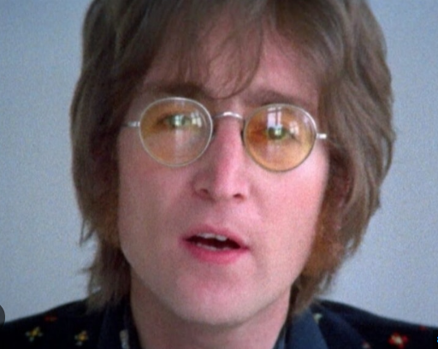
Impact of agency cost (indirect)
a world without agency cost

Slide 70






Impact of agency cost (indirect)
a world without agency cost
a world with agency cost

Slide 71
Impact of agency cost
Conclusions:
  agency costs results in value-decreasing decisions ex post;
  ex post agency cost will be taken into account ex ante:
    agency cost impacts cost of capital and thus a firm’s ability to raise additional capital;
    agency cost impacts the possibility of firms to have an optimal ownership structure:
      if agency cost of the public firm (be it horizontal or vertical) exceeds efficiency gains (as opposed to the closed firm), a firm cannot go public (all else being equal);
      if (vertical) agency costs of the widely held firm exceed efficiency gains (as opposed to the controlled firm), a firm cannot become widely held (all else being equal);
  agency cost impacts the efficiency of an economy and thus social welfare.
Ownership structure
Agency cost

Slide 72
1.3. The role of markets

Slide 73
The role of markets
Markets (may) reduce agency cost:
  product markets: if a firm is badly run, products will be more expensive/less good, and the firm will eventually disappear (along with the insiders);
  capital markets: if a firm is badly run, it will be more difficult to attract additional capital to fund new projects;
  however:
    markets are never fully competitive, and sometimes not competitive at all;
    market effects may be long-term and exceed tenure of management/board;
    stealing may represent small portion of firm value;
    price of capital have less impact of no additional capital is required; in addition, the price of capital may be less of a problem for manager than for shareholders;
    path-dependency: do strong markets require strong firms ?
    other arguments ?

Slide 74
The role of markets
Markets (may) reduce agency cost:
  market for corporate control: if a firm is badly run, share price will be low; as prices are low, firm may be subject to a (hostile) takeover;
  since management may lose jobs, market for corporate control keeps management in check;
  however:
    in controlled companies, control may not be contestable;
    incumbents (controlling shareholders / management) have ways to deter or frustrate takeovers; control premium needs to be paid;
    takeovers are not necessarily efficient (e.g., takeover may be the result of agency cost within the bidder; free cash flow problem).
Roe, “The Institutions of Corporate Governance” (2004): “markets [do not] utterly fail to constrain managers, but that they are not tight, perfect constraints. […] if the firm gets seriously out of line, it will hit a limit in another of these markets. But it can, depending on its market setting, waste major corporate resources before hitting that market-imposed limit.”

Slide 75

The real question

Slide 76
1.4. The role of (company) law

Slide 77
The role of (company law) law
Two types of rules:
  default rules: rule applies, unless otherwise ageed (“opting out”)
  mandatory rules: rules applies, even if otherwise agreed (no “opting out”)
Functions of (corporate) law:
    mitigating externalities (e.g., moral hazard – creditor protection (infra))
    completing the (corporate) contract (cf. transaction cost)
    overriding inefficient terms.
When must corporate law be mandatory?

Slide 78
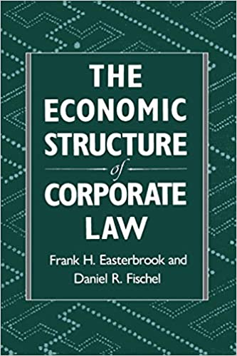
The role of (company law) law
Easterbrook & Fischel, The Economic Structure of Corporate Law (1991):
“There are many actors from production employees to managers to equity investors to debt investors to holders of warranty and tort claims against the firm. The arrangement among these persons usually depend on contracts and on positive law, not on corporate law or the status of the corporation as an entity. More often than not a reference to the corporation as an entity will hide the essence of the transaction. So often we speak of the corporation as a “nexus of contracts” or a set of implicit or explicit contracts. […] The form of reference is a reminder that the corporation is a voluntary adventure, and that we must always examine the terms on which real people have agreed to participate.”

Slide 79
The role of (company law) law
Contract as a bonding mechanism: firms may reduce agency cost ex ante by committing to certain standards ex post.
Moreover, economic theory suggest that, under certain conditions, contractual parties will adopt efficient terms, i.e.,terms which maximize utility and social welfare.
Shortcomings of contract:
  absence of public enforcement and cost of (private) enforcement;
  the “latecomer term”:
    possibility of amending the corporate contract without unanimity is desirable;
    amendments are driven by insiders (controlling shareholders / management), thus creating a risk of opportunistic amendments, i.e., amendments that benefit the insiders;
    markets constrain outsiders, but not perfectly (supra);
    shareholders can sell their shares, but would still lose money.

Slide 80
The role of contract
Bebchuk, “Limiting Contractual Freedom in Coporate Law: The Desirable Constraints on Charter Amendments (1989):
“Rational and informed parties forming a corporation would recognize the desirability of a charter amendment procedure that enables charter changes without unanimous shareholder consent. But they would also recognize the imperfections of this procedure, as neither the requirement of a shareholder vote nor the requirement of a board proposal can be relied on to preclude value-decreasing amendments. Consequently, the optimal arrangement that such parties would wish to adopt with respect to opt-out amendments is one that places significant limits on opting out in midstream. This optimal arrangement is the one that the law should provide, at least in the absence of an explicit provision to the contrary in the initial charter. Because even strong believers in free markets should accept this optimal arrangement in the common case when such an explicit contrary provision is absent, they should recognize that mandatory corporate law rules have an important role to play in midstream.”

Slide 81
Impact of law on agency cost and ownership structures – firm level
Working assumptions:
  good company law prevents insiders from stealing and reduces agency cost;
  bad company law does not prevent insiders from stealing and does not reduce agency cost.
If company law is good, firms can reduce agency cost ex ante and:
  more easily go public;
  more easily become (or remain) widely held,
  in each case, all else being equal.
80

Slide 82
Impact of law on agency cost and ownership structures – firm level
If company law is good, firms can reduce agency cost ex ante and more easily become (or remain) widely held (all else being equal), and vice versa:
  if company law does not protect investors against management, vertical agency cost shall be higher and becoming a widely held firm shall less likely be optimal (all else being equal);
  if company law does not protect minority investors against controlling shareholders, then becoming a widely held firm would leave private benefits of control “up for grabs” to be captured by a corporate raider; becoming a widely held firm shall therefore be sub-optimal (all else being equal);
    Bebchuk, “A Rent-Protection Theory of Corporate Ownership and Control” (1999): “While being more efficient is a necessary condition for an NCS structure to be chosen, it turns out not to be a sufficient condition. The reason for this is that setting an NCS structure does not ensure that the company remain in an NCS structure. A rival might seek to wrest control by acquiring a controlling block through market purchases or a takeover bid. When private benefits of control are large enough — and when control is thus valuable enough — an initial setting of an NCS structure will create a very tempting target for potential grabbers of control. Under such circumstances, an initial setting of an NCS structure will not be a stable equilibrium; the initial setting will likely revert eventually to a CS structure following the acquisition of a control block by a rival manager or, in a defensive move to prevent such an acquisition, by the incumbent manager. And when an NCS structure can be expected to unravel in this way, it would not be chosen to begin with. Thus, when private benefits of control are large, owners might choose a CS structure, notwithstanding some efficiency advantages that an NCS structure could have, in order to maintain a lock on control.”

Slide 83
Impact of law on agency cost and ownership structures – firm level
Conclusions
  if company law does not constrain controlling shareholders, then:
    a firm will less likely go public;
    a firm will less likely become widely held; and
  if company law does not constrain management, then a firm will less likely become widely held,
  in each case, all else being equal.
Law
Ownership structure
Agency cost

Slide 84
What is good law?
Controlling shareholders may lower vertical agency cost through increased monitoring; however, doing so creates a cost for controlling shareholders (lack of diversification and monitoring cost).
Cost is incurred by controlling shareholders, while benefits of increased monitoring benefit all shareholders. Good company therefore not necessarily reduces PBD to zero:
  Gilson, “Controlling Shareholders and Corporate Governance: Complicating the Comparative Taxonomy” (2006): “good law […] effectively limit[s] private benefit extraction to an amount sufficient to compensate a controlling shareholder for the cost of monitoring, but less than the benefit all shareholders receive from such monitoring.”

Slide 85
Impact of law on agency cost and ownership structure – country level
It can be expected that if the quality of corporate law is higher in one country than in another country, the former country will comparatively have more public companies and more widely held companies than the latter, all else being equal (!).
Empirical data suggests that:
  ratio market capitalization / GDP differs across jurisdictions;
  ratio public firms (or IPO) / population differs across jurisdictions.
Country | # listed companies¹ | # inhabitants² | Inhabitants / listed company
USA | 4,381 | 329,484,120 | 75,207
EU | 5,470 | 380,586,130 | 81,864
UK | 1,858 | 67,215,290 | 36,176
Belgium | 117 | 11,556,000 | 98,769
Lebanon | 263 | 6,825,440 | 25,952
Turkey | 226 | 84,339,070 | 373,181
Italy | 290 | 59,554,020 | 205,358
Germany | 555 | 83,240,520 | 149,982
¹ https://data.worldbank.org/indicator/CM.MKT.LDOM.NO
² https://data.worldbank.org/indicator/SP.POP.TOTL

Slide 86
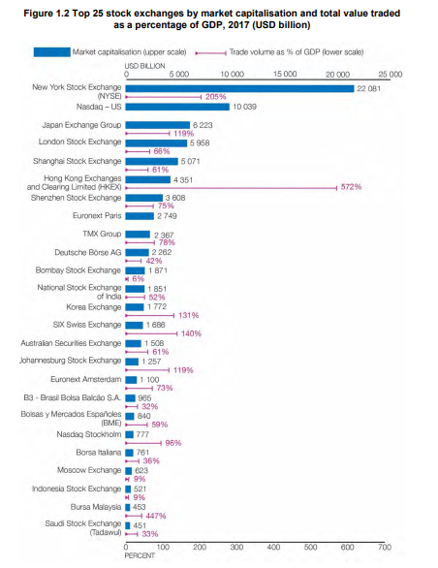
Impact of law on agency cost and ownership structure – country level
Source: https://www.oecd.org/daf/ca/OECD-Corporate-Governance-Factbook-2019.pdf

Slide 87
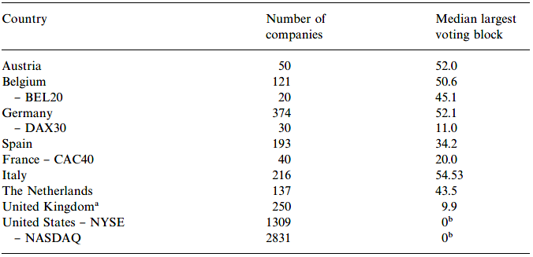
Impact of law on agency cost and ownership structure – country level
It can be expected that if the quality of corporate law is higher in one country than in another country, the former country will comparatively have more public companies and more widely held companies than the latter, all else being equal (!).
Empirical data suggests that:
  blockholding in public companies differs across jurisdictions:
    widely held firms dominate in, among others, the United States of America;
    controlled firms dominate in most of the other jurisdictions;
    e.g., Becht & Roel, “Blockholdings in Europe: an International Comparison” (1999):

Slide 88
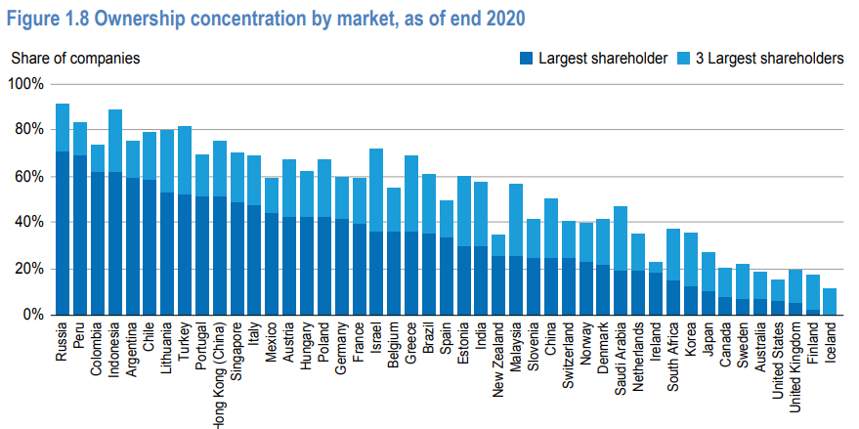
Impact of law on agency cost and ownership structure – country level
Source: https://www.oecd.org/corporate/OECD-Corporate-Governance-Factbook.pdf

Slide 89
Impact of law on agency cost and ownership structure – country level
It can be expected that if the quality of corporate law is higher in one country than in another country, the former country will comparatively have more public companies and more widely held companies than the latter, all else being equal (!).
Dyck & Zingales, “Private Benefits of Control: an International Comparison” (2002):
  control premium as a proxy for PBC;
  countries with higher PBC have more concentrated ownership;
  countries with more anti-director rights have lower PBC;
  average level of PBC differ subtantially across legal families.

Slide 90
Impact of law on agency cost and ownership structure – country level
Legal origins theory
  La Porta, Lopez-de-Silanes, Schleifer & Vishny, “Law and Finance” (1997)
    quantification of investor protection: “anti-director index”;
    strongest protection in common law systems, then German civil law systems, then Scandinavian civil law systems, then French civil law systems;
    correlation between level of investor protection and ownership concentration.
  Djankov, La Porta, Lopez-de-Silanes & Schleifer, “The law and economics of self-dealing” (2006):
    quantification of protection against self-dealing: “anti-self-dealing index”;
    similar findings: “Overall, the evidence shows that a high anti-self-dealing index is associated with valuable stock markets, more domestic firms, more initial public offerings, and lower benefits of control.”
Strong opposition against the legal origins doctrine, e.g.:
  Spamann, “The “Antidirector Rights Index” Revisited” (2009)
  Cools, “The Real Difference in Corporate Law between the United States and Continental Europe: Distribution of Powers” (2005):

Slide 91
Impact of law on agency cost and ownership structure – country level
Ownership dispersion requires good company law; however, if company law is good, ownership is not necessarily dispersed (e.g., Sweden).
Gilson, “Controlling Shareholders and Corporate Governance: Complicating the Comparative Taxonomy” (2006):
  distinction between efficient and non-efficient controlling shareholder systems;
  if company law is bad, ownership will always be concentrated (and ownership distribution will be sub-optimal) (inefficient);
  if company law is good, ownership may be either concentrated or dispersed, depending on other factors (efficient);
  possible explanation: “non-pecuniary private benefits of control”: “The family confronts a tradeoff: control of a major industrial company versus a 7.5% increase in family wealth. Is maintaining the role of leading industrialists in a country, with the social and political access associated with that role, worth more than additional wealth at a point where decreasing marginal returns to wealth must surely have set in?”

Slide 92
1.5. Other determinants of corporate governance

Slide 93
Other determinants of corporate governance
Which other factors may determine/explain a country’s ownership distribution?
  Market competition (supra):
    if market competition is weak (small/closed economy; monopolies; etc.), net benefits of public or widely held firm may be low or negative (as opposed to closed firm c.q. controlled firm);
    however, globalization should result in stronger competition;
  Strength of reputational markets (supra) and contract law (supra);
  Politics:
    Roe, Political Determinants of Corporate Governance (2003):
      “social democracies denigrate the modern pro-shareholder tools—such as incentive compensation, hostile takeovers, shareholder wealth maximization norms, etc.—because it is not their policy to promote purely shareholder values”
      social democracies press managers to coalesce with employees, not with distant shareholders, […]. Owners must consequently seek other means to control managers, and the best alternative is close ownership or block ownership of the equity.”

Slide 94
Other determinants of corporate governance
Which other factors may determine/explain a country’s ownership distribution?
  Politics:
    Perotti & von Thadden, “The Political Economy of Corporate Control and Labor Rents” (2006):
      depending on whether the median voter depends on capital or labour, policy-makers will favor c.q. disfavor development of strong financial markets;
    Pagano & Volpin, “The Political Economy of Corporate Governance” (2005):
      impact of electoral system; proportional voting systems are negatively correlated with investor protection and positively correlated with employment protection;
  Labour:
    if influence of employees (through unions, works council, co-determination) is high, shareholders are more likely to hold a controlling block (infra);

Slide 95
Conclusion
Politics
Culture
Labour
Geography
History
Law
Ownership structure
Agency cost

Slide 96
Other determinants of corporate governance
Which other factors may determine/explain a country’s ownership distribution?
  Path-dependency
    Bebchuk & Roe, “A Theory of Path Dependence in Corporate Ownership and Governance” (1999):
      “structure-driven path dependence”: e.g., controllers will prevent change that would result if efficiency gains that would not be captured by them but by others
      example: controlling shareholder (owning 50%) wants to divest; which firm will more likely become widely held?
 | Firm A | Firm B
Pre-transaction
Firm value | $50 | $100
Horizontal agency cost (PBC) | $50 | $0
Utility owner | $75 | $50
Post-transaction
Firm value | $100 | $100
Value of 50% | $50 | $50
95

Slide 97
Other determinants of corporate governance
Which other factors may determine/explain a country’s ownership distribution?
  Path-dependency
    Bebchuk & Roe, “A Theory of Path Dependence in Corporate Ownership and Governance” (1999):
      “rule-driven path dependency”: “When a certain set of rules leads corporate control to be at the hands of one group of players, their control of existing structures will make these players more influential in subsequent interest group politics and will thus make it more likely that the country will have these or similar rules in the future.”
      e.g., anti-takeover rules:
        takeovers could result in a shift from a widely held firm to controlled firm, thus lowering vertical agency cost; in countries with dispersed ownership, managers are assumed to lobby for anti-takeover rules.
      other examples?
96

Slide 98
Conclusion

Slide 99
Conclusion
Politics
Culture
Labour
Geography
History
Law
Ownership structure
Agency cost

