Slide 1

PRIVILEGED & CONFIDENTIAL
Advice from EU Competition Law Counsel
R&D Collaborations
David Hull

Slide 2




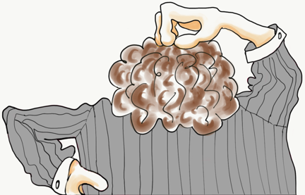


































Little wonder that mistakes are made…
Navigating the regulatory framework
Article 101 TFEU or EU Merger Regulation?
Guidelines on the applicability of Article 101 TFEU to horizontal cooperation agreements
Consolidated Jurisdictional Notice on JV full-functionality
Commission notice on the concept of a concentration
National merger regimes of EU Member States
R&D Block Exemption Regulation
Technology Transfer Block Exemption Regulation
Specialisation Block Exemption Regulation
Technology Transfer Guidelines
Decisions of the Commission and European Courts
De Minimis Notice
And that’s just the EU…

Slide 3
A hypothetical collaboration

Slide 4

A hypothetical collaboration
Major Japanese company with global operations
Producer of a leading treatment for Stage II/III breast cancer, delivered via an IV (Abacir)
Medium-sized Spanish pharma company with European operations
Extensive experience with subcutaneous injectable therapies
Producer of a treatment for Stage I breast cancer, deliverable via injection
Pipeline product for Stage II/III breast cancer
Nippon Pharma
Iberica Labs
Alliance to jointly develop and sell a treatment for Stage II/III breast cancer, deliverable via a subcutaneous injection

Slide 5
Collaboration timeline
Negotiation of key commercial terms
Ensuring key competition law principles communicated to business
Fine-tuning the deal to achieve business goals and avoid future complications
Creating structures to ensure ongoing competition law compliance and commercial success of deal
Clearance
Implementation
Preliminary issues
Negotiation
Do the parties compete and can the deal be done?
(relevant where prior regulatory approval required)
Will the deal require prior regulatory approval?
Due diligence on alliance partner
Information exchange protocols?

Slide 6
Can the parties do the deal?
Do the parties’ products compete?
Do the parties have competing R&D projects?
Do the parties compete in terms of technology licensing?
YES
NO
The parties are the main players
There are multiple other credible competitors
Likely that deal can be done
Deal likely problematic

Slide 7
Can the parties do the deal?
Do the parties’ existing products compete?
Are treatments for Stage I breast cancer interchangeable with treatments for Stage II/III breast cancer?
Do injectable therapies compete with treatments delivered via an IV?
Can both treatments be administered from home? Must either be administered from hospital?
Are both treatments purchased by the same type of organisation (e.g. hospitals rather than pharmacies)?
Are the treatments used in combination? (rather than as alternatives)
Nippon
Nippon
OR
Iberica
Iberica
Reminder:
Nippon
Leading treatment for Stage II/III breast cancer, delivered via IV
Iberica
Extensive experience with injectable therapies
Treatment for Stage I breast cancer, deliverable via injection

Slide 8
Can the parties do the deal?
Analysing the competitive landscape
Problematic
More likely permissible
Before alliance
Nippon
EF Innovations
Nippon
Iberica
CD Sciences
AB Pharma
During alliance
EF Innovations
Nippon & Iberica
CD Sciences
AB Pharma

Slide 9
Can the parties do the deal?
Are the parties potential competitors (R&D projects / poles of innovation)?
Reminder:
Nippon
ON THE MARKET
Producer of treatment for Stage II/III breast cancer, delivered via IV
Iberica
EF Innovations
Pipeline product for Stage II/III breast cancer
Phase III
MARKET
CD Sciences
Phase II
Phase I
AB Pharma
Nippon
Pre-clinical
Iberica

Slide 10

Can the parties do the deal?
Do the parties have competing R&D projects?
Remember to consider whether the parties have overlapping R&D poles
1
MARK
E
T
2
Nippon
3
4
Iberica
5
Iberica
Which picture most accurately depicts innovation efforts in treatments for stage II/III breast cancer, deliverable via injection?
Nippon

Slide 11
Can the Parties do the deal?
Do the parties have competing R&D projects?
Recent examples of intervention to protect innovation competition and avoid killer acquisition risks
Takeda/Shire (2018)
J&J/Actelion (2017)
Pfizer/Hospira (2015)
Novartis/GSK (2015)
Both parties had pipeline insomnia medicines. Behavioural remedies required to ensure continuity of both projects
Parties had parallel projects to develop competing biosimilars. Divestment of Pfizer’s project required for deal to proceed
Novartis would have acquired products that compete with its existing R&D projects for cancer drug. Divestment of GSK products required for deal to proceed
Both parties had activities in biologic treatments for inflammatory bowel disease (IBD). Deal approved on condition of divestment of rights to Shire’s pipeline treatment for IBD
Illumina/Pacific Biosciences (2020)
(UK CMA decision)
CMA provisionally found that Illumina/PacBio would result in a reduction in innovation. Parties abandoned the transaction

Slide 12
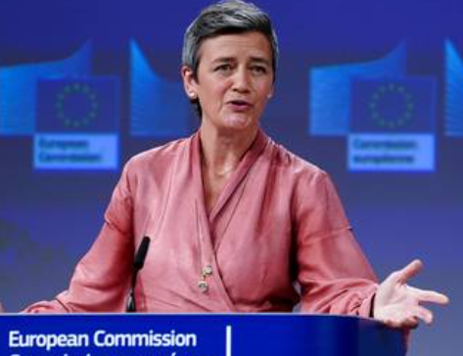
Can the parties do the deal?
Do the parties have competing R&D projects?
The Commission shall scrutinise the impact that a deal has on innovation competition. In recent years, these concerns have extended to pipeline products at earlier stages of development
Increased scepticism of “killer acquisitions” (i.e. the acquisition of an innovative competitor with the intention of discontinuing its innovative projects, so as to kill the competitive threat before it can materialise)
Paper by OECD quotes estimate that “almost 6% of all acquisitions of firms with drug projects in development are killer acquisitions”
“Protecting competition is not only about the medicines produced and sold today. It is also about future drugs that companies have in the pipeline. Even in early development”
Commissioner Vestager, 20 August 2018

Slide 13
Can the Parties do the deal?
Risks associated with pursuing “Killer Acquisitions”
Regulatory clearance
Killer acquisitions often avoid requirement to obtain merger clearance (target is often low-turnover/low-market share so filing thresholds typically not met)
Abuse of dominance
Case T-691/14 - Servier’s strategy to systematically buy out competitive threats to make sure they stayed out of the market held to be abusive
Hot topic amongst regulators. Additional merger filing thresholds introduced in certain member states (Austria, Germany) to catch killer acquisitions; topic of ongoing discussion at EU level
Case T-51/89 (Non-pharma but relevant) - dominant company acquired patents for the only alternative to its own technology, in order to shelve the patent

Slide 14
A hypothetical collaboration
Does the deal require regulatory approval?

Slide 15
Will the deal require prior regulatory approval?
…increasingly likely the more the JV operates as an independent entity
Agreement between independent entities:
Prior regulatory clearance unlikely* to be required
THE GREY AREA
Entities no longer independent:
Prior regulatory clearance may be required
Licensing
A
B
A
B
A
R&D Alliance
OR…
A
AB
… Independent
Joint Venture
A&B
B
R&D Alliance
(including sale of developed product)
AB
* There are exceptions

Slide 16
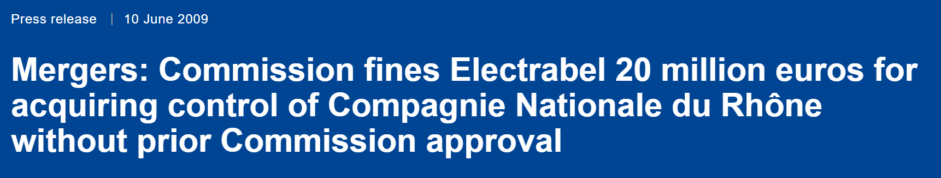
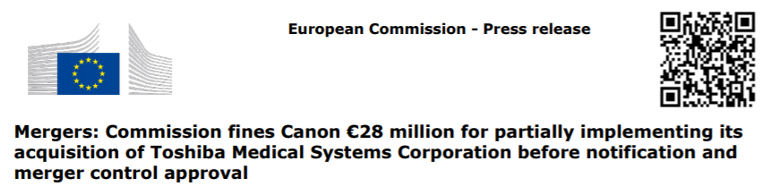

Will the deal require prior regulatory approval?
The importance of getting it right!
Failing to obtain approval when there is a requirement to do so may result in:
Fines of up to 10% of aggregate worldwide turnover
The unwinding of the deal

Slide 17
A hypothetical collaboration
Does the deal require regulatory approval?
Due diligence on partner to the collaboration

Slide 18
Due diligence
Could the current/past activities of the other party impact the success of the alliance?
Ability to achieve business goals: enforceability of key contracts and provisions
Illegal licensing or collaboration agreements with competitors
Enforceability of agreements with generics (e.g. patent settlements)
Illegal distribution / supply arrangements
Relationships with other competitors
Ongoing major competition investigations
Liability / reputational risks:
due to partner’s past or ongoing illegal conduct
Need to implement information exchange protocols?
Notes:
Adequate due diligence on competition law issues is important to avoid competition law liability and ensure that key contracts of target / partner are legal and enforceable

Slide 19
Need for information exchange protocols?
Protocols may need to be implemented to ensure competitively sensitive information is not exchanged between the parties
Competitively Sensitive
Research and development initiatives, including plans to launch or terminate new programs
Technical information about the mechanism of action to the extent it is not publicly disclosed
Plans, projections, or other forward-looking information surrounding future commercialisation and marketing efforts (including detailed assessments regarding existing products or treatments)
Not Competitively Sensitive
Data regarding clearly non-competing programs
Publicly available information about existing pipeline programs
General aggregated or historical R&D related information
Strictly organisational information (such as business flowcharts, HR processes, systems and reporting model documents)
Notes:
Adequate due diligence on competition law issues is important to avoid competition law liability and ensure that key contracts of target / partner are legal and enforceable

Slide 20
A hypothetical collaboration
Does the deal require regulatory approval?
Due diligence on the partner to the collaboration
Structuring / Negotiating the deal

Slide 21
Structuring / Negotiating the deal
Achieving business goals and complying with competition law: key issues
Allocation of distribution territories and minimising cross-border trade
Creating and managing an effective pricing strategy
Ensuring focus of both parties on the joint collaboration
Restrictions to protection of IP rights
Dividing channels / customers / fields of use

Slide 22




Structuring / Negotiating the deal
Allocation of tasks during commercialisation of the joint product
In principle, this is an acceptable division of responsibilities
Nippon Pharma will be sole manufacturer of the joint product
Each party will be exclusively responsible for distribution of the joint product in their respective allocated territories

Slide 23
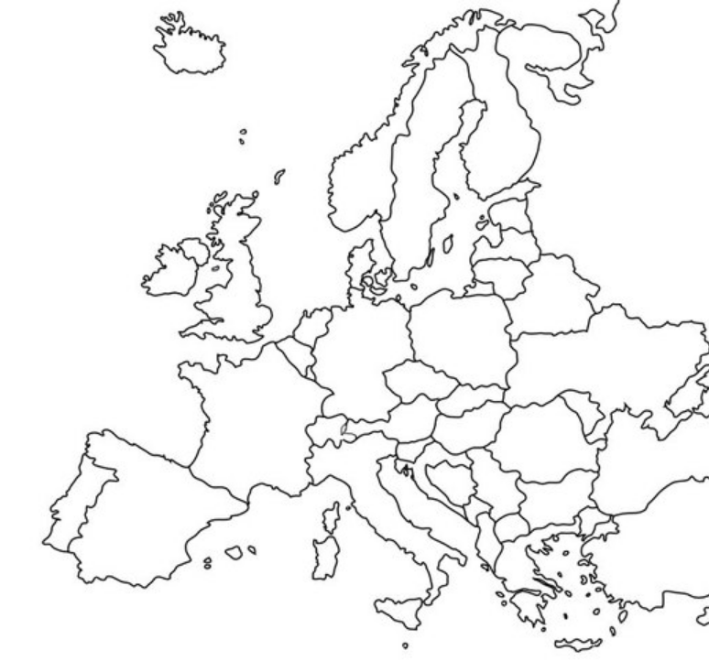
Structuring / Negotiating the deal
Allocation of distribution territories
Nippon Pharma will supply customers across Europe (other than those located in Spain and/or Portugal)
Iberica Labs will use its existing distribution network to supply customers in Spain and Portugal
Okay so long as no restrictions (in terms of sales/output limits) placed on either party within their own territory

Slide 24
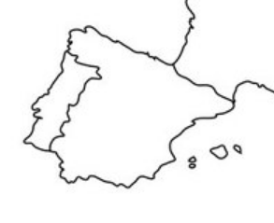



Structuring / Negotiating the deal
Ensuring agreed territory allocation not undermined by cross-border trade
Nippon Pharma:
“…our profits will be negatively affected if Iberica sells outside of its allocated territories. We want to restrict this as much as possible”
Can prohibit Iberica from actively selling to customers outside Spain and Portugal
Nippon territory
  Little effect in practice as cannot prohibit passive sales.
  Iberica can still sell to exporting wholesalers and traders
Iberica
territory
Cross-border (or “parallel”) trade is legal and protected between countries within the European single market. Nippon cannot put in place policies aimed at blocking all parallel trade

Slide 25

Structuring / Negotiating the deal
Managing pricing
Nippon Pharma:
“We need to ensure that Iberica’s prices are not significantly lower than ours so that customers in our territories don’t demand similarly lower price terms. This is also important to protect our revenue”
HIGH-RISK ACTIVITIES
Directly setting Iberica’s net price or setting a minimum net price
Indirectly preventing lower prices, through:
  penalties
  inducements
  indirectly fixing Iberica’s price
  requiring that all prices are subject to Nippon’s prior consent

Slide 26




Structuring / Negotiating the deal
Managing pricing
Nippon Pharma:
“We need to ensure that Iberica’s prices are not significantly lower than ours so that customers in our territories don’t demand similarly lower price terms. This is also important to protect our revenue”
Because Nippon is sole manufacture, it may control the price at which it supplies the joint product to Iberica
As the product is jointly developed, Nippon and Iberica may jointly prepare and agree a global pricing strategy
Can discuss and make non-binding recommendations with respect to price
Discussions must not amount to setting fixed or minimum prices!

Slide 27




Structuring / Negotiating the deal
Ensuring the other party’s efforts are focused on the collaboration
Iberica Labs
Can we prevent Nippon innovating independently in the field of the collaboration?
Can we restrict Nippon’s R&D activities in general?
“We want to ensure that Nippon remains focused on the collaboration and cannot work on separate R&D projects that will undermine its success.”
Cannot restrict Nippon R&D in unconnected field
Can restrict Nippon’s independent R&D in same or connected field during joint R&D phase

Slide 28

Structuring / Negotiating the deal
Ensuring both parties are focused on the collaboration
Iberica Labs
“We also need to ensure Nippon’s commitment to the alliance during commercialisation of the joint product.”
YIELD
RIGHT
OF
WAY
Can prevent Nippon from manufacturing or selling products that compete with jointly developed product
Cannot prevent Nippon from manufacturing or selling products in unrelated field

Slide 29

Structuring / Negotiating the deal
Limitations to the protection of IP rights
Iberica Labs
“The unique contribution we bring to this collaboration is our expertise in injectable therapies. We will grant Nippon a license to utilise this expertise to manufacture the joint product, but need to ensure that Nippon won’t seek to challenge our IP rights”
Contractual provision preventing Nippon from challenging Iberica’s IP rights
Contractual provision enabling Iberica to terminate the alliance if Nippon challenges its IP rights

Slide 30



Structuring / Negotiating the deal
Field of use restrictions
Nippon Pharma:
Insert clause restricting Iberica’s field of use of the jointly developed product
“Initial research indicates that Nippon may be able to adapt its treatment for Stage II/III breast cancer to develop a treatment for certain rare ear diseases.
This is a lucrative opportunity that Nippon intends to explore independently of Iberica.”
Stage II/III breast cancer
Rare ear diseases

