Slide 1


Structured finance and the desirable transformation of EU financial markets (CMU and SIU)
Banking & Finance
14/03/2026
Ivan Peeters Attorney, Nauta Dutilh
Lecturer ULB LLM International Business Law (financial markets/financial transactions)

Slide 2
Content
1 | The State of the EU banking & capital markets
2 | CMU and SIU
3 | Tools for transformation: covered bonds – securitisation – private credit
4 | What the future may bring

Slide 3

The State of the EU banking & capital markets
1

Slide 4
The EU’s banking and capital markets to date
Insufficiently supports economic development
Too fragmented
Too bank driven, weaker/smaller capital markets vs USA
Needs transformation to better support economic growth

Slide 5
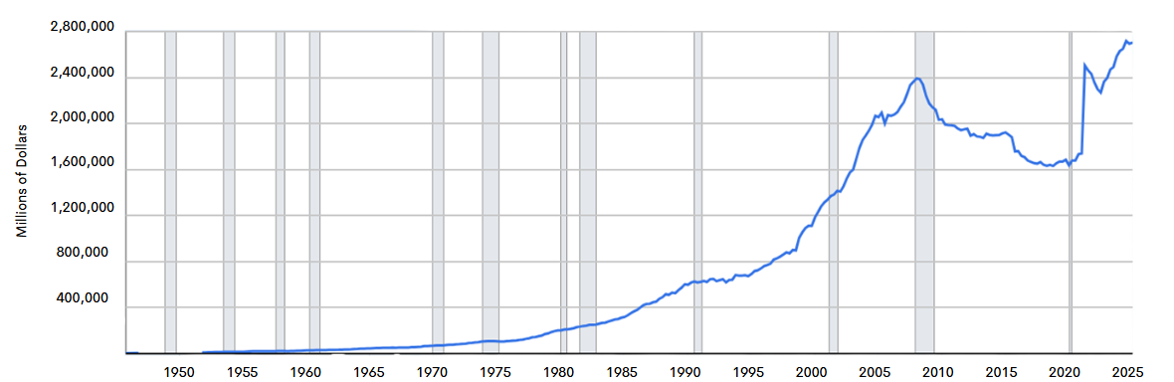
Growth of Non-depository Lenders in the US
Long duration evolution
Finance Companies; Total Financial Assets, Level
Note: Shaded areas indicate U.S. recessions
Banks and NBFIs are covering similar ground
Source: Federal Reserve
© PCS (Prime Collateralised Securities)
40

Slide 6
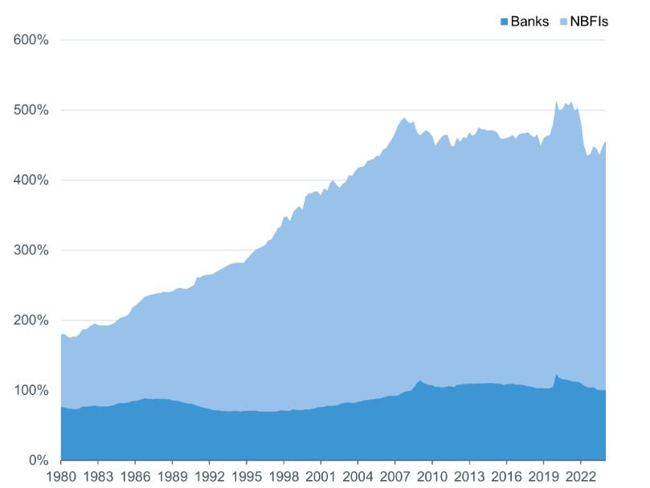
Assets as a share of US GDP
Assets as a share of US GDP
Long duration evolution
Growth NBFIs - US
“only” 310% of (a bigger) GDP
Source: FDIC
© PCS (Prime Collateralised Securities)
36

Slide 7
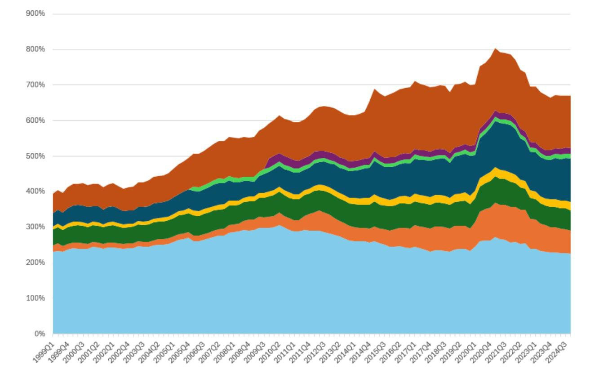
Total assets of the Euro Area financial sector as % of nominal GDP
Long duration evolution
And that is our industry
Growth and composition of
NBFIs - EZ
Source: ECB financial integration and structure indicators
© PCS (Prime Collateralised Securities)

Slide 8
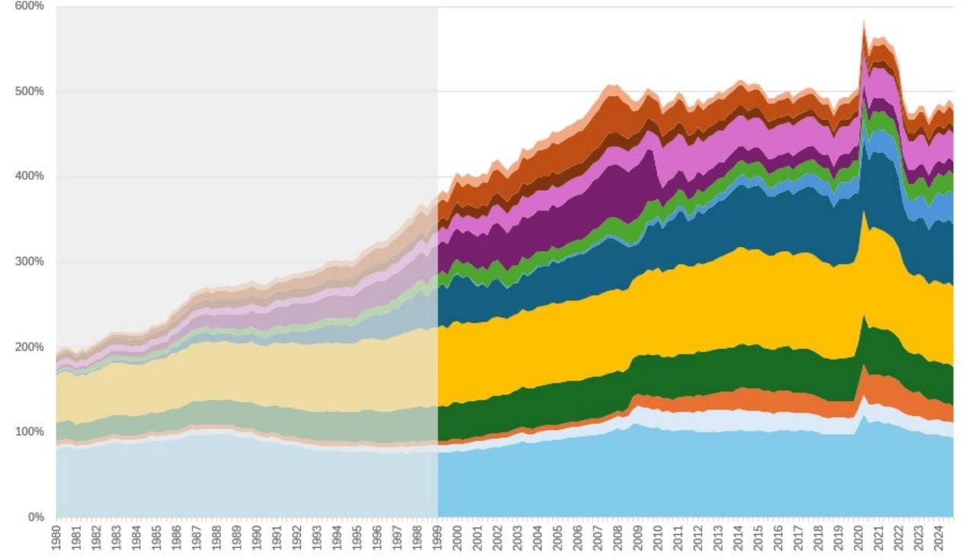
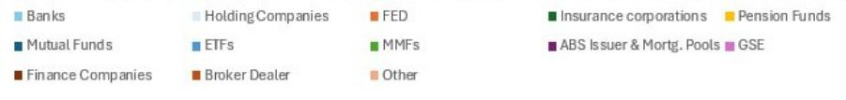
Total assets of the US financial sector as % of nominal GDP
Long duration evolution
Less than 100%
Growth and composition of
NBFIs - US
Source: ECB; FDIC
© PCS (Prime Collateralised Securities)

Slide 9

CMU - SIU
2

Slide 10
The Capital Markets Union (CMU) – September 2015
Official EU Objectives
create a single market for capital
to get money – investments and savings – flowing across the EU so that it can benefit consumers, investors and companies, regardless of where they are located.
provide businesses with a greater choice of funding at lower costs
offer new opportunities for savers and investors
Translated into financial market dynamics
create a single market for capital across the EU
by reducing fragmentation
diversifying funding sources beyond bank lending
channelling capital more efficiently to support growth, innovation, SMEs, and long-term investments

Slide 11
The Savings and Investment Union (SIU) – March 2025
Successor and evolved/rebranded version of the CMU
Official EU Objectives
Create better financial opportunities for EU citizens
Enhancing our financial system’s capability to connect savings with productive investments
More choice for savers who wish to grow their household wealth
Allow businesses across Europe to grow
Translated into financial market dynamics
Mobilizing household savings (Europe's high savings rate but low retail participation in capital markets) toward productive investments
Combining capital markets integration with elements of banking union progress
Stronger retail focus
Better incentives for investors and issuers.

Slide 12

Tools for transformation?
3

Slide 13
What is securisation and how is it regulated?
Product description
a financial process
that transforms illiquid assets—typically loans or receivables that generate regular cash flows
into tradable securities
that can be sold to investors in capital markets.
Regulatory definition (Sec Reg)
transaction or scheme
credit risk associated with an exposure or a pool of exposures is tranched
having all of the following characteristics:
(i) payments in the transaction or scheme are dependent upon the performance of the exposure or of the pool of exposures;
(ii) the subordination of tranches determines the distribution of losses during the ongoing life of the transaction or scheme;

Slide 14
Classic securitisation scheme – true sale
Transfer Receivables
Originator /Seller
Special
Purpose Vehicle
Notes
Investors
1
2
Proceeds
Proceeds
3
Structural
Enhancements

Slide 15
How are securitisations regulated? (1)
EU
Regulation (EU) 2017/2402 of the European Parliament and of the Council of 12 December 2017 laying down a general framework for securitisation and creating a specific framework for simple, transparent and standardised securitisation, and amending Directives 2009/65/EC, 2009/138/EC and 2011/61/EU and Regulations (EC) No 1060/2009 and (EU) No 648/2012
Regulation (EU) 2017/2401 of the European Parliament and of the Council of 12 December 2017 amending Regulation (EU) No 575/2013 on prudential requirements for credit institutions and investment firms
    Commission Delegated Regulation (EU) 2024/584 of 7 November 2023 amending the regulatory technical standards laid down in Delegated Regulation (EU) 2019/1851 as regards the homogeneity of the underlying exposures in simple, transparent and standardised securitisations
    Implementing and delegated acts - Securitisation Regulation
Directive (EU) 2021/2167 of the European Parliament and of the Council of 24 November 2021 on credit servicers and credit purchasers and amending Directives 2008/48/EC and 2014/17/EU

Slide 16
How are securitisations regulated? (2)
Belgium
Deel 3bis. - Instellingen voor belegging in schuldvorderingen - Wet van 3 augustus 2012 betreffende de instellingen voor collectieve belegging die voldoen aan de voorwaarden van richtlijn 2009/65/EG en de instellingen voor belegging in schuldvorderingen
Wet van 3 augustus 2012 betreffende diverse maatregelen ter vergemakkelijking van de mobilisering van schuldvorderingen in de financiële sector
Burgerlijk Wetboek, Boek 5, Titel 3, Ondertitel 4. - Overdracht van verbintenissen
Oud Burgerlijk Wetboek, Boek 3, Titel XVII, Hoofdstuk 1, Afdeling 7 – Pand Schuldvorderingen
Hypotheekwet, Hoofdstuk III, Afdeling V. Overdracht van bevoorrechte en hypothecaire schuldvorderingen
Wet van 15 december 2004 betreffende financiële zekerheden en houdende diverse fiscale bepalingen inzake zakelijke-zekerheidsovereenkomsten en leningen met betrekking tot financiële instrumenten
Wetboek van de inkomstenbelastingen - Artikel 185bis
Wetboek van de Btw - Artikel 44 §3
KB/WIB 92 - Artikel 117
Koninklijk besluit van 18 september 2022 houdende wijziging van diverse reglementaire bepalingen betreffende institutionele en private instellingen voor collectieve belegging en instellingen voor belegging in schuldvorderingen
Koninklijk besluit van 30 juli 2018 houdende bepaalde uitvoeringsmaatregelen inzake institutionele instellingen voor belegging in schuldvorderingen

Slide 17
How are securitisations regulated? (3)
Useful Websites
European Commission - Securitisation
EBA - European Banking Authority
ESMA - Securitisation
PCS - Setting the Standard for Securitisation
True Sale International GmbH
STS securitisation practical guide (Norton Rose Fulbright)
Securitisation – risk retention Q&A(Norton Rose Fulbright)

Slide 18
What are covered bonds and how are they regulated?
Three types
- On balance sheet
- SPV structure
- Specialised credit institutions

Slide 19
Full-on balance sheet issuance for banks generally
Germany, Belgium, Luxembourg
General recourse
Bank
Bond Holders
A
L
Covered bonds
Special Estate (cover assets)
Preferential recourse

Slide 20
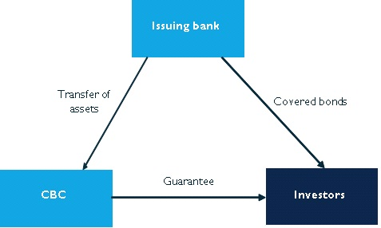
SPV structure
The Netherlands, UK

Slide 21
Specialised credit institutions
France (sociétés de crédit foncier/sociétes de financement de l’habitat)
Fully on balance sheet
Single purpose entities
Bankruptcy remote
Independent from other group companies

Slide 22
How are covered bonds regulated in Belgium and the EU? (1)
EU
Regulation (EU) 2019/2160 of the European Parliament and of the Council of 27 November 2019 amending Regulation (EU) No 575/2013 as regards exposures in the form of covered bonds
Directive (EU) 2019/2162 of the European Parliament and of the Council of 27 November 2019 on the issue of covered bonds and covered bond public supervision and amending Directives 2009/65/EC and 2014/59/EU

Slide 23
How are covered bonds regulated in Belgium and the EU? (2)
Belgium
Wet van 3 augustus 2012 betreffende diverse maatregelen ter vergemakkelijking van de mobilisering van schuldvorderingen in de financiële sector
Wet van 25 april 2014 op het statuut van en het toezicht op kredietinstellingen [...]. (Aangehaald als : Bankwet), (a) Boek I, Titel III, Hoofdstuk II , (b) Boek II, Titel II, Hoofdstuk IV, Afd. III en (c) Bijlage III
Hypotheekwet, Hoofdstuk III, Afdeling V. Overdracht van bevoorrechte en hypothecaire schuldvorderingen (in het bijzonder: afdeling V, art. 81quater, §1, 2° en art. 81decies, §1-2.)
Koninklijk besluit van 11 oktober 2012 betreffende de uitgifte van Belgische covered bonds door kredietinstellingen naar Belgisch recht
Koninklijk besluit van 11 oktober 2012 betreffende de portefeuillebeheerder in het kader van de uitgifte van Belgische covered bonds door een kredietinstelling naar Belgisch recht
Koninklijk besluit van 27 januari 2022 tot wijziging van het koninklijk besluit van 11 oktober 2012 betreffende de uitgifte van Belgische covered bonds door kredietinstellingen naar Belgisch recht, van het koninklijk besluit van 11 oktober 2012 betreffende de portefeuillebeheerder in het kader van de uitgifte van Belgische covered bonds door een kredietinstelling naar Belgisch recht, van het koninklijk besluit van 12 november 2012 met betrekking tot de instellingen voor collectieve belegging die voldoen aan de voorwaarden van Richtlijn 2009/65/EG en van het koninklijk besluit van 25 februari 2017 met betrekking tot bepaalde openbare alternatieve instellingen voor collectieve belegging en hun beheervennootschappen, en houdende diverse bepalingen
Circulaire NBB_2022_15 / Praktische regels voor de toepassing van de wet van 25 april 2014 op het statuut van en het toezicht op kredietinstellingen en beursvennootschappen
Circulaire NBB_2022_16 / Circulaire aan de portefeuillesurveillanten bij kredietinstellingen naar Belgisch recht die Belgische covered bonds uitgeven

Slide 24
How are covered bonds regulated in Belgium and the EU? (3)
Useful websites
European Covered Bond Council (https://hypo.org/ecbc/)
Covered Bond Label (National Information :: Covered Bond Label)

Slide 25
What is private credit and how is it regulated? (1)
Private credit – private debt – direct lending
  Loans or debt financing provided directly by non-bank lenders
  private credit funds, alternative asset managers business development companies or private equity firms
  to borrowers, usually companies.
How is private lending regulated?
  No overarching activity or institution regulation
  AIFMD: recent amendments allow AIFs to originate loans
  Respect mandatory bank regulation (“banking monopoly”, CSD VI…)

Slide 26
What is private credit and how is it regulated? (2)
Structural risks?
  Credit risk quality concerns
    Borrowers
    Managers
    Lending terms
  Lack of liquitidy
    Bilateral loans are less illiquid and typically held to maturity by the lender
    closed end funds vs open end funds ?
    current “crisis” ? (BlackRock, …)

Slide 27
How securitisation can help transform financial markets
How does it change the structure of the financing market?
Shift from bank lending to capital markets funding
Borrowers originating securitisations
Private credit funds tapping capital markets via securitisations
Banks tapping capital markets via securitisations
Borrowers diversify funding sources
Private Credit Funds: originate to distribute model
Banks: originate to distribute model
How does it increase the total volume of financing available to the EU economies
Access to capital markets investors

Slide 28
How private credit can help transform financial markets
Shift lending from banks to non-banking institutions?
Lending in a less regulated environsment (cost!)
More flexibility in terms of origination (terms, covenants, return)
Other risk profiles ?
Complementary, not (full) replacement
Attracts other types of funds/investors: increases volume of financing available to the EU economies
Investor demand for higher yield
Investor demand for diversification (Risk/return, business sectors…)
Borrower demand for flexibility & speed

Slide 29
Systemic impact/risks
Shift to more risky investments?
Distribution of risks from highly regulated environment to less regulated entities ?
Fundamentals: no risk no return
Challenge for the bank business model ?
  Less deposit funding (cheap)
  Less on balance sheet income
  Other developments e.g. stable coin

Slide 30

What the future may bring
4

Slide 31
EU Reform Securitisation Regulatory Framework (1)
What and why ?
Significant revisions primarily through proposals adopted by the European Commission
Part of the Savings and Investments Union (SIU) strategy
Revive the EU securitisation market by making the rules simpler, more proportionate, and less burdensome while preserving financial stability.
Boost issuance (by easing supply-side burdens) and investor demand (via better prudential incentives), supporting EU economic priorities like funding the green/digital transitions and SME lending.

Slide 32
EU Reform Securitisation Regulatory Framework (2)
Key changes ?
Securitisation Regulation (SECR)
due diligence and transparency requirements (streamine, simplify)
reduce compliance costs and barriers
differentiate for private vs. public securitisations
STS (Simple, Transparent, Standardised) criteria adjustments
Capital Requirements Regulation (CRR) for banks,
lower risk weights/floors for certain positions
revisions to significant risk transfer (SRT) rules to make capital relief easier and more accessible.
Solvency II for insurers
Better risk treatment for certain securitisation tranches (STS/ non-STS)

Slide 33

Some potential scenario’s

Slide 34

Four possible futures
Impact of enhanced securitisation activity on the lending market (1)
Investments
CM investments (bonds, commercial paper)
Traditional CM NBFIs
CLOs
Investments
Investments
New Corporate Lenders
Loans (private credit)
Deposits
Loans
Loans
CORP.
CORP.
Traditional Lenders
Loans
New Retail Lenders
PEOPLE
PEOPLE
Deposits
Loans
The new ecosystem (redux and with securitisation ex OBS)
ABS/RMBS/CMBS
Loans
Ultimate Lenders
Ultimate
Borrowers
Financial Intermediation
© PCS (Prime Collateralised Securities)

Slide 35
Impact of enhanced securitisation activity on the lending market (2)
Banks: move to originate to distribute
Reducing need of (expensive capital)
Allows for growth in lending business
Alternative for reducing retail deposits ?
Supporting shift to more fee income (origination, fees, placement fees) ?
NBFI: originate to distribute
CM funding
CM cost of funding
Allows for growth in lending volumes

Slide 36
Impact on corporate borrowing market
Origination of securitisation by corporations
Additional volume of borrowing/financing for the real economy
Diversification of funding sources (cost mix, stability)
Stand alone transactions ?
Conduit type transactions ?
Increase of volume of fee business for FIs (structuring, arranging, underwriting) and service providers (corporate services, trustee services, legal services …)

Slide 37
Impact of changes in relation to private credit (NBFI)
Current turbulence in the private credit market(s)
  Liquidity
  Quality (credit risk)
  Integrity (fraud ?...)
Regulatory response ?
  Regulate NBFI like credit institutions ?
  Key considerations:
    Cost of regulation
    Global playing field: competitiveness / attractiveness of the European market
  Difficult choices ahead ….

