Slide 1

Securitisation
Banking & Finance
12.02.2026
Ivan Peeters

Slide 2
Content
1 | Introduction
2 | Securitisation
3 | Asset segregation
4 | Servicing
5 | Pledging of assets
6 | Particular tax considerations
7 | Data protection
8 | Other important considerations
9 | Securitisation vehicle
10 | How is securitisation regulated ?
11 | What a real transaction looks like ?

Slide 3
Introduction
1

Slide 4
Differences between debt and equity (1)
Nature of Investment:
  Debt: A financial obligation requiring repayment of principal and mandatory payment of interest, with no ownership stake for creditors.
  Equity: An ownership interest in the company, granting investors a share of profits and decision-making rights, with full exposure to the enterprise risk (no guaranteed repayment, no mandatory remuneration).
Legal characteristics:
  Debt: 100% contractual rights, freedom of contract, limited mandatory requirements (DCM…)
  Equity: more rigid corporate rules, with more limited freedom of contract (prep shares, hybrids …), impact on “ownership/management rights”.

Slide 5
Differences between debt and equity (2)
Insolvency:
  Holder of debt = creditor, full recourse to all assets of the debtor (subject to priority rights of some other creditors).
  Holder of equity = entirely subordinated to all other creditors, no recourse to asset only right to.
Cost and Financial Implications:
  Debt: mandatory interest payments (fixed or floating interest rate), often tax-deductible, without impact on ownership.
  Equity: no guaranteed right to remuneration; dividend type remuneration to the extent the criteria for profit distribution are met.

Slide 6
Transaction types
Bilateral loans/facilities (syndicated)
DCM (Debt Capital Markets)
Securitisation
Covered Bonds
Synthetics

Slide 7
Securitisation
2

Slide 8
What you may have heard …
A financing structure and an investment product
A reputation tarnished by the 2017-2018 global financial crisis (“subprime MBS”, “credit default swaps”, toxic assets, etc.)
A reputation tarnished by modern scholarly trends (K. Pistor–The Code of Capital)
ECB: a genuine Capital Markets Union would mean building a sufficiently large securitisation market, allowing banks to transfer some risk to investors, release capital and unlock additional lending

Slide 9
Our experience
Experience through the full cycle:
  pre-crisis market boom
  financial crisis collapse
  rescue of banks
  litigation
  post-financial crisis regulatory
  and recent market developments (incl. sustainability and digitalization)

Slide 10
Classic securitisation scheme – true sale
Transfer Receivables
Originator /Seller
Special
Purpose Vehicle
Notes
Investors
1
2
Proceeds
Proceeds
3
Structural
Enhancements

Slide 11
Different structural components (1)
Origination
Sale/risk transfer
  No recourse
  “true sale”
Servicing
Hedging

Slide 12
Different structural components (2)
Issuance of asset backed securities
  Marketing
  Disclosure (data, financial structure, risk factors)
Servicing
Rating
  Rating models
  Disclosure (historical performance, legal structure, operational due diligence)
Distribution/sale of securities

Slide 13
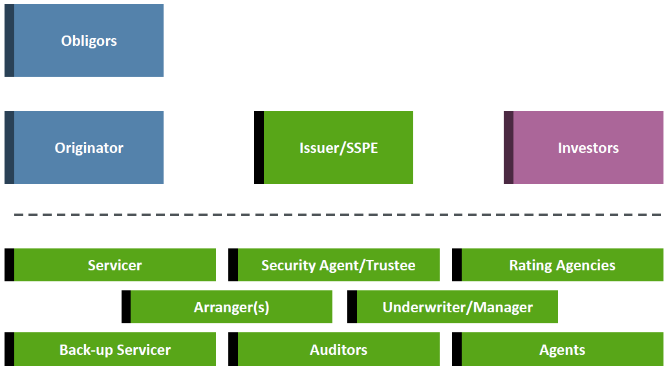
Parties involved

Slide 14
Why is securitisation used?
Funding, debt finance (market, retained)
Risk transfer (capital relief, …)

Slide 15
Economics of a true sale securitisation
Asset based financing, with (full) risk transfer and partial transfer of “rewards”
Example: RMBS
Mortgage loans
Principal + %
Originator obtains funding through purchase price: sale for face value, no price for interest component
Investors hold a limited recourse, secured bond

Slide 16
Variety based on underlying assets : “asset classes”
Auto-loan ABS
Residential mortgages (RMBS)
Commercial mortgages (CMBS)
Corporate loans (CLOs)
Consumer loans
Trade receivables
Commodities (e.g. diamonds)
Equipment leases
Whole business

Slide 17
Variety based on originates
Bonds
Industrial
Servitisation
Utilities
Credit funds
Leasing companies
Diamond trade

Slide 18
Asset Segregation
3

Slide 19
Asset segregation : what and why ?
Asset based finance
Exclusive recourse to assets
Which technique(s) ?

Slide 20
About « asset segregation » - Receivables
Article 5.179 et seq. j°3.28, §2 Civil Code
  Validity of assignment of receivables inter partes:
    valid agreement on object and price of the sale
    ancillary items (behorigheden/accessoires) (art. 5.177 CC)
Effectiveness (tegenstelbaarheid/opposabilité) of the assignment of receivables against third parties:
  debtor
  third parties without vested rights in the receivable
  third parties with vested rights in the receivable

Slide 21
About « asset segregation » - Receivables
Effectiveness of the assignment of receivables against the debtor (art. 5.179, 2nd par. CC)
  Prior to notification or acknowledgement
    valid discharge of obligations by payment to transferor
    possibility to invoke all type of defenses which have accrued up to date of notification/acknowledgment including set-off (schuldvergelijking/ compensation)
  “Good faith requirement” (i.e. no knowledge of assignment):
    discharge of assigned receivable by way of payment; and
    Defenses arising out of certain actions agreed between debtor and transferor (i.e. waivers, amendments, novation, etc.)

Slide 22
About « asset segregation » - Receivables
Effectiveness of the assignment of receivables against third parties without vested rights in the receivable (art. 5.179, 1st par. CC)
  e.g. administrator insolvency procedure or a seizing creditor
  Conclusion of assignment agreement / no formalities (!)

Slide 23
About « asset segregation » - Receivables
Effectiveness of the assignment of receivables against third parties with vested rights in the receivable (art. 5.179, 3rd par. j° 3.28, §2 CC)
Assignment/pledge to multiple transferees:
  Time of notification determines raking among transferees/pledgees
Creditor who has attached the receivable and received in good faith payment of receivables from the debtor acting in good faith:
  Effectiveness upon notification/acceptance

Slide 24
Other assets ?
Diamonds
Leasing vehicules
Servitisation

Slide 25
Servicing
4

Slide 26
What is servicing?
Definition in Directive (EU) 2021/2167 of the European Parliament and of the Council of 24 November 2021 on credit servicers and credit purchasers and amending Directives 2008/48/EC and 2014/17/EU
‘Credit servicing activities’ means one or more of the following activities:
  collecting or recovering from the borrower any payments due related to a creditor’s rights under a credit agreement or to the credit agreement itself;
  renegotiating with the borrower any terms and conditions related to a creditor’s rights under a credit agreement, in line with the instructions given by the credit purchaser;
  administering any complaints relating to a creditor’s rights under a credit agreement or to the credit agreement itself;
  informing the borrower of any changes in interest rates or charges or of any payments due related to a creditor’s rights under a credit agreement or to the credit agreement itself.

Slide 27
Legal aspects of servicing
Book XIX of the Belgian Code of Economic Law (amicable debt recovery)
Power of Attorney
Credit Institutions Supervision Law
Directive (EU) 2021/2167 of the European Parliament and of the Council of 24 November 2021 on credit servicers and credit purchasers and amending Directives 2008/48/EC and 2014/17/EU (“NPL Directive”)

Slide 28
Pledging of assets
5

Slide 29
Current legal framework
Rules of Belgian civil code/commercial code
Specific protection in art. 271/12, § 2 of UCITS and SIC Act against claw-back rule of art. 17,3° of the Bankruptcy Act for receivables added after the date of the conclusion of the pledge provided that the pledge was created at the time of issuance of securities by the SIC
In case receivables are “bank claims” (as defined in the Belgian Financial Collateral Act), protection of pledge or creation of security interest over bank claims as set out in the Financial Collateral Act
Rules of the Mobilisation Law (including in respect of Mortgage Credit)
Rules of the New Belgian Act of 11 July 2013 on movable security

Slide 30
Particular tax considerations
6

Slide 31
Particular tax considerations
Tax considerations with regard to a transfer of mortgage-backed receivables to a SIC
  VAT
    Transfer is principally not subject to Belgian VAT pursuant to art. 44, §3,7 Belgian VAT Code
    Purchase price paid by SIC is lower than book value receivables in the hands of the originator (i.e. sale with a discount)?
  Registration tax
    Registration tax 1% calculated on the nominal amount of the receivables payable upon registration
    No legal obligation for mobilisation institutions to submit for registration

Slide 32
Other tax considerations
Withholding tax on interest payments made by the (original) borrowers
Article 116 of the royal decree implementing the ITC (RD/ICT) provides for a full exemption from Belgian withholding tax on interest payments made to certain types of investment companies, including e.g. institutional SICs. This exemption is subject to the affidavit requirement laid down in Article 117, §9 RD/ITC, meaning that an affidavit should be remitted by the SIC to the borrower upon each interest payment date.
A full exemption of Belgian withholding tax could equally be obtained by the borrowers pursuant to Article 107, §2, 9°of the RD/ITC, which provides that interest payments due on ordinary loans and payable to Belgian companies are exempt from Belgian withholding tax on interest, without any specific formalities having to be complied with.

Slide 33
Data protection
7

Slide 34
Data protection
Regulation 2016/679 (the GDPR) and the Belgian Act of 30 July 2018 on the protection of natural persons with regard to the processing of personal data
The GDPR permits the processing of personal data under several permissibility grounds (legal bases), including:
  the prior consent of the data subject;
  the necessity of the processing for the execution of an agreement to which the data subject is a party; and
  if the data processing is necessary for the legitimate interests pursued by the seller or for those pursued by the purchaser (and these interests are not overridden by privacy interests of the borrowers as data subjects).

Slide 35
Data protection
In securitisation transactions whereby:
  the loan receivables are transferred to an SPV by way of a silent assignment;
  the servicing remains with the originator; and
  the terms governing the loan permit the assignment of the receivable (in the context of a securitisation transaction)
Good arguments are available to take the view that a transfer of rights in respect of loans by the transferor to the transferee is permitted under the latter two grounds, so that the prior consent of the borrowers must not be obtained.
In practice: role of a “Data Protection Agent”

Slide 36
Other important considerations
8

Slide 37
Other important considerations
Capital and liquidity requirements
Eurosystem eligibility
Securitisation and the challenges of sustainability
  Sustainability transition requires billions of EUR private investment
  Securitisation market is seen as a key market for raising such funding
Investor’s perspective

Slide 38
Securitisation vehicle
9

Slide 39
Securitisation vehicle
Belgian dedicated securitisation vehicle: institutionele VBS / SIC institutionnelle
Introduced into the Belgian Act of 20 July 2004 on certain forms of collective management of investment portfolios:
  Alternative for the public SIC: burdensome regulation
  Licenced management company
  Supervised by FSMA
  Custodian
  Retail prospectus

Slide 40
Securitisation vehicle
Initially limited changes in the Belgian Act of 3 August 2012 on certain form of collective management of investment portfolios
However, as a result of the implementation of the AIFM Directive and implementation of the AIFM act, significant overhaul of the Belgian Act of 3 August 2012
  Scope limited to UCITS (satisfying EU Directive 2009/65)
  Other collective investment vehicles governed by AIFM Act
  One exception (as a result of the exclusion of Securitisation Special Purpose Entities): the SIC now included in separate part 3bis

Slide 41
Securitisation vehicle
New legal framework (since AIF Act): Art. 271/1 to 271/18 in Part 3bis of Belgian UCITS and SIC Act
  Characteristics
  Investors
  Corporate
  Regulatory requirements
  Tax Status

Slide 42
How is securitisation regulated ?
10

Slide 43
How is securitisation regulated ?
Global
EU
Belgium

Slide 44
What a real transaction looks like ?
11

Slide 45
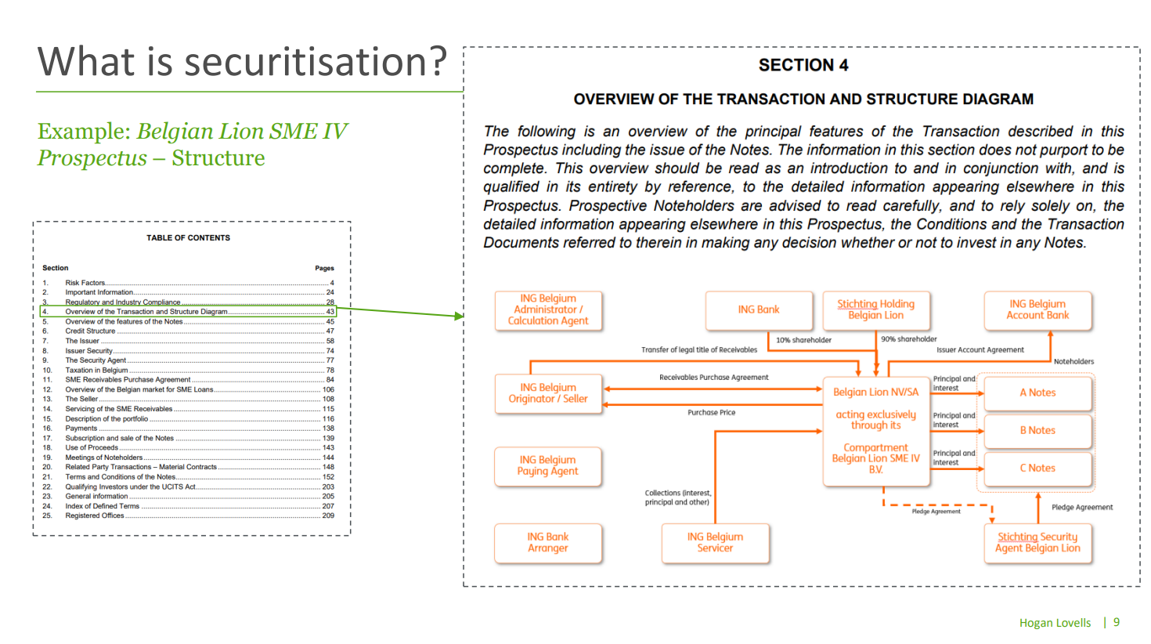
Example

Slide 46
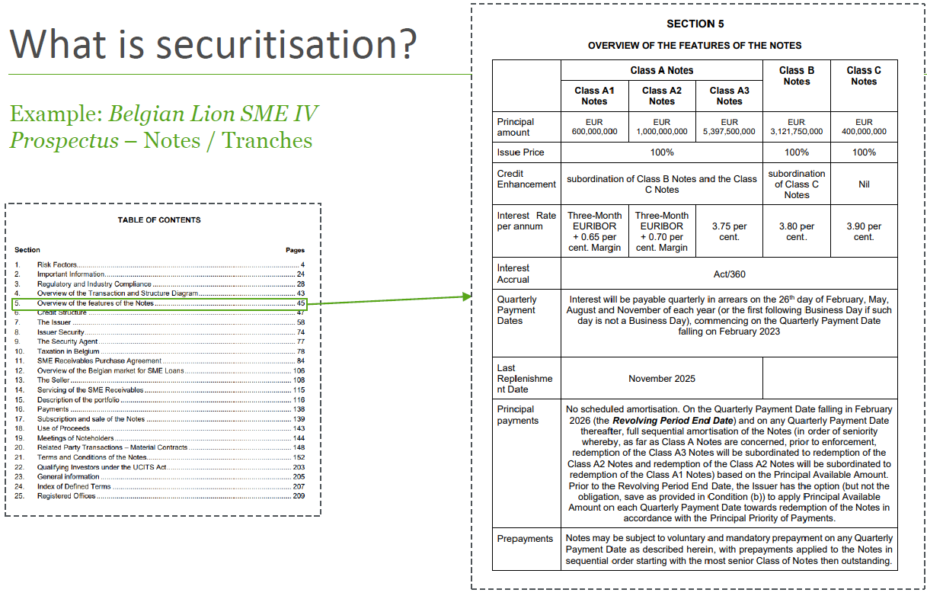
Example

Slide 47
Example: transaction documents (1)
Master Definitions Agreement
SME Receivables Purchase Agreement (the SRPA)
Servicing Agreement
Pledge Agreement
Clearing Agreement
Domiciliary Agency Agreement
Administration Agreement
GIC Agreement
Corporate Services Agreement
Transparency Reporting Agreement

Slide 48
Example: transaction documents (2)
Issuer Management Agreements
Stichting Holding Belgian Lion Management Agreements
Security Agent Management Agreement
Subscription Agreement
Prospectus
Articles of Association Issuer

