Slide 1
REIT-financing – Cofinimmo – Case-study
Sophie Grulois
26 February 2026

Slide 2
1 About Cofinimmo
Table of
2 REIT-regime
    What is a REIT
    History
    Legal framework
    Examples
contents
3 Sources of financing
    Overview
    Cofinimmo Sustainable Finance Framework
    Rights issue
    ABB
    Contribution of assets
    Optional dividend
    Bank financing
    Bonds
    Commercial paper
    Sale of rental receivables

Slide 3

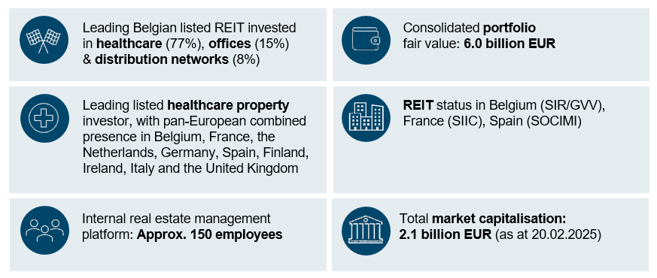

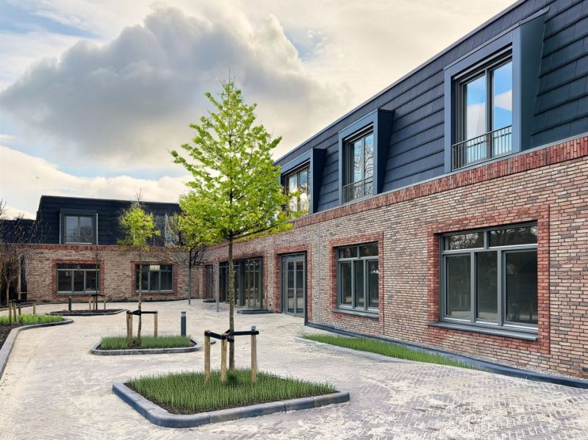
About Cofinimmo

Slide 4




REIT-regime
    What is a REIT
    History
    Legal framework
    Examples

Slide 5

What is a REIT
DEFINITION
A Real Estate Investment Trust (REIT) is a company that
    owns, operates and finances income-producing real estate
    across a range of property sectors such as offices, logistics, retail, healthcare and residential
  Two types: (1) public REITs and (2) private REITs, but many are public REITs
PRIMARY PURPOSE OF A PUBLIC REIT
= To democratise real estate investment by allowing individual investors to invest in large-scale, diversified real estate portfolios by way of buying shares in these REITs

Slide 6




What is a REIT
ATTRACTIVE FOR INVESTORS
Access to a diversified real estate portfolio
        REITs often own different types of real estate
Access to a steady income
        REITs have the obligation to pay a certain minimum amount of dividends to their shareholders every year
Liquidity
        The shares can be bought and sold on stock exchanges
  Access to professional management
        The real estate is managed by professionals (the REIT has specialised teams)
  Transparency and regulation
        REITs are subject to regulatory oversight and as a listed entity they are obliged to disclose their financial performance

Slide 7
History
1995
Royal Decree of 10 April 1995:
Regulatory framework in place for
Vastgoedbevak/SICAFI
Origin in US:
US Federal Law of 14 September 1960:
extending fiscal transparency to Real Estate Investment Trusts
Creation of Operational REIT (GVV/SIR) status:
Law of 12 May 2014
Royal Decree of 13 July 2014
1960
2014
Concept first introduced in the US in 1960
Belgium one of the first countries to introduce the REIT-regime in Europe (in 1995)
Current legal basis: the Law of 12 May 2014 regarding REITs and its implementing
Royal Decree of 13 July 2014

Slide 8
Legal framework of the Belgian REIT
AIM OF THE REGULATORY FRAMEWORK
 Promote a fair, efficient and stable real estate investment market, which is protective of the
interests of the investors
At least 30% of the shares must be trading on a Belgian-regulated market (Euronext Brussels)
Principal activity is active management of real estate
Maximum debt-to-assets ratio of 65%
Quarterly valuation of the assets by an independent expert
Obligation to pay out at least 80% of its net result
A maximum of 20% of its total assets can be invested in
1 single “real estate complex” (risk diversification)
Low corporate income tax
Specific rules regarding internal control structures

Slide 9












Examples in Europe

Slide 10
Sources of financing
  Overview
  Cofinimmo Sustainable Finance Framework
  Rights issue
  ABB
  Contribution of assets
  Optional dividend
  Bank financing
  Bonds
  Commercial paper
  Sale of rental receivables

Slide 11

Overview
Types: equity, debt and other
1. Equity
    Rights issue
    ABB
    Contribution of assets
    Optional dividend
2. Debt
    Bank financing
    Bonds
    Commercial paper
3. Other
    Sale of rental receivables

Slide 12
Cofinimmo Sustainable Finance Framework May 2020
Framework developed to attract funding for assets and activities that contribute to Cofinimmo's sustainability strategy
Outlines what the funds should be used for (e.g. type of building) in accordance with criteria set out in the Green Bond Principles, Social Bond Principles and Green Loan Principles
Cofinimmo has 2.6 billion EUR in sustainable financing
Cofinimmo - Sustainable Finance Framework

Slide 13
Rights issue
Offering of new shares to existing shareholders (secondary public offering (SPO)) (standard capital increase)
Legal framework
        Code of Companies and Associations of 28 May 2019
        Prospectus Regulation (EU 2017/1129)
        Law on Public take-over Bids of 1 April 2007
        Law regarding supervision on the financial sector and financial services of 2 August 2002
        Law on REITs of 12 May 2014

Slide 14
Rights issue
Key steps
  Board decision
        Approval to launch the capital increase
        Approval on the amount
        Approval on the subscription price (always at a discount to the current stock-price)
  Opening of offer period
        Minimum 15 calendar days (non-REITs) and minimum 3 business days (REITs) (legal requirement)
        Existing shareholders have possibility to subscribe pro rata their shareholding (preference right)
  End of initial offer period – second offer period
        If not all existing shareholders have exercised their preference right, the other shareholders/new investors can subscribe during a second offer period to the not yet subscribed offers
  End of second offer period – approval of shareholders meeting
        Majority 75%
        Company may revoke transaction if a certain minimum amount has not been subscribed to

Slide 15
Rights issue
Short prospectus required (summary document – 11 pages) (new EU Listing Act –
since 4 December 2024) provided
        over 12 months, the total amount of offer of securities are < 30% of the capital, or
        the company has been listed for 18 months
FSMA (Financial Services and Markets Authority)
        No approval summary document (only filing with the FSMA) (since new EU Listing Act)
        Approval corporate documentation and press-releases
Market abuse rules (MAR)
        A rights issue will constitute inside information at some point in the process
        Specific rules apply
        Prohibition to trade in the shares/to do equity transactions when in possession of inside information

Slide 16
Accelerated book-building (ABB)
Offering of securities in a very short period of time
        Preparation: a few weeks
        Offering open for a few hours
Legal framework (see rights issue)
Offering to qualified investors only (never to retail)
  Preference right for existing shareholders is always disapplied
  Formalities
        No approval from shareholder meeting, board approval only (within authorised capital)
        No prospectus (over 12 months, the total amount of offer of securities are < 30% of the capital)
  Cumulative amount of capital increases carried out through ABB over a period of 12 months cannot exceed 10% of the amount of the capital (REIT-specific)

Slide 17
Accelerated book-building (ABB)
The subscription price is at a discount
  Smaller discounts than for rights issues
FSMA
  Approval corporate documentation and press-releases
Market abuse rules (see rights issue)

Slide 18
Zoom on the authorised capital
Authorised capital = the maximum amount of capital that a company can issue, pursuant to its articles of association, without needing approval from the shareholders
Maximum of 5 years
Legal maximum amount
  100% of the capital
Proxy advisers’ guidelines are much stricter (see next slide)
Cofinimmo:
        50%: capital increases in cash with preference right (rights issue)
        20%: capital increase through optional dividend
        10%: capital increase through contribution in kind and capital increase in cash with
        cancellation of preference right (ABB)
        5 years

Slide 19
Proxy advisers’ guidelines
ISS – Continental Europe Proxy Voting Guidelines
“Vote for issuance authorities with pre-emptive rights to a maximum of 50% over currently issued capital […]”
“Vote for issuance authorities without pre-emptive rights to a maximum of 10% (or a lower limit if local market best practice recommendations provide) of currently issued capital […]”
Glass Lewis – Continental Europe Guidelines
“In our view, any general authorisation to issue shares and/or convertible securities with pre-emptive rights should not exceed 100% of a company’s total share capital…
… and any general authorisation to issue shares and/or convertible securities without pre-emptive rights should not exceed 20% of the company’s total share capital.”

Slide 20
Contribution of assets
A technique to increase the equity whereby the acquisition of assets is paid with shares of the REIT instead of with cash
Usually done within the authorised capital, so no shareholder approval required
FSMA-approval required
Subscription price cannot be lower than the lower of (specifically for REITs):
(1) the net asset value per share not older than 4 months prior to the contribution, and
(2) the average share-price over 30 calendar days prior to the contribution

Slide 21
Optional dividend
    A technique to increase the equity
    Option for shareholder to receive their dividend in shares
    instead of in cash
    Contribution of the dividend to the capital (contribution in kind)
    Usually done within the authorised capital, so no shareholder approval required
    FSMA-approval required

Slide 22
Bank financing
      Types:
        Bi-lateral loans (one credit institution)
        Syndicated loans (a pool of credit institutions - often LMA-type because international lenders)
      Usually bullet-loans (to have a stable cash-position at all times; refinancing at maturity)
      Unsecured (international investors require a “free asset-base”)

Slide 23
Bonds
      A debt-instrument that allows a company to raise money by borrowing from investors
      Reimbursement at a maturity date and periodic interest payments
      Bonds are financial instruments that are traded
      Summary document, FSMA and market abuse rules (see rights issue)
      No shareholder approval
      Unsecured

Slide 24
Commercial paper
      Is a short-term debt instrument
      Maturity:
          Usually a few months
        Maximum 1 year
      Generally rolled-over
      Secured by “back-up lines”

Slide 25
Sale of rental receivables
  A way to obtain cash through the sale of (part of) rent receivables to a credit institution
  (Part of) the rent will be paid to the credit institutions but the landlord remains liable under the lease (e.g. for maintenance) => sale of 85% of the rent only (15% for maintenance expenses)
  Only possible when tenants are institutional investors or public entities
  Down-side: the credit institutions do not allow the asset to be sold as they want the initial landlord to stay on the hook for the maintenance (asset is illiquid)

Slide 26

Any questions?

Slide 27

THANK YOU

