Slide 1


LL.M. in International Business Law, ULB
What only the practitioner knows: beyond the textbook and AI
26 March 2026

Slide 2
CONTENT
About Me
The Foundation: Understanding the Economic World
Tools of the Trade: AI and Reading
The Legal Toolkit: What You Must Know
The Mindset: Think on Your Feet
Types of Financing: Overview
Security Packages: What Would You Suggest?
Enforcement: What, When and How
Case Study: Independent Payment Guarantee
The Sparring Partner
Building Your Network
Q&A

Slide 3
I. About Me
Founding Partner Dupont Partners Luxembourg (prior White & Case and Clifford Chance)
FUNDP, KUL, Coimbra Univeristy, London King’s College (LL.M. Banking & Finance 2003)
Key practice areas: Finance Law, Acquisition Finance, Fund Finance, Securitisation, Group Financing, Corporate law, insolvency and restructuring
Notable transactions and experience
Why I am here today

Slide 4
II. The Foundation: Understanding the Economic World
"If you don't understand why a deal is structured the way it is, you cannot advise on it.”
You Cannot Do Finance Law Without Understanding Finance
Finance lawyers do not just draft documents — they understand deals
You must be able to read the room: markets, cycles, credit risk, leverage
Understanding the economic rationale behind a transaction is non-negotiable
The law follows the economics — not the other way around

Slide 5
III. Tools of the Trade: AI and Reading
Leveraging AI — But Never Replacing Your Own Mind
AI is a powerful tool for research, drafting, and analysis
However: AI is only as good as the prompt — and the lawyer behind it
There is no substitute for reading extensively:
    Financial press (FT, Bloomberg, The Economist)
    Transaction documentation
    Court decisions and market guidance
Develop your own legal instinct — AI cannot do that for you
READ BOOKS

Slide 6
IV. The Legal Toolkit: What You Must Know
Core Areas of Law for Any Finance Lawyer
Area | Why It Matters
Company Law | Understanding corporate structures, capacity, and governance
Insolvency Law | What happens when things go wrong — critical for risk analysis
Contract Law | The backbone of every financing document
Sûretés / Security Law | How lenders protect themselves
Accounting | You must be able to read annual accounts

Slide 7
V. The Mindset: Think on Your Feet
Be Curious. Be Commercial. Be Connected.
Finance law is multidisciplinary — tax, corporate, regulatory, litigation all intersect (united in legal opinions)
Think on your feet: clients do not wait, markets do not wait
Be genuinely interested in other silos — tax structuring, regulatory capital, insolvency proceedings
The best finance lawyers are those who ask "why" — not just "how"
Intellectual curiosity is a competitive advantage
A client doesn’t care how much you know but wants to know you care about him

Slide 8
VI. Types of Financing: Overview
The Main Financing Structures You Will Encounter
Each type has its own logic, its own documentation standards, and its own risk profile. The security package follows the structure.
Type | Core Purpose
Acquisition Finance | Funding the purchase of companies or businesses
Real Estate Finance (RÉF) | Property-backed lending and development finance
Fund Finance | Lending to investment funds against capital commitments or portfolio value
Securitisation | Converting asset pools into tradeable securities
Group / Corporate Financing | Revolving credit, intercompany structures, and group-level security

Slide 9
VI. Types of Financing: Overview
Acquisition Finance
What is it?
Financing the purchase of a company or business, typically combining equity and debt
The target's assets and cash flows serve as the primary source of repayment and security comfort
Typical Structure:
Senior secured debt (Term Loan A/B, revolving credit facility)
Mezzanine / second lien debt
PIK (Payment in Kind) instruments
Vendor loans / seller notes

Slide 10
VI. Types of Financing: Overview
Acquisition Finance
Key Security Package:
Share pledge over shares in the acquisition vehicle (HoldCo) and the target (OpCo)
Pledge over bank accounts (transaction accounts, proceeds accounts)
Assignment of intercompany loans by way of security (what is difference with pledge)
Pledge over receivables of the operating company
Real property mortgage if the target owns real estate
Assignment of material contracts and insurance policies

Slide 11
VI. Types of Financing: Overview
Acquisition Finance
Jurisdiction-Specific Considerations:
Upstream security and financial assistance rules vary significantly by jurisdiction — always check
Whitewash procedures available in some jurisdictions (e.g. UK)
Corporate benefit analysis required for each entity granting security
Intercreditor arrangements between senior and junior creditors are critical and heavily negotiated
Key Risk:
Leveraged structures are vulnerable in downturns — covenant headroom and enforcement rights must be carefully negotiated from the outset

Slide 12
VI. Types of Financing: Overview
Real Estate Finance
What is it?
Financing secured primarily against real estate assets
Used for commercial property acquisition, development finance, and refinancing of existing portfolios
Typical Structure:
Senior mortgage loan against the property (LTV)
Mezzanine debt secured on shares in the property-owning entity
Development facilities with drawdown conditions linked to construction milestones
Key Security Package:
Mortgage / hypothec over the real property itself — the cornerstone of any RÉF security package
Pledge over shares in the property-owning SPV
Assignment of rental income — by way of security or through a blocked / pledged account mechanism
Pledge over bank accounts (rental income accounts, debt service reserve accounts, capex accounts)
Assignment of key contracts: building contracts, architect agreements, property management agreements, insurance policies
Pledge over intra-group loans from the SPV to its parent or shareholder

Slide 13
VI. Types of Financing: Overview
Real Estate Finance
Jurisdiction-Specific Considerations:
German RETT (Real Estate Transfer Tax): enforcement of a share pledge in a German property-owning entity can trigger RETT at up to 6.5% — structuring requires extremely careful thought
Belgian registration duties and notarial requirements for mortgages
Key Risk:
LTV (Loan-to-Value) covenants — breach triggers acceleration or cash trap mechanisms
Valuation risk in a falling market — enforcement proceeds may not recover the full outstanding debt
QUID: LTV is breached but debt is serviced

Slide 14
VI. Types of Financing: Overview
Fund Finance: Subscription Line Facilities and NAV Facilities
What is it?
Financing provided to investment funds (private equity, real estate, infrastructure, credit)
Two main categories: subscription line facilities (capital call facilities) and NAV facilities
Subscription Line Facilities:
Short-term bridge financing drawn against uncalled capital commitments of investors (Limited Partners)
Repaid through LP capital calls — the lender's primary comfort is the quality and diversity of the investor base
NAV Facilities:
Financing based on the Net Asset Value of the fund's portfolio of investments
Longer-term in nature — used for liquidity management, follow-on investments, or distributions to LPs

Slide 15
VI. Types of Financing: Overview
Securitisation: Asset-Backed Securities and Structured Finance
What is it?
A financing technique whereby a pool of assets (loans, receivables, mortgages) is transferred to a Special Purpose Vehicle (SPV), which then issues notes to capital markets investors
The SPV is bankruptcy-remote from the originator — this is the fundamental legal and structural requirement
Typical Assets Securitised:
Mortgage loans (RMBS / CMBS)
Auto loans and leases
Consumer and corporate loans (CLOs / CDOs)
Trade receivables and lease receivables
Key Legal Concepts:
True sale analysis — the transfer of assets from originator to SPV must constitute a true sale (not a secured loan) to achieve bankruptcy remoteness
SPV structuring — the SPV must be insolvency-remote: limited purpose, no other liabilities, independent directors
Tranching — senior, mezzanine, and junior / equity notes with different risk/return profiles

Slide 16
VI. Types of Financing: Overview
Securitisation: Luxembourg
Broad use of securitisation vehicles
Debt funding
Limited security granting (how to circumvent)

Slide 17
VI. Types of Financing: Overview
Group Financing and Security: Corporate and Group-Level Financing Structures
What is it?
Financing provided at group level, typically to a parent or holding company, with the proceeds on-lent or distributed to operating subsidiaries
Includes revolving credit facilities (RCFs), term loans, and multi-currency facilities for corporate groups
Typical Structure:
Single borrower (parent) with guarantees from material subsidiaries
Multiple borrowers / multiple guarantors across the group
Intercompany loan structures to channel funds down the group

Slide 18
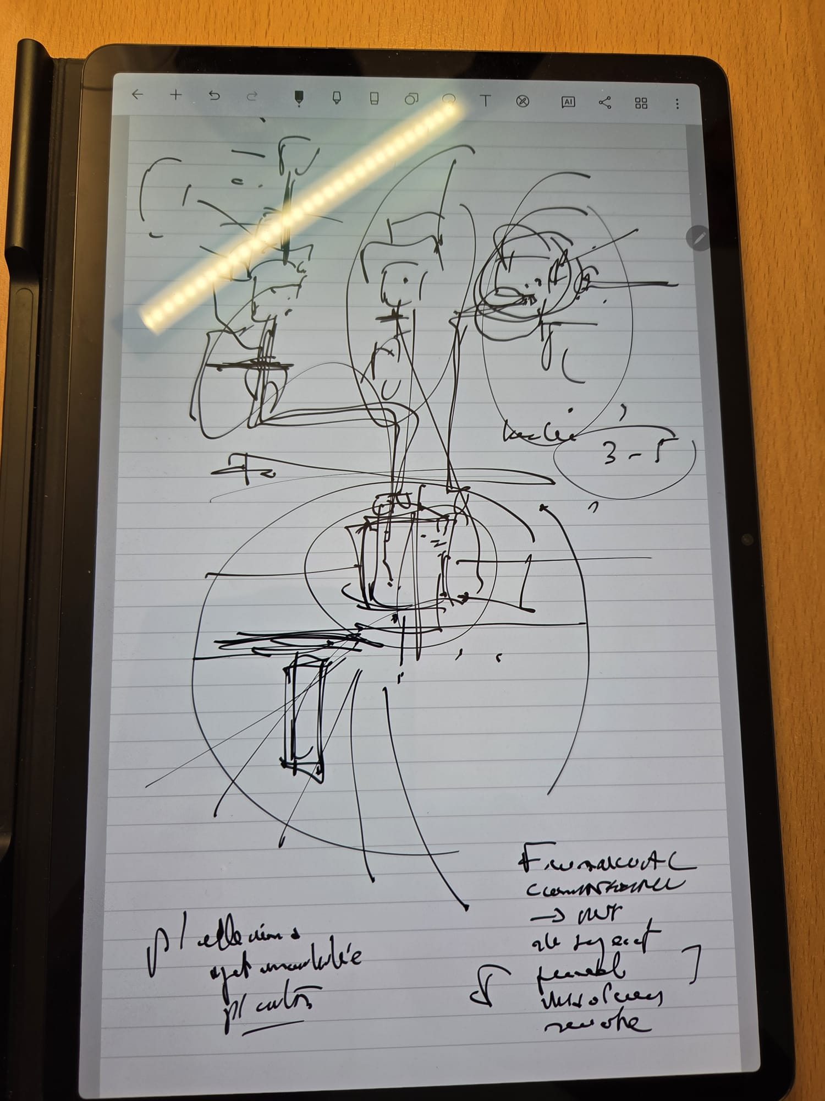
VI. Types of Financing: Overview
Group Financing and Security: How to save your own group

Slide 19
VII. Security Packages: What Would You Suggest?
Structuring the Right Security Package
There is no one-size-fits-all answer — it depends on the asset, the jurisdiction, the borrower, and the lender's risk appetite
Key questions to ask:
    What assets are available and where are they located?
    What jurisdiction governs the security instrument?
    What is the enforcement risk and timeline in that jurisdiction?
    What is the applicable insolvency regime?
    What is the cost of taking and perfecting the security?
Common security types: pledge over shares, pledge over receivables, mortgage / hypothec, assignment by way of security, guarantee
Practical exercise: given a transaction, what security package would you recommend?
Creation of security and perfection of security interst

Slide 20
VIII. Enforcement: What, When and How
When the Deal Goes Wrong
Enforcement is where theory meets reality — and where the quality of your drafting is truly tested
Key considerations:
    What can be enforced and in what order?
    When is enforcement triggered? (event of default, acceleration, insolvency)
    How is enforcement carried out in practice — court process or out-of-court?
Caveats and Traps:
German RETT: enforcement of a share pledge over a German property-owning entity can trigger Real Estate Transfer Tax — potentially destroying the value of the enforcement
Combined enforcement of GP and LP shares: structural complexity where enforcement of both simultaneously raises practical and legal questions
Combined GP/LP liability: if both the GP and LP shares carry combined liability for fund obligations, the practical value of holding a GP share pledge must be seriously questioned — why take it if enforcement adds no meaningful additional recovery?
Always war-game the enforcement scenario before you close the transaction.

Slide 21
IX. Case Study: Independent Payment Guarantee
Practical Illustration — The Slovak File
Walk through the facts of the case discussed
Key legal issues:
    Nature and independence of the payment guarantee
    Distinction from a suretyship (cautionnement / borgtocht)
    Demand vs. accessory nature of the instrument
    First demand vs. conditional guarantee — practical drafting differences
    Practical pitfalls encountered in the Slovak context
Lessons learned for structuring and drafting payment guarantees
An independent payment guarantee is only as strong as the demand mechanism behind it — drafting matters.

Slide 22
X. The Sparring Partner
You Need Someone to Think With
Finance law is complex — do not try to figure it all out alone
Find a sparring partner: someone to challenge your thinking and stress-test your analysis
This does not have to be someone within your own firm:
    Peers from law school
    Lawyers at other firms
    In-house counsel on the client side
    Notaries, accountants, or bankers you trust
A good sparring partner will:
    Ask the questions you forgot to ask
    Offer a different angle on the problem
    Keep you intellectually honest
    Tell you when you are wrong — before the client finds out
The best lawyers are the ones who never stop questioning their own analysis.

Slide 23
XI. Building Your Network
Your Network Is Your Long-Term Asset
Start building your network now — not when you need it
Attend seminars, conferences, and industry events
Connect with people across disciplines: bankers, accountants, notaries, in-house counsel, regulators
Be genuinely interested in people — purely transactional relationships do not last
Your network will:
    Bring you mandates and deals
    Help you solve problems quickly
    Open doors you did not know existed
    Give you access to market intelligence
Maintain relationships actively — not only when you need a favour

Slide 24
XII. Q&A
What Makes a Great Finance Lawyer?
Understands the economics, not just the law
Masters the core legal toolkit — and keeps learning
Is curious, commercial, and connected
Knows when to pick up the phone — and who to call
Has a sparring partner and a strong network
Never stops reading, thinking, and questioning
Finance law is one of the most intellectually demanding and rewarding areas of practice. Embrace the complexity.
Questions & Discussion

Slide 25





EXPERTISES
  Dupont Partners is involved in the broadest scope of transactional matters including tax and legal structuring, fundraising, deployment of capital, equity operations, financing and refinancing, final asset disposition, as well as complex restructuring, internal or recapitalization transactions. With a proactive and grounded approach, we work to tailor the best legal solution for each of our clients.
Tax
Corporate
Banking & Finance
Investment funds
Insolvency and Restructuring

Slide 26
CONTACT
  2, Avenue Charles de Gaulle I L-1653 Luxembourg
  M + 352 691 139 596
  D +352 2899 8886 21
  T +352 2899 8886 10
  pjbossuyt@dupontpartners.com I dupontpartners.com

