Slide 1


DeFi & Law
Sinan Vanden Eynde – PhD Candidate Financial Law Institute
27/03/2026 European Banking Institute - Young Researchers Group

Slide 2
Decentralised Finance (DeFi) 101

Slide 3
DeFi definitions…
“An umbrella term commonly used to describe a variety of services in crypto-asset markets that aim to replicate some functions of the traditional financial system while seemingly disintermediating their provision and decentralising their governance.”
FSB (2023) The Financial Stability Risks of Decentralised Finance, Feb 2023.
“Decentralised finance (DeFi) represents a novel way of providing financial services that cuts out traditional centralised intermediaries and relies on automated protocols instead … in simple terms, DeFi participants are part of a peer-to-peer network (built on a public blockchain) where assets represented in the network can be transferred automatically (via so-called smart contracts).”
ECB Macroprudential Bulletin, July 2022.
“Decentralized Finance (DeFi) is a competitive, contestable, composable and non-custodial financial ecosystem built on technology that does not require a central organization to operate and that has no safety net.”
  It consists of financial protocols — implemented as “smart contracts” — running on a network of computers to automatically manage financial transactions. Implemented on top of DLT, it does not require banks or other traditional centralized intermediaries. The underlying ecosystem is competitive as novel intermediaries — miners or validators — compete to process and settle transactions. Users can choose from different financial protocols; these are contestable as anyone can become an intermediary or deploy a protocol or even start a new ledger; composable as complex services can be assembled from basic protocols; and non-custodial as users can keep direct custody of their assets when accessing financial services. DeFi does not come with any safety net as it lacks protection from criminal conduct or investor fraud and erroneous transactions cannot be undone.
  Bank of International Settlements – BiS WP 1066 - Auer et al. (2023)

Slide 4
DeFi 101
Core characteristics of DeFi
1. Non-custodial
  Participants have full control over their funds at any point in time.
2. Permissionless
  Anyone can interact with financial services without being censored or blocked by a third party.
3. Auditable
  Anyone can audit the state of the system, e.g., to verify that it is healthy.
4. Composable
  Financial services can be arbitrarily composed (“money legos”).

Slide 5
DeFi Stack
The DeFi stack refers to the layered technological architecture that enables decentralised financial services to operate without traditional intermediaries. It describes how different components build on one another to create a fully functioning DeFi ecosystem. Although various models exist, the stack is commonly understood as consisting of four to five layers, each with a distinct role:

Slide 6
DeFi Stack
1. Settlement Layer (Base Layer)
  The foundational blockchain on which DeFi applications run.
  It provides consensus, data storage, transaction finality and native assets (e.g., ETH).
  Examples: Ethereum, Solana, Avalanche, Layer-2 networks (Optimism, Arbitrum).
2. Asset Layer
  Tokens that circulate on the settlement layer.
  Includes native tokens, ERC-20 tokens, stablecoins, governance tokens and tokenised real-world assets.
  These assets are the units used in lending, trading, liquidity provision and other DeFi activities.
3. Protocol Layer
  Smart contracts providing core financial functions.
  These are the rules, logic and automated mechanisms that replicate banking and market-infrastructure services.
  Examples:
    lending protocols (Aave, Compound)
    decentralised exchanges (Uniswap, Curve)
    derivatives platforms (Synthetix, dYdX)
    stablecoin issuers (MakerDAO)

Slide 7
DeFi Stack
4. Application (Interface) Layer
  User-facing applications that allow interaction with protocols.
  This includes dashboards, portfolio trackers, mobile apps and web front-ends.
  Examples:
    Metamask, Rabby (wallets)
    Zapper, Instadapp (portfolio tools)
    Protocol-specific websites.
5. Aggregation Layer (sometimes included)
  Services that combine multiple protocols into unified interfaces or automated strategies.
  Examples:
    yield aggregators (Yearn)
    cross-protocol routing (1inch)
    institutional access platforms.

Slide 8
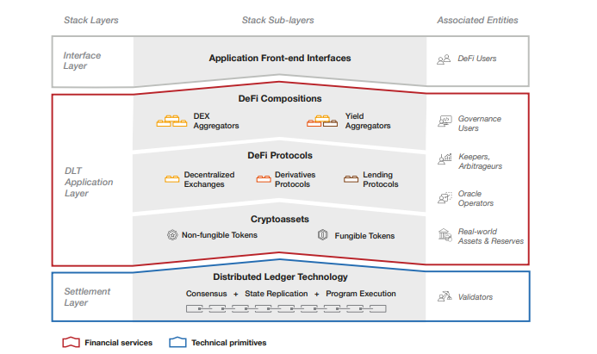
DeFi Stack (Auer)

Slide 9
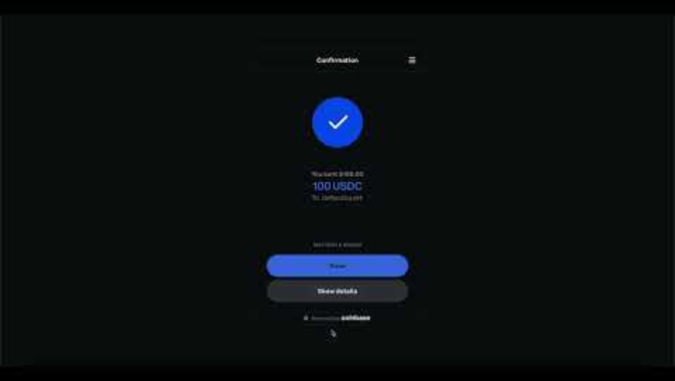
DeFi in real life – video of DeFi Education Fund

Slide 10
Regulation? MiCAR in the EU

Slide 11
High-level overview of MiCAR
As of 30 December 2024, the Markets in Crypto-Assets Regulation (MiCAR) has become fully applicable
  = Regulation 2023/1114 of the European Parliament and of the Council of 31 May 2023 on markets in crypto-assets
  After preparatory work by EBA and ESMA, already 30-ish delegated acts have been adopted by the Commission (e.g., RTS 2025/296 specifying the procedure for the approval of a crypto-asset white paper)
For certain crypto-assets, MiCAR harmonizes requirements for:
  Offering to the public or seeking admission to trading on a trading platform
  Service providers
  Market abuse
Prior to MiCAR, EU law did not comprehensively regulate crypto-markets, meaning that many crypto-assets and crypto-asset service providers were only subject to applicable national provisions, if any
  Limited regime for certain crypto-asset service providers under AMLD V
Viewed from a global perspective, MiCAR is the most advanced legislation on crypto-assets to date
  Most countries are still weighing options or applying “traditional” financial law to crypto-assets
  MiCAR is taking a leap forward with an extremely granular set of requirements (160+ pages in the Official Journal plus many delegated acts)
USA still negotiating the Digital Assets Market Clarity Act (CLARITY) in the Senate – likely end of 2026.
Notes:
See: https://www.coindesk.com/policy/2026/03/18/key-u-s-senator-on-crypto-market-structure-bill-negotiation-we-think-we-ve-got-it

Slide 12
Formal objectives of MiCAR
Objectives (i.e., justifications for regulating markets in crypto-assets):
  Support innovation and fair competition in the financial sector through new technologies;
  Ensure a high level of protection of retail holders (cf. many scandals and frauds);
  Ensure integrity of markets in crypto-assets => financial stability concerns in case of spillovers to the financial system (or real economy);
  Enable crypto-asset service providers to grow their businesses on a cross-border basis
Since MiCAR has been developed with one technology in mind (DLT), MiCAR does not seem technology-neutral (contrary to the baseline principle typically maintained in EU financial law)
  Cf. DLTR, which is also not technology-neutral (the regulatory sandbox only applies to DLT)
  Still, MiCAR does not exclusively deal with DLT: cf. MiCAR-definition of crypto-asset: “digital representation of a value or of a right that is able to be transferred and stored electronically using distributed ledger technology or similar technology”

Slide 13
Scope of application
MiCAR applies to natural and legal persons and certain other undertakings (e.g., commercial partnerships) that are engaged in the EU in certain activities/services (issuance, offer to the public, seeking admission to trading, services) with respect to crypto-assets (art. 2(1) MiCAR)
  ‘Crypto-assets’ notion is central to the scope of application of MiCAR
Important to note that MiCAR does not regulate crypto-assets as such, but only their markets, i.e., certain services and activities
  Cf. MiFID II, which also regulates markets (persons) and not instruments
MiCAR does not regulate smart contracts

Slide 14
DeFi & MiCAR ?
Recital 22 of MiCAR
  This Regulation should apply to natural and legal persons and certain other undertakings and to the crypto-asset services and activities performed, provided or controlled, directly or indirectly, by them, including when part of such activities or services is performed in a decentralised manner.
  Where crypto-asset services are provided in a fully decentralised manner without any intermediary, they should not fall within the scope of this Regulation.
De facto : MiCAR distinguishes between partially decentralised and fully decentralised crypto-asset services.
But no definition, no guidelines, no statements … = regulatory grey zone
Reality: until now no DeFi arrangement has a license.
3 main arguments
  Settlement layer is decentralised
  The governance (decision-making) is decentralised
  The custody of the assets is decentralised (self-custody)

Slide 15
DeFi is often organised through Decentralised Autonomous Organisations (DAO)
A DAO is a blockchain-based form of human organisation.
Participants pool assets or resources to pursue a shared activity, = providing financial services in DeFi.
DAOs are:
  decentralised because important decisions are taken directly by members rather than by a central management body.
  autonomous because smart contracts automate key organisational and treasury functions.
In practice, DAOs often serve as the governance structure of DeFi projects, organising decision-making, treasury management and protocol development.
DAOs differ from traditional companies because governance is shaped by token holders, smart contracts and blockchain-based rules, rather than conventional corporate management.
Notes:
See: https://lisbondaoobservatory.cidp.pt/publications

Slide 16
DAO Governance
DAOs use smart-contract–based rules to coordinate decision-making among token holders.
Governance typically relies on governance tokens, which grant voting power over protocol upgrades, treasury use and policy parameters.
Most DAOs operate through on-chain proposals and voting, often requiring quorum and majority thresholds.
Many DAOs also rely on off-chain governance tools such as Snapshot, forums and social-signaling mechanisms, where members express preferences without committing transactions
Delegation mechanisms allow token holders to assign their voting power to delegates for more efficient governance.
Governance design may affect legal classification, accountability and the extent to which a DAO can be viewed as decentralised.
Some jurisdictions have tailored legislation to recognise DAO’s as legal entity (see: DUNA)…

Slide 17
DAO Governance - examples
https://gov.uniswap.org/
https://www.tally.xyz/gov/uniswap
https://vote.uniswapfoundation.org/
https://snapshot.org/#/explore

Slide 18
Fake-DeFi
DeFi often presents itself as decentralised, but many systems remain controlled by identifiable parties.
“Fake DeFi” describes projects that claim decentralisation while retaining centralised governance, control or dependencies.
Possible Indicators of “Fake DeFi”
  Centralised protocol governance (e.g., founders or small groups hold decisive governance tokens).
  Administrative keys enabling upgrades, emergency shutdowns or fund transfers by insiders.
  Centralised front-ends or servers, meaning user access depends on one operator.
  Critical reliance on centralised infrastructure, such as centralised oracles or hosting.

Slide 19
DAO Caselaw: bZx / Ooki DAO Case (CFTC, N.D. Cal. 2022–23)
CFTC sanctioned bZeroX and its founders for unlawful leveraged digital asset transactions, acting as unregistered futures commissions merchant, and lacking a required AML program.
  Founders transferred control to the Ooki DAO to make the protocol “enforcement-proof”, but the CFTC held that this transfer did not remove legal obligations.
In its settlement order, the CFTC determined that Ooki DAO is an unincorporated association, defined as:
  a voluntary group of persons, without a charter, formed by mutual consent for the purpose of promoting a common objective
Voting token holders were deemed members of this association because they jointly govern and operate the protocol through token-based voting.
The DAO lacks a formal charter, but mutual consent is shown through participation in governance.
CFTC argued the DAO continues the same business purpose as bZeroX: operating and governing the protocol.
The court, in granting default judgment, affirmed association status under both California and federal law.
Only voters, not passive token holders, were treated as members of the association,
Commissioner Mersinger’s dissent warned that this approach lacks clear legal authority, creates unfairness, and discourages governance participation, including votes aimed at improving compliance.
Notes:
Commodity futures trading commission

Slide 20
Thank you!

