Slide 1
Sustainable business and access to finance. Are they linked?
NautaDutilh/Howden Belgium
Ingrid D’Haeyer – Head Group Legal Group Solutions - KBC Group
15 May 2025

Slide 2


Slide 3
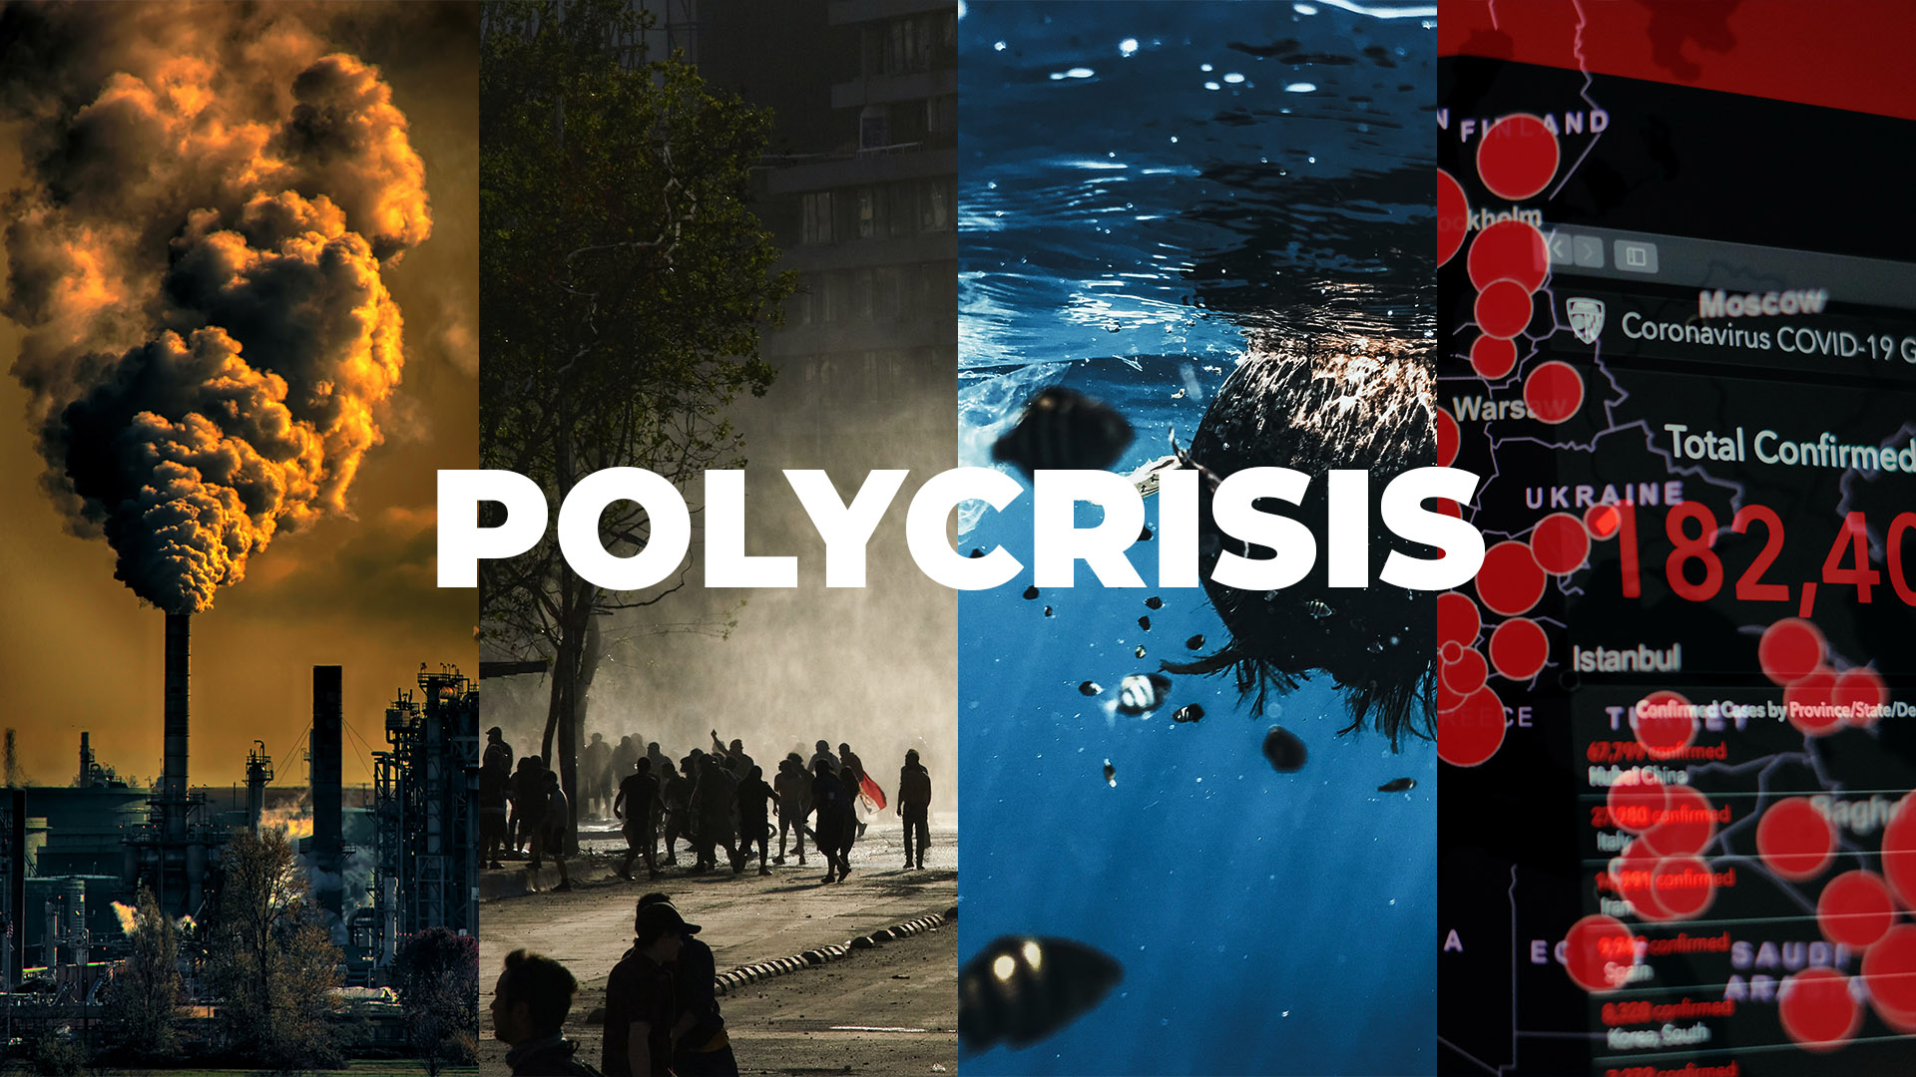
The perfect storm
Notes:
Climate change, biodiversity loss, resource issues, interstate conflicts, war for talent, large-scale migration etc ... Summarized in the word polycrisis. This makes our companies gasp. Is the situation serious? Yes. Is it hopeless? No.
But, both practically and ethically, businesses cannot label these issues as "someone else's problem”. Whoever that "someone" may be. Also, now more than ever, society is looking to companies to take care of our planet and its people.

Slide 4
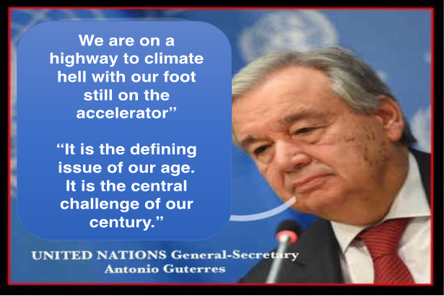
Notes:
Climate change, biodiversity loss, resource issues, interstate conflicts, war for talent, large-scale migration etc ... Summarized in the word polycrisis. This makes our companies gasp. Is the situation serious? Yes. Is it hopeless? No.
But, both practically and ethically, businesses cannot label these issues as "someone else's problem”. Whoever that "someone" may be. Also, now more than ever, society is looking to companies to take care of our planet and its people.

Slide 5
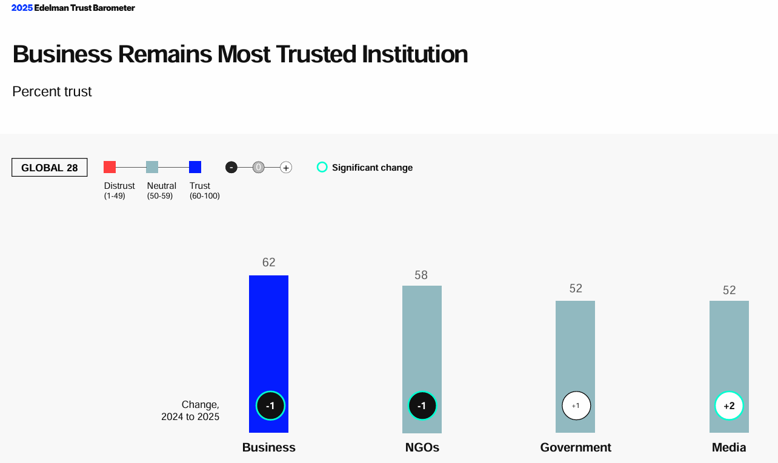
Notes:
Climate change, biodiversity loss, resource issues, interstate conflicts, war for talent, large-scale migration etc ... Summarized in the word polycrisis. This makes our companies gasp. Is the situation serious? Yes. Is it hopeless? No.
But, both practically and ethically, businesses cannot label these issues as "someone else's problem”. Whoever that "someone" may be. Also, now more than ever, society is looking to companies to take care of our planet and its people.

Slide 6

Notes:
Climate change, biodiversity loss, resource issues, interstate conflicts, war for talent, large-scale migration etc ... Summarized in the word polycrisis. This makes our companies gasp. Is the situation serious? Yes. Is it hopeless? No.
But, both practically and ethically, businesses cannot label these issues as "someone else's problem”. Whoever that "someone" may be. Also, now more than ever, society is looking to companies to take care of our planet and its people.

Slide 7
Agenda
1. Setting the scene
2. Are investors and banks interested in companies’ ESG story?
3. What’s meant by sustainable finance?
4. How does ESG impact lending?
5. What’s the impact of the EU omnibus package on the financial sector?

Slide 8
Employees
Investors
Banks
Insurance companies
B2B customers/consumers
Suppliers
Local community

Slide 9

ESG is about staying attractive to investors

Slide 10

ESG is about keeping your banks on board

Slide 11

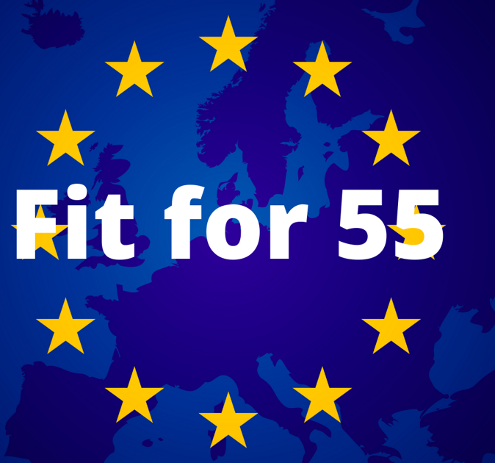

Slide 12
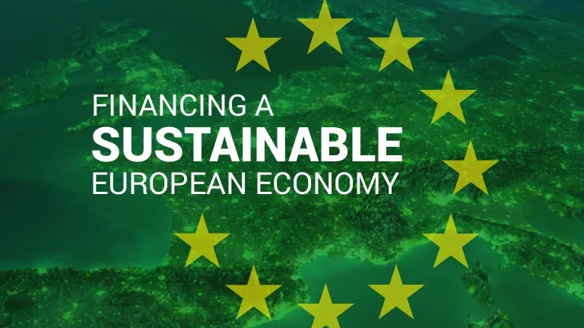

Slide 13
2018 EU Action Plan on sustainable finance
(renewed strategy 2020)
Reorienting capital flows towards a more sustainable economy
Mainstreaming sustainability into risk management
Promoting transparency and long-term thinking in financial and economic activities

Slide 14
Put into practice through specific EU regulation
Taxonomy Regulation
Corporate Sustainability Due Diligence Directive (CS3D)
Corporate Sustainability Reporting Directive (CSRD)
EU Green Bonds Regulation
ESG in CRD/CRR & Solvency 2
Sustainable Finance Disclosure Regulation (SFDR)
Notes:
Corporate Sustainability Reporting Directive (CSRD) – zie verder
Taxonomy Regulation – zie verder
Corporate Sustainability Due Diligence Directive (CS3D) – zie verder
Sustainable Finance Disclosure Regulation (SFDR): in voege vanaf 2021 - tot doel om duurzame beleggingen transparanter te maken en beleggers in staat stellen om financiële producten te vergelijken op basis van gemeenschappelijke ESG criteria. – classificatie van producten (art. 6 – 8 – 9 fondsen) – hoe gaan we om met duurzaamheidsrisico’s?
Green Bonds Regulation: Bij uitgifte van green bonds worden verplichtingen en standaarden opgelegd, bijv bepaalde rapportering, externe audit, alignering met de EU Taxonomy.
Directive on Pay Transparency: Meer transparantie en informatie ivm loon zowel voor potentiële als bestaande werknemers. Er moet ook rapportering gebeuren ivm de pay gap tussen vrouwen en mannen en in sommige gevallen zullen er maatregelen genomen dienen te worden om dit te remediëren.
Womens on Boards Directive: minimum van 40% van niet-uitvoerende bestuurders en 33% van alle bestuursfuncties moeten door het ondervertegenwoordigde geslacht ingevuld worden.
ESG in CRD/CRR & Solvency 2: Integreren van ESG risico’s in de bankstrategie en processen en invloed op de kapitaalreserves – rapporteren van ESG risico’s,
Daarnaast nog andere aspecten die we opvolgen: ecocide – ESG in mededingingsrecht – litigations – consumentenwetgeving/greenwashing

Slide 15
What is sustainable finance?
Process of taking ESG considerations into account when making investment decisions in the financial sector
Transparency on ESG risks that may impact the financial system and mitigation of such risks through appropriate governance of financial and corporate actors
Green finance
Transition finance

Slide 16
Forms of financing
Investment funds
Green bonds
Loans
Crowdfunding
Others (leasing …)

Slide 17

No specific regulation (~Taxonomy)
LMA Green Loan Principles
Green loans (green asset financing)
Sustainability-linked loans (company level/KPIs/interest rate discount)
LENDING

Slide 18

LENDING & SUSTAINABILITY ASSESSMENT@KBC
Sustainability Report 2024

Slide 19
CHOICE, leading to policy choices including restrictions on financing
REGULATORY PRESSURE/RISK MANAGEMENT: European Banking Authority (EBA) - Guidelines on Loan Origination and Monitoring (incorporate ESG factors and risks in credit risk appetite, risk policies and procedures)
REGULATORY PRESSURE/RISK MANAGEMENT: European Central Bank (ECB) expectations (major transition risks for many European banks/need to make and implement transition plans)
FINANCIAL SECTOR LEGISLATION: Transition plans mandatory under Capital Requirements Directive (CRD6), Capital Requirements Regulation (CRR3) and Solvency 2 Amending Directive

Slide 20

LENDING & SUSTAINABILITY ASSESSMENT@KBC

Slide 21
Basic principles on granting credit
Sound governance from our side
Critical on clients and projects
  Bona fide borrowers
  Attention to subcontractors, suppliers … of our customers
  No financing of projects violating UN Global Compact Principles
  Incorporation of ESG principles into our credit policy

Slide 22
Set of sustainability policies
Restriction policies
Excluded customers (totally or partially)
  No credit to companies active in the development, testing and production of controversial weapons
  …
Excluded sectors and activities (totally or partially)
  No financing exploration of new gas and oil fields
  Coal production, trading and storage: exit strategy existing customers + no lending to new customers
  …

Slide 23
Green transition & opportunities
Rewarding clients (financial incentives, additional services …)
No special forms of credit
No separate pricing policy
‘green’ emphasis

Slide 24


Support by providing partners

Slide 25

OMNIBUS I & IMPACT ON FINANCIAL SECTOR

Slide 26
Aims to reduce administrative burden
In scope: CSRD – EU Taxonomy – CSDDD
No changes to financial sector legislation (CRD/CRR/SFDR)
No changes to EU objective of becoming climate-neutral and climate resilient continent by 2050 (European Climate Law)
‘Stop the clock’ directive
  CSRD: delay wave 2 and 3 with 2 years (first reporting 2028)
  CSDDD: delay transposition deadline and wave 1 with 1 year

Slide 27
IMPACT ON FINANCIAL SECTOR?
Less value chain data will be available given:
  80% scope reduction of CSRD
  Limited information that may be requested
  Reduced content of CSRD reporting
  Voluntary character of article 8 EU Taxonomy reporting
  2-years delay of the reporting obligations
Impact?
  Quality of our reporting likely to decrease (increased use estimates)
  Negative impact on risk management and other prudential obligations
  More difficult to target sustainable products and services to the appropriate clients

Slide 28
To conclude …
Yes, there is a link between financing and clients’ ESG journey
Reduced data availability (Omnibus I) threatens to impact the financial sector in several areas

Slide 29
Thank you!

