Slide 1

International Banking and Finance Law - 2026
10/04/2025
Section: International Finance Law - SUSTAINABLE FINANCE
Ivan Peeters

Slide 2
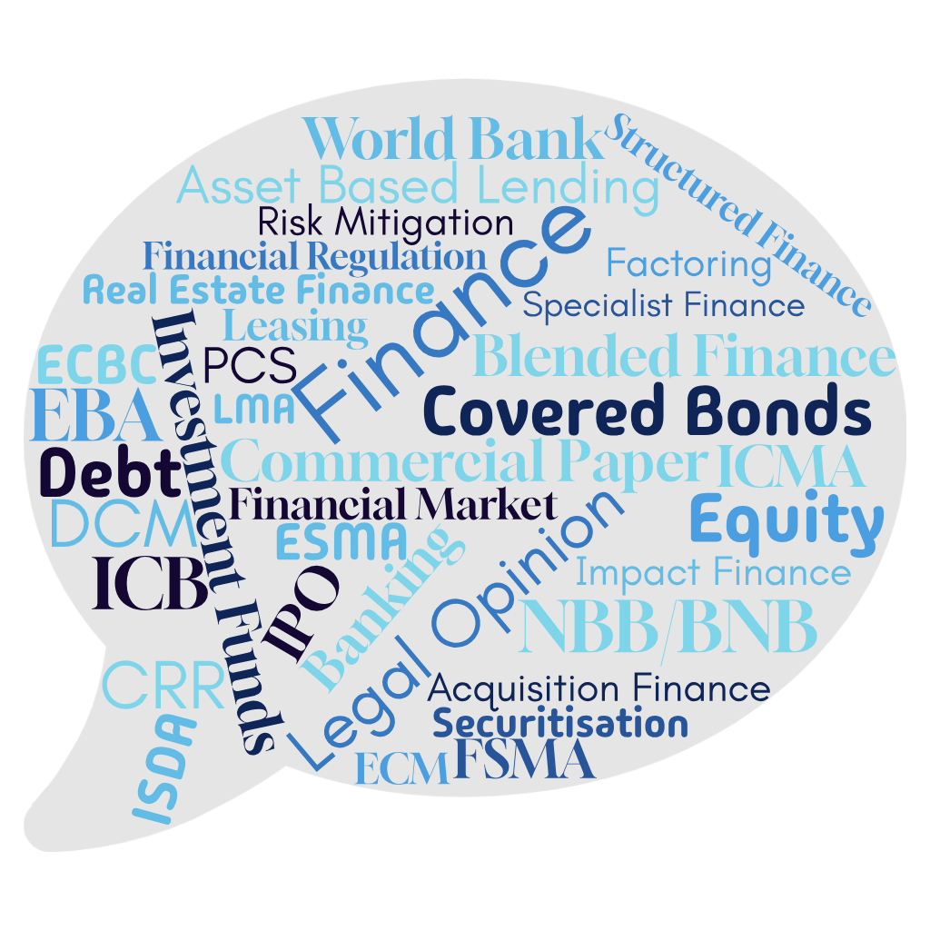

Slide 3
Content
1 | Sustainable finance?
2 | Regulation driving sustainability in finance
3 | Sustainability driving change of business models and of financial regulation
4 | Sustainability embedded in different types of finance
5 | Contractual aspects
6 | Litigation aspects

Slide 4
Sustainable Finance? (1)
Broader definition
the process of taking environmental, social and governance (ESG) considerations into account
when making investment decisions in the financial sector
leading to more long-term investments in sustainable economic activities and projects
Narrower definition
finance to support economic growth while reducing pressures on the environment
to help reach the climate- and environmental objectives (European Green Deal, Paris Accord …)
while taking into account social and governance aspects

Slide 5
Sustainable Finance? (2)
ESG risks vs financial system
also encompasses transparency as to risks related to ESG factors that may impact on the financial system
the mitigation of such risks through the appropriate governance of financial and corporate actors
What is transition finance?
Sustainable finance: (a) financing what is already environment-friendly today (green finance) and (b) what is transitioning to environment-friendly performance levels over time (transition finance)
Transition finance = financing private investments to reduce today’s high greenhouse gas emissions or other environmental impacts and transition to a climate neutral and sustainable economy.
E.g. investments in green production methods or reducing the environmental footprint as far as possible, where no green technologies are yet available.

Slide 6
Regulation driving sustainability (1)
Corporate sustainability reporting – CSRD - Directive 2013/34/EU
https://eur-lex.europa.eu/legal-content/EN/TXT/?uri=CELEX:32022L2464
Sustainability-related disclosure in the financial services sector - SFDR - Regulation (EU) 2019/2088
https://finance.ec.europa.eu/sustainable-finance/disclosures/sustainability-related-disclosure-financial-services-sector_en
Non-Financial Reporting Directive -NFRD - Directive 2014/95/EU
https://eur-lex.europa.eu/legal-content/EN/TXT/?uri=CELEX:32014L0095
EU Taxonomy
https://eur-lex.europa.eu/legal-content/EN/TXT/?uri=CELEX:32020R0852
EU Green Bond Standard
https://eur-lex.europa.eu/legal-content/EN/TXT/?uri=CELEX:32023R2631
EBA Guidelines on Loan Origination and Monitoring
https://www.eba.europa.eu/activities/single-rulebook/regulatory-activities/credit-risk/guidelines-loan-origination-and-monitoring
Circular letters of national supervisors implementing EBA Guidelines
Circulaire NBB_2021_18 / Orientations de l’ABE sur l’octroi et le suivi des prêts (EBA/GL/2020/06) | nbb.be

Slide 7
Regulation driving sustainability (2)
EU's Stop-the-Clock Directive (Directive (EU) 2025/794)
Part of the European Commission's Omnibus I package:
• simplify sustainability rules
• reducing regulatory burdens
• boosting competitiveness.
Impact:
• temporary delays to key ESG-related obligations under
Corporate Sustainability Reporting Directive (CSRD) the Corporate Sustainability Due Diligence Directive (CSDDD/CS3D)
• while substantive revisions (the full Omnibus amendments) are negotiated.

Slide 8
Regulation driving sustainability (2)
EU's Stop-the-Clock Directive (Directive (EU) 2025/794)
Current Status (as of March 2026)
      - adopted by the European Parliament and Council in April 2025, published in the Official Journal on 16 April 2025, and entered into force on 17 April 2025
    - Transposition in progress (variable progress)
    - Delays buy time for broader Omnibus negotiations on substantive changes to CSRD, CSDDD, the EU Taxonomy, and European Sustainability Reporting Standards (ESRS).

Slide 9
Change of business models and financial regulation
Impact on the distribution of consumer goods
  Circular/Sharing economy
  Use/lease consumer goods rather than purchase consumer goods = “servitisation”
  Seller is replaced by service provider/lessor
  Impact on the financing of consumer goods
  Shift of lending volumes from consumer credit to corporate credit?
  Impact on the volume of consumer finance
  Shift to corporate funding
  Need to shift consumer protection towards “servitisation”
  Need to update consumer protection
  Need to update consumer credit regulation?

Slide 10
Sustainability embedded in different types of financings
Green loans / facilities
ESG investment funds
Green bonds
Sustainability Linked bonds
Green securitizations
  Green assets
  Use of proceeds
Impact finance?

Slide 11
Contractual aspects
Pre-contractual phase
  Application
  Lending policy
  Refusal? Bank’s liability?
  No universal “lending” service …
Contract terms
  Pricing
  Use of proceeds
  Finance framework
Termination issues
  Events of default
  Termination rights
  Banker’s liability towards other creditors

Slide 12
Litigation aspects
Litigation against borrowers
Litigation against banks
  Milieudefensie vs ING
  https://lnkd.in/ej4wsbkH
  Companies vs banks ?
Litigation against States and supervisors
  Litigation against states (environmental liabilities)
  Litigation against central banks (ClientEarth v. de Nationale Bank van België)

Slide 13
Recommended websites
EU
https://finance.ec.europa.eu/sustainable-finance_en
https://finance.ec.europa.eu/publications/commission-simplifies-rules-sustainability-and-eu-investments-delivering-over-eu6-billion_en
Markets
https://www.icmagroup.org/sustainable-finance/the-principles-guidelines-and-handbooks/sustainability-linked-bond-principles-slbp/
https://finance.ec.europa.eu/sustainable-finance/tools-and-standards/european-green-bond-standard-supporting-transition_en
https://www.icmagroup.org/sustainable-finance/the-principles-guidelines-and-handbooks/green-bond-principles-gbp/
https://www.lsta.org/content/green-loan-principles/
Impact finance/investing
https://thegiin.org/
https://impactfinance.be/wp-content/uploads/2024/09/241001-Policy-Paper-Digital.pdf

Slide 14
Recommended literature
Sustainable Finance in Europe: Corporate Governance, Financial Stability and Financial Markets Hardcover – 19 May 2024 – English edition by Danny Busch (Sous la direction de), & 2 more
Handbook of Sustainable Finance - Thierry Roncalli, Université Paris-Saclay, 2024
Sustainable Finance and ESG Investing by Marcel Jeucken, Springer, 2021
The Sustainable Finance Handbook: A Guide to the Future of Finance by Dirk Schoenmaker, Routledge, 2021
ESG compliance in lending: the role of EBA guidelines and civil liability in Belgian banking, Niels Rogge, Routledge, Law and financial markets review, 2024
Sustainability and bank lending : assessing ESG-related lender liability, Niels Rogge (UGent), 2025

