Slide 1
Introduction
  What, how, who ?
  Scope of the market
  What do we cover ?
  What is our primary focus ?
2

Slide 2
In-house lawyers:
  Large market – most companies employ inhouse lawyers
  Employee status vs. self-employed (contractors / consultants)
  Dynamic career platform (legal, compliance, corporate secretariat, growing to commercial/management, growing internationally)
  Company values and culture
  Examples: from operational lawyer to banking lawyer to corporate and regulatory lawyer to M&A lawyer to Chief Operations Officer & IT/IP – Supply Chain lawyer
4

Slide 3
In house counsel : Compensation
Category | Belgian (Avg.)
Experience: 0-5 year | €42,000 - €64,000
Experience: 5 to 10 years | €72,000 - €82,000
Experience: 10 years | €82,000 - €110,000
Disclaimer: Compensation figures provided are for general informational purposes only and may vary based on location, experience, company size, and market conditions.
13
Notes:
All expertise
Competition associate
Experience 0-1 years, 2 years, 3 years

Slide 4
Overview of legal teams within a legal department
  Antitrust and Competition
  Banking and Finance
  Corporate M&A
  Commercial & Contracts
  Operations
  Regulatory
  Supply Chain / Procurement
  Cyber & Digital
  IP, IT & Data Protection
  Tax
  Corporate/ Company law
  Dispute Resolution
  Employment
  Projects
  Governance
  Knowledge Management
17

Slide 5
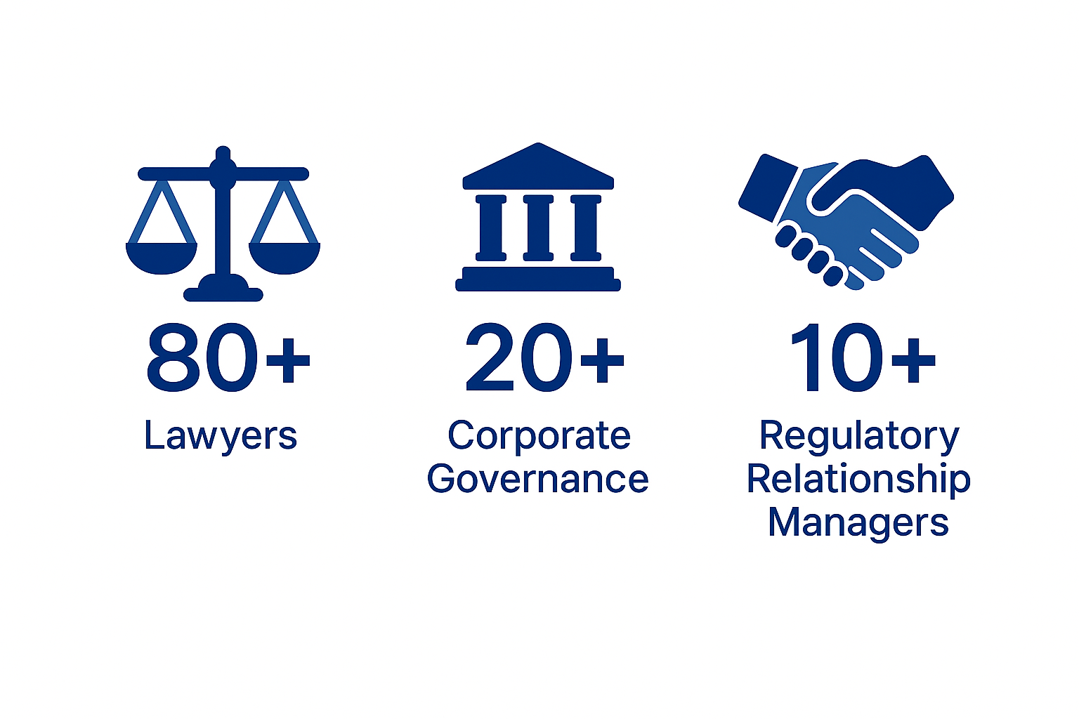
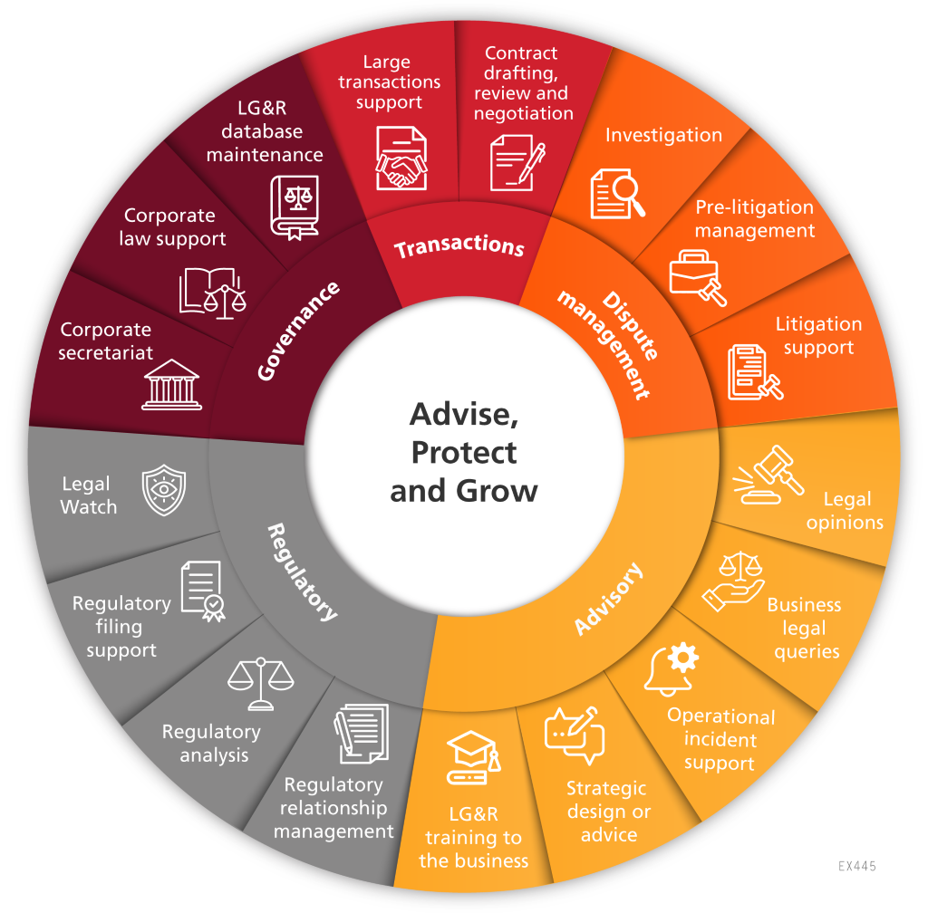
Example of a Legal, Governance & Regulatory Division
LG&R
120+

Slide 6
