Slide 1

Introduction – the evolving ESG landscape
ULB, 4 November 2025

Slide 2
Practicalities
Curriculum (université virtuelle)
Slide deck for each session; further readings
Interactive
Do participate, ask, challenge, interrupt
Exam
Written exam; practical questions
Questions?
guillaume.croisant@linklaters.com
+32 2 501 93 45

Slide 3

What is ESG?

Slide 4
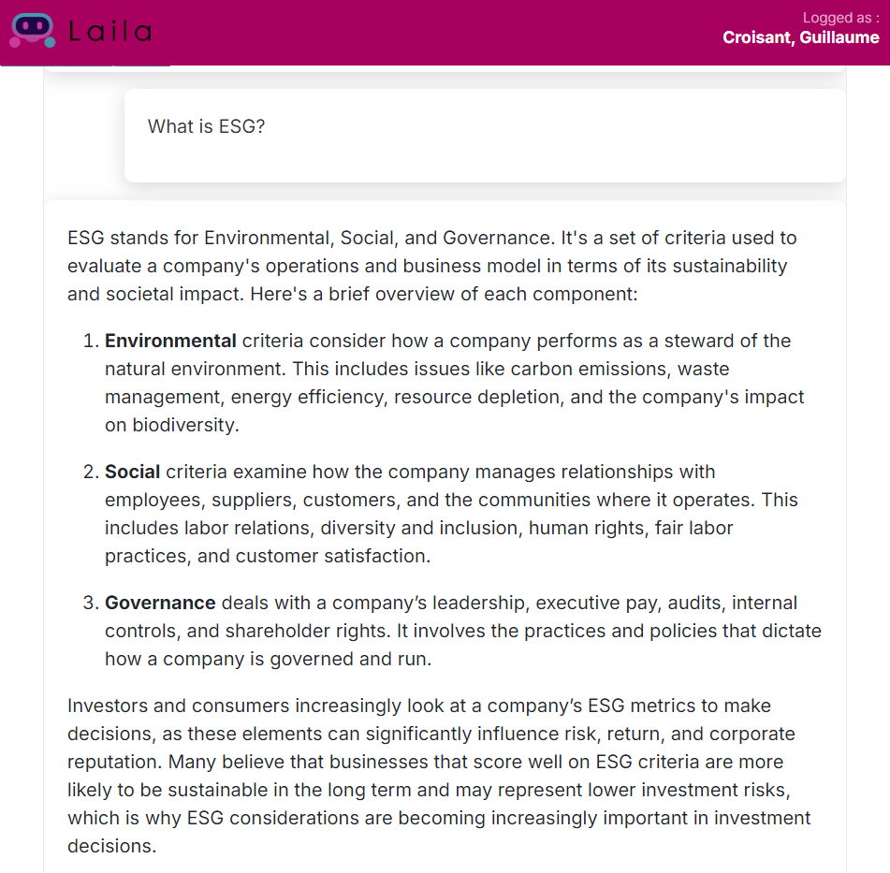
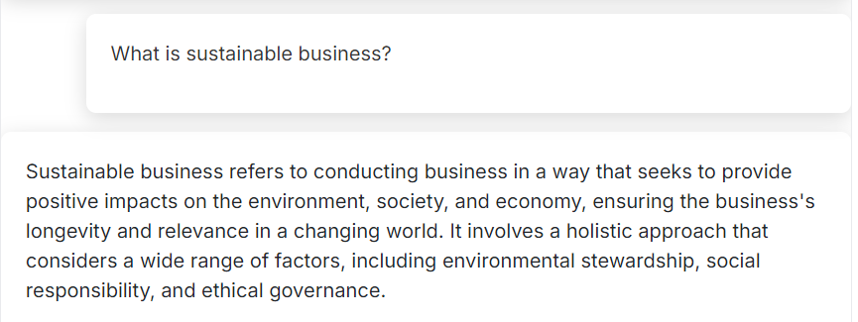

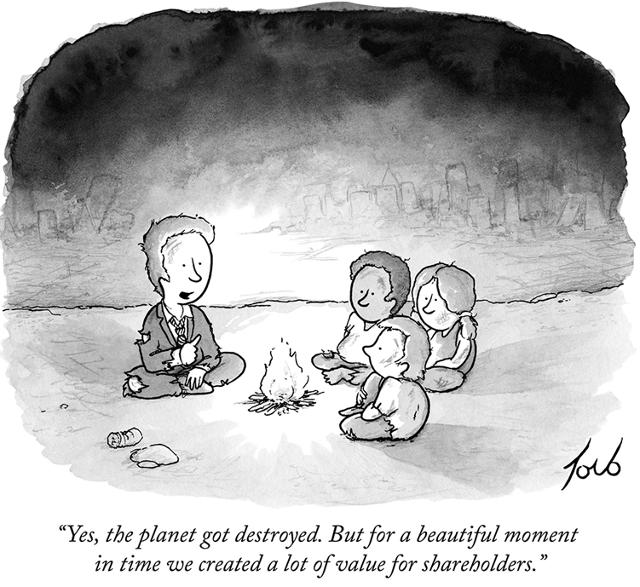

Slide 5
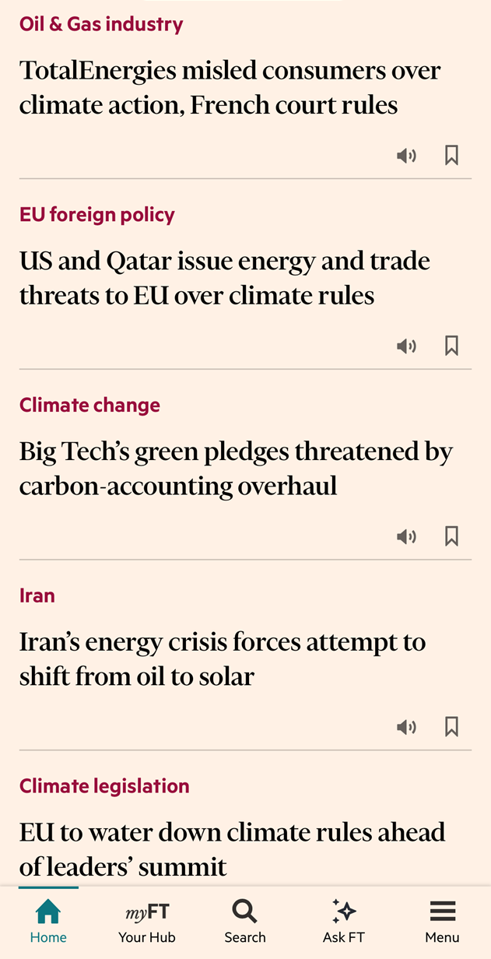
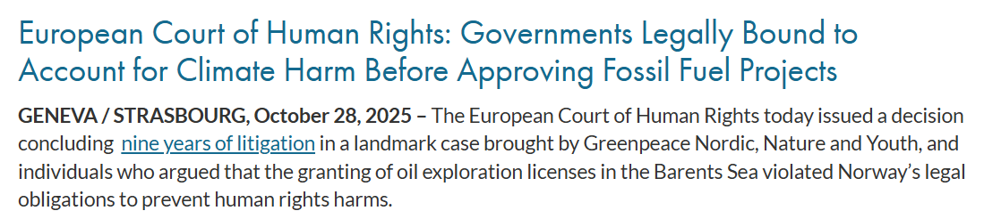
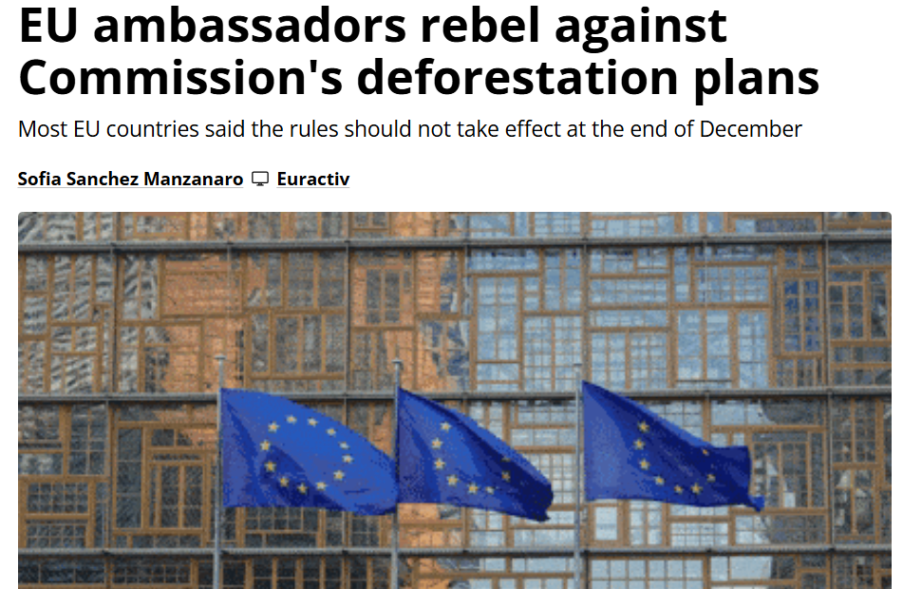
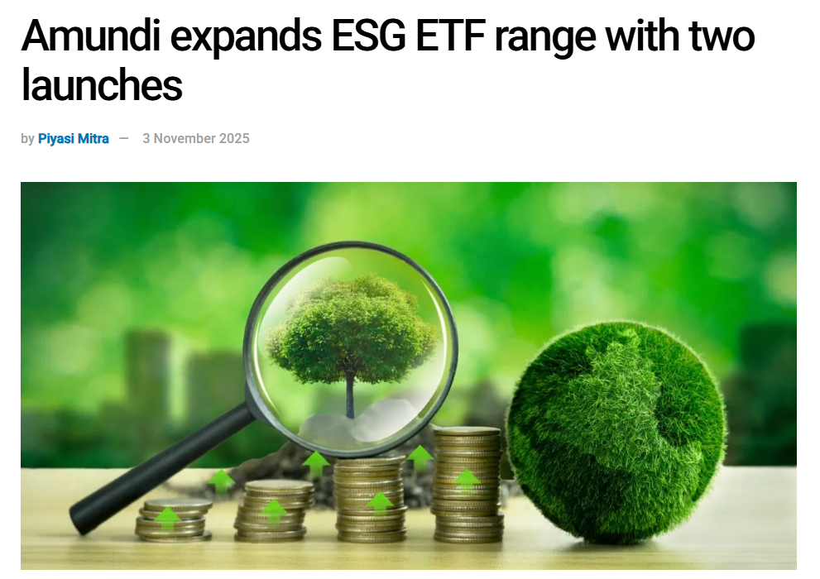
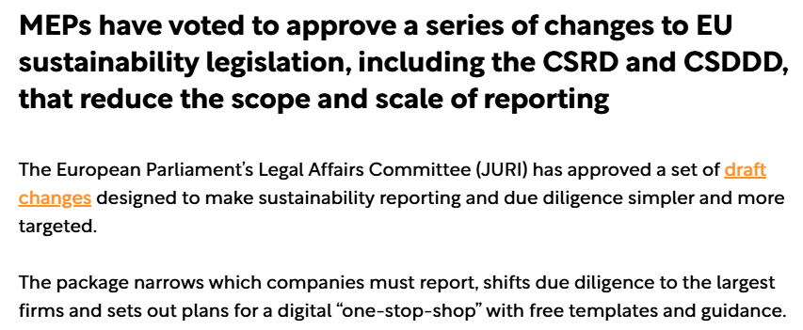
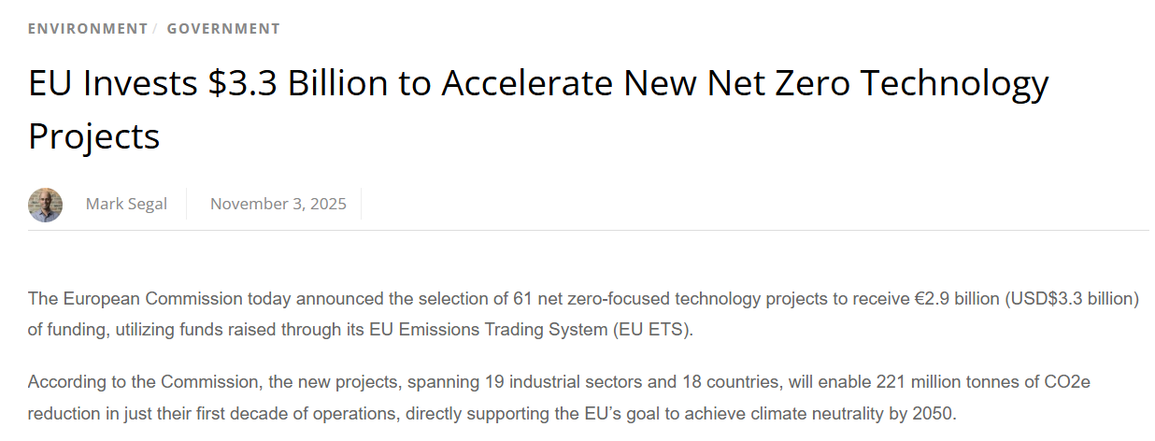
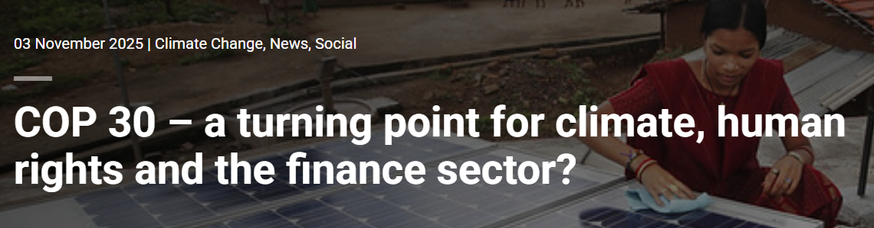

Far-reaching and fast-evolving legal framework(s)
In the news over the last days…

Slide 6
Agenda for the classes
1
Introduction – what is ESG and why does it matter? (4 November 2025)
2
Sustainable finance and disclosure (7 November 2025)
3
From a duty to report to a duty to act – climate transition plans and supply chain due diligence (18 November)
4
ESG litigation and liability risks (25 November)
5
Focus on specific regimes and practical examples (2 December)
6
“Backlash”/”recalibration” and future perspectives (9 December)

Slide 7

Why does it matter

Slide 8
Climate crisis
Climate change is already affecting every inhabited region across the globe with human influence unequivocally contributing to many observed changes.
Three possible warming scenarios:
1.5°C
Major impacts can be avoided
Global GDP loss could be limited to 0.3% by 2100
This is our likely best possible outcome. It is very difficult to achieve and depends on
immediate, very significant
action
2°C
Climate impacts potentially catastrophic, including sea level rise, extreme weather and biodiversity loss
Significant adaptation measures needed
Strong risk of ‘runaway’
climate change
3°C+
Severe climate impacts
Losses in income to the global economy would be over US$23 trillion, roughly one third of global GDP
Many areas of the planet uninhabitable; mass migration and conflict virtually
certain

Slide 9
Global commitment under the Paris Agreement
EU
The Paris Agreement’s goal is to limit global warming to below 2 (and preferably below 1.5) degrees compared to pre-industrial levels.
The world has to have net zero GHG emissions by 2050 to meet this goal.
Commitments made under the Paris Agreement start to have a direct impact on domestic policy and regulation, particularly for carbon intensive sectors.
UK
China
US
Pledged to reduce GHG emissions by 55% by 2030 compared to 1990 levels
Target to be net zero by 2050
Pledged to introduce legislation to reduce GHG emissions by 78% by 2035 compared to 1990 levels
Target to be net zero by 2050
Target to reduce CO2 intensity by 18% and energy intensity by 13.5% by 2025 compared to 2021 levels
Target to be net zero by 2060
Pledged to reduce GHG emissions by 50-52% by 2030, compared to 2005 levels
Had target to be net zero by 2050...
... but Trump impact

Slide 10
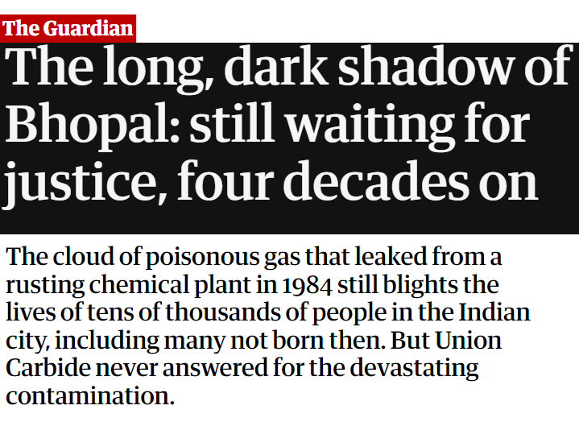






Greater accountability for adverse impacts caused at the level of the value chain
The Commission undertook and reviewed various studies and found:
25,000,000
victims of forced labour
374,000,000
non-fatal work-related injuries per year
152,000,000
victims of child labour
2,780,000
deaths due to work-related diseases per year
Only
37%
of businesses conduct environmental and human rights due diligence
Only
16%
cover the entire supply chain

Slide 11
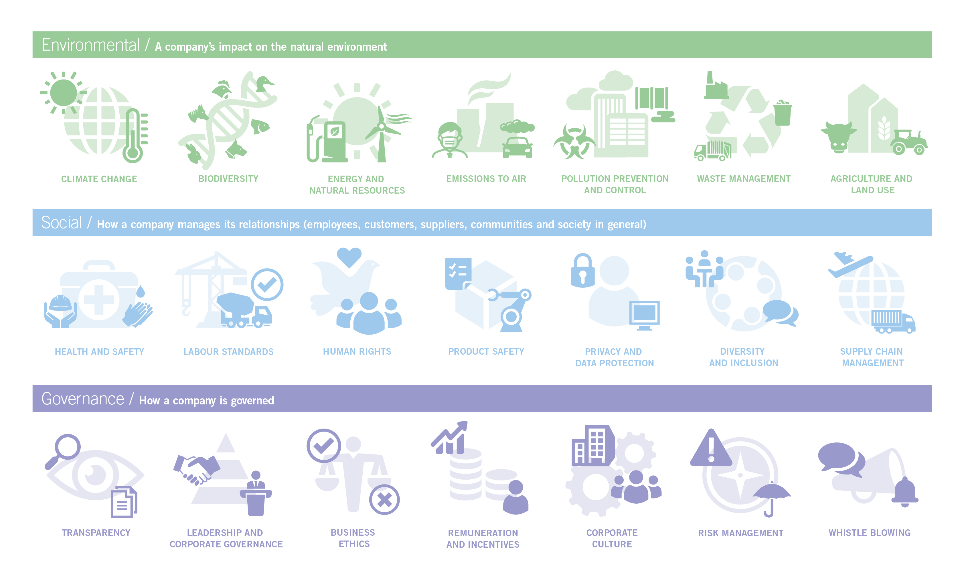
E, S and G are all central to the policy response
To secure the stability of our economies and society and to address the risks of climate change, a broad policy response is required to ensure economic activities and development are sustainable.
This is why environment, social and governance factors are all under scrutiny, and are integral to the policy response to climate change.

Slide 12
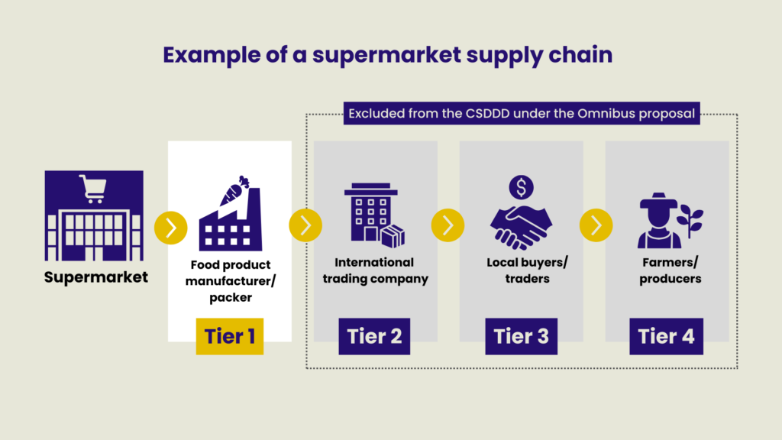
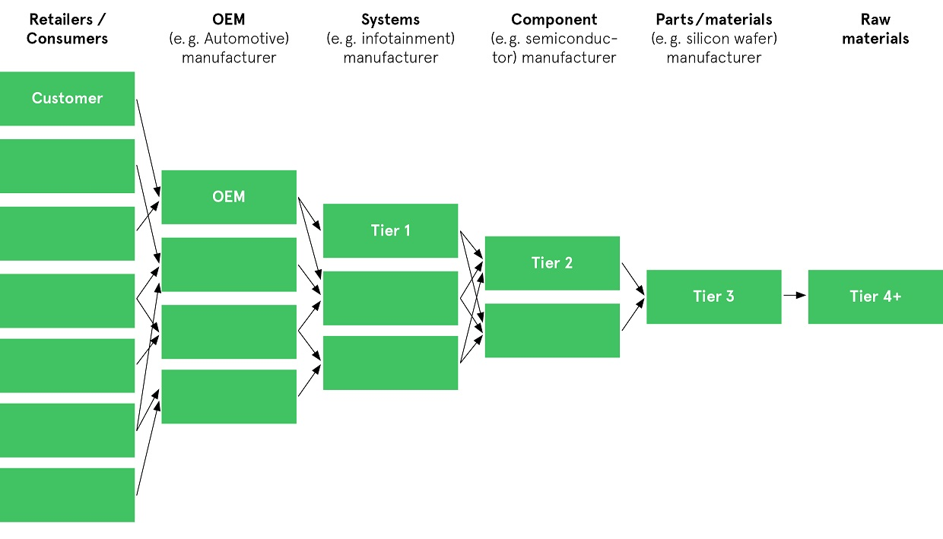
Simplified value chain

Slide 13
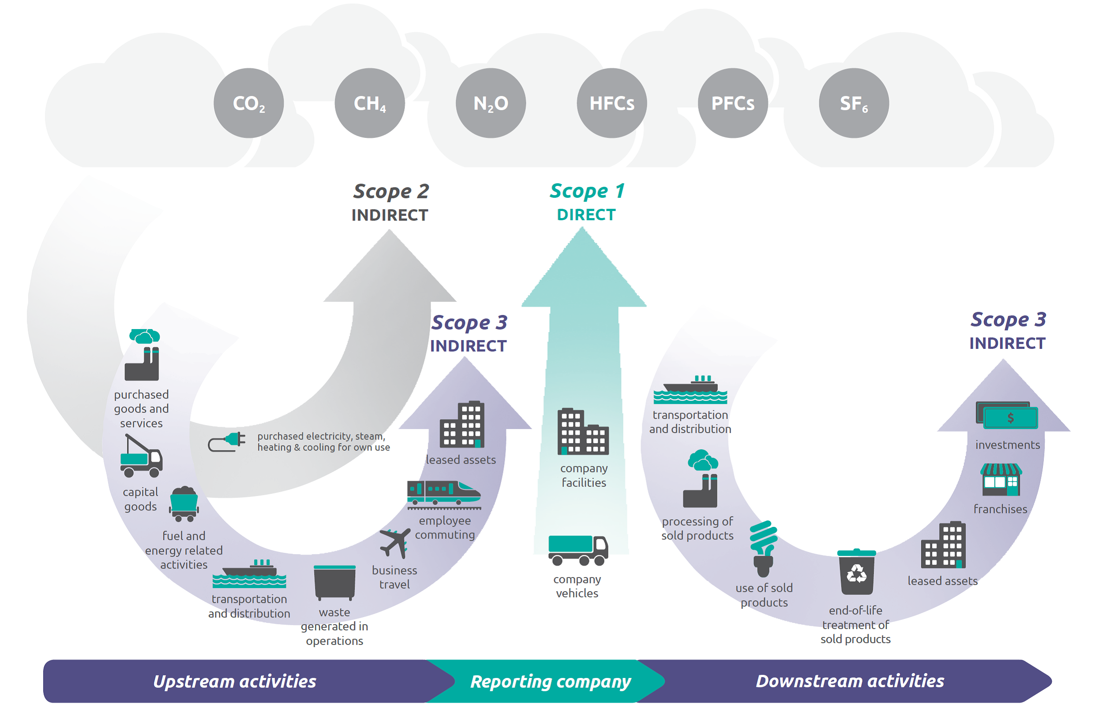
Scope 1, 2 and 3 emissions

Slide 14



Three key drivers of change
Stakeholders’ scrutiny (investors, employees, consumers, etc.)
Corporates are coming under significant pressure from institutional investors to articulate their approach to them and in particular their transition plans. Employees and customers have started to engage too.
Soft law commitments
The breadth and wide ranging implications of ESG initially resulted in principles based frameworks as a result of inability to adopt global or even national regulatory change. Companies’ public commitments to these can be superficial. Increasingly they are not risk free. Failure to ‘walk the talk’ can lead to claims and serious brand damage.
Regulation
In the EU, the Commission has been engaged in a rapid and ambitious roll out of green regulation, initially impacting financial markets but extending into industrial activity.
Notes:
Els

Slide 15

Stakeholders’ scrutiny

Slide 16
Investors and financial institutions are looking for green opportunities
Financiers are under pressure to decarbonise their portfolios and use their leverage to address ESG risks.
There is great appetite for ‘green’ and ‘sustainable’ financial products (but also increasing scrutiny and greenwashing risk).
NGOs are gearing up to assess the robustness of disclosures in debt instruments, and are putting pressure on financiers to engage more actively with investee companies (particularly on social issues).
Increasingly ESG due diligence is a major factor on transactions
Pressure to tighten ESG covenant packages is mounting
We are
starting to see ESG dilemmas crystallise at credit committee level
‘Green’ and ‘sustainable’ financial products are on the rise
ESG impacts on access to finance
Financiers are keen to invest in ‘green’ (especially Taxonomy-aligned) businesses
Some asset classes (e.g. coal) are extremely difficult to
finance

Slide 17
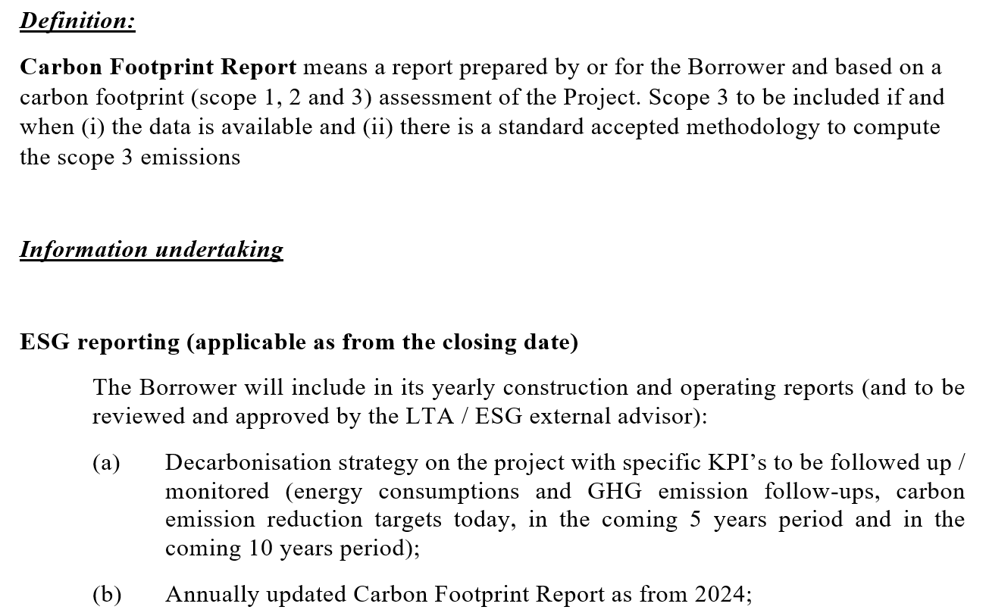
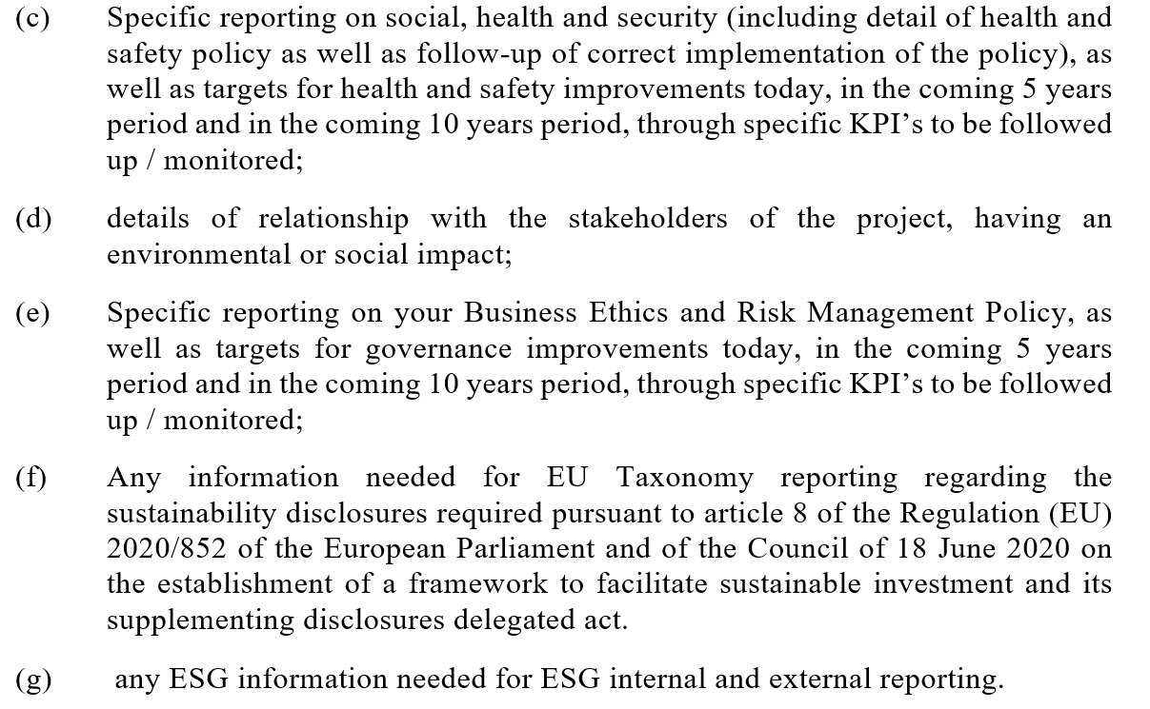
Example of requested ESG covenant for an industrial project
Increasingly ESG due diligence is a major factor on transactions
Pressure to tighten ESG covenant packages is mounting
We are
starting to see ESG dilemmas crystallise at credit committee level
‘Green’ and ‘sustainable’ financial products are on the rise
Financiers are keen to invest in ‘green’ (especially Taxonomy-aligned) businesses
Some asset classes (e.g. coal) are extremely difficult to
finance

Slide 18
Investors are engaging actively on ESG
Key investor expectations:
particular focus on climate and decarbonisation (although ESG more broadly is still important)
KPIs and targets are important, but increasingly the focus is on a clearly articulated ESG strategy explaining how those targets will be met
explanation of how governance and risk management processes incorporate ESG risks and impacts
alignment with best practice (TCFD is the gold standard)
regular updates on progress, in reasonable detail
limited appetite for disclaimers – but articulating challenges is important
suspicious of quick wins (e.g. excessive/early offsetting)
Pressure to tighten ESG covenant packages is mounting
Provides some reassurance that their investment is sustainable
We are
starting to see ESG dilemmas crystallise at credit committee level
Helps them decide whether the company’s strategy is aligned with their own strategy
Provides a framework through which to engage and measure investee company progress
Some asset classes (e.g. coal) are extremely difficult to
finance
Financiers are keen to invest in ‘green’ (especially Taxonomy-aligned) businesses

Slide 19
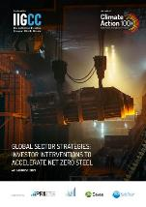
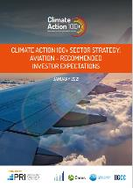




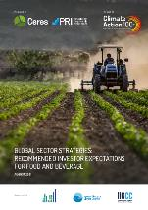
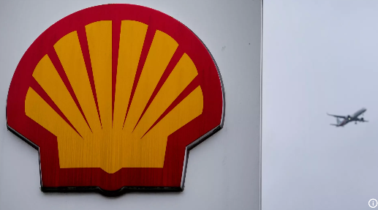




Shareholders start to flex their muscles
Some recent examples:
The “Say on Climate” campaign (backed by the CIFF) prompted a number of major corporates to table climate transition plans during the 2021 AGM season for shareholder advisory votes.
Points to bear in mind:
Even if shareholder-put resolutions do not pass, they can still effect change and are often brought strategically for this purpose
Support for shareholder resolutions appears to be increasing across the board
Companies increasingly considering formulating their own proposals to counteract activism
This trend has spread across the Atlantic (US activists have argued that US companies should follow the lead of their European counterparts on climate transparency) – but “Trump effect”
Other aspects of ESG are not immune (e.g. racial equality, treatment of workers, nutrition and health, etc.)
99% of shareholders backed a resolution to phase out coal financing (proposed by management after an alliance of investors filed their own proposal).
A majority of shareholders voted in favour of an activist proposal from Dutch campaign group “Follow This” to force Chevron to cut its Scope 3 emissions.
27 institutional investors, including UK’s biggest pension scheme, agree to back call for oil firm to set bigger scope 3 emissions targets
Activist investor Engine No. 1 successfully securing seats for three of its candidates on the board with support from both investors and proxy advisors (including Glass Lewis and ISS).
Aviva Investors has threatened to divest 30 "systemically important carbon emitters" if they don't adopt credible net-zero transition plans under its Climate Engagement Escalation Programme.
Mitsubishi UFJ Financial Group and Sumitomo Corp targeted with climate resolutions from activist shareholders at their AGMs.

Slide 20
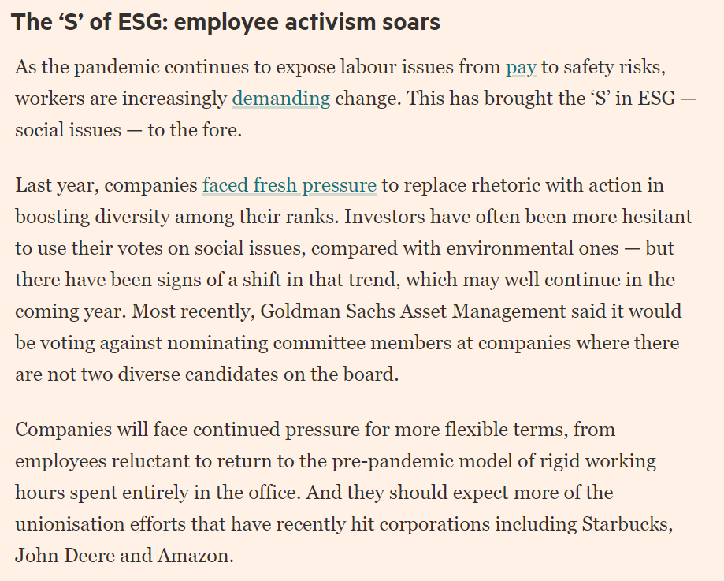
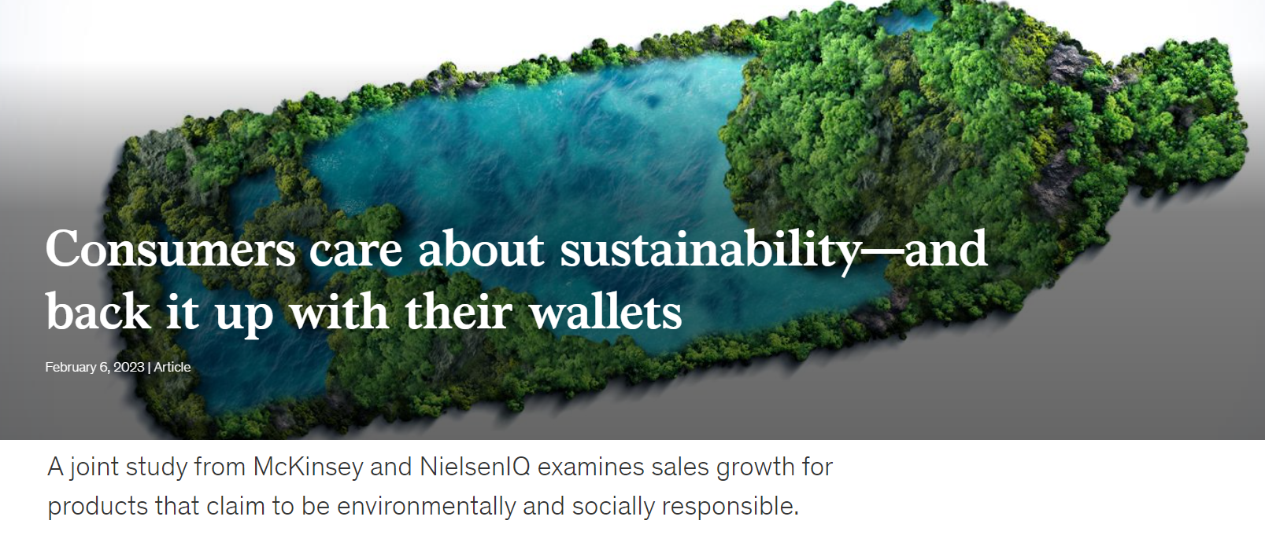
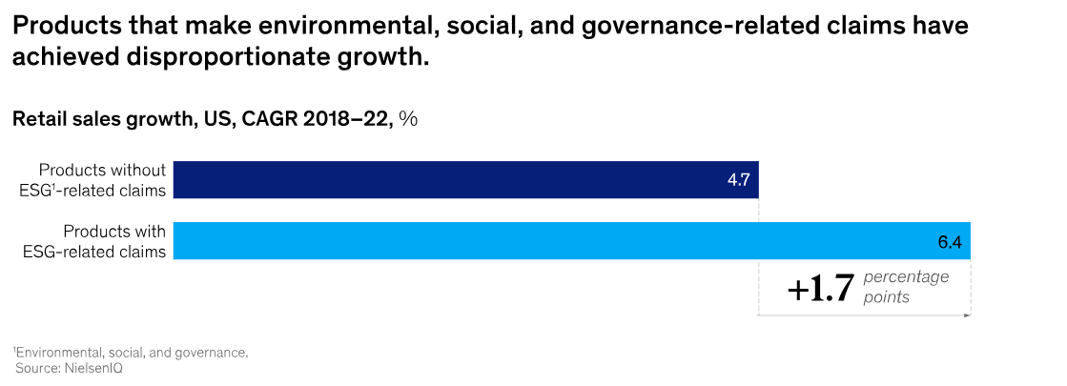
Increased pressure from employees and consumers

Slide 21

Legislative and regulatory wave

Slide 22
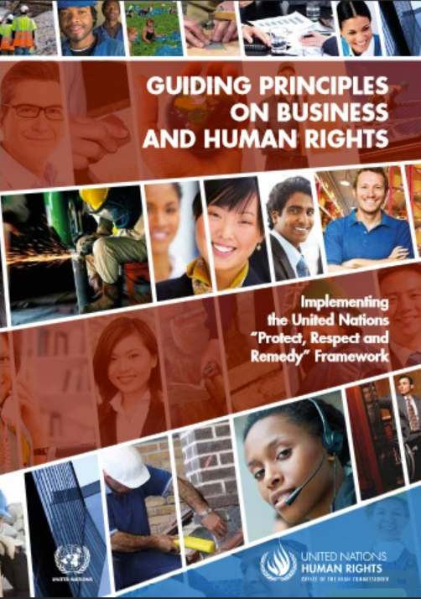

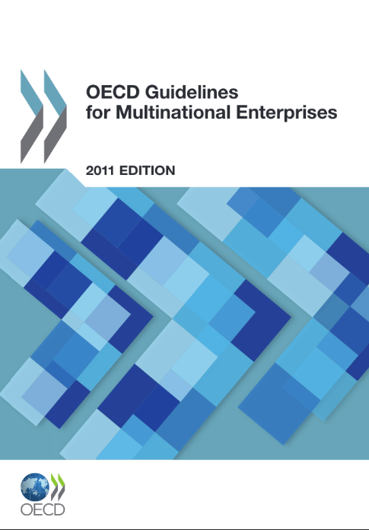


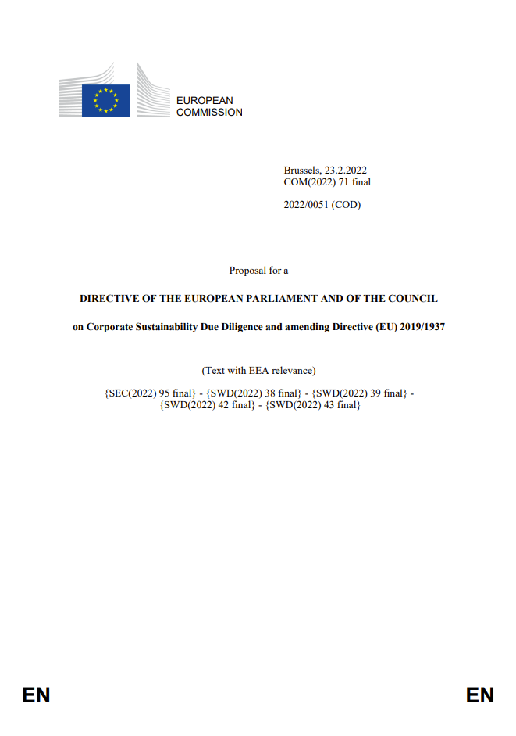
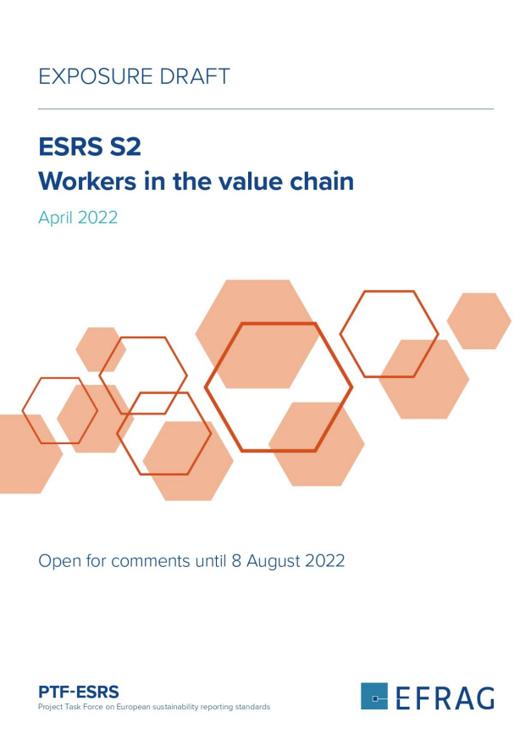
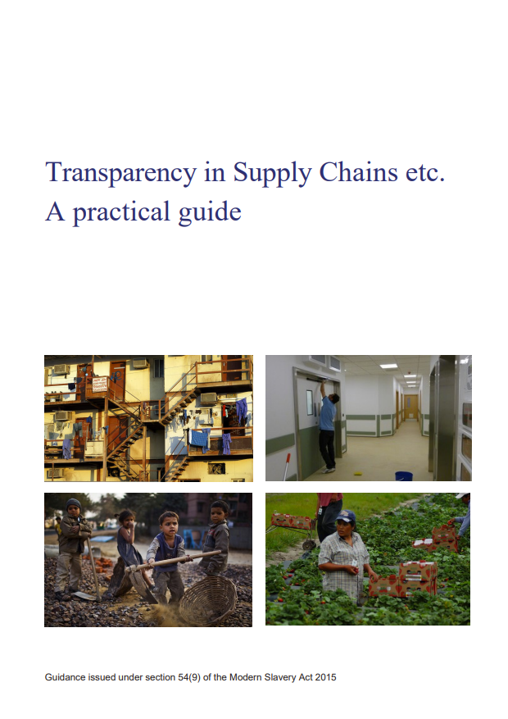
A rapid evolution: from soft law to the statute book
Broad application with
extraterritorial effect
Wide range of topics
in scope
Real consequences
for non-compliance
Historically, business efforts to address human rights risks have been guided by ‘soft’ laws (which are not legally binding) and voluntary industry initiatives
There has been widespread business convergence around these standards, which have been highly influential
Over time, the concepts contained in them have found their way into regulation and government guidance
These regulations are now evolving in complexity and are growing teeth
Regulations may apply even if the company is not incorporated in the relevant jurisdiction (e.g. because it does a lot of business there).
Their requirements typically extend to the whole supply chain (all tiers globally).
Initially regulations tended to be topic-specific (e.g. limited to modern slavery).
More recent regulations cover a wide range of environmental and social topics (e.g. human rights generally and indigenous community protection)
Early regulation tended to rely on public censure for enforcement.
This has given way to financial penalties and other sanctions as well as proposals to make it easier for affected persons to bring claims against the company.

Slide 23
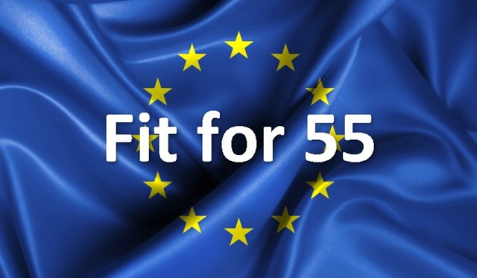
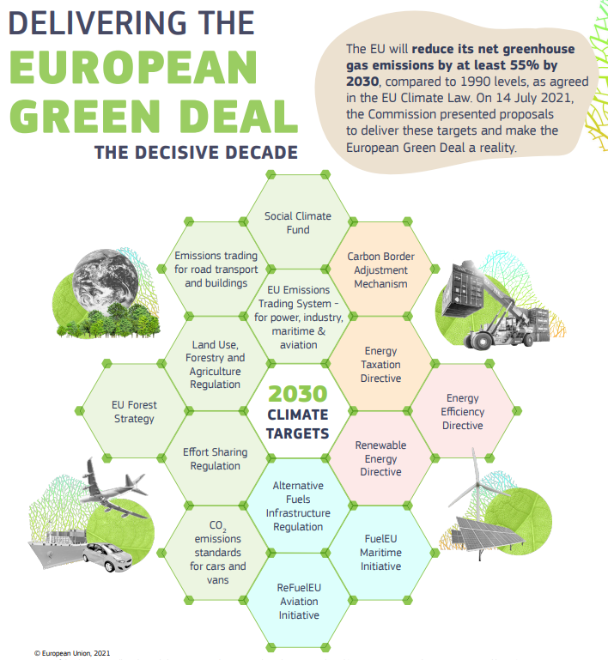
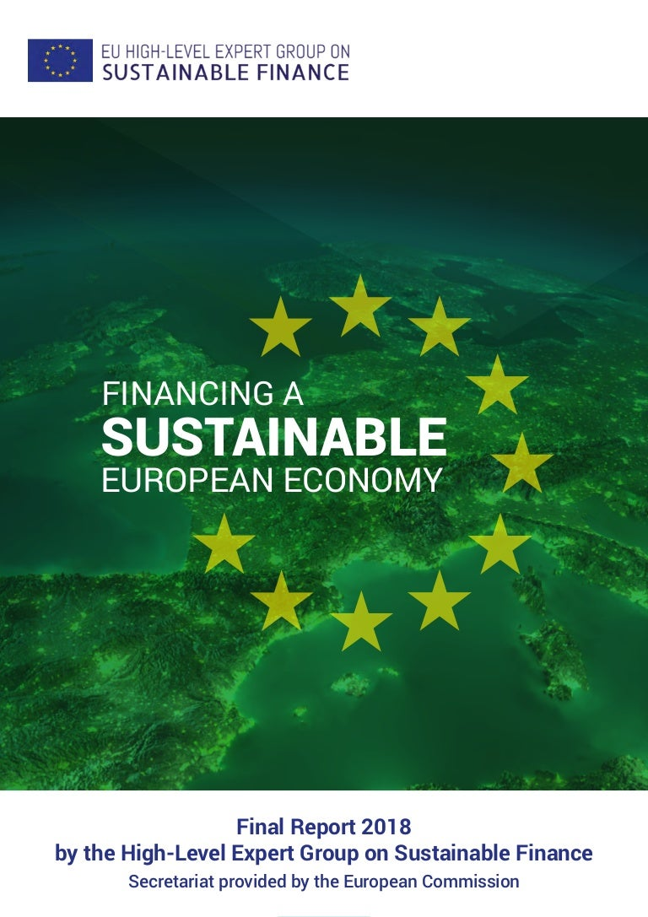
EU Green Deal
Binding EU Climate Law
Disclosure to foster private investment needed for the transition
Evolving towards binding commitments and net-zero plans

Slide 24
Introduction – the EU’s corporate sustainability blueprint
Transparency
New mandatory disclosure regimes covering the spectrum of E, S and G issues. With different regimes across multiple jurisdictions, interoperability remains a key challenge
What does it mean to be green?
“Taxonomies” set out detailed criteria on what economic activities can be considered “sustainable” to promote better capital allocation and reduce greenwashing
Due
diligence
New general and commodity-specific regimes require a better understanding of E and S impacts and actions to address them to secure resilient value chains
Transition
planning
New rules will require adoption and disclosure of climate targets and transition plans but also present opportunities to attract investment
Sectorial legislation:
circular
economy, protection of the environment and of the biodiversity, etc.
CSRD / SFDR
Taxonomy
CSDDD
CSDDD

Slide 25
Introduction – the EU’s corporate sustainability blueprint
E, S and G disclosures against new EU corporate sustainability reporting standards (own operations and value chain; material risks and impacts).
Disclosure of % Taxonomy-alignment of activities integrated with CSRD disclosures).
ESG due diligence on own business and value chain, address impacts and report (integrated with CSRD disclosures).
Corporate Sustainability Reporting Directive
Sustainable Finance Disclosure Regulation (SFDR)
Lays down rules on transparency with regard to the integration of sustainability risks and the consideration of adverse sustainability impacts in processes and the provision of sustainability‐related information with respect to financial products
Taxonomy Regulation
Corporate Sustainability Due Diligence Directive
Classification
Transparency
Accountability

Slide 26
Taxonomy Regulation (Regulation 2020/852 of 18 June 2020)
The Taxonomy Regulation provides a means to determine which economic activities are “environmentally sustainable”. Only some economic activities can qualify for Taxonomy-alignment.
To qualify as “environmentally sustainable” an economic activity must:
Climate change mitigation
1
substantially contribute to one of six objectives (detailed technical screening criteria apply)
Protection & restoration of biodiversity/ ecosystems
Climate change adaptation
2
do no significant harm the other objectives (detailed technical screening criteria apply)
Environmental objectives
3
be carried out in accordance with minimum social and governance safeguards
Sustainable
use and protection of water and marine resources
Pollution prevention and control
The Taxonomy Regulation puts forward reporting requirements:
non-financial undertakings have to report on their turnover, capital expenditures and operating expenditures
financial undertakings, which include banks, asset managers, investment firms and insurers/reinsurers, have to report on specific KPIs
Transition to a circular economy

Slide 27
Non-Financial Reporting Directive (NFRD) – evolving to Corporate Sustainability Reporting Directive (CSRD; Directive 2022/2464 of 14 December 2022)
Scope: from public-interest entities with more than 500 employees currently to all large EU entities and certain large non-EU entities as from 2025/2026 (FY24/25), certain EU and non-EU SMEs as from 2027 (FY2026) and certain non-EU groups as from 2029 (FY 2028)
Report on full range of ESG issues relevant to the business, with double materiality:
1) risks to the company arising from sustainability issues; and
2) company’s impact on people and the environment
Report on:
Environment,
Social and employees,
Respect for human rights, and
Bribery and corruption
to the extent necessary for understanding of the company’s development and performance
Auditor limited assurances
Net-zero transition plan in line with 1.5°C Paris Agreement
Information on companies’ global supply chain and human rights due diligence under Sustainable Corporate Governance
European Sustainability Reporting Standard (ESRS) prepared by EFRAG

Slide 28
Sustainability matters in scope of CSRD
Climate change
e.g. mitigation, adaptation, energy consumption
Own workforce
e.g. working conditions, collective bargaining, equal treatment/DEI
Pollution
e.g. pollution of air/water/soil, use of substances of concern
Workers in the value chain
e.g. working conditions, forced/child labour
Sustainability matters
Water and marine resources
e.g. withdrawal, consumption, discharge
Affected communities
e.g. land-related impacts, security-related impacts, indigenous peoples
Biodiversity and ecosystems
e.g. drivers of biodiversity loss, impacts on species and ecosystems
Consumers and end users
e.g. health and safety, responsible marketing
Circular economy
e.g. resource inflows and outflows, waste
Business conduct
e.g. political engagement, corruption and bribery
These topics must be considered as part of the DMA. Must add other topics if relevant to the business/sector (e.g. cyber security)

Slide 29


Corporate Sustainability Due Diligence Directive (CSDDD or CS3D)
Due diligence
In-scope companies must conduct human rights and environmental due diligence (based on existing international soft law standards).
Climate change transition plan
Due Diligence
Environmental and human rights due diligence arising from group and value chain
In-scope companies must adopt and put into effect a transition plan for climate change mitigation aiming to ensure, through best efforts, that the business model and strategy of the company are compatible with limiting global warming to 1.5 °C
Transition plans must include time-bound targets related to climate change including, where appropriate, absolute emission reduction targets for greenhouse gas (scopes 1, 2 and 3)
Strong public and private enforcement
Transition plan
Public and private enforcement
EU Member States are required to designate authorities to supervise compliance. They will have the power to request information, order the cessation of infringements, impose administrative fines and order interim measures carry out investigations.
In-scope companies may be held liable in court provided that they intentionally or negligently failed to comply with their obligations to prevent, mitigate, end or minimise adverse impacts
Evaluating risk or impact of climate change on operations
Supervisory authorities at the level of the EU Member States and specific liability provisions

Slide 30
CSDDD human rights and environmental due diligence obligations
Integrate due diligence into companies’ policies
Scope: actual and potential adverse human rights and environmental impacts arising from the in-scope companies’
own operations;
subsidiaries; and
“chain of activities”:
  Upstream business partners: production of goods or the provision of services by the company
  Downstream business partners: distribution, transport and storage of the product (where the business partners carry out those activities for the company or on behalf of the company)
  Carve-out of financial services (but: likely upcoming dedicated legislative proposal and impact of CSRD, SFDR, etc.)
Communicate (annual statement for companies not subject to CSRD)
Identify adverse human rights and environmental impacts
Six steps
Monitor and assess effectiveness
Prevent, cease or minimise actual and potential adverse impacts
Remediate (restitution)
Business partners are defined as entities with whom the in-scope company has a commercial agreement related to the operations, products or services of the company or to whom the company provides services (direct business partners) or which perform business operations related to the operations, products or services of the company (indirect business partners).

Slide 31

Global landscape of due diligence and reporting instruments
Europe and UK
French Duty of Vigilance Law
Swiss Non-Financial Reporting Regime
Swiss Conflict Minerals Regime
Dutch Bill on Responsible and Sustainable International Business Conduct
Dutch Child Labour Due Diligence Law (ongoing status pending subject to EU CSDDD)
German Supply Chain Due Diligence Act (this may be repealed but specific proposals not yet clear)
Norwegian Transparency Act
Key
Canada
Represents a reporting obligation
Canada Act to enact the Fighting Against Forced
Labour and Child Labour in Supply Chains Act
Note voluntary sustainability standards (based on ISSB)
Represents a due diligence (with reporting) obligation
Represents a proposal for regimes that are being developed/considered
EU Corporate Sustainability Reporting Directive (CSRD)
EU Corporate Sustainability Due Diligence Directive (CSDDD)
EU Conflict Minerals Regulation
EU Regulation on Deforestation-Free Products (EUDR)
EU Forced Labour Regulation
UK Modern Slavery Act
UK Forest Risk Commodities Scheme
UK Sustainability Reporting Standards
Note incoming ESG reporting regimes will also require extensive reporting on ESG issues (incl. human rights topics) in the supply chain (e.g. the new IFRS sustainability disclosure standards (ISSB) and the EU’s Corporate Sustainability Reporting Directive (and accompanying reporting standards)). This global snapshot of ISSB implementation is based on IFRS jurisdictional profiles at 17 October 2025, available here.
Qatar
Consultation on use/adoption of ISSB Standards closed in March 2025.
Asia
US
US Conflict Minerals Rule
US Uyghur Forced Labor Prevention Act 2021
California Transparency in Supply Chains Act
California climate disclosure laws
Various State level climate disclosure proposals including in New York, Colorado, New Jersey and Illinois
No legislation to directly address human rights and modern slavery.
A draft modern slavery bill was tabled in Hong Kong, but it has not been passed into law.
In 2022, the Japanese Government published the Guidelines on Respecting Human Rights in Responsible Supply Chains. While non-binding, legislation against human rights abuses may follow.
Thailand is in the early stages of developing a mandatory human rights and environmental due diligence law but at this stage it remains unclear what form this will take.
In South Korea, a draft human rights due diligence bill has also been tabled.
Various APAC jurisdictions including Australia, Bangladesh, China, Hong Kong SAR, Indonesia, Japan, Malaysia, Pakistan, Philippines, Singapore, South Korea, Sri Lanka, Chinese Taipei, and Thailand, have finalised, or are in the process of, or are expected to, use/adopt the ISSB standards.
Various countries are considering human rights and/or climate-related legislation.
In Mexico there are new environmental risk evaluation requirements and a legislative reform initiative is proposed which, if passed, would impose a corporate obligation to implement human rights risk analysis.
Many countries (e.g., Peru, Colombia, Chile, Brazil) have a National Action Plan in Business and Human Rights, some of which include promoting implementation of due diligence processes for large companies.
Various countries are looking to introduce additional protections for indigenous communities, including Mexico.
Other countries including, Bolivia, Brazil, Chile, Costa Rica, El Salvador, Mexico, Panama, have finalised, or are in the process of, or are expected to, use/adopt the ISSB standards.
Latin America
Australia
Africa
Various countries including, Ghana, Kenya, Nigeria, Rwanda, Tanzania, Uganda, Zambia, and Zimbabwe, have finalised, or are in the process of, or are expected to, use/adopt the ISSB standards.
Mandatory climate reporting regime
Australia Modern Slavery Act (reviewed in 2024 and one of the recommendations was to consider introducing mandatory human rights due diligence. The Australian Government has agreed in principle to these recommendations, but no timeline for implementation has been announced and there would be further consultations before any mandatory due diligence).
New Zealand
Mandatory climate reporting regime
Modern slavery reporting bills introduced into Parliament in 2025

Slide 32

Liability and litigation risks
A45554948
Notes:
GILLY

Slide 33
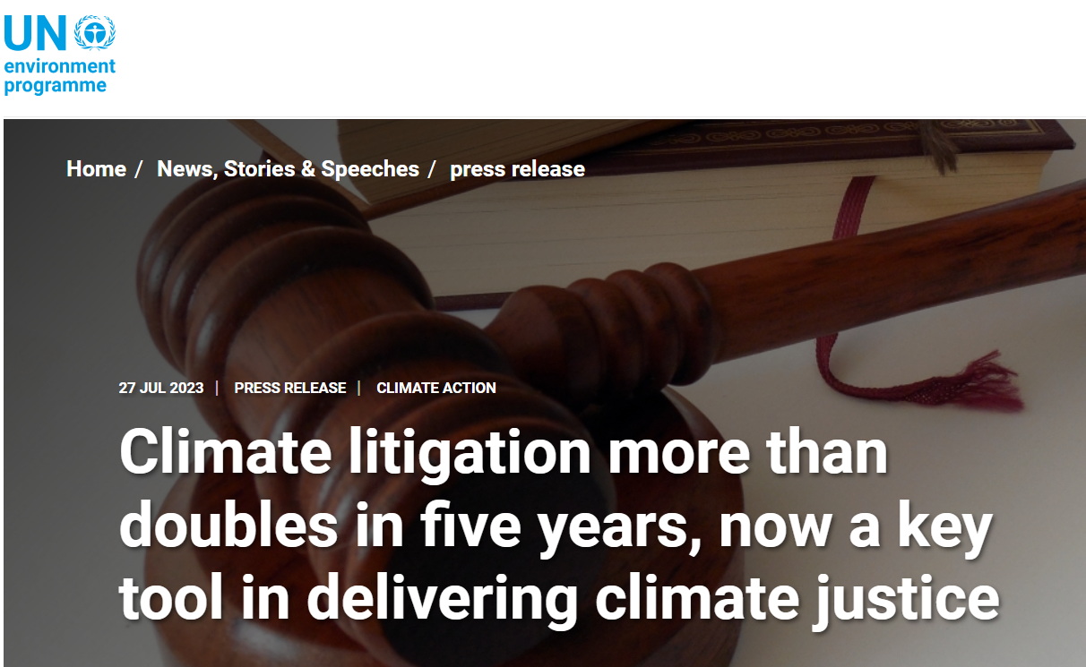
The rise of ESG litigation
“[I]t is difficult to overstate the impact of increased scrutiny of ESG issues. In particular, it is evident that the shift towards greater accountability and transparency in the ESG space—propelled by stakeholder and consumer demand—is resulting in corresponding legal and regulatory developments
Over time, this will likely result in the expansion of the range of theories under which relevant actors may be held liable for non-compliance with ESG standards and, relatedly, greater scope for ESG disputes.”
United Nations Environment Programme (2023). Global Climate Litigation Report: 2023 Status Review, p. 19

Slide 34
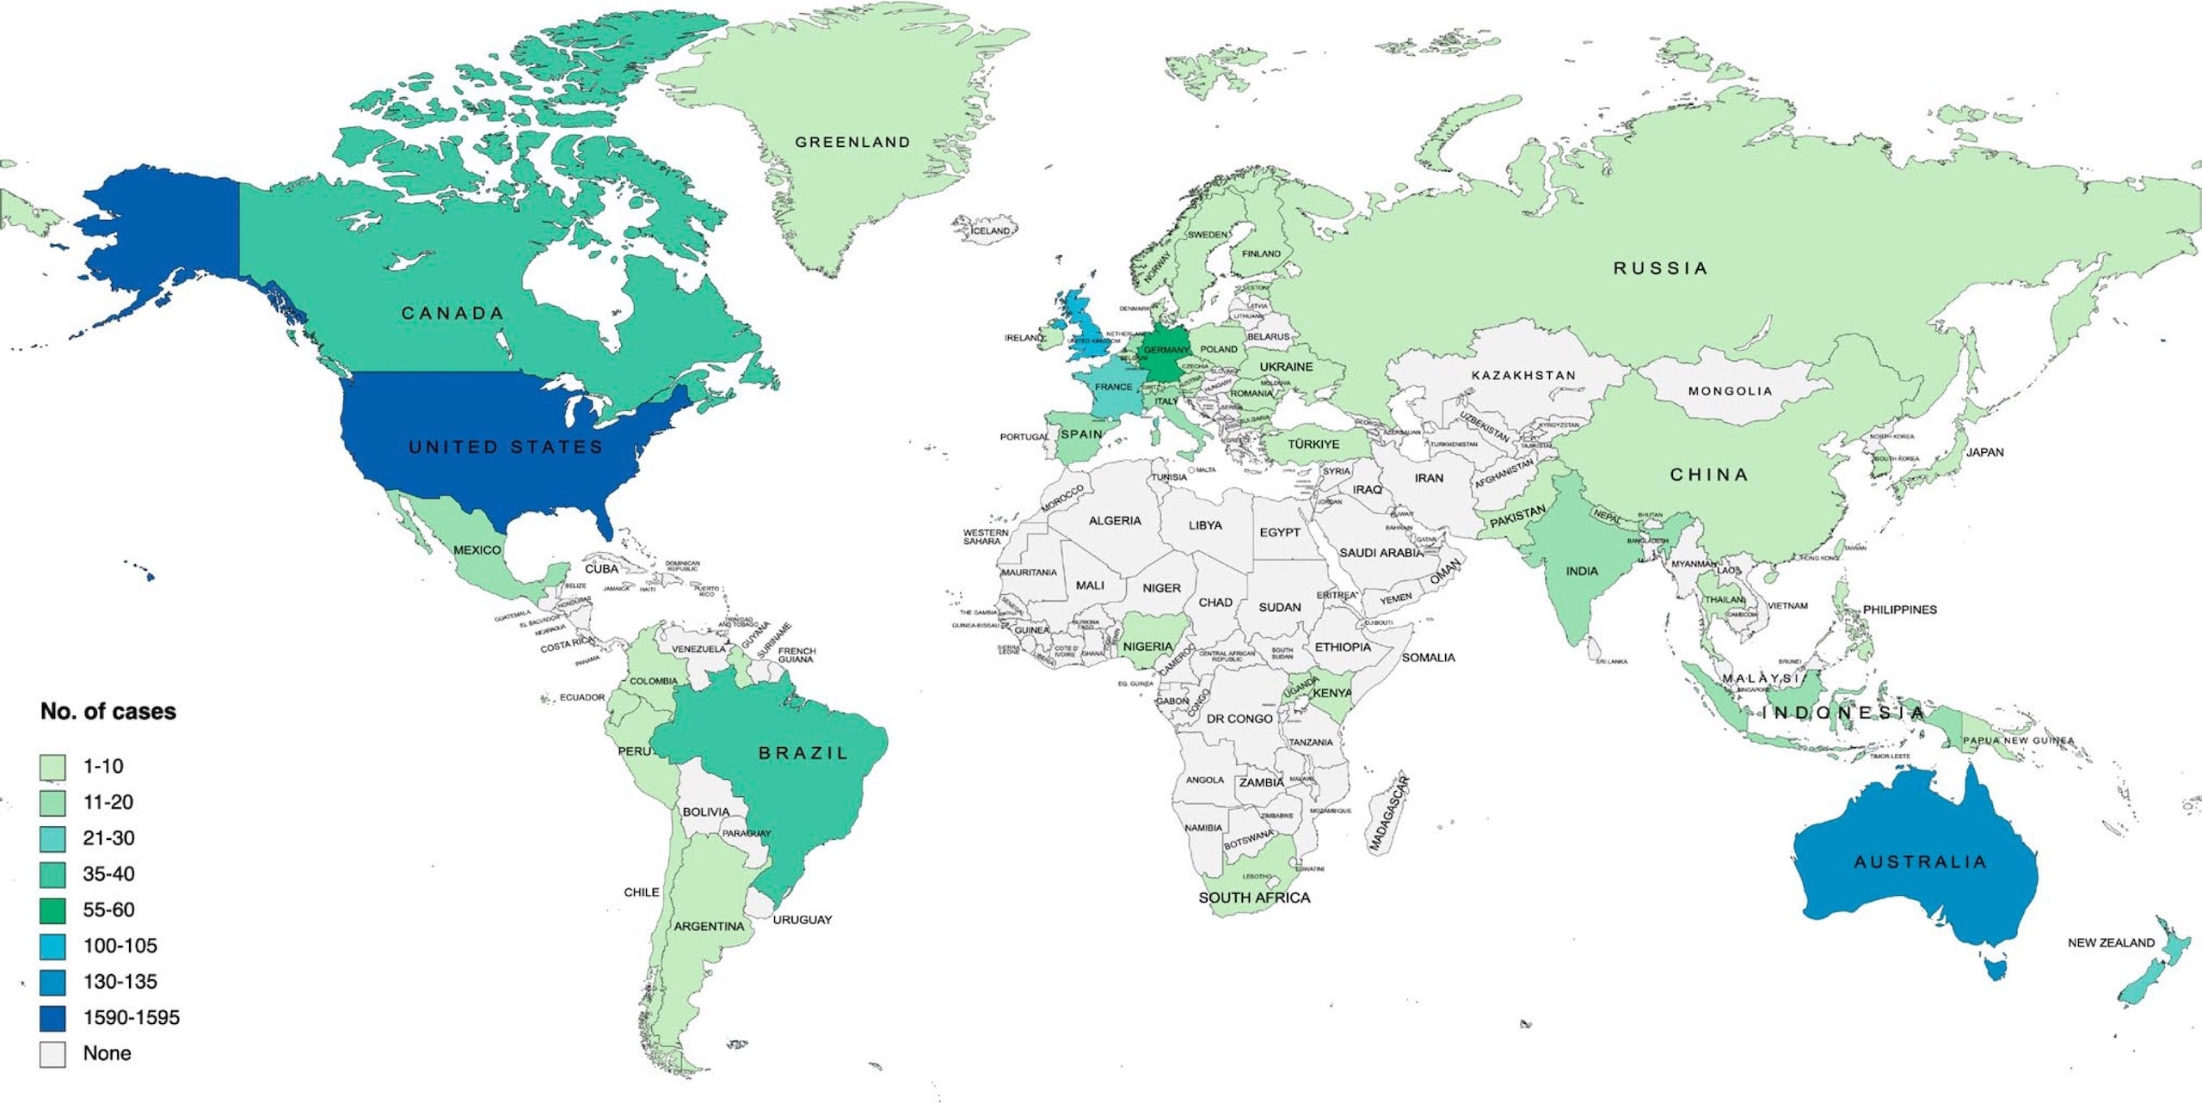
Panorama of grounds for “ESG” claims
Parent company liability
Disclosure litigation
Mis-selling and greenwashing
Challenges to Government decisions
Breach of directors’ duties
Accountability for ESG harms
Judicial intervention in climate transition planning
Source: Global trends in climate change litigation: 2023 snapshot,
based on Sabin Center data.
Contractual breach

Slide 35


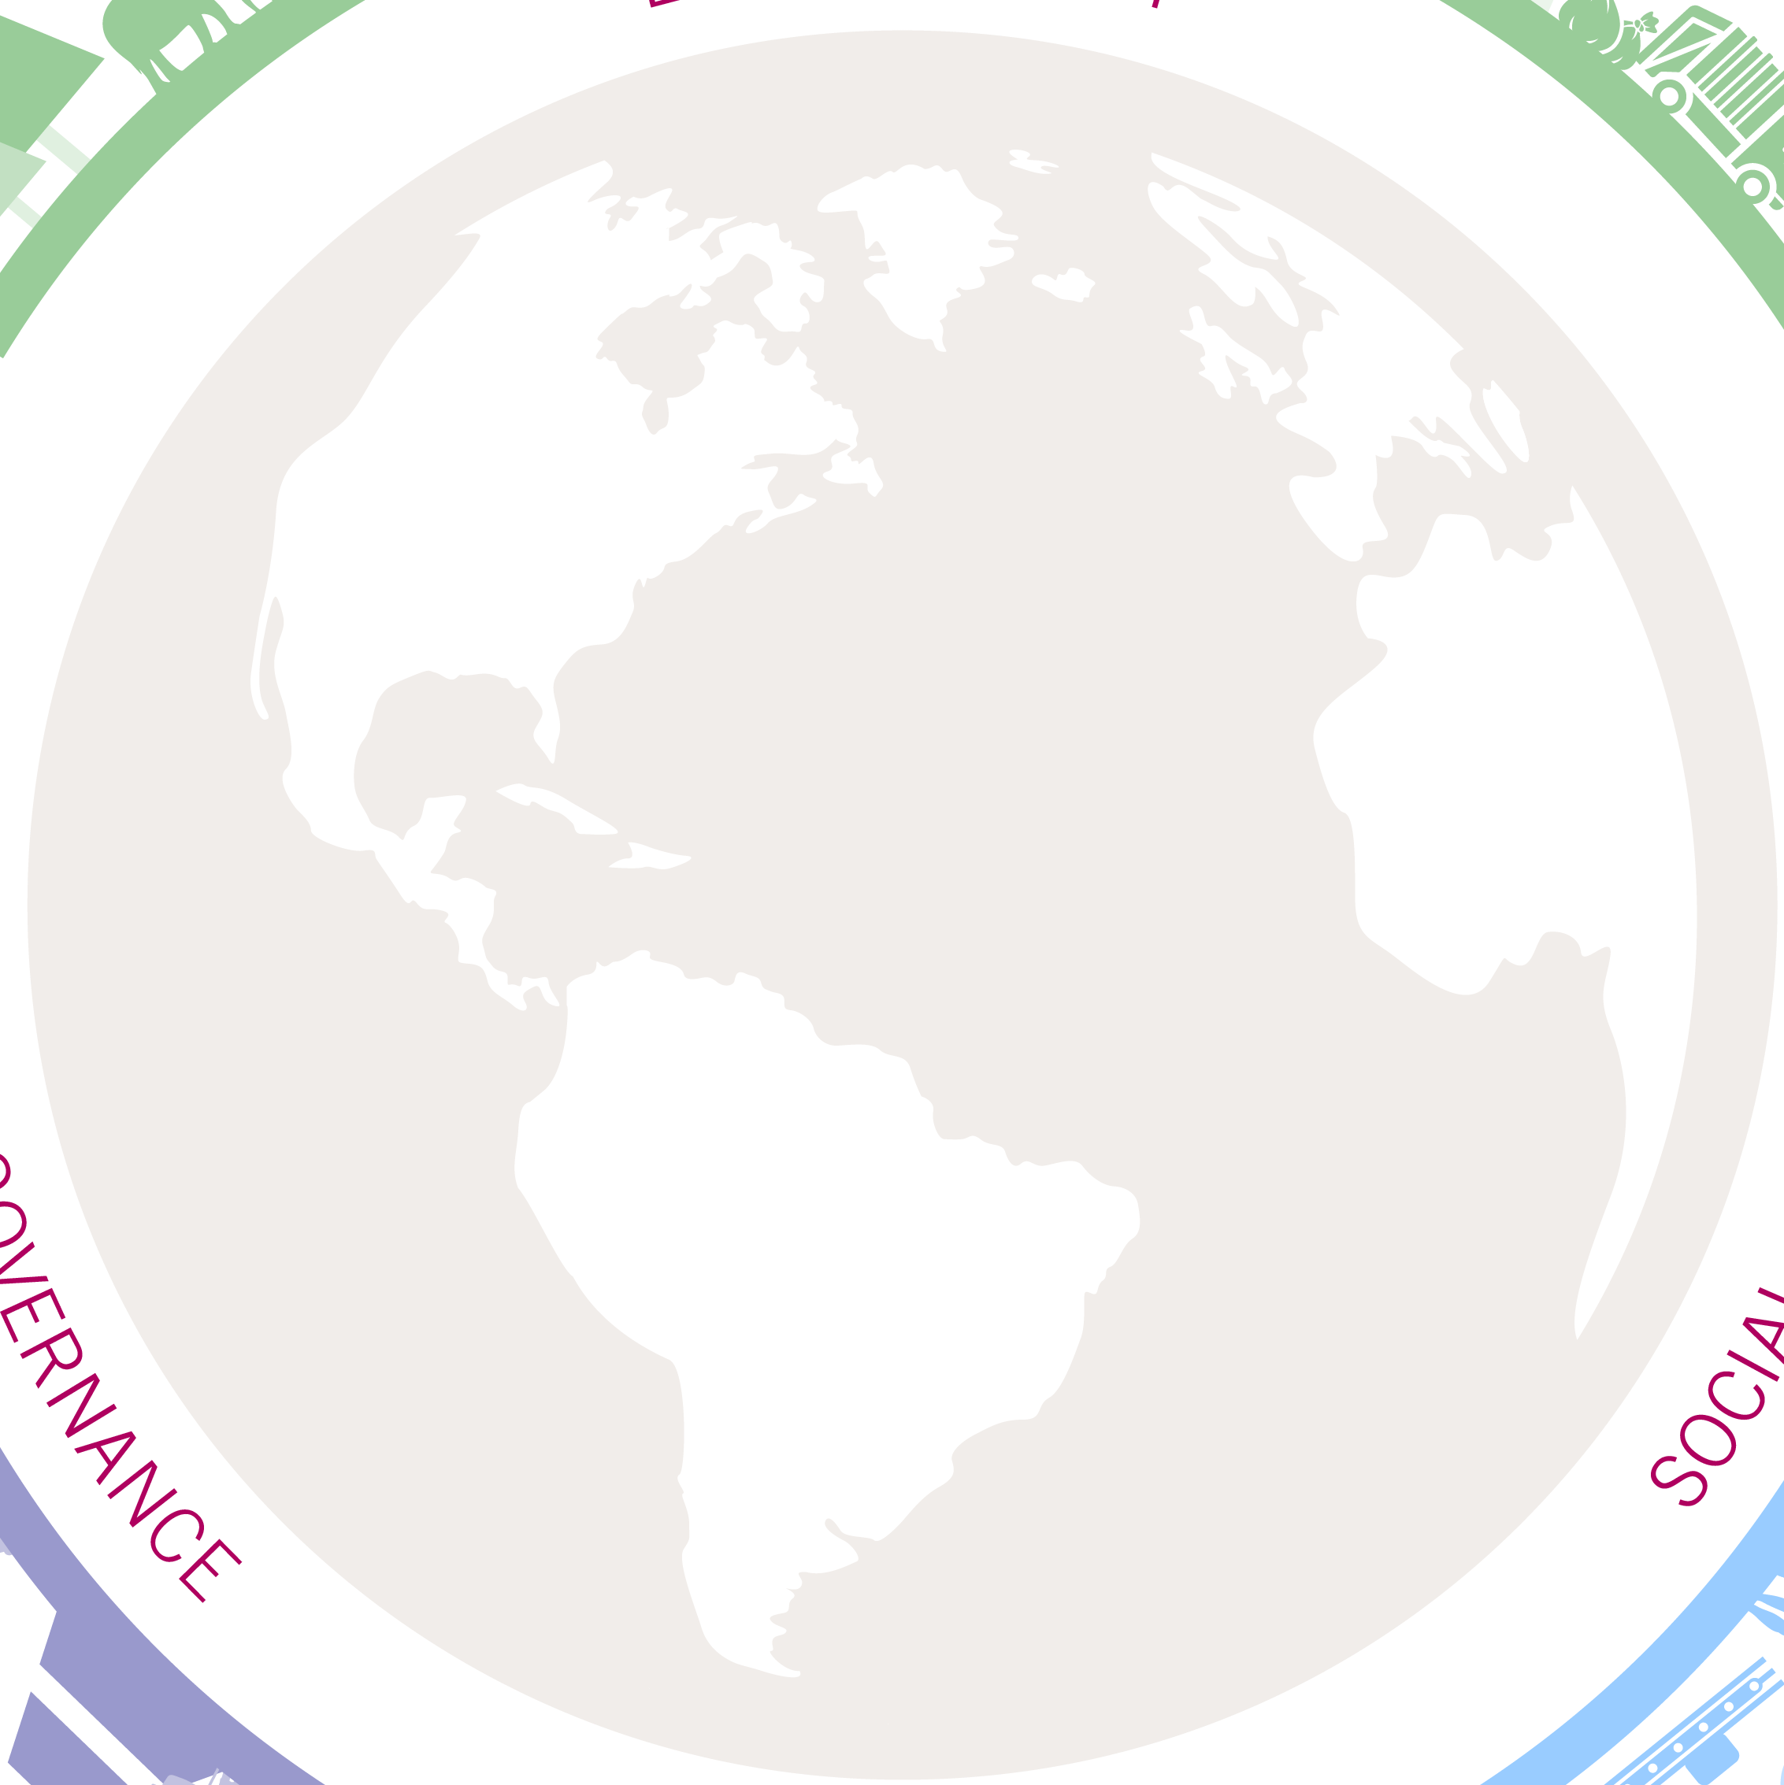


Global trends in ESG litigation
Risk of ‘green/fair/social-washing’ claims brought by investors / other interested parties where disclosures are false, misleading, vague, or insufficient (e.g. misrepresentation, negligent misstatement, statutory liability, etc.)
Aside from civil claims, inaccurate or misleading disclosures also attract the attention of the relevant regulator(s), who may be empowered to impose penalties even where inaccurate statements were inadvertent
International trend of activists challenging government or central bank policies (e.g. ClientEarth / NBB) and permitting decisions for inconsistency with climate targets
Growing trend of activists challenging project specific approvals, seeking to de-rail planned infrastructure investments
Key trends in ESG Litigation
Emerging trend of claims against parent companies of multinational groups alleging breach of a duty of care owed to those impacted by an alleged failure to adhere to ESG standards
Increasingly based on statutory due diligence regimes
Some soft law standards may include their own non-judicial “enforcement” mechanism
Debates on extent of general duty of care / fiduciary duties
Civil claims focused on future emissions and emissions reductions targets are becoming more prevalent
Claims have also been brought against directors for breach of directors’ duties in the context of climate strategy
Corporate accountability for
ESG harms

Slide 36
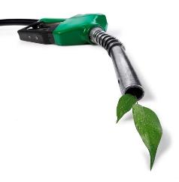

Shell case: a game changer regarding corporate duties?
Landmark decision by Hague District Court against Shell in May 2021 – appealed by Shell
Shell was found to be in breach of the general standard of care under Dutch law
The Court found that Shell’s decarbonisation plan was not ambitious enough and ordered it to reduce its CO2 emissions by 45% by 2030 (compared with 2019 levels)
The Court placed significant weight on the UN Guiding Principles on Business and Human Rights (UNGPs) given their wide acceptance
The application of the UNGPs allowed the Court to find that Shell had an obligation of result to reduce CO2 emissions from the activities of the Shell group (Scope 1 and 2), but also a significant best efforts obligation to reduce the emissions of its end users (Scope 3)
The responsibility of business enterprises to respect human rights, as formulated in the UNGP, is a global standard of expected conduct for all business enterprises wherever they operate. It exists independently of States’ abilities and/or willingness to fulfil their own human rights obligations and does not diminish those obligations. And it exists over and above compliance with national laws and regulations protecting human rights. Therefore, it is not enough for companies to monitor developments and follow the measures states take; they have an individual responsibility. It can be deduced from the UNGP and other soft law instruments that it is universally endorsed that companies must respect human rights.
– Shell judgement

Slide 37
Shell’s Q&A on the case
Q7: Can you summarize the arguments in your appeal?
The court based its ruling on an 'unwritten standard of care' under Dutch law. To be an unwritten standard of care, it would need to be so obvious, widely known and understood that everyone – not just countries and companies, but every person – knows and accepts that they must lower their carbon emissions by 45% by 2030. It's not clear how can Shell be ordered to reduce carbon emissions we do not control from customers who are not under a similar legal obligation to reduce their emissions. Shell alone cannot directly influence the energy choices made by its customers; it is for governments to determine the right trade-offs for society and put in place the policies that bring about fundamental changes in the way society consumes energy. Nor can we go faster to decarbonise than the sectors in which we operate, although we will give it our best to push the pace.
The obligation the court has set is much more stringent than the world’s most progressive energy pathways and scenarios, such as the 3 EU’s proposed ‘Fit for 55’ package and the International Energy Agency's Net Zero Emissions scenario.
Recent challenges in energy supply and spikes in energy prices further underscore the important role governments need to play in balancing the need to address climate change with ensuring a secure, reliable and affordable supply of energy.

Slide 38
Shell case: appeal decision (12 November 2024)
Starting point: confirmation that Shell has an obligation towards citizens to limit its CO2 emissions. This obligation is based on the human right to protection against dangerous climate change. It is first and foremost up to governments to ensure the protection of human rights, but indirectly those rights also have a bearing on the social standard of care which companies like Shell must observe
Nuance vis-à-vis first instance decision: the court of appeal denied the claims of Milieudefensie because the court was unable to establish that the social standard of care entails an obligation for Shell to reduce its CO2 emissions by 45%, or some other percentage. There is currently insufficient consensus in climate science on a specific reduction percentage to which an individual company like Shell should adhere. Moreover, Shell is already working to reduce its own scope 1 and 2 emissions. Lastly, the court of appeal is of the opinion that an obligation for Shell to reduce CO2 emissions caused by buyers of Shell products, scope 3 emissions, by a particular percentage would be ineffective in this case (Shell could meet that obligation by ceasing to trade in the fuels it purchases from third parties; other companies would then take over)
An appeal in cassation against this ruling has been brought before the Dutch Supreme Court.

Slide 39

“Backlash” and “recalibration”

Slide 40
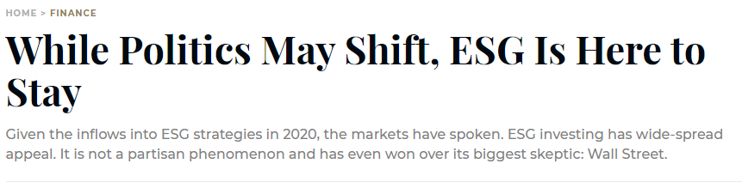
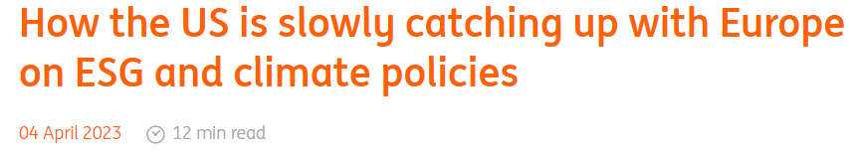
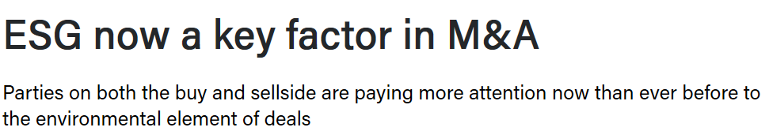

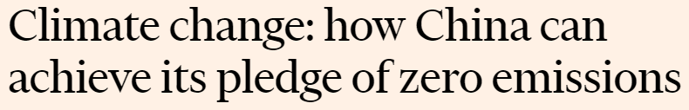
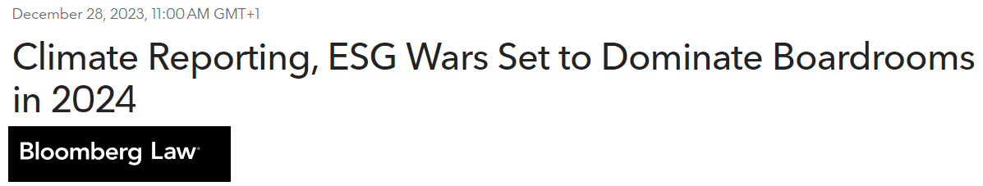


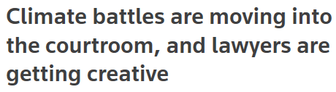

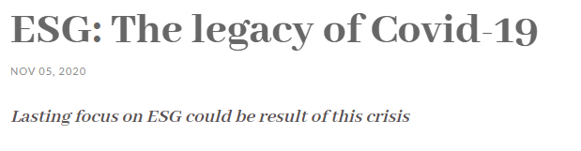

Slide 41
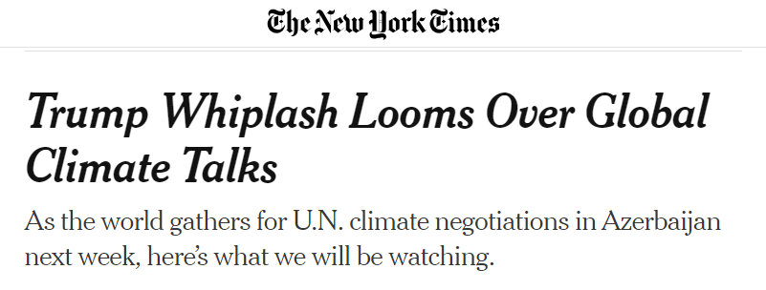
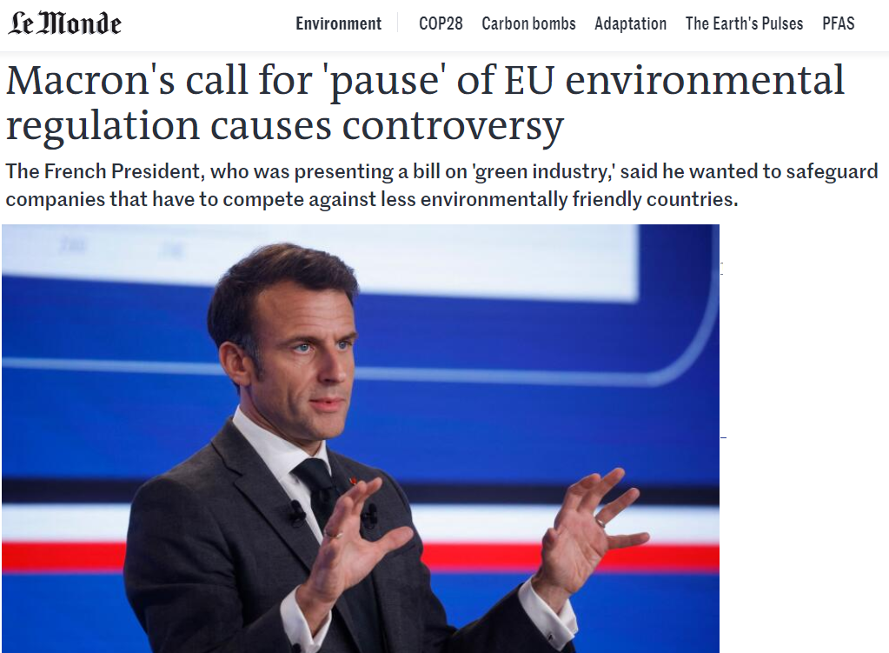
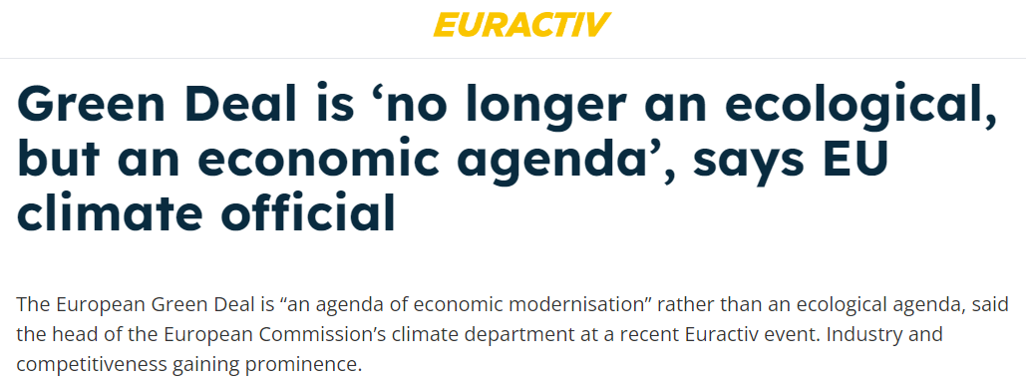
ESG backlash

Slide 42
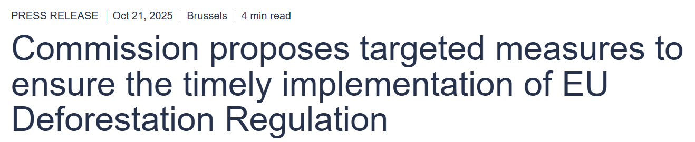
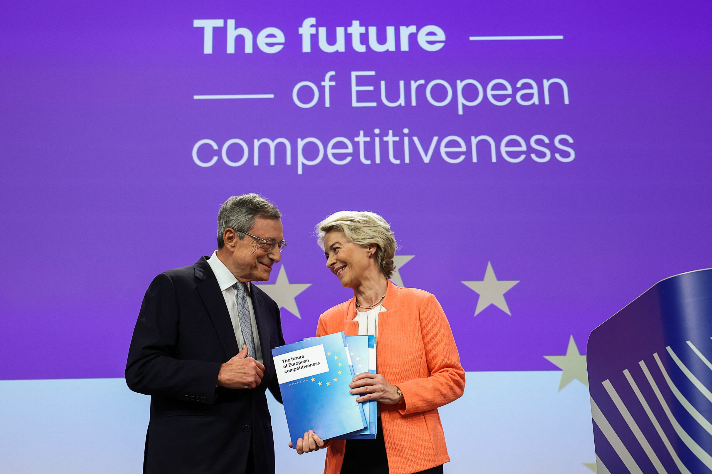
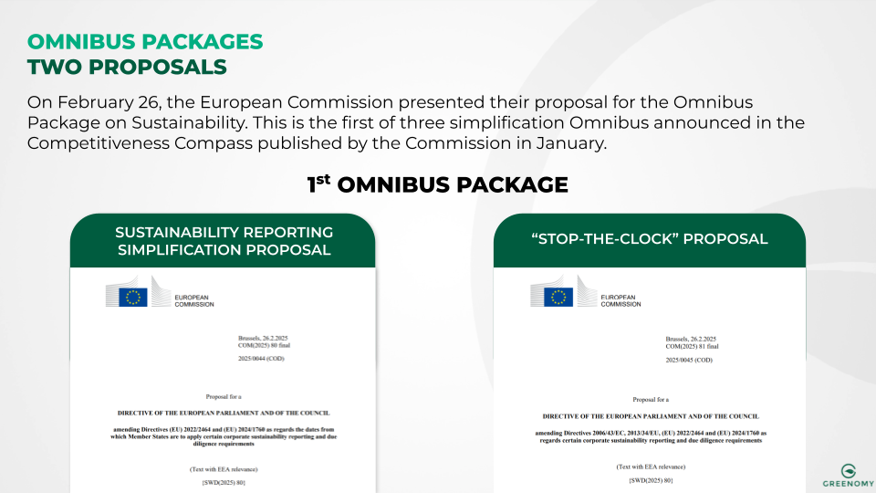

EU “recalibration” of sustainability legislation

Slide 43

Questions?

