Slide 1

Sustainable finance and disclosure
ULB, 7 November 2025

Slide 2
Agenda for the classes
1
Introduction – what is ESG and why does it matter?
2
Sustainable finance and disclosure
3
From a duty to report to a duty to act – climate transition plans and supply chain due diligence
4
ESG litigation and liability risks
5
Focus on specific regulatory and legislative regimes
6
Backlash and recalibration

Slide 3

How much do we need to invest by 2050 to stop climate change?
USD 250,000,000,000,000

Slide 4
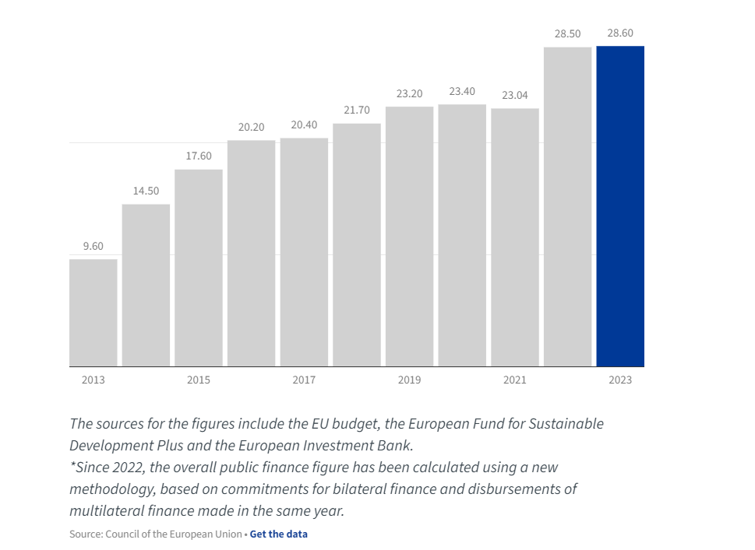

Key outcomes of COP29 (ended 24 November 2024)
Developed countries pledging to provide $300 billion annually by 2035 to developing countries, mostly in the form of loans
  Developing countries were adamant that they needed $1.3tn a year, exclusively from developed countries
  Instead, the text calls on “all actors” to scale up funds from “all public and private sources” to “at least $1.3tn” by 2035
Implementation of Article 6 of the Paris Agreement on:
  Corporate carbon markets
  Country-to-country trading
  Cf. EU ETS

Slide 5

30th Conference of the Parties (COP30) – 10-21 November 2025
The 1.5°C threshold was exceeded for the entirety of 2024 for the first time, and UN leaders increasingly acknowledge that it will likely be permanently breached by the early 2030s if current trends continue.
The Paris Agreement requires signatories to submit new carbon-cutting plans, known as Nationally Determined Contributions (NDCs) every five years. The new NDCs are meant to contain countries’ climate targets for 2035. The NDC Synthesis Report, released by the UN on 28 October, revealed that only 64 countries had (at the time; now incl. China and the EU) submitted updated NDCs, despite all being required to do so ahead of COP30.
Nature and biodiversity will feature prominently. Brazil’s presidency has put
deforestation at the top of the agenda, recognising that reaching net zero will
be impossible without halting and reversing nature loss, and announcements
about a new forests financing initiative are expected
To date, the focus has largely been on “mitigating” the effects of climate
change (i.e. reducing GHG emissions). However, this year COP will also be
focusing on “adaptation” (i.e. dealing with and adapting to the effects of climate
change). 144 countries have now initiated the National Adaptation Plan (NAP) process.
A bit of optimism: the Granary of Solutions

Slide 6
Agenda for today
1
From soft law standards to hard law
2
Taxonomy
3
Sustainable finance (incl. SFDR)
4
CSRD
5
Carbon markets
6
Greenwashing in financial sector

Slide 7
Agenda for today
Investors
CSRD disclosures (including Taxonomy alignment)
SFDR disclosures
(including taxonomy-alignment)
Grant sustainability-linked products (e.g. green bonds/loans)
Financial institutions
Corporates
CSRD disclosures (including Taxonomy alignment)
Big emitters/importers part of mandatory carbon markets (ETS/CBAM)

Slide 8
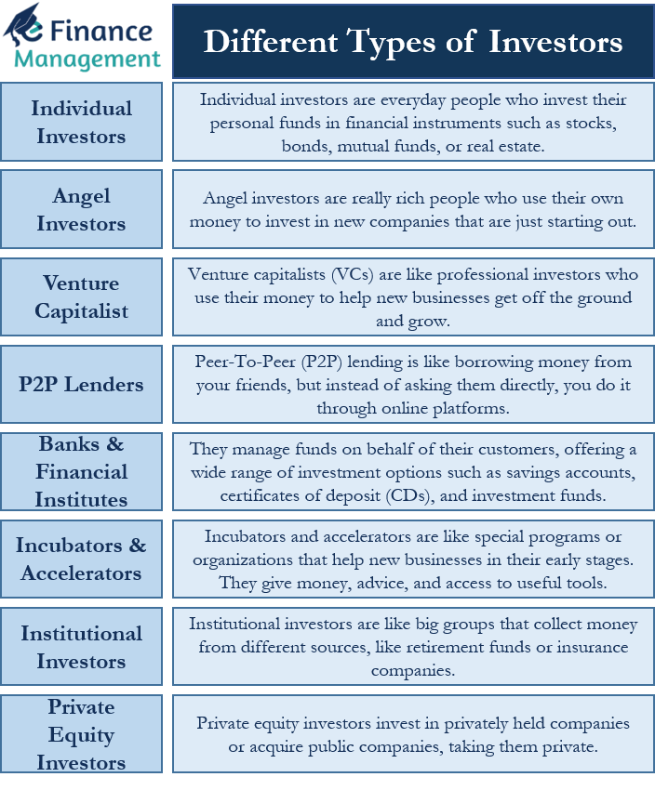
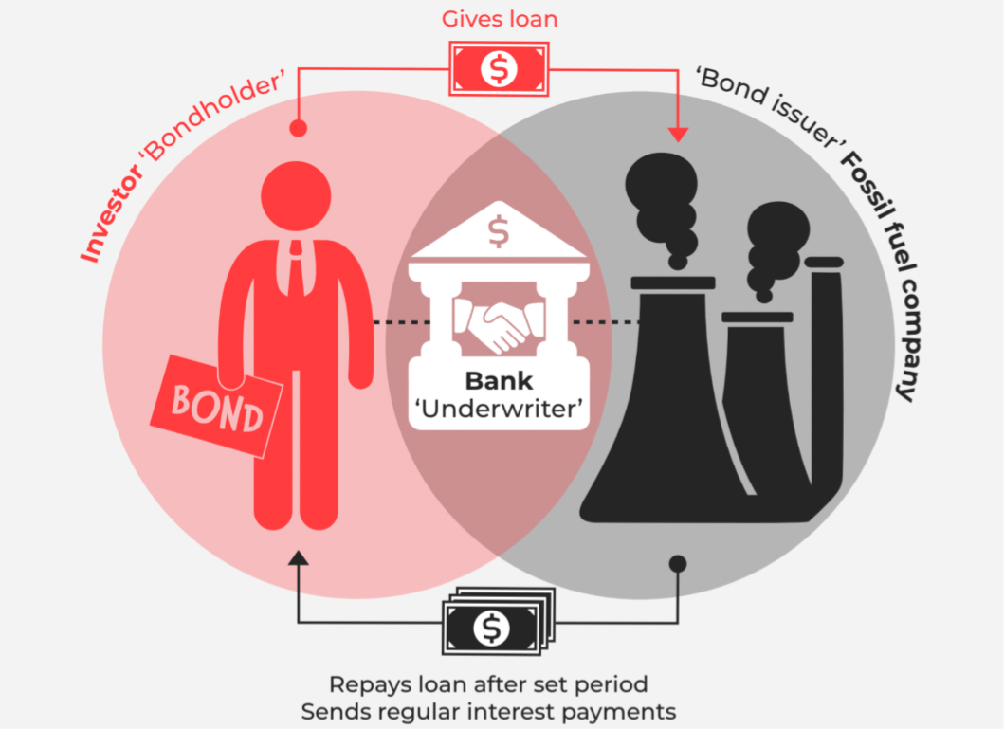
Some key concepts

Slide 9

From soft law initiatives to hard law requirements

Slide 10

2004 UN Global Compact report – Who Cares Wins
2004 UN Global Compact report, drawn up at the invitation of UN Secretary-General Kofi Annan and endorsed by 18 global financial institutions, titled “Who Cares Wins. Connecting Financial Markets to a Changing World. Recommendations by the financial industry to better integrate environmental, social and governance issues in analysis, asset management and securities brokerage”
“Ultimately, successful investment depends on a vibrant economy, which depends on a healthy civil society, which is ultimately dependent on a sustainable planet. In the long-term, therefore, investment markets have a clear self-interest in contributing to better management of environmental and social impacts in a way that contributes to the sustainable development of global society. A better inclusion of environmental, social and corporate governance (ESG) factors in investment decisions will ultimately contribute to more stable and predictable markets, which is in the interest of all market actors”

Slide 11
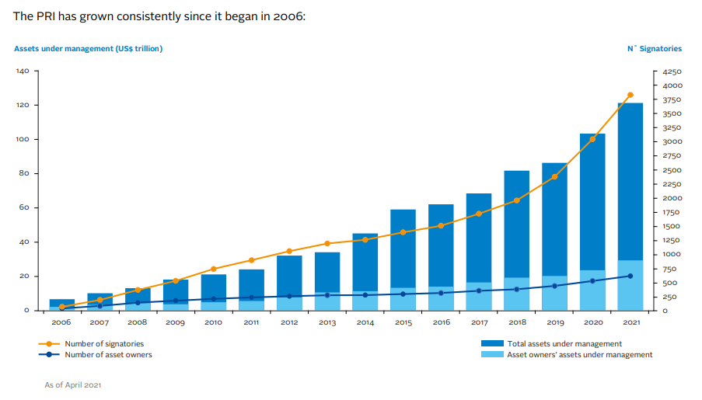
2006 Principles for Responsible Investment (PRI) (cont’d)
Year-long process coordinated by the UN Environment Programme Finance Initiative (UNEP FI) and the UN Global Compact
“The PRI defines responsible investment as a strategy and practice to incorporate environmental, social and governance (ESG) factors in investment decisions and active ownership. There are many terms - such as sustainable investing, ethical investing, and impact investing
- associated with the plethora of investment approaches that consider ESG issues. Most lack formal definitions, and they are often used interchangeably. A key to understanding how responsible investment is broader than these concepts is that where many make moral or ethical goals a primary purpose, responsible investment can and should be pursued by the investor whose sole focus is financial performance, as well as those looking to build a bridge between financial risk/opportunities and outcomes in the real world”

Slide 12
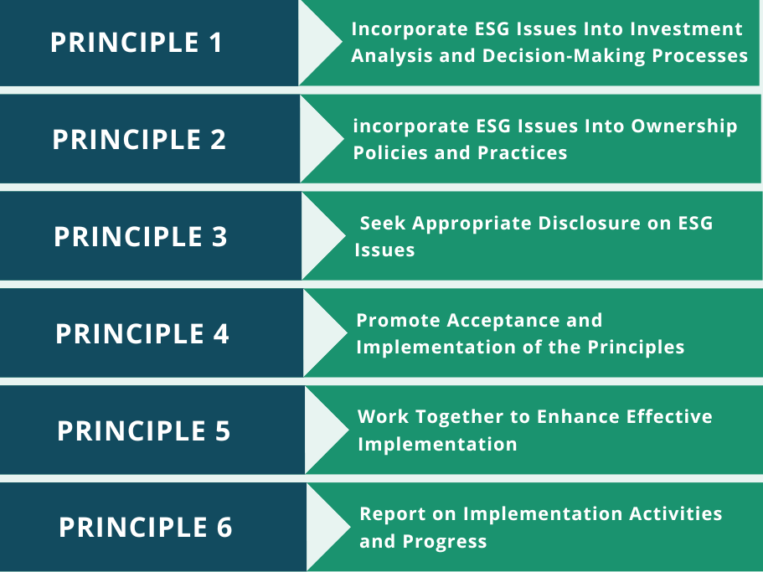

2006 Principles for Responsible Investment (PRI)
6 principles underpinned by a set of 35 possible actions that institutional investors can take to integrate ESG considerations into their investment activities

Slide 13
Taskforce on Climate-related Financial Disclosures (TCFD)
(COP21)
2015 Paris Agreement (Article 2):
  The agreement’s overarching goal is to hold “the increase in the global average temperature to well below 2°C above pre-industrial levels” and pursue efforts “to limit the temperature increase to 1.5°C above pre-industrial levels” (i.e. net worldwide carbon emissions need to be reduced by 45% by 2030 and reach net zero by 2050)
  Objective of “making finance flows consistent with a pathway towards low greenhouse gas emissions and climate-resilient development” is also included
G20 set up the TCFD:
  Publishes recommendations designed to standardise worldwide climate-related disclosures that could "promote more informed investment (...) and in turn, enable stakeholders to understand better concentrations of carbon-related assets in the financial sectors."
  These recommendations allow companies to use a standardised way to report their own climate-related financial risks, consisting of physical, liability and transition risks, to stakeholders (>< double materiality at EU level)

Slide 14
International Sustainability Standards Board (ISSB)
(COP26)
Set up at 2021 COP26
Standard-setting board of the International Financial Reporting Standards (IFRS) Foundation, a not-for-profit organisation that sets global, corporate reporting (usually financial) standards
The IFRS Foundation has taken over the monitoring of the progress on companies’ climate-related disclosures from the TCFD, through the International Sustainability Standards Board (ISSB)
First two ISSB Sustainability Disclosure Standards published in 2023: (i) general requirements and
(ii) climate-related risks and opportunities
“The ISSB is committed to delivering standards that are cost-effective, decision-useful and market informed.
  The standards are developed with efficiency in mind, helping companies to report what is needed globally to investors across markets globally.
  The standards are designed to provide the right information, in the right way, to support investor decision-making and facilitate international comparability to attract capital.
  A company can avoid double-reporting by applying the ISSB’s standards. When jurisdictional requirements build on the global baseline, companies are able to meet jurisdictional requirements while benefiting from the efficiency and comparability of the global baseline.”

Slide 15

ISSB Sustainability Disclosure Standards
Europe and UK
French Duty of Vigilance Law
Swiss Non-Financial Reporting Regime
Swiss Conflict Minerals Regime
Dutch Bill on Responsible and Sustainable International Business Conduct
Dutch Child Labour Due Diligence Law (ongoing status pending subject to EU CSDDD)
German Supply Chain Due Diligence Act (this may be repealed but specific proposals not yet clear)
Norwegian Transparency Act
Key
Canada
Voluntary standards, but increasingly imposed by national laws
Represents a reporting obligation
Canada Act to enact the Fighting Against Forced
Labour and Child Labour in Supply Chains Act
Note voluntary sustainability standards (based on ISSB)
Represents a due diligence (with reporting) obligation
Represents a proposal for regimes that are being developed/considered
EU Corporate Sustainability Reporting Directive (CSRD)
EU Corporate Sustainability Due Diligence Directive (CSDDD)
EU Conflict Minerals Regulation
EU Regulation on Deforestation-Free Products (EUDR)
EU Forced Labour Regulation
UK Modern Slavery Act
UK Forest Risk Commodities Scheme
UK Sustainability Reporting Standards
Note incoming ESG reporting regimes will also require extensive reporting on ESG issues (incl. human rights topics) in the supply chain (e.g. the new IFRS sustainability disclosure standards (ISSB) and the EU’s Corporate Sustainability Reporting Directive (and accompanying reporting standards)). This global snapshot of ISSB implementation is based on IFRS jurisdictional profiles at 17 October 2025, available here.
Qatar
Consultation on use/adoption of ISSB Standards closed in March 2025.
Asia
US
US Conflict Minerals Rule
US Uyghur Forced Labor Prevention Act 2021
California Transparency in Supply Chains Act
California climate disclosure laws
Various State level climate disclosure proposals including in New York, Colorado, New Jersey and Illinois
No legislation to directly address human rights and modern slavery.
A draft modern slavery bill was tabled in Hong Kong, but it has not been passed into law.
In 2022, the Japanese Government published the Guidelines on Respecting Human Rights in Responsible Supply Chains. While non-binding, legislation against human rights abuses may follow.
Thailand is in the early stages of developing a mandatory human rights and environmental due diligence law but at this stage it remains unclear what form this will take.
In South Korea, a draft human rights due diligence bill has also been tabled.
Various APAC jurisdictions including Australia, Bangladesh, China, Hong Kong SAR, Indonesia, Japan, Malaysia, Pakistan, Philippines, Singapore, South Korea, Sri Lanka, Chinese Taipei, and Thailand, have finalised, or are in the process of, or are expected to, use/adopt the ISSB standards.
Various countries are considering human rights and/or climate-related legislation.
In Mexico there are new environmental risk evaluation requirements and a legislative reform initiative is proposed which, if passed, would impose a corporate obligation to implement human rights risk analysis.
Many countries (e.g., Peru, Colombia, Chile, Brazil) have a National Action Plan in Business and Human Rights, some of which include promoting implementation of due diligence processes for large companies.
Various countries are looking to introduce additional protections for indigenous communities, including Mexico.
Other countries including, Bolivia, Brazil, Chile, Costa Rica, El Salvador, Mexico, Panama, have finalised, or are in the process of, or are expected to, use/adopt the ISSB standards.
Latin America
Australia
Africa
Various countries including, Ghana, Kenya, Nigeria, Rwanda, Tanzania, Uganda, Zambia, and Zimbabwe, have finalised, or are in the process of, or are expected to, use/adopt the ISSB standards.
Mandatory climate reporting regime
Australia Modern Slavery Act (reviewed in 2024 and one of the recommendations was to consider introducing mandatory human rights due diligence. The Australian Government has agreed in principle to these recommendations, but no timeline for implementation has been announced and there would be further consultations before any mandatory due diligence).
New Zealand
Mandatory climate reporting regime
Modern slavery reporting bills introduced into Parliament in 2025

Slide 16
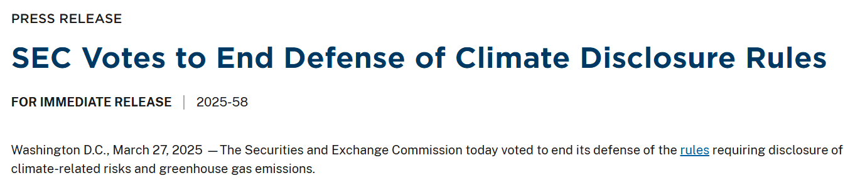
U.S. – impact of Trump administration
In March 2024, the Security and Exchange Commission (“SEC”; federal level; California has its own rules) issued a rule that requires registrants to provide comprehensive climate disclosures in their annual reports and registration statements as from FY 25’. Requirement to disclose:
  Material scope 1 and scope 2 GHG emissions, subject to assurance requirements that will be phased in (>< scope 3 included under CSRD and California law)
  Governance and oversight of material climate-related risks.
  The material impact of climate risks on the company’s strategy, business model, and outlook (>< double materiality included under CSR)
  Risk management processes for material climate-related risks
  Material climate targets and goals
Rules challenged in court; SEC
(under Trump administration)
abandoned the Rules in March 2025

Slide 17
EU’s corporate sustainability blueprint
E, S and G disclosures against new EU corporate sustainability reporting standards (own operations and value chain; material risks and impacts).
Disclosure of % Taxonomy-alignment of activities integrated with CSRD disclosures).
ESG due diligence on own business and value chain, address impacts and report (integrated with CSRD disclosures).
Corporate Sustainability Reporting Directive
Sustainable Finance Disclosures Regulation (SFDR)
Lays down rules on transparency with regard to the integration of sustainability risks and the consideration of adverse sustainability impacts in processes and the provision of sustainability‐related information with respect to financial products
Taxonomy Regulation
Corporate Sustainability Due Diligence Directive
Classification
Transparency
Accountability

Slide 18

Taxonomy regulation

Slide 19
Taxonomy Regulation (regulation 2020/852)
The Taxonomy Regulation provides a means to determine which economic activities are “environmentally sustainable”. Only some economic activities can qualify for Taxonomy-alignment.
To qualify as “environmentally sustainable” an economic activity must:
Climate change mitigation
substantially contribute to one of six objectives (detailed technical screening criteria apply)
Protection & restoration of biodiversity/ ecosystems
Climate change adaptation
1
2
do no significant harm to the objectives (detailed technical screening criteria apply)
Environmental objectives
Sustainable
use and protection of water and marine resources
3
be carried out in accordance with minimum social and governance safeguards
Pollution prevention and control
The Taxonomy Regulation puts forward reporting requirements:
companies subject to CSRD must report on their turnover, capital expenditures and operating expenditures (phased approach from 2021 to 2026). Companies that are not in scope can use it on a voluntary basis. Currently around 15% of “taxonomy aligned” activities
financial undertakings, which include banks, asset managers, investment firms and insurers/reinsurers, have to report on specific KPIs
Transition to a circular economy

Slide 20


EU Taxonomy Overview – What is it and what is it not
Objective – what is the Taxonomy
What is the Taxonomy not?
A classification system to establish clear definitions of what is an environmentally sustainable economic activity
It does not make any judgement on the financial performance of an investment
Tool to help investors and companies to make informed investment decision
It’s not a mandatory list to invest in
Fostering Transparency by disclosures for financial market participants and large companies related to the Taxonomy
What’s not green is not necessarily harmful. Activities that are not on the list, are not necessarily harmful activities. The focus is simply on activities that contribute substantially to environmental objectives.
Reflecting technological and policy developments
Facilitating transition of polluting sectors
Technology neutral

Slide 21
Environmentally Sustainable
Art.2(1): “ ‘environmentally sustainable investment’ means an investment in one or several economic activities that qualify as environmentally sustainable under this Regulation;
Art.3: “[…] an economic activity shall qualify as environmentally sustainable where that economic activity:
(a) contributes substantially to one or more of the environmental objectives […];
(b) does not significantly harm any of the environmental objectives […];
(c) is carried out in compliance with the minimum safeguards […]; and
(d) complies with technical screening criteria […]
Legal term:
‘environmentally sustainable’
Informal terms:
‘Green’
‘Taxonomy-compliant’
SC
+
5x DNSH
+
Minimum social*
safeguards
* Alignment with
OECD Guidelines for MNE
UN Guiding Principles on Business and Human Rights,
ILO core labour conventions,
International Bill of Human Rights.
Detailed by
Specific to a set of activities
(e.g. hydropower activities)
Spelled out in Delegated Acts
+
Technical Screening Criteria

Slide 22
Example – Climate Change Mitigation
Sector classification and activity
Macro-Sector | D - Electricity, Gas, Steam and Air Conditioning Supply
NACE Level | 4
Code | D.35.1.1
Description | Construction and operation of electricity generation facilities that produce electricity from Hydropower
Mitigation criteria
Principle | Support a transition to a net-zero emissions economy • Avoidance of lock-in to technologies which do not support the transition to a net-zero emissions economy • Ensure that economic activities meet best practice standards • Ensure equal comparability within an economic activity with regards to achieving net-zero emissions economy target • Where necessary, incorporating technology-specific considerations into secondary metrics and thresholds
Metric & Threshold | […] Declining threshold: Facilities operating at life cycle GHG emissions lower than 100gCO2e/kWh, declining to 0gCO2e/kWh by 2050, are eligible • This threshold will be reduced every 5 years in line with a net-zero CO2e in 2050 trajectory • Assets and activities must meet the threshold at the point in time when taxonomy approval is sought For activities which go beyond 2050, it must be technically feasible to reach net-zero emissions

Slide 23
Example – Climate Change Mitigation
Do no significant harm assessment
The main environmental impacts associated with hydropower installations are: - Emissions to water and generation of waste during construction; - Impacts on biodiversity associated with fragmentation of ecosystems and changes to habitat, to hydrological and hydrogeological regimes, water chemistry, and interference with species migration pathways as a result of the establishment of the installation and its operation
(2) Adaptation | Refer to the screening criteria for DNSH to climate change adaptation.
(3) Water | For new projects: Ensure implementation of a River Basin Management […] and ensure that an appropriate cumulative impact assessment or equivalent study has been undertaken […] Ensure that the conditions outlined in article 4(7) of the WFD are met based on ground evidence. […] Construction of new hydropower should not lead to increase fragmentation of rivers, consequently refurbishment of existing hydropower plant and rehabilitation of existing barriers should be prioritised. […]
(4) Circular Economy
(5) Pollution | Establishing a River Basin Management Plan (as outlined in the EU Water Framework Directive) and ensure compliance with applicable EU regulations. Reference for outside EU: IFC’s and World Bank Group’s environmental and social standards. Parameters and acceptable limits/ranges and necessary sampling and measuring frequency are contained in EU Directive 2006/44/EC […]
(6) Ecosystems | Ensure an Environmental Impact Assessment (EIA) has been completed in accordance with […] Ensure any required mitigation measures for protecting biodiversity/eco-systems have been implemented. For sites/operations located in or near to biodiversity-sensitive areas […] ensure that an appropriate assessment has been conducted in compliance with the provisions of the EU Biodiversity Strategy (COM (2011) 244), the Birds (2009/147/EC) and Habitats (92/43/EEC) Directives or in the case of activities located in non-EU countries, other equivalent national provisions or international standards […]

Slide 24

The Taxonomy Regulation – Scope of uses
The Taxonomy Regulation imposes an obligation on three types of users
Financial market participants offering financial products in the EU, including occupational pension providers
Article 5 – Article 7
Large companies who are already required to provide a non-financial statement under the Non-Financial Reporting Directive (to be replaced by CSRD)
Article 8
The EU and Member States
Article 4
How and to what extent the Taxonomy was used in determining the sustainability of the underlying investments;
To what environmental objective(s) the investments contribute; and
The proportion of underlying investments that are Taxonomy-aligned, as a percentage of the investment, fund or portfolio.
The proportion of turnover aligned with the EU taxonomy;
CAPEX and, if relevant, OPEX aligned with the EU taxonomy.
→ KPIs for financial companies will be established in a seperate delegated act
When setting out measures on standards or labels for green financial products or green (corporate) bonds
Capex (capital expenditure) is a long-term investment in a company's assets, such as buildings and machinery
Opex (operating expenditure) refers to the day-to-day costs of running a business, like rent, wages, and utilities

Slide 25
How does the Taxonomy enable companies to transition?
By defining green economic activities, not companies
The Taxonomy enables companies to transition by gradually increasing their share of green activities
Legend
= Site/project/operation that is Taxonomy-compliant
= Site/project/operation that is not Taxonomy-compliant
Company Z
Share of green activities
2020
A
B
C
D
20%
Factory A expands
Factory B increases energy efficiency
2025
A
B
C
D
50%
Factory C is closed
Factory E is built
2030
A
B
E
D
70%

Slide 26
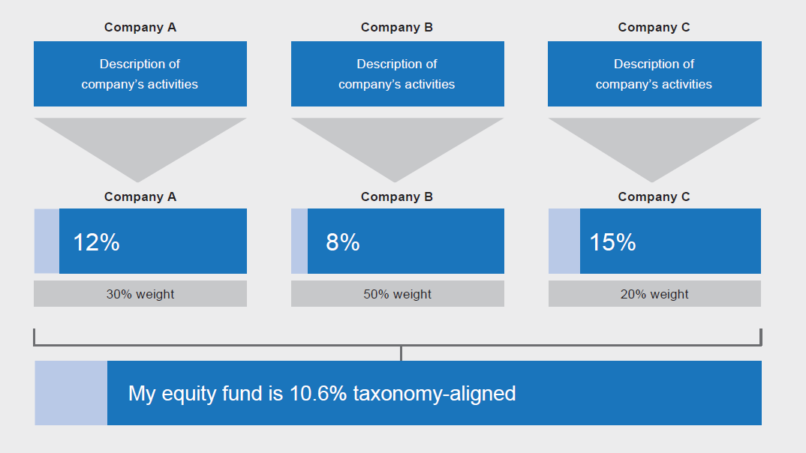
Measuring use of the taxonomy by investors

Slide 27
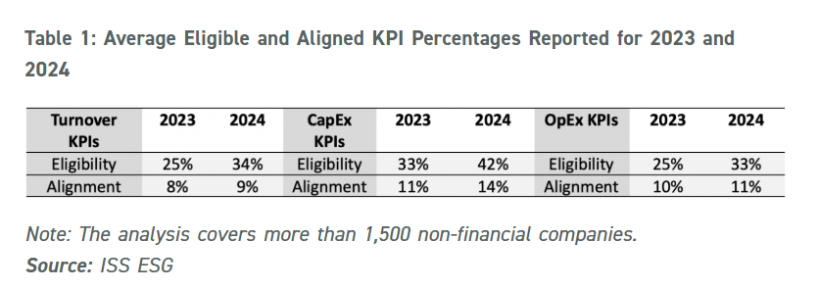
Taxonomy – where are we?
Example: Unilever Annual Report on Form 20-F, p, 76

Slide 28

Sustainable finance

Slide 29
Regulation 2019/2088 on sustainability‐related disclosures in the financial services sector (SFDR)
SFDR has two underlying policy objectives
  preventing greenwashing in the financial sector; and
  directing flows into sustainable economic activities by requiring fund managers to be upfront on the ESG profile of their funds and broader investment activities
These policy objectives are achieved by imposing detailed disclosure (on website and pre-contractual), reporting and product eligibility obligations on EU managers / AIFMs marketing into the EU, both at an entity and product level
Funds must be categorised into one of three categories – the categorisation will impact on their design, sustainability profile and how they can be marketed
Started to apply in 2021
The European Commission has been working on a “SFDR 2,0” (draft leaked on 6 November – see last class)
In practice, e.g.: Deutsche-Bank-ESG-Investments-Framework.pdf

Slide 30
SFDR – Eligibility Criteria
Article 9 Products
Must only invest in sustainable investments, cash and hedging instruments. Note: this is the case even if the fund has a carbon reduction objective
Article 8+ Products
Must make one or more SIs - no minimum percentage presented under the rules.
Issuer can therefore set the min %, which must be disclosed in SFDR pre-contractual disclosure and reported against in SFDR periodic reports.
Note: the min % will be a binding commitment that the product must meet on an ongoing basis.
Must have binding E/S characteristics i.e. take ESG factors into account on a binding basis as investment guidelines / restrictions
Investee companies must follow good governance practices
No minimum threshold of E/S investments
No requirement to make SIs and in fact such products should not present themselves as making any SIs (if they do, they will be re-categorised as Article 8+ products)
Article 8 Products
Article 6 Products
No eligibility criteria (all non-Article 8 / 9 products will fall in this bucket)
Limited disclosure obligations
These products should not be promoted or presented as taking ESG considerations into account in a binding or material manner – can briefly mention non-binding ESG integration / risk management

Slide 31
SFDR – 3 building blocks for sustainable investments
1. Positive Measurable ‘E’ or ‘S’ contribution made by Investment
No definition or minimum proportion prescribed under the rules and a variety of approaches could meet this limb - e.g. investee company is better than peers / benchmark on specific ESG metrics or has a 20% renewable business
2. Investment Does No Significant Harm (DNSH) other E / S objectives
This must be assessed using:
at least the mandatory indicators in the SFDR RIs Annex (e.g. GHG emissions) by setting thresholds for significant harm that all investments must be screened against – these are effectively negative screens but with some potential to build in buffer for temporary blips;
minimum social safeguards i.e. OECD guidelines for multinationals and UN Guiding Principles on Business and Human Rights.
3. Good governance practices at investee company level
Qualitative assessment including consideration of sound management structures, employee relations, staff remuneration and tax compliance at least.

Slide 32
SFDR – Eligibility Criteria
SFDR “Sustainable Investments”
Taxonomy “Environmentally Sustainable”
Test: Under SFDR you must determine whether an investment is a “sustainable investment” (within Art 9 and 8+ funds) by:
getting comfortable the investment positively contributes to an E/S objective.
using PAI based DNSH screens;
determining whether the investments are aligned with the OECD Guidelines for Multinational Enterprises and the UN Guiding Principles on Business and Human Rights (including the principles and rights set out in the eight fundamental conventions identified in the Declaration of the International Labour Organisation on Fundamental Principles and Rights at Work and the International Bill of Human Rights); and
determining that the investee companies issuing those investments have good governance.
Note: this is an investment level test – i.e. you assess the investee company and its business as a whole.
Test: Under the Taxonomy Regulation, you must determine whether an investment consists of “environmentally sustainable economic activities” and the extent to which this is the case by:
getting comfortable that the relevant economic activity makes a significant contribution to climate change mitigation / adaptation (and in due course the other 4 E objectives covered by the Taxonomy) – in accordance with the criteria set out in the Taxonomy Regulation. Note: this is a higher test of significant contribution vs. the SFDR test;
applying the Taxonomy Level 2 DNSH criteria at the economic activity level (and these DNSH criteria only cover the Taxonomy E objectives and not any S objectives unlike the SFDR PASI based DNSH test); and
getting comfortable that the investments are aligned with the OECD Guidelines for Multinational Enterprises and the UN Guiding Principles on Business and Human Rights (this limb is the same as SFDR limb (iii)).
Note: this is an economic activity level test – i.e. you assess each business line separately to derive an overall score for investee company.
How the two regimes interact:
The tests above are not connected – i.e. a Taxonomy aligned investment will not automatically be an SFDR sustainable investment and vice versa.
Article 8+/9 products under SFDR, which commit to make environmental SIs, must disclose the extent to which their activities are Taxonomy aligned (however there is no requirement for such products to in fact be Taxonomy aligned – this is just a disclosure and reporting obligation).

Slide 33
SFDR – Product level obligations
Article 6 (all funds):
Transparency of integration of sustainability risks
Article 8:
Transparency of the promotion of “E” or “S” characteristics in pre-contractual disclosures
Article 9:
Transparency of sustainable investments in pre-contractual disclosures
  Include in pre-contractual disclosures (e.g. PPM):
    the manner in which sustainability risks are integrated into investment decisions/investment; and
    the results of the assessment of the likely impacts of sustainability risks on the returns of the financial products they make available/advise on.
  OR state that sustainability risks are not relevant and explain why not.
  Include in pre-contractual disclosures:
    information on how those E or S characteristics are met;
    if an index has been designated as a reference benchmark, information on whether and how this index is consistent with those characteristics (and information on where the methodology used for calculation of the index can be found).
    In due course Taxonomy disclosures also required.
  FMP must periodically report in fund’s annual reports the extent to which ESG characteristics were met.
  Include in pre-contractual disclosures:
    if and an index has been designated as a reference benchmark:
      information on how the designated index is aligned with that objective;
      an explanation as to why and how the designated index aligned with that objective differs from a broad market index, or
    if no index has been designed at as a reference benchmark, an explanation of how the objective is to be attained.
    Where the financial product has a reduction in carbon emissions as its objective, it must be aim to achieve the long term global warming objectives of the EU Paris Climate Agreement and explain how it ensures this (by reference to an EU Climate Transition or EU Paris-aligned Benchmark, if available).
    In due course, Article 5 Taxonomy Regulation information must be included – along with a disclaimer on whether and to what extent the fund is Taxonomy compliant or not.
    FMP must periodically report in fund’s annual reports the extent to which ESG objective was met.

Slide 34
SFDR – August 2024 ESMA Fund Name Guidelines
“The name of a fund is a means of communicating information about the fund to investors and is also an important marketing tool for the fund. A fund’s name is often the first piece of fund information investors see and, while investors should go beyond the name itself and look closely at a fund’s underlying disclosures, a fund’s name can have a significant impact on their investment decisions”
Terms used | 80% alignment to E/S characteristic or sustainable investment objective? | Minimum sustainable investment requirement | Exclusions
Sustainability related terms | ✔ | ✔ - no minimum proportion specified but the product must "invest meaningfully" in sustainable investments | PAB
Transition related terms | ✔ - and investments must be on a clear and measurable path to social or environmental transition | X | CTB
Impact related terms | ✔- and investments must be made with objective to generate positive, measurable social or environmental impact alongside a financial return | X | PAB
Environmental terms | ✔ | X | PAB
Social terms | ✔ | X | CTB
Governance terms | ✔ | X | CTB
“ESG” or a mix of environmental, social and governance terms | ✔ | X | The conditions of the above rows will apply on a cumulative basis, depending on the terms used

Slide 35


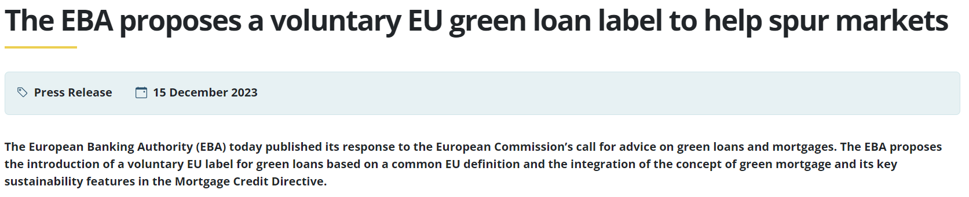
Green and sustainability linked loans
Two different products, but the term “green loan” is sometimes used as an umbrella term to cover both:
Green loan
Proceeds are used for green purposes
Sustainability linked loan
Classification does not depend on use of proceeds
Pricing is tied to the borrower’s performance against certain pre-determined sustainability criteria

Slide 36
Green bonds
Regulation (EU) 2023/2631 of the European Parliament and of the Council of 22 November 2023 on European Green Bonds and optional disclosures for bonds marketed as environmentally sustainable and for sustainability-linked bonds (European Green Bonds Regulation or EuGB Regulation)
Create a designation which can be used on a voluntary basis by bond issuers
Establishes a system to register and supervise external reviewers of European Green Bonds
Is intended to provide issuers and investors with greater confidence when issuing and investing in green bonds
Disclosure requirements, in addition to existing ones under regulation (EU) 2017/1129 (prospectus regulation):
  Pre-issuance: European green bond factsheet and CapEx plan (if applicable)
  Post-issuance: annual allocation report and impact report

Slide 37
ESG ratings regulation (ERR; Regulation (EU) 2019/2088)
ERR adopted in November 2025; apply as from 2 July 2026
The aim is to strengthen the reliability and comparability of ESG ratings “by improving the transparency and integrity of the operations of ESG ratings providers and preventing potential conflicts of interests”
An “ESG rating” is defined as “an opinion, a score or a combination of both, regarding a rated item’s profile or characteristics with regard to environmental, social and human rights, or governance factors or exposure to risks or the impact on environmental, social and human rights, or governance factors, that are based on both an established methodology and a defined ranking system of rating categories, irrespective of whether such ESG rating is explicitly labelled as ‘ESG rating’, ‘ESG opinion’ or ‘ESG score’
ESG ratings providers will need to be authorised and supervised by the European Securities and Markets Authority (ESMA) and comply with certain transparency and organisation requirements “when they operate in the Union” (broadly defined)
Non-EU ESG ratings providers will generally have to establish an authorised EU entity under the ERR to continue undertaking business in the EU (equivalence decisions can be sought but are uncertain)

Slide 38
Regulatory intervention (EBA)
The European Banking Authority (EBA) has released comprehensive guidelines on managing Environmental, Social, and Governance (ESG) risks
  Large institutions must comply by 11 January 2026
  Small and non-complex institutions have until 11 January 2027
Key provisions of the guidelines:
  Risk Integration: Institutions must incorporate ESG risks into credit, market, operational, and liquidity frameworks
  Materiality Assessments: Annual (or biannual for smaller entities) reviews to gauge ESG risks’ impacts.
  Transition Planning: Mandatory plans aligning with EU’s climate-neutrality targets
ESG dashboard | European Banking Authority:
  Key indicators enabling benchmarking and monitoring of climate-related risks
  Exposure by banks to corporates from sectors highly contributing to climate change is 61% overall as of June 2024

Slide 39

CSRD

Slide 40





Corporate Sustainability Reporting Direcive (CSRD) in a nutshell (replaces NFRD)
EU regime on sustainability-related disclosures.
Phased-in from 2025, but “stop the clock” legislation adopted – see class 6).
Detailed disclosure requirements set out in European Sustainability Reporting Standards (“ESRS”).
Comprises general disclosures, and specific topical disclosures in relation to matters that are “material”, based on a double materiality assessment (“DMA”).
Process for determining what is material is subject to limited assurance by company auditors.
Must consider own operations and value chain (but expectations in relation to value chain are more limited).

Slide 41

Double materiality: Impact materiality vs financial materiality
Financial materiality
Impact materiality
Risks/opportunities for the business
Focus is on the reporting undertaking
Materiality is based on the likelihood and potential magnitude of financial effects triggered by the relevant sustainability matter
Impacts of the business or its value chain on people and the environment
Focus is on others, not on the reporting undertaking
Materiality of an impact is based on its severity (which is based on scale, scope and irremediability, and for potential impacts, likelihood)
Think of it as…: “Outside → In”
Think of it as…: “Inside → Out”

Slide 42
CSRD – scope of application
All large EU companies, that is, EU companies (including EU subsidiaries of non-EU parent companies) exceeding at least two of the following criteria:
  more than 250 employees
  a turnover of more than €40 million
  total assets of €20 million
Companies with securities listed on an EU-regulated market, irrespective of whether the issuer is established in the EU or a non-EU country
Non-EU undertakings with annual EU-generated revenues in excess of €150 million and which also have either a large or listed EU subsidiary or a significant EU branch (generating €40 million in revenues). The respective subsidiary or branch will be responsible for publishing CSRD-style sustainability reports for these non-EU undertakings at a consolidated level

Slide 43
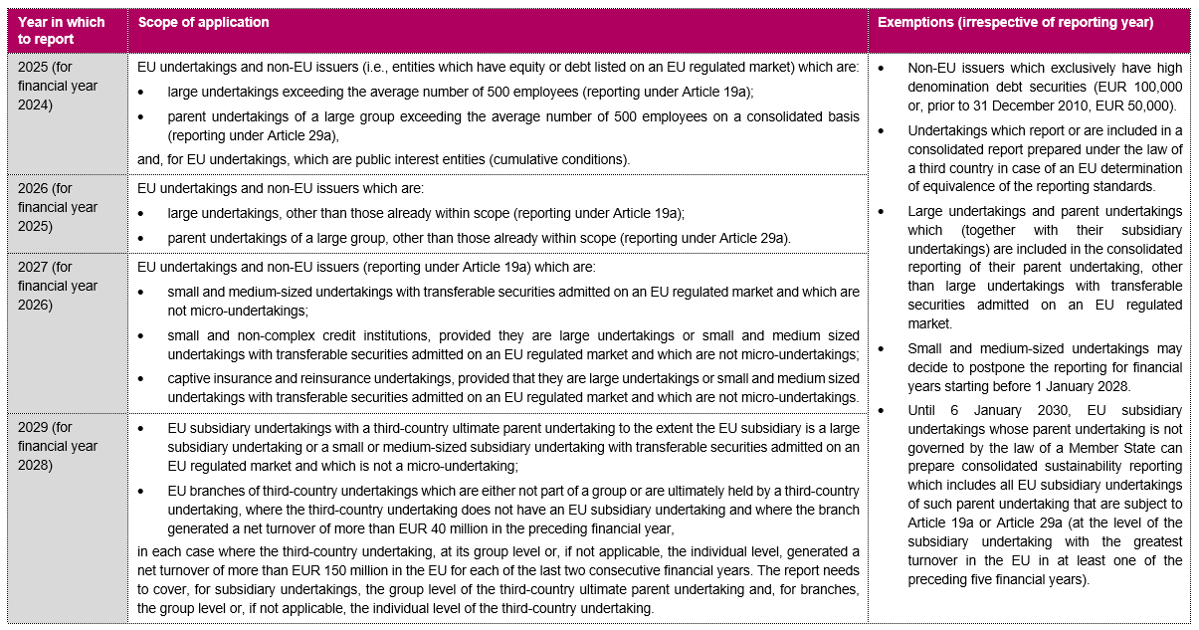
CSRD – temporal scope of application
Changed by “stop the clock” proposal for post-wave 1 companies

Slide 44
Sustainability matters in scope of CSRD
Climate change
e.g. mitigation, adaptation, energy consumption
Own workforce
e.g. working conditions, collective bargaining, equal treatment/DEI
Pollution
e.g. pollution of air/water/soil, use of substances of concern
Workers in the value chain
e.g. working conditions, forced/child labour
Sustainability matters
Water and marine resources
e.g. withdrawal, consumption, discharge
Affected communities
e.g. land-related impacts, security-related impacts, indigenous peoples
Biodiversity and ecosystems
e.g. drivers of biodiversity loss, impacts on species and ecosystems
Consumers and end users
e.g. health and safety, responsible marketing
Circular economy
e.g. resource inflows and outflows, waste
Business conduct
e.g. political engagement, corruption and bribery
These topics must be considered as part of the DMA. Must add other topics if relevant to the business/sector (e.g. cyber security)

Slide 45
ESRS
The European Financial Reporting Advisory Group (EFRAG) developed detailed European Sustainability Reporting Standards which organisations in scope of the CSRD will be required to comply with.
Final standards adopted by the European Commission.
Cross-Cutting Standards
ESRS 1 – General requirements
ESRS 2 – General disclosures
Topical Standards (sector agnostic)
Environment
Social
Governance
ESRS E1 – Climate Change
ESRS E2 – Pollution
ESRS E3 – Water and marine resources
ESRS E4 – Biodiversity and ecosystems
ESRS E5 – Resource use and circular economy
ESRS S1 – Own workforce
ESRS S2 – Workers in the value chain
ESRS S3 – Affected communities
ESRS S4 – Consumers and end-users
ESRS G1 – Business conduct
Sector-Specific Standards
Sector-specific standards are to be developed.

Slide 46
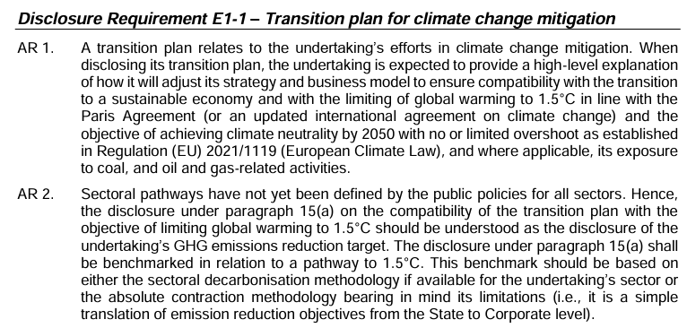
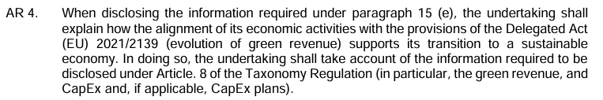
ESRS E1 (Climate Change)
Science based target initiative (SBTI): organisation developing standards, tools and guidance (both cross-sector and sector-specific) which allow companies to set greenhouse gas (GHG) emissions reductions targets in line with the Paris Agreement

Slide 47
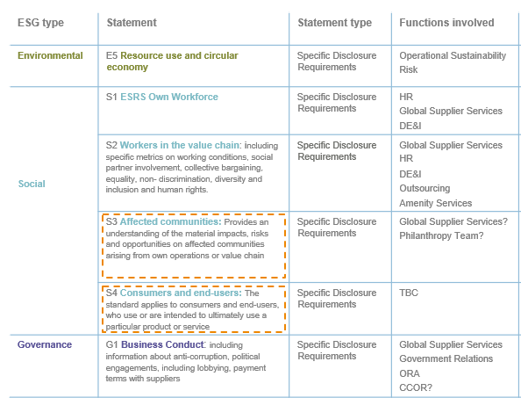
ESRS Social Standards

Slide 48
ESRS S1 (Own Workforce)
1. Objective and definitions |  | Own workforce includes; (1) workers with an employment relationship with the undertaking (i.e. employees); (2) non-employee workers : individuals with contracts with undertaking to supply labour (i.e. self-employed workers) or workers provided by undertakings primarily engaged in “employment activities”
2. ESRS 2 General Disclosures |  | Describe general strategy and business model & how sustainability matters are reflected + Stakeholder interests (ESRS 2 SBM-2) Material impacts, risks and opportunities and how they interact with strategy and business model + their financial effects (ESRS 2 SBM-3) Report activities resulting in negative and positive material impacts on its own workforce. Including impacts from transition plans for reducing negative impacts on environment. Outline material risks and opportunities for the undertaking that arise from negative and positive material impacts on own workers. Specify the type of workers subject to material impacts by the undertaking’s operations (i.e. employees, contractors, self-employed workers). Explain how workers with attributes that may be at greater risk of harm are identified. Examples include; (1) young workers more susceptible to impacts on physical and mental health development; (2) women workers in an environment where discrimination is routine; (3) workers handling chemicals or low paid workers on “zero hours contracts”. Where there are material impacts on workforce from the undertaking’s operations, explain how views and expectations of own workforce inform the undertaking’s strategy and business model.
3. Policies related to own workforce |  | Description of workforce policies should include: Summary of implemented policies to manage material impacts, risk and opportunities on own workers; Human rights policy commitments relevant to own workforce and alignment with internationally recognized standards* Processes and mechanisms to engage with affected stakeholders and remediate issues arising from human rights impacts; Explicit acknowledgment that policies have measures in place for human trafficking, forced labour and child labour. Description of discrimination policies should include: Summary of discrimination policies and coverage of discrimination forms (e.g. racial and ethnic origin, colour, gender identity, sexual orientation, disability, age, religion, political opinion, national extraction or social origin) outlined in EU regulation and national law; Inclusion and/or Affirmative Action policy commitments; Procedures to prevent and mitigate discrimination, and initiatives to advance diversity and inclusion.
4. Processes for engaging with own workforce and workers representatives about impacts |  | If applicable, describe how employees’ views are considered when making decisions that impact them, including: Type and frequency of engagement; How worker feedback is captured and integrated into decision-making, and subsequently shared with workers about the way in which their feedback has influenced decision-making; Resources allocated to engagement; Separately, how workers and workers representatives are engaged on climate change transition plans and its impact on own workforce.

Slide 49
What must be disclosed?
Policies in place to address the sustainability matter
Some general disclosures about sustainability matters are always mandatory.
When a sustainability matter is assessed to be material, this will also trigger additional topical disclosure requirements. These require disclosure of policies, actions and targets used to address that sustainability matter, as well as specific metrics.
Policies
Actions
Actions that have been taken to address impacts, mitigate risks and pursue opportunities
Material topic
Metrics
Targets
Topic-specific data points against which data must be disclosed
If policies, actions and/or targets are not in place, then there is no requirement to implement them.
Targets set to assess performance over time in relation to the sustainability matter

Slide 50
Key stages and milestones
Double materiality assessment (DMA)
Determine Disclosure Requirements
Gather information and prepare report
Assurance of DMA and report
Publication of report
Determines what sustainability matters are material and therefore need to be reported on
Map material sustainability matters to Disclosure Requirements in the ESRS (and consider entity-specific disclosures)
Information about relevant policies, actions and targets; quantitative data for metrics disclosures
Auditor limited assurance on double materiality assessment process and reported information
Final report to be published and subsidiary requirements to be satisfied

Slide 51
What is a “material” sustainability matter?
What are the key stages of the double materiality assessment (DMA)?
  Objective of the DMA is to identify material impacts, risks and opportunities (“IROs”) in relation to sustainability matters which support a conclusion that a particular sustainability matter is material.
  “Sustainability Matters” are broadly, but not exclusively, those environmental, social and governance-related topics covered by the topic-specific ESRS.
  The DMA process itself will be subject to limited assurance and a description of the process must be disclosed.
  Draft guidance suggests the following staged approach:
Step 2: Identify actual and potential IROs relating to Sustainability Matters in own operations and value chain.
Step 4: Determine material information to be disclosed.
Step 1: Understanding the context.
Step 3: Identify which IROs are material.
Output: Internal document setting out relevant contextual information applicable to the business within the reporting perimeter.
Can start with list of IROs or list of Sustainability Matters. Can be top down or bottom up from a group structure perspective.
Output: A “long” list of IROs mapped to sustainability matters.
Apply criteria for assessing impact and financial materiality. Can use existing processes. Can be qualitative or quantitative. Can rely on established scientific consensus/existing objective evidence.
Output: A shortlist of material IROs.
Policies/actions/targets – is the information relevant from the perspective of significance or capacity to meet the user’s decision-making needs?
Metrics – is all or part of the disclosure requirement material?
Output: Disclosure against topical ESRSs relating to each material sustainability matter.

Slide 52



What are sustainability impacts, risks and opportunities (IROs)?
Negative impact
Risk
The actual or potential negative effect the undertaking has or could have on the environment and people.
Relevant negative impacts are those that are connected with the undertaking’s own operations and upstream and downstream value chain, including through its products and services, as well as through its business relationships.
Negative impacts can be intended or unintended, and reversible or irreversible. They can arise over the short-, medium-, or long-term.
Sustainability-related risks with negative financial effects
Sustainability-related risks are uncertain ESG events or conditions that, if they occur, could cause a potential material negative effect on the undertaking’s business model or strategy and on its capability to achieve its goals and targets and to create value. They therefore may influence its decisions and those of its business relationships with regard to sustainability matters.
Financial effects are those that affect the undertaking’s financial position, financial performance, cash flows, access to finance or cost of capital in the short, medium or long term.
Positive impact
Opportunity
The actual or potential positive effect the undertaking has or could have on the environment and people.
Relevant positive impacts are those that are connected with the undertaking’s own operations and upstream and downstream value chain, including through its products and services, as well as through its business relationships.
Positive impacts can be intended or unintended, and reversible or irreversible. They can arise over the short-, medium-, or long-term.
Sustainability-related opportunities with positive financial effects.
Sustainability-related opportunities are uncertain ESG events or conditions that, if they occur, could cause a potential material positive effect on the undertaking’s business model or strategy and on its capability to achieve its goals and targets and to create value. They therefore may influence its decisions and those of its business relationship partners with regard to sustainability matters.
Financial effects are those that affect the undertaking’s financial position, financial performance and cash flows in the short, medium or long term.

Slide 53
Own operations vs value chain
  CSRD requires businesses to consider not just their own operations, but also how they might be connected to impacts and/or exposed to risks through their upstream and downstream value chains
  The definition of “value chain” is broad – must map the value chain and define a defensible risk-based approach to identifying IROs
  Data gathering expectations are limited for the first three years – can limit to inhouse and, for value chain, publicly available information
  Connection
  undertaking/group
  Connection
  Connection
Upstream
value chain
Own
operations
Downstream
value chain
  Impacts that suppliers of raw materials, component parts, equipment and services (etc.) have on people and/or the environment
  Impacts that own operations have on people and/or the environment
  Impacts that customers, transportation and distribution providers (etc.) have on people and/or the environment

Slide 54
How can a company be “connected to” an impact?
1
Company’s impacts
2
Value chain impacts
3
What must the company report on its value chain impacts?
The company needs to consider what material impacts on people and/or the environment it has or could have.
It doesn’t matter where these impacts occur – they might be on its own people, its sites, on neighbouring communities or on workers or sites in its value chain, for example.
The company also needs to consider what material impacts might arise in its value chain due to the actions of others.
These might be impacts resulting from the actions of a business partner, a supplier’s operations, or a customer’s use of the company’s products, for example.
Provide a high-level description of value chain impacts.
Explain how the DMA considered value chain impacts.
Explain whether the policies/actions/targets extend to the value chain (it’s fine if they don’t – the company just need to explain with reasons).
There are essentially no metrics which require value chain information except for Scope 3 (for which the company can use estimates and proxies).
NB the UNGPs/OECD Guidelines have their own way of describing the ways in which a company can be connected to impacts, which is also referred to in the ESRS.
Impacts that the company cause or contribute to (i.e. cause itself or jointly with others)
Impacts that the company is linked to through its business relationships

Slide 55
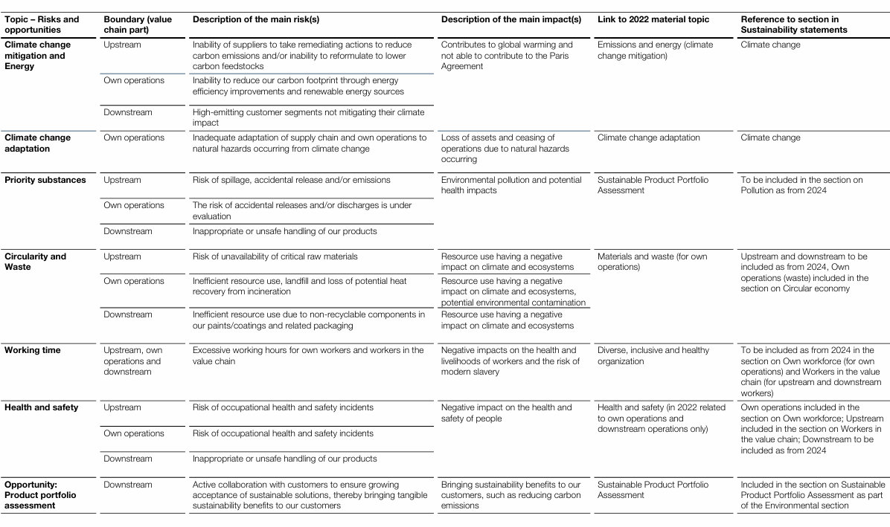
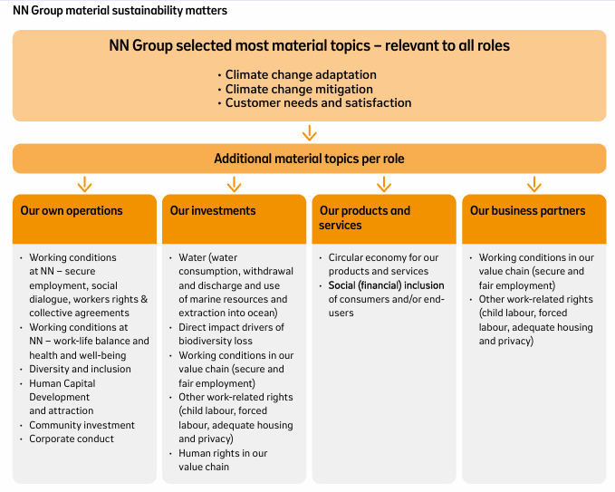
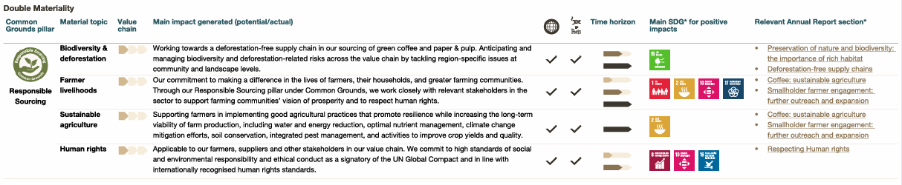
What can we learn from early adopters and wave-1 companies
key takeaways
Although expectations are likely to increase as approaches to CSRD reporting mature, key takeaways at this stage include:
There is no “one way” or standardised approach to CSRD reporting
Generally, disclosures are similar in style to current (voluntary) sustainability reporting
Descriptions of DMA process and outcomes are brief and grouped so disclosures have limited granularity
Limited focus on value chain
Sector peer reports offer insights into potentially material sustainability matters
AkzoNobel
JDE Peets

Slide 56
Out of CSRD corporate reporting in practice:
Belgium as an example
For annual reports published before 1 June 2024 (before the start of CSRD for wave 1 companies):
  68% of Belgium’s 50 largest companies have set quantified decarbonisation targets for 2030 (or earlier) and share concrete plans for achieving them
  41 out of 50 companies (up 20% vis-à-vis 2023) report their scope 3 emissions
  Usually carbon emissions reported under SBTI (but one big bank decided to stop applying this method on the basis that if it were to apply this calculation system strictly, it would no longer be able to grant loans to certain customers on the grounds that their homes were not sufficiently insulated)
  Couple of examples of “sustainability warnings” (// profit warnings)
One example of anticipated adoption of CSRD regime (DMA on p. 58): EN_2024_AnnualIntegratedReport_Vandemoortele_1.pdf

Slide 57
Carbon markets

Slide 58
Emission trading systems (ETS and ETS2)
Directive 2003/87/EC (“ETS Directive”)
Aim of reducing greenhouse gas emissions from most emitting sectors by transforming the possibility to emit greenhouse gases into a scarce commodity that must be purchased in the form of so-called “EU allowances”
Revised ETS entered into force on 5 June 2023; target is to achieve a 62% reduction in carbon emissions from the sectors covered by it by 2030 (up from the 41% reduction that has been achieved since introduction in 2005)
  In phase 3 (2013-2020), yearly reduction of allowances of 1.74%. In phase 4 (2021-2030), 2.2%
Currently: around 10,000 in-scope installations (exceptions for small operators):
  Electricity and heat generation
  Energy-intensive industry sectors, including oil refineries, steel works, and production of iron, aluminium, metals, cement, lime, glass, ceramics, pulp, paper, cardboard, acids and bulk organic chemicals
  Aviation within the European Economic Area and departing flights to Switzerland and the United Kingdom
  Maritime transport (50% of emissions from voyages starting or ending outside of the EU and 100% of emissions from voyages between two EU ports and when ships are within EU ports)
ETS2 (operational in 2027): to cover emissions from buildings, road transport and additional sectors (small industry not yet covered). Social Climate Fund created to address the social impact. Aim is to mobilise EUR 86.7 billion from the ETS2 revenue for 2026-2032

Slide 59
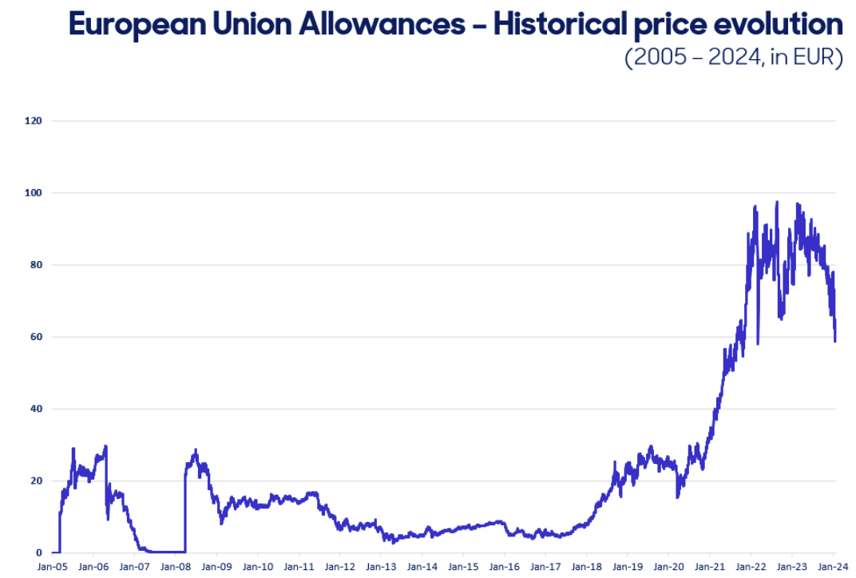
ETS – in figures
57% of the total amount of allowances were auctioned (rest granted free of charge)
The total revenues generated by Member States, the UK and EEA countries from the auctions since 2013 exceeds EUR 175 billion
The ETS Directive provides that Member States should use at least 50% of auctioning revenues or the equivalent in financial value for climate and energy-related purposes (in practice 78% of revenues in 2013-2019)

Slide 60
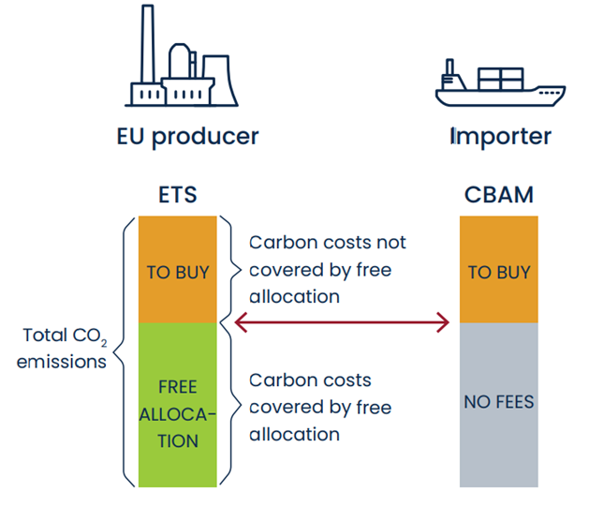
Carbon border adjustment mechanism (CBAM)
Entered into force on 17 May 2023
CBAM applies to goods imported into the EU to prevent “carbon-leakage”, i.e. relocation of energy intensive production from the EU to countries with lower levels of regulation of GHG emission
Covers iron and steel, cement, aluminium, fertilisers and electricity, as well as hydrogen, indirect emissions under certain conditions, certain precursors and certain downstream products (such as screws and bolts and similar articles of iron or steel)
The European Commission will assess whether it should be extended to organic chemicals and polymers (plastics) by 2026
By 2030, CBAM will cover all goods covered by the ETS

Slide 61

Greenwashing

Slide 62
What legal risks does greenwashing entail?
    Private litigation, initiated by:
    - competitors (unfair commercial practices, competition law, etc.),
    - business partners (contractual terms),
    - Investors (securities / disclosure litigation),
    - consumer organisations (including class actions)
.
  Allegations of greenwashing are on the rise globally, and have attracted increased scrutiny from all stakeholders (legislators, regulators, investors, business partners consumers, competitors), entailing material legal (and reputational) risks
Legal risks
Regulatory enforcement: fines and orders by regulators (fair trade practice, consumer protection, advertisement, securities regulators), on their own motion or following a complaint from a third party (competitor or consumer organisations)
    Criminal law risks (in countries where the breach of certain market practice or disclosure obligations are subject to criminal sanctions)

Slide 63
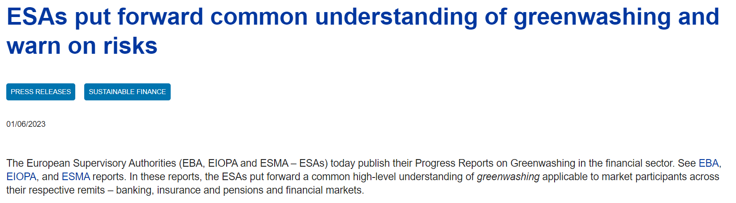
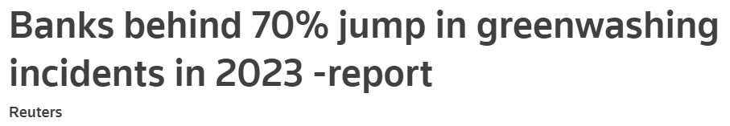
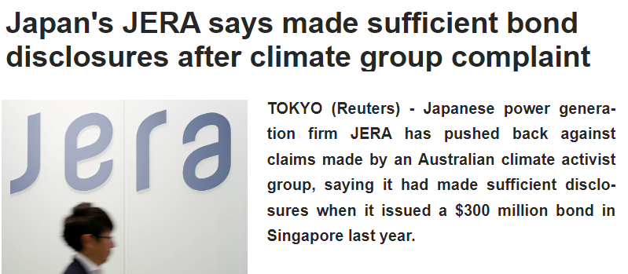
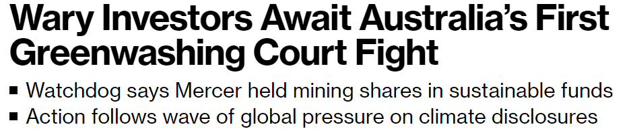
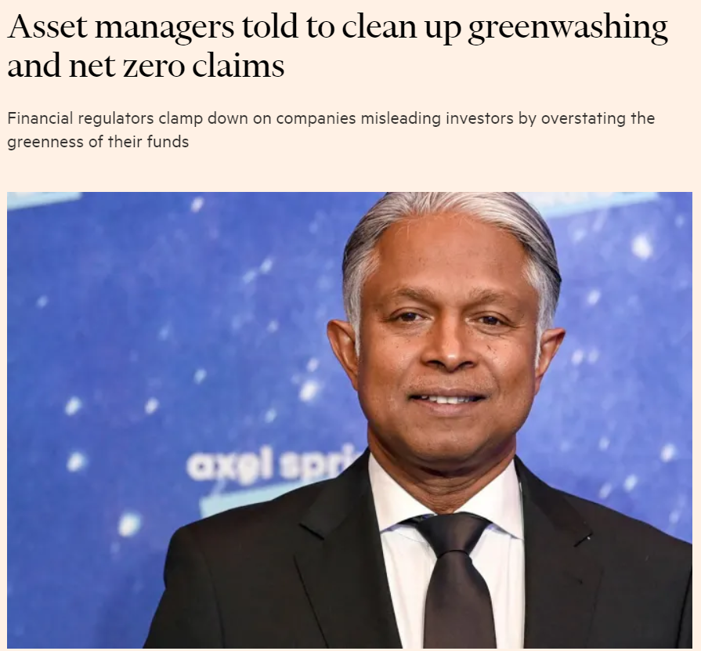
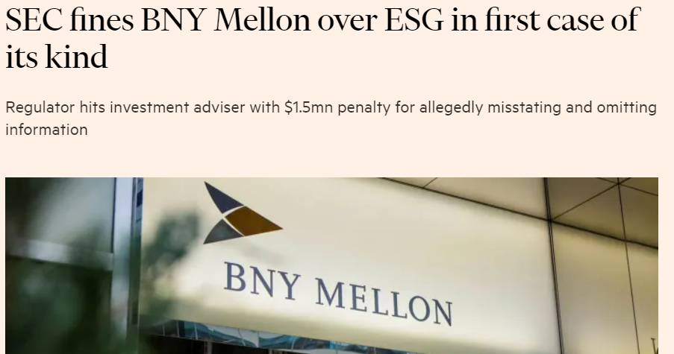
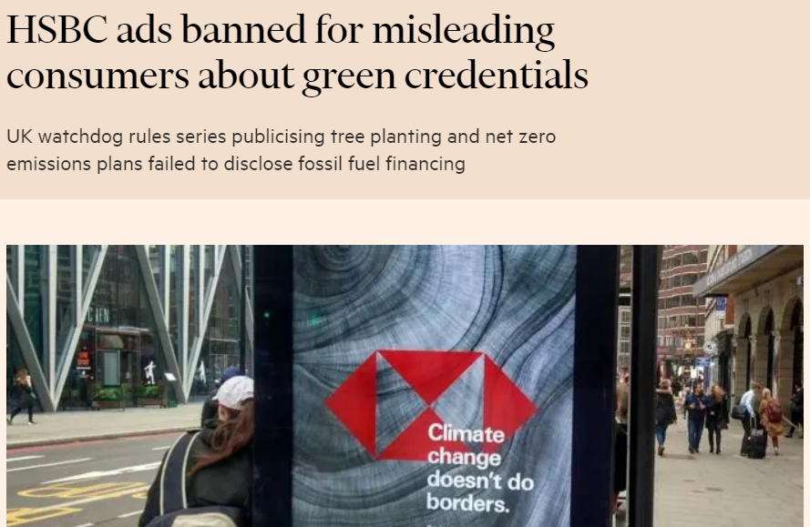
Disclosure and greenwashing claims are skyrocketing in the financial sector

Slide 64

Questions?

