Slide 1

ESG liability and litigation risks
ULB, 23 November 2025

Slide 2
Agenda for today
1
Introduction – main trends
2
Climate litigation
3
Directors’ and officers’ duties and liability
4
Disclosure and greenwashing
5
Parent company liability for ESG harm in the supply chain
6
Contractual disputes

Slide 3

Introduction
A45554948
Notes:
GILLY

Slide 4
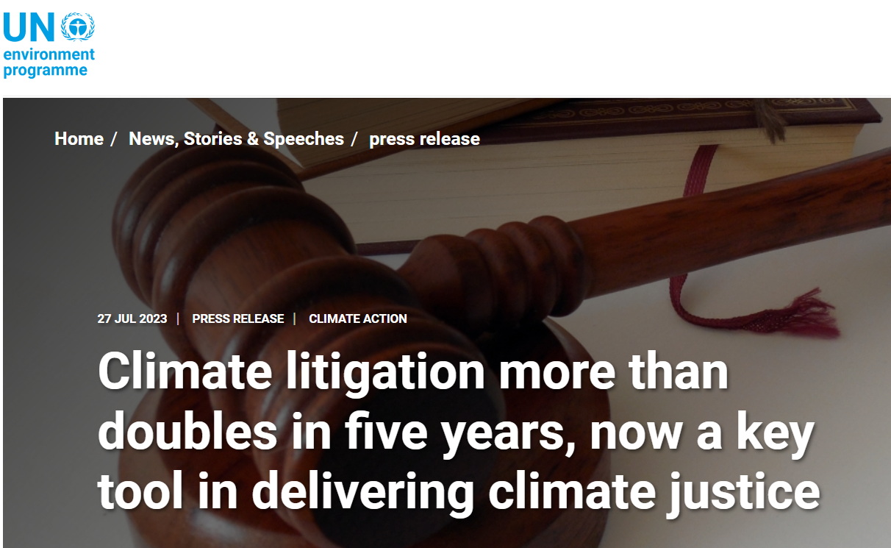
The rise of ESG litigation
“[I]t is difficult to overstate the impact of increased scrutiny of ESG issues. In particular, it is evident that the shift towards greater accountability and transparency in the ESG space—propelled by stakeholder and consumer demand—is resulting in corresponding legal and regulatory developments
Over time, this will likely result in the expansion of the range of theories under which relevant actors may be held liable for non-compliance with ESG standards and, relatedly, greater scope for ESG disputes.”
United Nations Environment Programme (2023). Global Climate Litigation Report: 2023 Status Review, p. 19

Slide 5
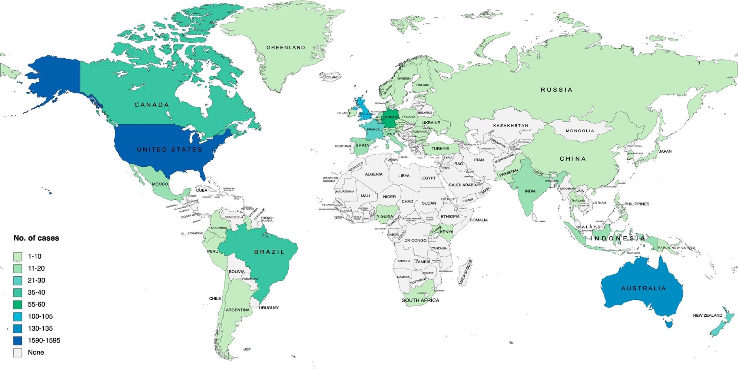
The rise of ESG litigation
Parent company liability
Disclosure litigation
Mis-selling and greenwashing
Challenges to Government decisions
Breach of directors’ duties
Accountability for ESG harms
Judicial intervention in climate transition planning
Source: Global trends in climate change litigation: 2023 snapshot,
based on Sabin Center data.
Contractual breach

Slide 6





Global trends in ESG litigation
Risk of ‘green/fair/social-washing’ claims brought by investors / other interested parties where disclosures are false, misleading, vague, or insufficient (e.g. misrepresentation, negligent misstatement, statutory liability, etc.)
Aside from civil claims, inaccurate or misleading disclosures also attract the attention of the relevant regulator(s), who may be empowered to impose penalties even where inaccurate statements were inadvertent
International trend of activists challenging government or central bank policies (e.g. ClientEarth / NBB) and permitting decisions for inconsistency with climate targets
Growing trend of activists challenging project specific approvals, seeking to de-rail planned infrastructure investments
Key trends in ESG Litigation
Emerging trend of claims against parent companies of multinational groups alleging breach of a duty of care owed to those impacted by an alleged failure to adhere to ESG standards
Increasingly based on statutory due diligence regimes
Some soft law standards (e.g. OECD Guidelines for Multinational Enterprises) include their own non-judicial “enforcement” mechanism which creates its own “case law”
Debates on extent of general duty of care / fiduciary duties
Civil claims focused on future emissions and emissions reductions targets are becoming more prevalent
Claims have also been brought against directors for breach of directors’ duties in the context of climate strategy
Corporate accountability for
ESG harms

Slide 7

Climate change disputes – increasingly relevant for companies

Slide 8

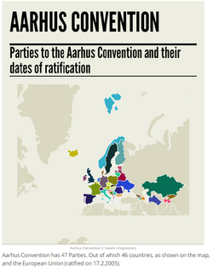
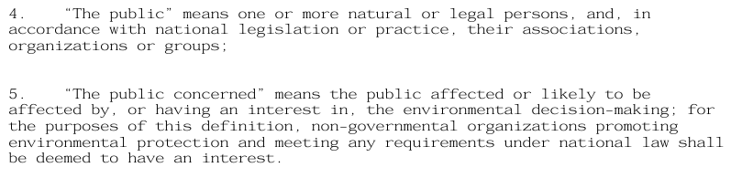
Key tool for NGO activism in public cases:
1998 Aarhus Convention
Convention on Access to Information, Public Participation in Decision-making and Access to Justice in Environmental Matters
48 State parties (Europe and Central Asia, with the exception of Guinea-Bissau) + the EU
Grants the public rights regarding (i) access to information, (ii) public participation (iii) and access to justice, in governmental decision-making processes on matters concerning the local, national and transboundary environment

Slide 9
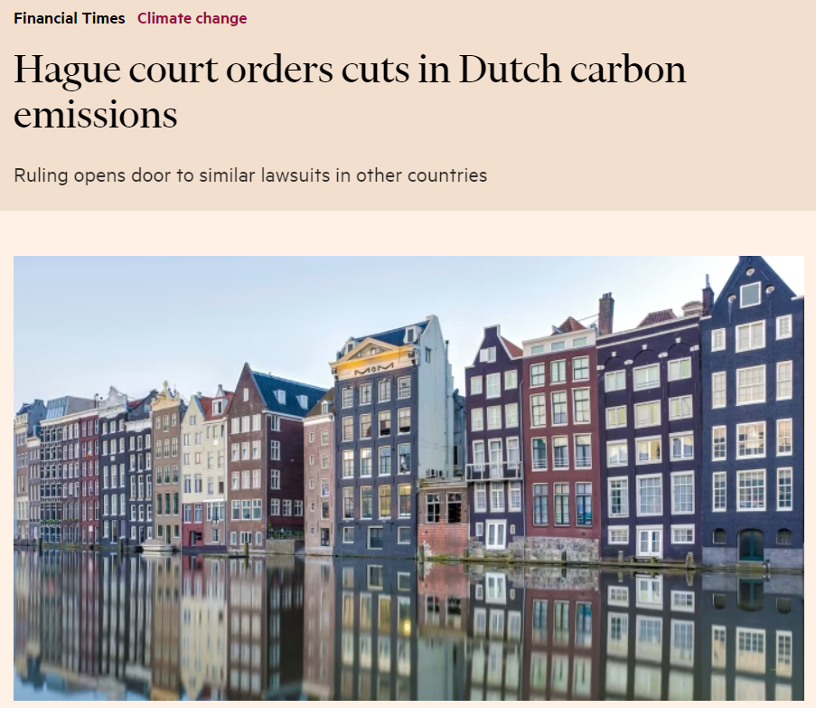
Dutch Urgenda case (2015 – 2018 - 2019)
The Urgenda Foundation (environmental NGO) and 900 Dutch citizens sued the Dutch government to require it to do more to prevent global climate change
Dutch courts (2015 district court decision confirmed in 2018 and 2019) ordered the Dutch state to reduce greenhouse gas emissions by at least 25% by end-2020 (finding the government’s existing pledge to reduce emissions by 17% insufficient)
Based on a breach of the duty of care under Articles 2 (right to life) and 8 (right to private life, including environment) of the ECHR
Followed by a wave of cases challenging Government climate policies

Slide 10
Court cases challenging Government policy and decisions
Government policy on climate change provides an increasingly fertile ground for legal challenge since the Urgenda decision.
...
Jun 2021
Belgian Court of First Instance held that, in pursuing their climate policy, the Belgian State infringes human rights by
failing to take all necessary measures to prevent the effects of climate change on the plaintiffs’ life and privacy
Jun 2021
Five Polish citizens took the Polish Government to court over its alleged failure to address climate change by delaying action to cut national carbon emissions and propping up the coal industry.
Jun 2021
More than 200 plaintiffs initiated a lawsuit against the State of Italy before the Civil Court of Rome seeking for an order to force Italian government to slash greenhouse emissions by 92 percent by 2030 compared to 1990 levels.
May 2021
The Federal Court of Australia found the environment minister, Sussan Ley, has a duty of care to protect young people from the climate crisis.
Mar 2021
Germany’s Federal Constitutional Court held that the German Climate Change Act was unconstitutional, as it failed to make sufficient emissions cuts beyond 2030 and so breached fundamental human rights.
Feb 2021
A French administrative court held that the French Government failed to do enough to curb greenhouse gas emissions and fight climate change as it had pledged to do under the Paris climate agreement.
Feb 2021
A group of NGOs commenced an action against the Belgian Central Bank challenging its policy of quantitative easing, on the basis that it applied to fossil fuel dependent companies without differentiation.
Oct 2020
Friends of the Earth applied for leave to bring judicial review proceedings in respect of a decision by UKEF to support a gas project in Mozambique, on the basis it was contrary to UK climate change policy.
Apr 2020
The Irish High Court dismissed a challenge to Ireland's National Planning Framework. Friends of the Irish Environment, had argued that the Government failed to properly analyse the Framework's impact on climate change.
Dec 2019
Dutch Supreme Court confirms Dutch State must reduce greenhouse gas emissions by at least 25% by the end of 2020 (compared to 1990 levels) in line with its human rights obligations.

Slide 11
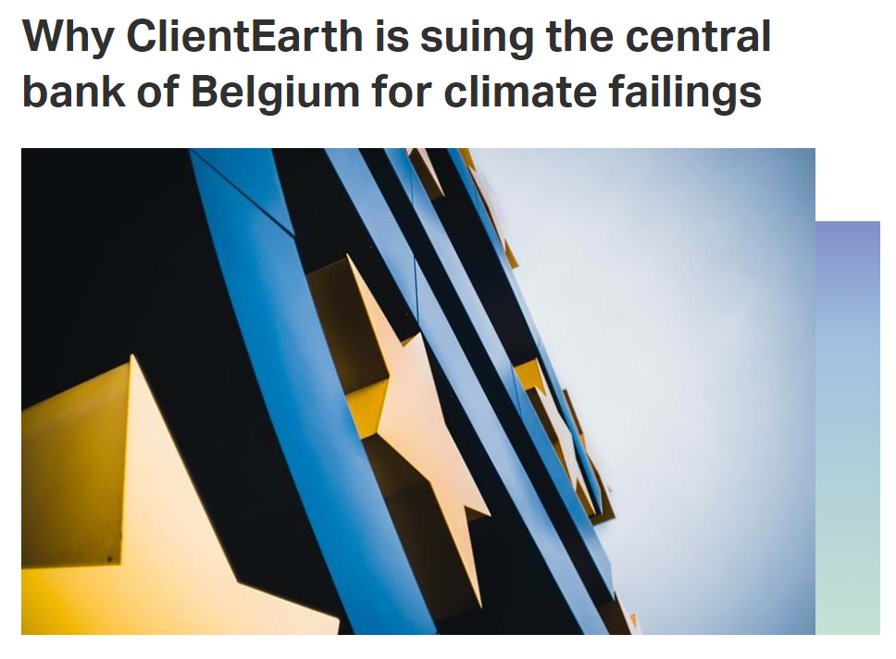
ClientEarth v. National Bank of Belgium
April 2021: NGO ClientEarth announced the filing of a legal action in Belgium against the implementation by the National Bank of Belgium of the Corporate Sector Purchase Programme (CSPP) of the European Central Bank (ECB), claiming that this programme would be invalid due to its environmental and human rights costs
December 2021: Brussels French-Speaking Court of First Instance dismissed ClientEarth’s claims on (mostly) procedural grounds
January 2022: ClientEarth announced that it appealed the decision with the Brussels Court of Appeal and maintained its request to refer the question of the validity of the CSPP to the CJEU
November 2022, ClientEarth eventually announced the withdrawing of its claim, considering that the ECB’s reforms announced in September 2022 have remedied the alleged violations
Similar case started by another NGO against Brazil's Development Bank in 2022
Through the CSPP, the Belgian National Bank and five other central banks in Europe are buying up huge volumes of bonds issued by companies that are exacerbating the climate crisis, including fossil fuel firms Shell, Eni, EDP and Schlumberger.
This effectively subsidises heavily polluting industries and allows companies to continue their climate damaging businesses with no strings attached.
To stop these purchases from impeding further on the economic transition, we will again ask for a question on the validity of the corporate bond purchase policy to be referred to the EU’s top court.
– ClientEarth

Slide 12
ECtHR (GC) – Verein Klimaseniorinnen Schweiz and Others v. Switzerland – 9 April 2024
Three climate cases ruled together by the ECtHR’s grand chamber (Verein Klimaseniorinnen Schweiz and Others v. Switzerland (accepted); Carême v. France; Duarte Agostinho and Others v. Portugal and 32 Others (both dismissed))
Admissibility:
  For their claims to be admissible, associations have to:
    be lawfully established in the jurisdiction concerned or have standing to act their
    demonstrate that it pursues a dedicated purpose, whether limited to or including collective action for the protection of those rights against the threats arising from climate change
    demonstrate that it could be regarded as genuinely qualified and representative to act on behalf of members or other affected individuals within the jurisdiction
  By contrast, high threshold of admissibility requirements for individuals: “everyone is concerned by the actual and future risks, in varying ways and to varying degrees, and may claim to have a legitimate personal interest in seeing those risks disappear”. However, the ECtHR held that general public-interest complaints (“actio popularis”) lie outside the scope of the Convention and could therefore not be admitted, since the Court has no jurisdiction to review relevant legislation and/or a practice “in abstracto”

Slide 13
ECtHR (GC) – Verein Klimaseniorinnen Schweiz and Others v. Switzerland – 9 April 2024 (cont’d)
Swiss climate association considered as victim able to argue its case (>< laims filed by the four individuals were declared inadmissible)
States have a positive obligation to ensure protection under Article 8 of the Convention (right to respect for private and family life), which includes protection against harmful effects and risks caused by climate change and requires the adoption of effective and concrete implementing measures to mitigate the current and future effects of climate change
Although generally being granted a wide “margin of appreciation” regarding their choice of means to mitigate climate change, States are required to establish clear timelines and carbon budgets to achieve carbon neutrality and to define sector-specific or equivalent interim goals and pathways to meet national greenhouse gas reduction targets within set timeframes. States also need to provide evidence of compliance or progress towards meeting these targets, regularly update the targets, and ensure timely and consistent action
“Article 8 of the Convention requires that each Contracting State undertake measures for the substantial and progressive reduction of their respective GHG emission levels, with a view to reaching net neutrality within, in principle, the next three decades”.

Slide 14
International courts’ advisory opinions
In May 2024, the International Tribunal for the Law of the Sea issued an advisory opinion confirming that all anthropogenic GHG constitute marine pollution and clarifying that States must take all measures to prevent, reduce and control emissions and to protect and preserve the marine environment against the impact of climate change
In May 2025, a petition was filed with the African Court on Human and Peoples’ Rights for an advisory opinion on the obligations of African Union member states in the context of climate change. The timing for when this final opinion will be issued remains unclear
On 3 July 2025, the Inter-American Court of Human Rights opined that States have a duty to mitigate and address environmental harms threatening human rights (such as climate change), including by adopting national laws, policies and actions
On 23 July 2025, the International Court of Justice rendered its advisory opinion on obligations of States in respect of Climate Change (see next slide)

Slide 15
ICJ advisory opinion - Obligations of States in respect of Climate Change (23 July 2025)
On 29 March 2023, the UN General Assembly adopted a resolution asking the ICJ to opine on the obligations of State in respect of climate change under international law (resolution 77/276)
ICJ concluded in non-binding opinion that States have an obligation to protect the climate system and other parts of the environment from the harmful effect of GHG emissions, including by regulating the activities of private actors such as businesses. These duties arise not just from climate change treaties, but from a wide range of international law (including customary international law, human rights frameworks and other environmental treaties)
The ICJ considered in detail States’ obligations under the Paris Agreement and how they are reflected in the obligation to prepare, communicate and maintain Nationally Determined Contributions ("NDCs") – cf. COP 30
Breach of their obligations constitutes an internationally wrongful act for which States may be liable for full reparation to injured States, including through restitution, compensation, and satisfaction
The ICJ also established that the primary temperature goal under the Paris Agreement is to maintain global warming below 1.5 degrees Celsius, and that developed countries must take the lead in combating climate change and provide financial assistance to developing countries for both climate mitigation and adaptation activities

Slide 16
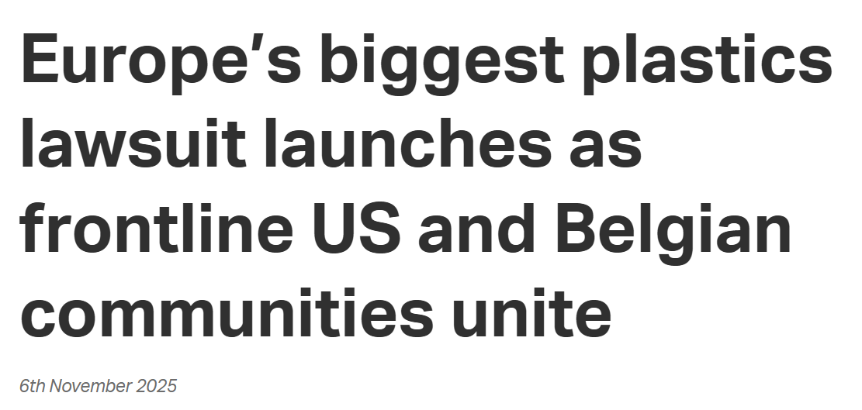
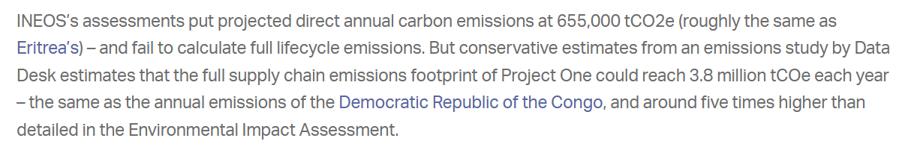

Challenge of project specific approvals
UK Supreme Court (UKSC/2022/0064): under UK “incorporation” of EU Directive 2011/92 (Environmental Impact Assessment), it was unlawful for the permit authority not to require the environmental impact assessment for a project of crude oil extraction for commercial purposes to include an assessment of the impacts of downstream greenhouse gas emissions resulting from the eventual use of the refined products of the extracted oil
ECtHR (Greenpeace Nordic and Others v. Norway, 28 October 2025): regarding a petroleum gas production project: “the environmental impact assessment must include, at a minimum, a quantification of the GHG emissions anticipated to be produced (including the combustion emissions both within the country and abroad)”
“Ineos” case in Belgium

Slide 17


“Private” case: Shell, a game changer?
Landmark decision by Hague District Court against Shell in May 2021 – appealed by Shell (see next slides)
Shell was found to be in breach of the general standard of care under Dutch law
The Court found that Shell’s decarbonisation plan was not ambitious enough and ordered it to reduce its CO2 emissions by 45% by 2030 (compared with 2019 levels)
The Court placed significant weight on the UN Guiding Principles on Business and Human Rights (UNGPs) given their wide acceptance
The application of the UNGPs allowed the Court to find that Shell had an obligation of result to reduce CO2 emissions from the activities of the Shell group (Scope 1 and 2), but also a significant best efforts obligation to reduce the emissions of its end users (Scope 3)
The responsibility of business enterprises to respect human rights, as formulated in the UNGP, is a global standard of expected conduct for all business enterprises wherever they operate. It exists independently of States’ abilities and/or willingness to fulfil their own human rights obligations and does not diminish those obligations. And it exists over and above compliance with national laws and regulations protecting human rights. Therefore, it is not enough for companies to monitor developments and follow the measures states take; they have an individual responsibility. It can be deduced from the UNGP and other soft law instruments that it is universally endorsed that companies must respect human rights.
– Shell judgement

Slide 18
Shell’s Q&A on the case
Q7: Can you summarize the arguments in your appeal?
The court based its ruling on an 'unwritten standard of care' under Dutch law. To be an unwritten standard of care, it would need to be so obvious, widely known and understood that everyone – not just countries and companies, but every person – knows and accepts that they must lower their carbon emissions by 45% by 2030. It's not clear how can Shell be ordered to reduce carbon emissions we do not control from customers who are not under a similar legal obligation to reduce their emissions. Shell alone cannot directly influence the energy choices made by its customers; it is for governments to determine the right trade-offs for society and put in place the policies that bring about fundamental changes in the way society consumes energy. Nor can we go faster to decarbonise than the sectors in which we operate, although we will give it our best to push the pace.
The obligation the court has set is much more stringent than the world’s most progressive energy pathways and scenarios, such as the 3 EU’s proposed ‘Fit for 55’ package and the International Energy Agency's Net Zero Emissions scenario.
Recent challenges in energy supply and spikes in energy prices further underscore the important role governments need to play in balancing the need to address climate change with ensuring a secure, reliable and affordable supply of energy.

Slide 19
Shell case: appeal decision
Starting point: confirmation that Shell has an obligation towards citizens to limit its CO2 emissions. This obligation is based on the human right to protection against dangerous climate change. It is first and foremost up to governments to ensure the protection of human rights, but indirectly those rights also have a bearing on the social standard of care which companies like Shell must observe
Nuances vis-à-vis first instance decision:
  The court of appeal denied the claims of Milieudefensie because the court was unable to establish that the social standard of care entails an obligation for Shell to reduce its CO2 emissions by 45%, or some other percentage. There is currently insufficient consensus in climate science on a specific reduction percentage to which an individual company like Shell should adhere.
  Shell is already working to reduce its own scope 1 and 2 emissions.
  An obligation for Shell to reduce CO2 emissions caused by buyers of Shell products, scope 3 emissions, by a particular percentage would be ineffective in this case (Shell could meet that obligation by ceasing to trade in the fuels it purchases from third parties; other companies would then take over)
An appeal in cassation against this ruling may be brought before the Dutch Supreme Court.

Slide 20
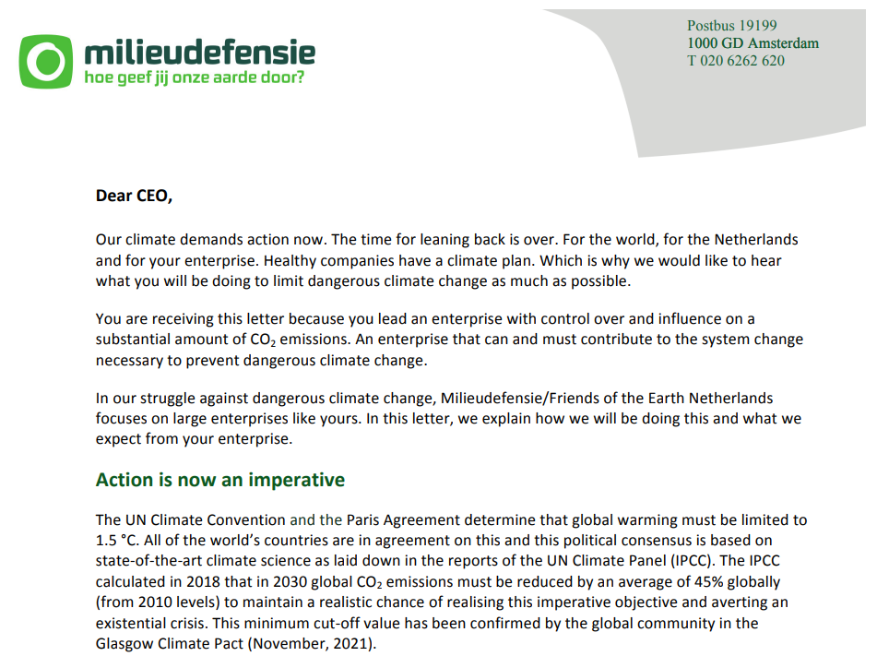
Increased pressure on corporate transition plans (cf. ING case)

Slide 21
German case against car manufacturers
Taking the Shell judgment as a blueprint, a German NGO filed climate-related lawsuits against German car manufacturers in autumn 2021, requesting the car manufacturers to stop distributing cars with a combustion engine after 31 October 2030 and to stop the distribution of cars with a combustion engine on the market between 1 January 2022 and 31 October 2030 if they exceed the alleged remaining budget for the car manufacturers of 604 million tons of CO2 in total and 516 million tons of CO2 in total respectively
Based on general provisions of German nuisance and tort law (sec. 1004, 823(1) German Civil Code), protecting the right of a free development of the personality against threats through interference by third parties which is stipulated in the German constitution
In both cases, the first instance courts had dismissed the claims as unfounded:
  Causation: it cannot be established whether and to what extent the claimants’ rights could be impeded in the future if the production of internal combustion engines continues
  Separation of power: it is the legislature’s duty to provide the legal framework to prevent further global warming. Individuals could not be granted the right to correct legislative decisions perceived as inadequate through civil law instruments
On 12 October 2023 and on 8 November 2023, the Courts of Appeal Munich and Stuttgart upheld the first instance courts’ rulings: if companies comply with the German and European regulation on the reduction of emissions, they cannot be obliged to take further measures under civil law

Slide 22
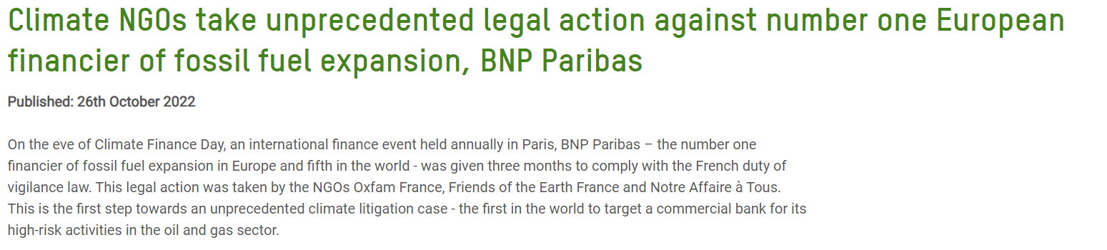
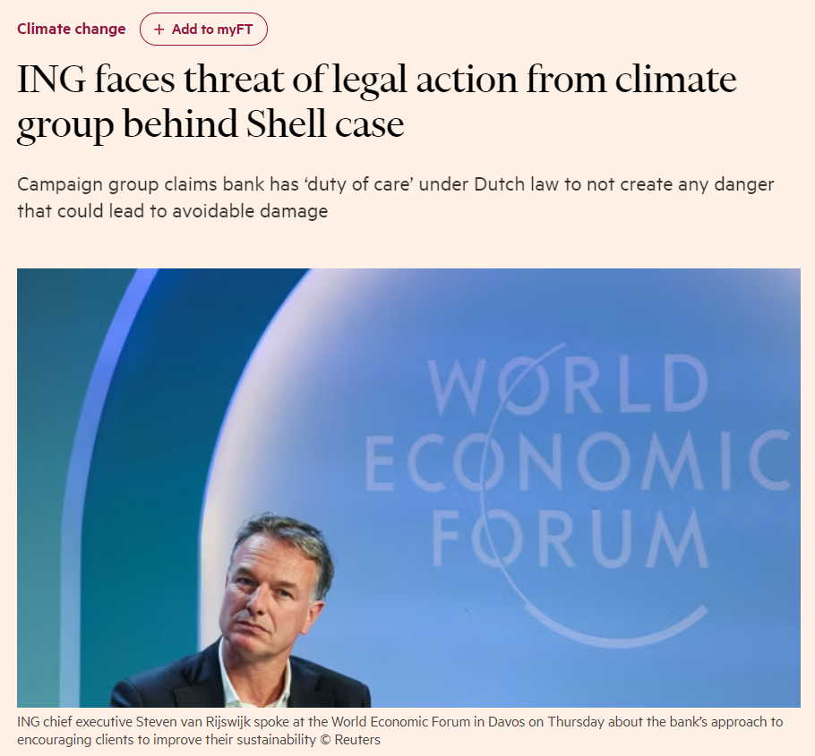
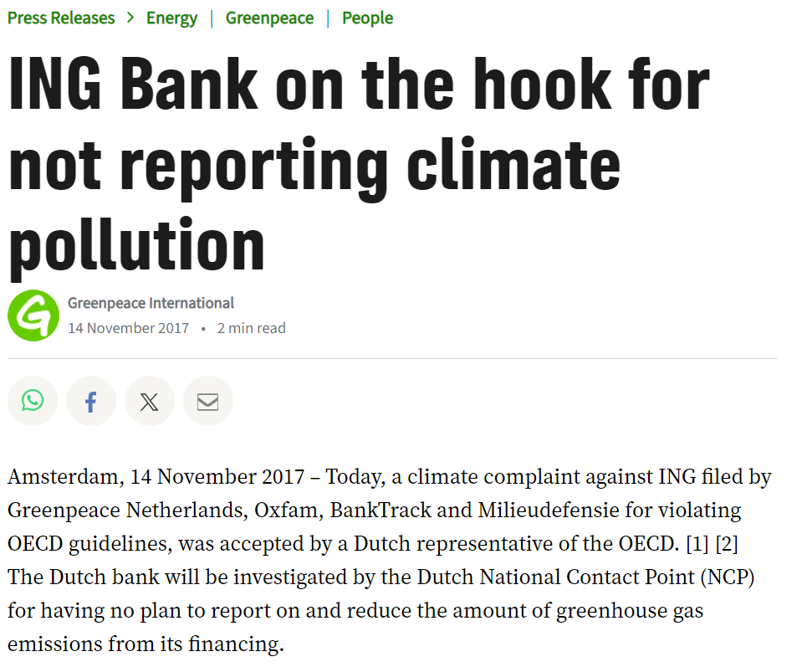
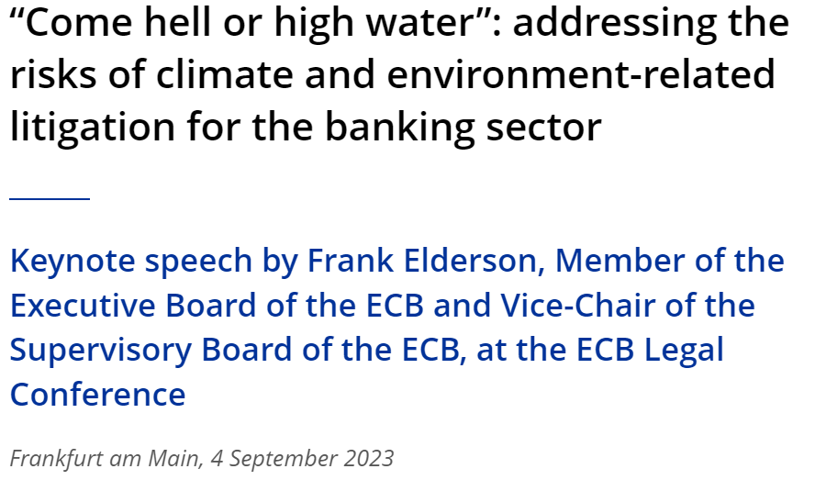
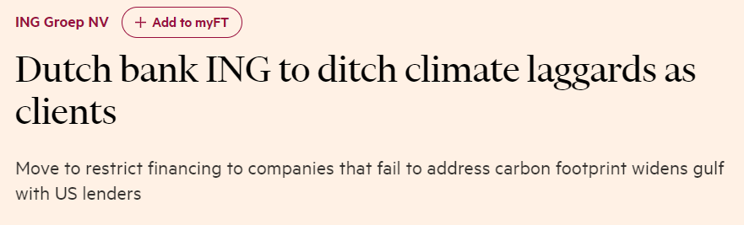
Financial institutions as new targets

Slide 23
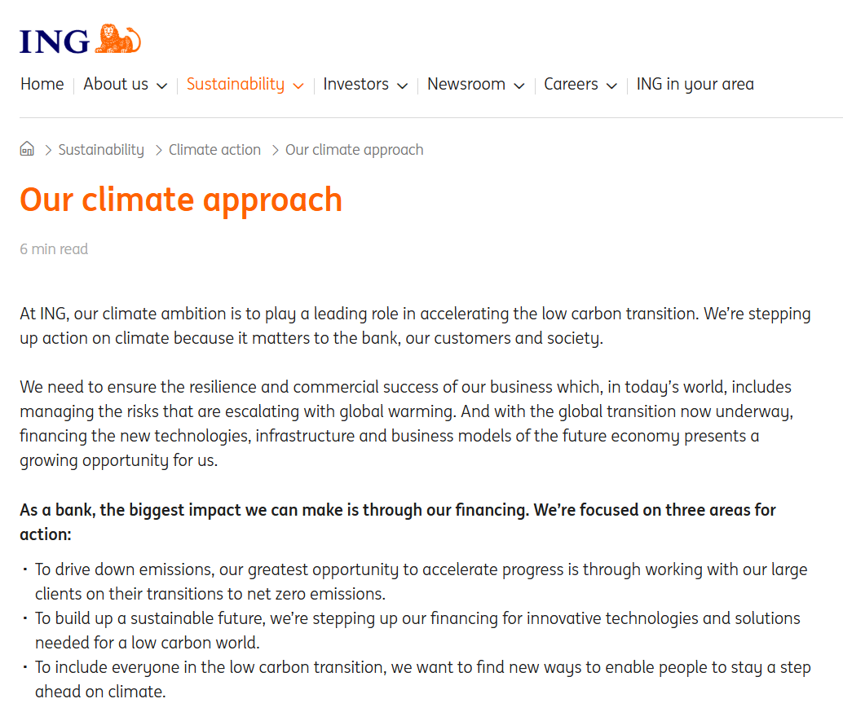
Sof law (NCP under OECD Guidelines) as precursor:
NGOs vs ING (2019)
In 2017, NGOs (incl. Milieudefensie) filed with Dutch NCP a complaint against ING for failure to commit appropriately to achieving targets under the 2015 Paris Agreement
The complaint alleged that ING had violated environment and consumer interest provisions of the OECD Guidelines by failing to set targets to reduce the emission of greenhouse gases from its financial products. Further, ING had not reported the indirect product emissions of companies and processes that it financed
The final statement by the NCP held that ING is obliged under the OECD Guidelines for Multinational Enterprises to set climate goals that are aligned with the Paris Agreement.
Pursuant to the willingness of both parties to participate in mediation, agreement was reached with respect to ING’s adoption of specific methodologies to measure and set targets with respect to the bank’s climate impact

Slide 24
Milieudefensie vs ING (ongoing)
Klimaatzaak | ING
On 28 March 2025, Milieudefensie served a formal summons to ING Bank (also on behalf of 30k+ co-claimants), initiating a civil lawsuit before the Amsterdam District Court
Milieudefensie alleges that ING’s climate conduct violates the societal duty of care under Article 6:162 of the Dutch Civil Code. Drawing from precedent (Urgenda v Netherlands, Milieudefensie v. Shell), international climate science (IPCC, IEA), and soft law instruments (UNGPs, OECD Guidelines), the NGO argues that ING’s failure to adopt sufficient emissions reduction policies constitutes a tortious act
The summons outlines that ING’s role as a financial enabler of fossil fuel expansion and other high-emission sectors results in both direct and facilitated emissions (scope 3), which ING fails to adequately report or reduce
Milieudefensie asks the court to compel ING to take the following actions:
  Halve its total emissions by 2030, and continue reducing thereafter, in line with the IPCC’s 1.5°C pathway
  Reduce emissions in eight major sectors it finances (e.g., steel, aviation) in line with the International Energy Agency’s Net Zero Emissions (NZE) scenario.
  Cease all financing and investment in companies starting new oil and gas projects,
  Require all large corporate clients to submit credible, science-based climate plans

Slide 25

Directors’ and officers’ duties and liability

Slide 26
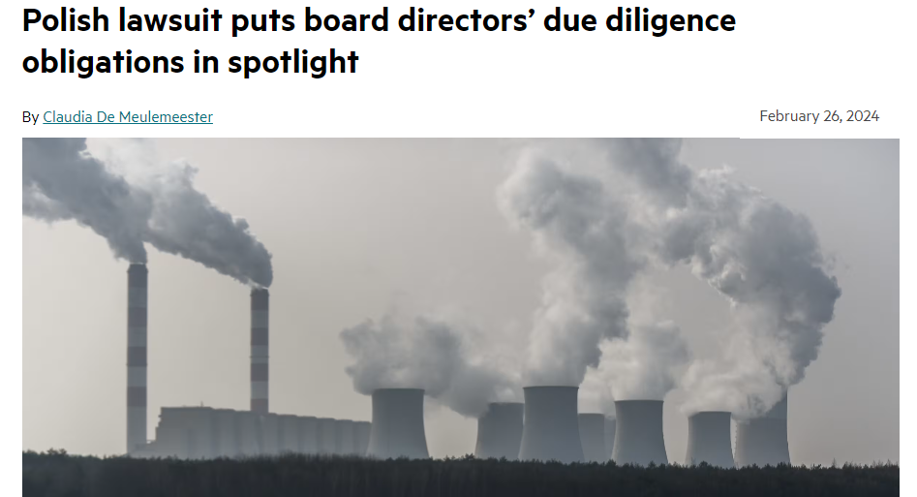
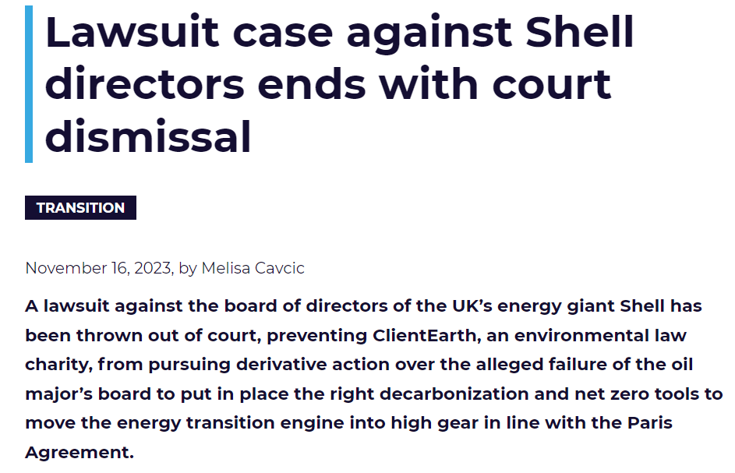
Directors’ and officers’ liability – admissibility challenges
What are directors’ duties? “The corporate purpose is determined by the aim of collective profit of the current and future shareholders of the company” (Belgian Supreme Court, 28 November 2013)
  “One of [the company’s] goals is to distribute or provide its partners with a direct or indirect patrimonial advantage” (Art. 1:1, of 2019 Belgian Code of Companies and Associations)
Sometimes started by company (ongoing Polish case of Enea vs former directors started in 2023 in the contect of board’s approval of coal investment)...
... but usually not, leading to admissibility challenges in many countries (first and foremost for company to start the claim); illustration in UK Shell case ([2023] EWHC 1897):
  NGO defends activist purposes rather than company’s interest
  Acknowledgment of “business judgment” rule

Slide 27
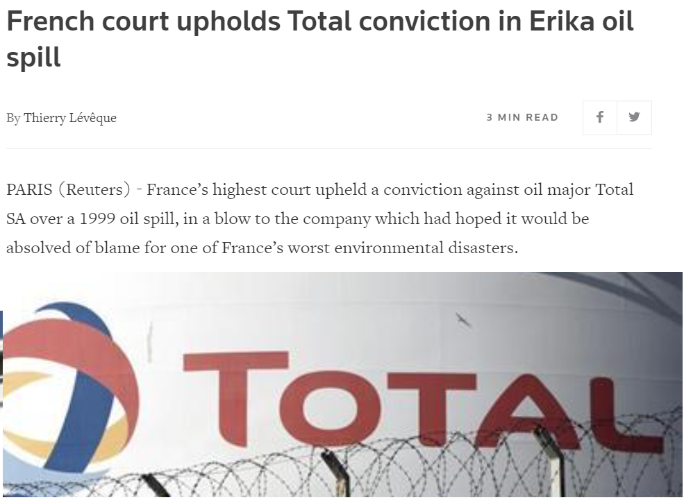
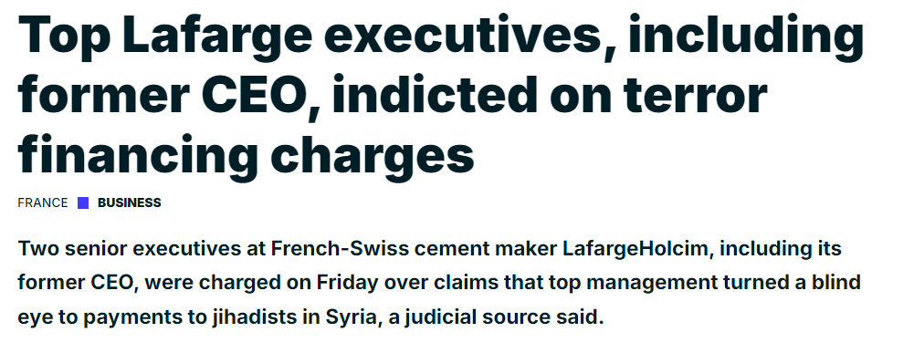
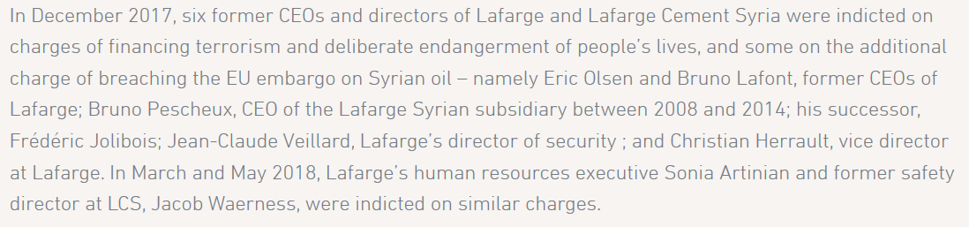
French cases – Lafarge and Erika

Slide 28
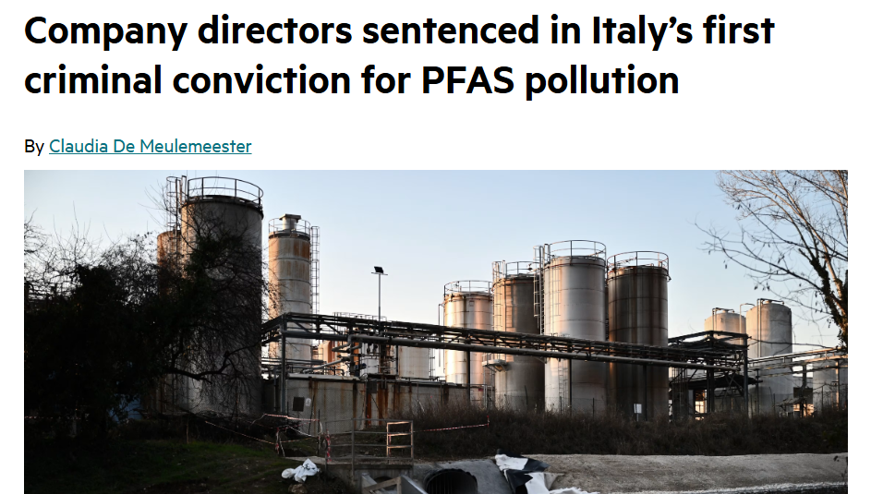
Italian ecocide case
Eleven company directors involved in the management of a chemical plant in Northern Italy have been convicted for knowingly polluting the soil and waterways of nearby communities (prison sentences of up to 17 years; millions in fine)
Directors knew there was a risk that its activities could lead to PFAS (Per- and polyfluoroalkyl substances or “forever chemicals”) pollution leaking into the environment
First case to reach verdict. It is estimated that in Europe alone 23,000 sites are contaminated by PFAS substances
EU’s updated Environmental Crime Directive does not explicitly covers ecocide, but includes serious environmental offences comparable to ecocide (see next class)

Slide 29
Disclosure and greenwashing

Slide 30
What is greenwashing?
  Specific definitions vary depending on
  context / local laws
  In general and broad sense, it is any misleading
  presentation of the extent to which products,
  services, businesses or entities have a positive
  environmental (and broader sustainable) impact
Increasingly heavier focus on social aspect, human rights and just transition
“a practice where sustainability-related statements, declarations, actions, or communications do not clearly and fairly reflect the underlying sustainability profile of an entity, a financial product, or financial services. This practice may be misleading to consumers, investors, or other market participants”.– European Supervisory Authorities
“exaggerating the
extent to which products or services take into account environmental and sustainability factors”
– U.S. SEC
“where a company uses advertising and public messaging to appear more climate friendly and environmentally sustainable than it really is” – ClientEarth

Slide 31
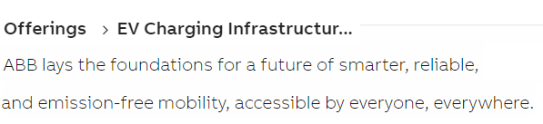
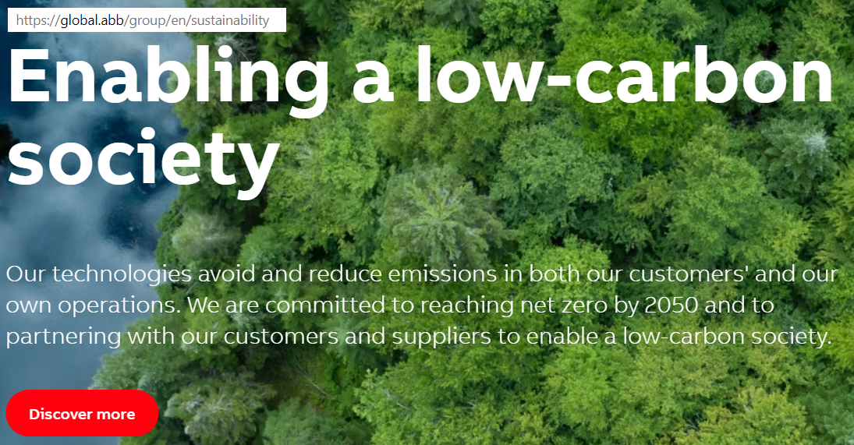
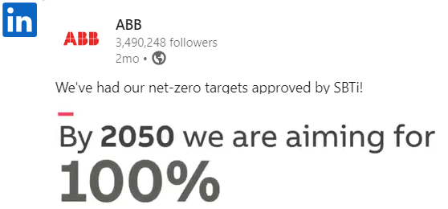

Where might greenwashing occur?
Statements that could give rise to potential liability risk can be made in various formats:
Mandatory climate reporting within formal documents e.g. annual reports
Mandatory disclosures to comply with legislation
e.g. prospectuses
Voluntary statements
Advertising
Labelling and product descriptions
Social media

Slide 32
What enforcement risks does greenwashing entail?
Regulatory enforcement: fines and orders by regulators (fair trade practice, consumer protection, advertisement, securities regulators), on their own motion or following a complaint from a third party (competitor or consumer organisations)
Regulatory enforcement
    Soft law mechanisms: more complaints are being made against companies via the National Contact Point (NCP) non-judicial grievance mechanism set up under OECD Guidelines
Soft law mechanisms
Private Litigation
Criminal law risks
    Criminal law risks: communication to criminal authorities by regulators; complaints by NGO / activist organisations; etc.
    Private litigation, initiated by:
    - competitors (unfair commercial practices, competition law, etc.),
    - business partners (contractual terms),
    - Investors (securities / disclosure litigation),
    - consumer organisations (including class actions)
.
Notes:
Tom and Guillaume exposed that misleading green claims can lead to various types of risks and on different grounds. Before going into the examples, let’s just recap the three main avenues for legal risks to materialize.
First of all, regulators may impose fines, in addition to other sanctions such as the publication of their decision or orders to cease the greenwashing practices for violation of different rules.
Second, litigations can be started in courts by diverse stakeholders impacted by the greenwashing practices, such as competitors, business partners, investors or consumer organisations. These parties will argue that they have bought a product, invested in a company on the basis of misleading sustainability claims, or – when it comes to competitors – that they have lost market shares.
Lastly, risks may go as far as criminal investigations and sanctions, both against the company and the individuals involved in the greenwashing practices. [More on this ici, j’ai ajouté tes notes de l’autre slide]
CSRD & criminal sanction attached
On 20 December 2017, the Bruges Criminal Court ruled on a criminal action brought for acts contrary to fair market practices.The defendant was accused of selling products whose availability in due time could not be guaranteed (which is classified as a misleading commercial practice within the meaning of Article VI.97 ELC) and of not having reimbursed all consumers when they exercised their right of withdrawal concerning an online purchase (which is contrary to Article VI.50 ELC).These acts attributable to the defendant have been proven. That being said, given his clean criminal record, the court granted him a stay of proceedings.This judgement illustrates that violations of unfair commercial practices are always criminally prosecuted. Moreover, although in most cases the case is settled by a transaction – whether at the level of the FPS Economy or the Public Prosecutor's Office – it is clear that, in practice, the criminal sanction is, in a limited number of cases, also pursued up to the criminal court.
France: Adidas, Total Energies

Slide 33


These risks will be reinforced by upcoming EU legislation (see next class)
  The EU is at the forefront of putting in place new legislation aimed at tightening restrictions on sustainability claims and prescribing requirements for those that are permitted
  The new rules are contained in two separate but complementary EU Directives applicable to B2C relations:
  These new rules are important in the B2B context too:
    In some EU Member States, the relevant consumer protection legislation also applies in B2B relationships
    Other EU Member States have a separate B2B unfair practice regime, for which the criteria of B2C regimes are source of inspiration
    Ongoing discussions on regulating B2B ecolabelling at both EU and Member State levels
Directive on Empowering Consumers for the Green Transition (the “ECD”)
Green Claims Directive (the “GCD”)
        Adopted at EU level. The new rules will apply to businesses from 27 September 2026.
        Amends existing consumer protection legislation and regulates the types of sustainability claim that can be made.
        Still being negotiated. Not expected to be finalised until Q1 2025. The earliest it is likely to apply to business is therefore some time in 2027.
        Intended to be complementary to the ECD by (i) setting minimum criteria that must be satisfied when making explicit green claims and (ii) regulating ecolabelling.

Slide 34
Other relevant regimes – the many faces of greenwashing risks
Advertisement rules
Regulatory requirements
Governance failures
Contractual liability
Ecolabelling rules
Unfair competition (B2B)
Criminal law
Prospectus legislation
Tort law
MiFID

Slide 35
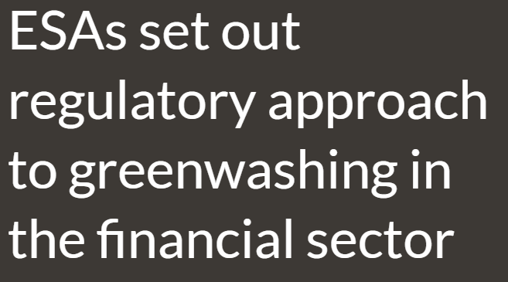


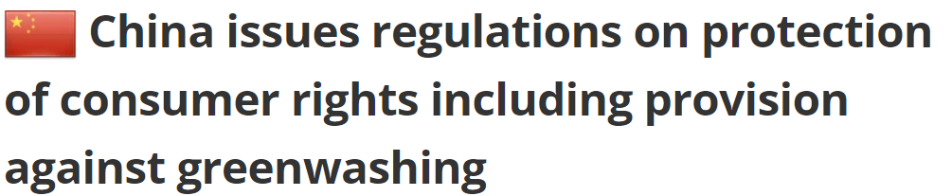

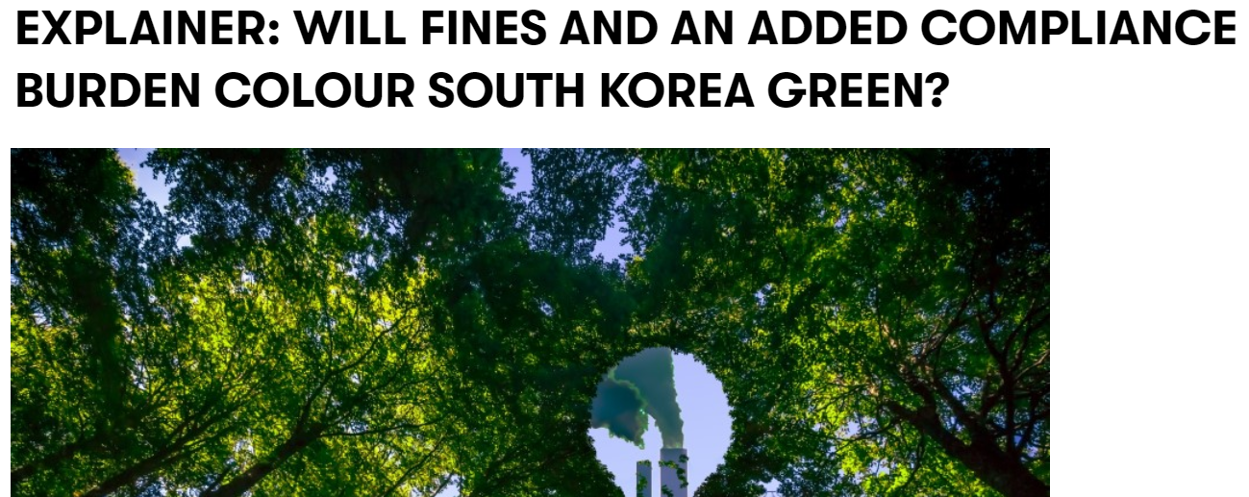
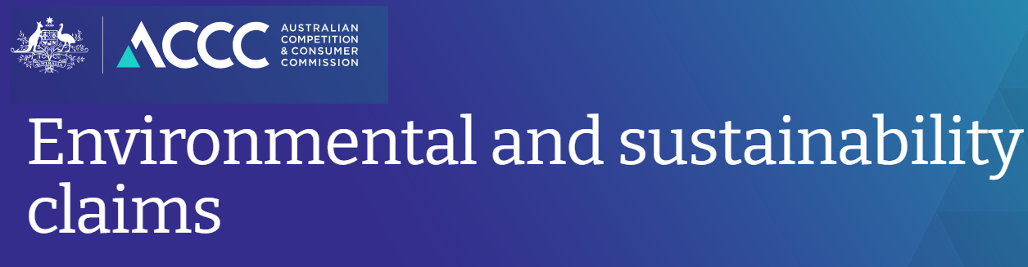
Regulators’ guidelines and expectations
  Regulators globally have made the fight against greenwashing a priority and issued guidelines setting out their expectations regarding the prohibition of greenwashing B2C relations
  Most of these guidelines have been issued by consumer protection and financial regulators
  However, they are relevant for B2B cases too:
    Some of these guidelines are expressly applicable in the B2B context too
    (e.g. U.S. Green Guides and UK Green Claims Code)
    They provide helpful and practical guidance

Slide 36
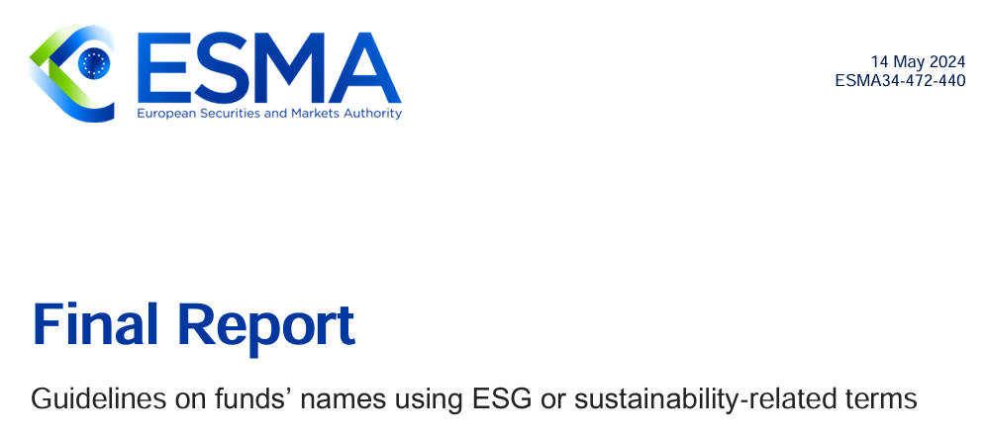
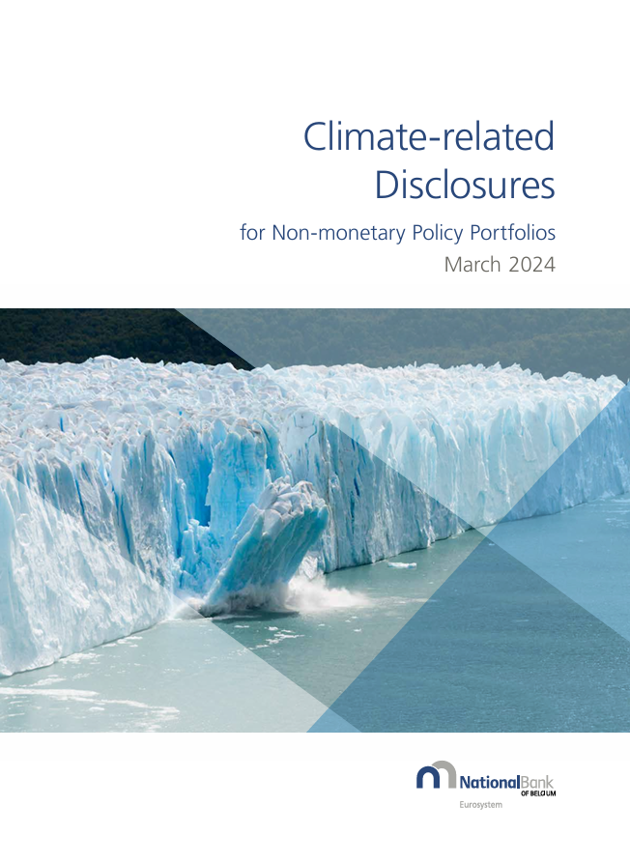

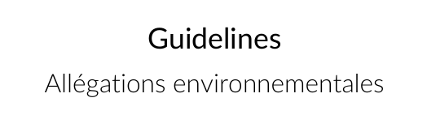
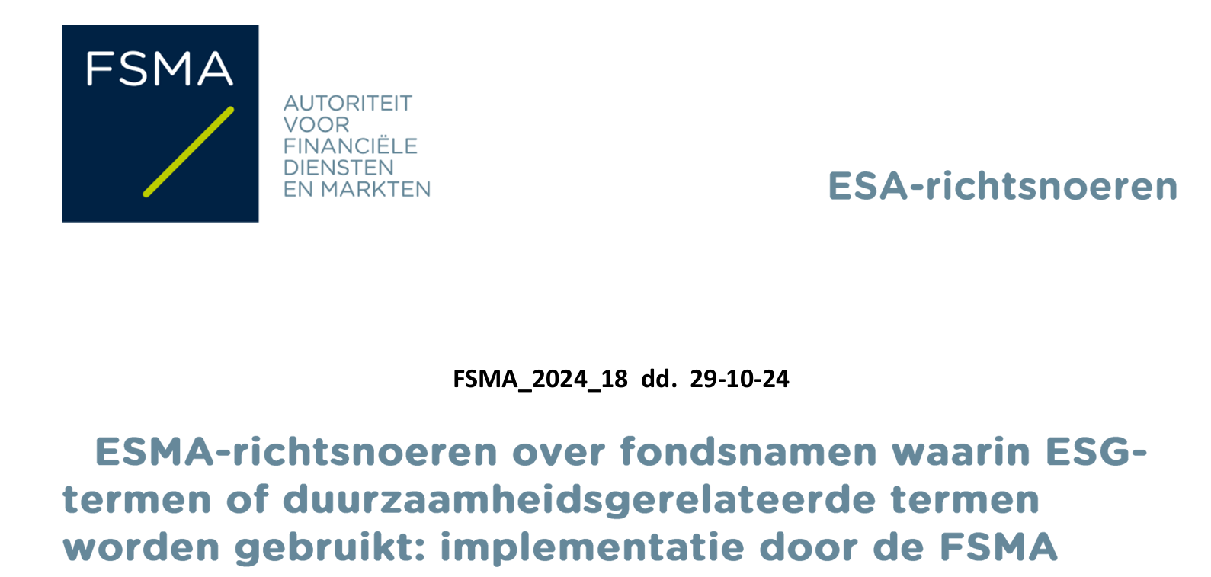
Regulators’ guidelines and expectations
Claims should be accurate, truthful, specific and not hide or omit important information which is relevant to the description of the environmental/sustainable impact
Claims need to be supported with a high level of substantiation, particularly absolute claims such as “sustainable” or “environmentally friendly”
Claims which refer to a business’ lower-carbon activities without including information about its overall harmful environmental impact may provide a misleading impression
Claims which appear supported by labels / logos which do not correspond to an independent third-party review
Conditions or qualifications to claims should be clearly explained and ideally incorporated as part of the claim
Imagery of the natural world in claims may contribute to the impression that the relevant activity is making a significant contribution towards reducing greenhouse gas emissions

Slide 37
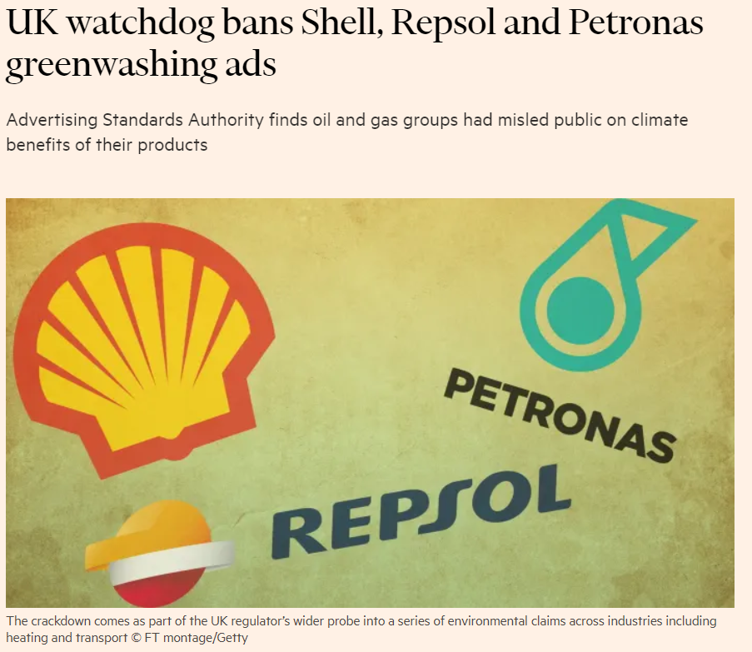
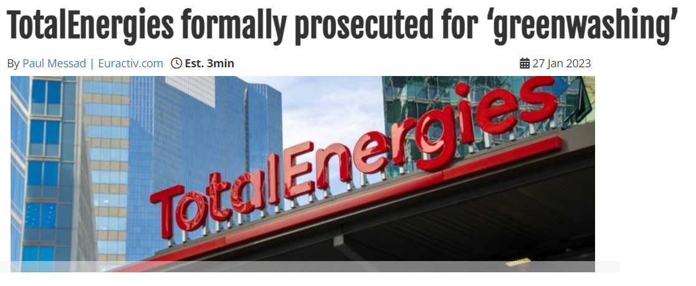
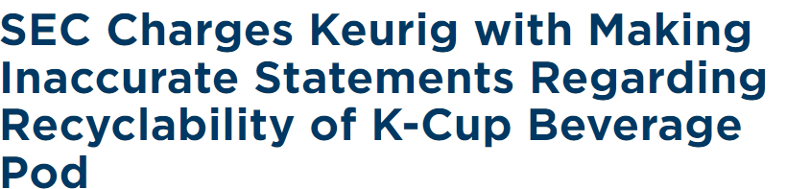
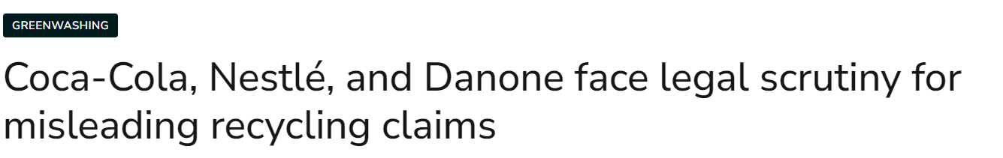
Regulatory crack down
  In recent years, regulators have imposed billion in fines globally, in hundreds of cases pertaining to e.g. unsubstantiated sustainability claims on labels, the recyclability of products, the environmental impact of products, the use of general terms such as “green” or “sustainable”, etc.
  Most of these cases have occurred in (i) consumer protection, (ii) advertising,
  (iii) financial sector or (iv) financial disclosure contexts
  In a number of countries, regulators have also powers for B2B unfair market practices, including misleading practices such as greenwashing

Slide 38
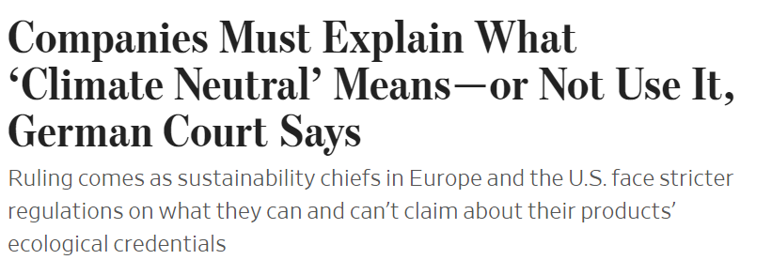
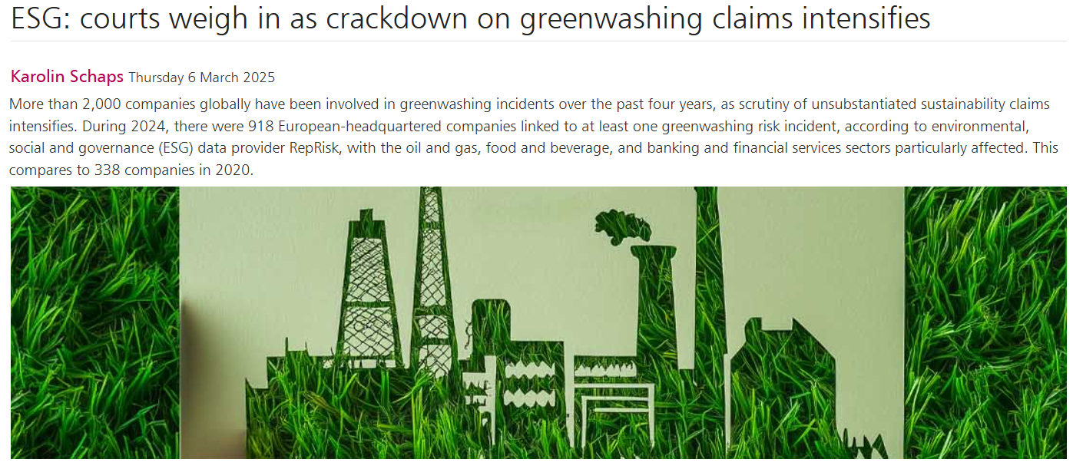

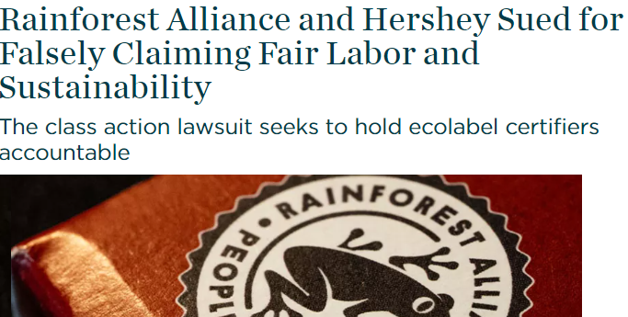
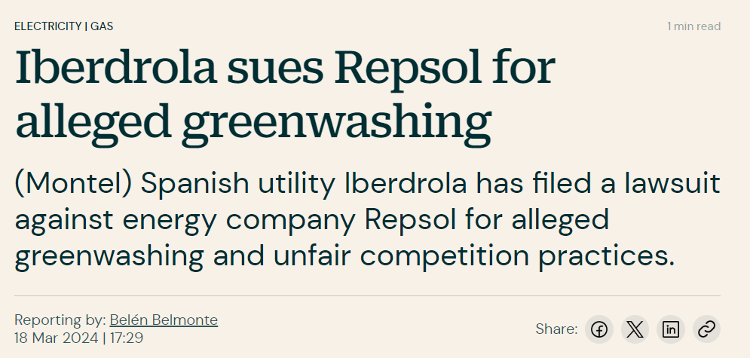
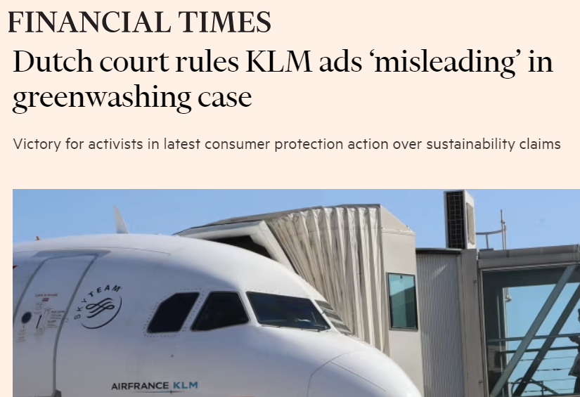
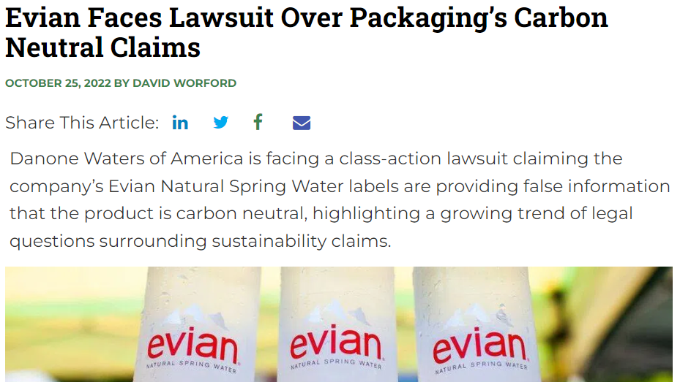
Court cases are also skyrocketing

Slide 39

Can you spot the potential greenwash?
“For the smoothness of our chocolate spread, we use palm oil naturally extracted from the fruit of oil palms”
“The world needs more energy and less CO2. To meet that challenge we need to turn bright ideas into workable solutions – and then make those solutions a reality. We’re working on a range of innovative projects. (…) At the same time we are making our existing fuels cleaner and more efficient, and working on technology to manage CO2 emissions. To find out how [X] is helping prepare for the new energy future visit www.[X].com/newenergyfuture”
“This bottle of washing-up liquid is made with ocean plastic”
Notes:
“For the smoothness of our chocolate spread, we use palm oil naturally extracted from the fruit of oil palms”
FERRERO – 05/09/2013
Regarding the statement ‘naturally extracted from the fruits of the oil palm’ in the advertisement, the Jury of Appeal considered that both the choice of the word ‘naturally’ and its use at that precise moment in the spot contribute to creating the general impression that the product, its ingredients and its manufacturing process are ‘natural’. As the jury of first instance noted, the use of the word ‘naturally’ in this context thus tends to confer a positive environmental connotation on a product that is still industrially manufactured. The Jury is also of the opinion that the use of the specific word ‘naturally’ is superfluous in this case if the aim is to provide the consumer with more information on the usual process of palm oil extraction. The Jury of Appeal therefore confirms that the use of the term ‘naturally’ in this advert is contrary to Article 1 of the Code of Ecological Advertising, which stipulates that advertising must be designed in such a way as not to unduly solicit the environmental concerns of society as a whole or exploit any lack of knowledge in this area.
In view of the above, the Jury asked the advertiser to modify the advertisement with regard to the use of the term ‘naturally’ and, failing that, to stop broadcasting it. The advertiser confirmed that he will respect the decision of the Jury of Appeal.
“At the same time we are making our existing fuels cleaner and more efficient, and working on technology to manage CO2 emissions”
SHELL – 27/01/2010
The Jury is of the opinion that this is clearly an informative announcement without any absolute or misleading statements or representations, and that this advertisement is not likely to be misunderstood by the public because :
This sentence talks about ‘cleaner and more efficient’ and not ‘clean and efficient’. These are not absolute statements and therefore do not imply that there would be no more consequences for the environment.- This sentence uses the words ‘are making’, the typically English ‘present continuous’. This implies that Shell is making efforts in this regard and not that everything has already been achieved. The Jury is therefore of the opinion that this sentence does not contain any absolute or misleading statement likely to mislead the consumer with regard to the environmental impact of Shell's products or activities.
The Jury also considers that this sentence should not be considered separately or separated from the rest of the advert, but that, on the contrary, the advert should be considered in its entirety in order to examine the meaning of the sentence in question. The Jury is of the opinion that, taking the advertisement as a whole (title, image and preliminary text), the message of this advert is not that Shell's products or activities have no impact on the environment, but merely that Shell makes various efforts to protect the environment. This is clearly illustrated by the combination of image and text. Finally, a link is provided to www.shell.com/newenergyfuture for more information on these efforts.
““This bottle of washing-up liquid is made with ocean plastic”
The Brussels Court of Appeal was referred to in 2019 regarding an Ecover advertisement for a bottle of dishwashing liquid called ‘Ocean Bottle’. A competitor considered that Ecover's advertising was misleading and unfair because Ecover claimed that the bottle of washing-up liquid was made from plastic recovered from the oceans, whereas the plastic in question was not collected from the oceans but collected on beaches, and Ecover alleged that the Ocean Bottle was made of 50% plastic from the oceans, although this was not established. The court of appeal ruled that even if these allegations are not correct or proven, they are in any case not likely to change the economic behaviour of the consumer. According to the Court, if the consumer buys the Ocean Bottle product because it helps to reduce ocean pollution, it does not matter whether the pollution is reduced in the ocean or near it. Regarding the precise percentage of plastic in the composition of the bottle, the court ruled that ‘there is no evidence to suggest that the indication of this percentage is currently likely to affect the economic behaviour of the average consumer’. The court thus reiterates that it is up to the party claiming that an environmental claim is misleading to demonstrate that it is likely to cause the consumer to make a commercial decision that they would not have made otherwise. The European directives presented earlier will make it possible to unblock the issue of the burden of proof in cases such as Ecover, since it will be up to Ecover to substantiate its green claim in this type of case.

Slide 40
Court cases – also in the B2B context
  Most of the advertised court cases have been started by consumer organisations in a B2C context
  Claims are also increasingly started with respect to B2B relationships. For example:
    In 2024, Iberdrola Energía España, a major renewable energy company, submitted a claim before Spanish courts on the basis that its competitor Repsol, a traditional oil and gas major, commits “marketing strategies aimed at exaggerating, or directly falsifying, its commitment to sustainability and the environment“
    In 2023, in Germany, manufacturers of various cleaning agents sued another one. The defendant company was certified by a third party as a "carbon neutral company" and promoted its company (targeting professional audience) in a YouTube video using the phrase "Carbon neutral company certified by [...]" as well as the catchphrase "carbon neutral hygiene". In the court's view, both professionals and consumers assume that all major emissions have been offset, including those from production. However, some of them had been excluded, which was found to be misleading
    In 2021, Italian courts ordered the end of misleading green claims by a manufacturer of a microfiber products used in the automotive sector (in breach of the Italian transposition of the UCPD). It held that the claimant had legal interest because it suffered a market share loss

Slide 41
Court cases – emergence of investor/security lawsuits
  Typical example: Boohoo case:
    A report by The Sunday Times in 2020 revealed multiple alleged labour rights violations at its suppliers’ factories in Leicester, highlighting that some workers were paid as little as £3.50 an hour.
    The firm’s share price tanked after the expose was published, wiping more than £1.5bn off the online retailer’s market value
    Court case started on behalf of 49 institutional investors in May 2024. The investors allege that Boohoo made untrue or misleading statements and failed to disclose or delayed the disclosure of material about the matter to the market, breaching its obligations under the Financial Services and Markets Act 2000.
  Likely increase of cases in the future as a result of the entry into application of the CSRD (first wave) and increased voluntary reporting

Slide 42

Parent company liability for ESG harm in the supply chain

Slide 43
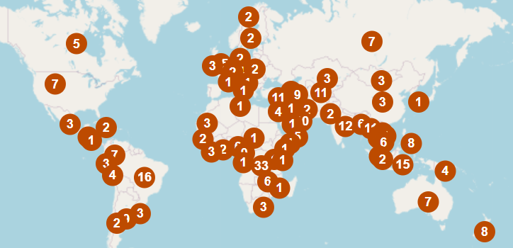
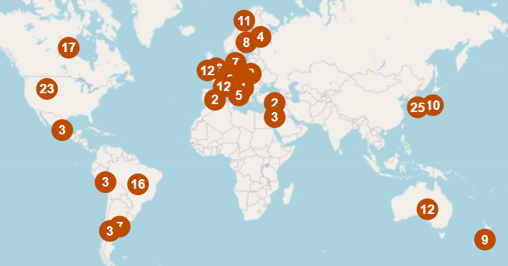
Grievance mechanism under the OECD Guidelines
All governments adhering to the OECD Guidelines are required to set up a National Contact Point (NCP) in their jurisdiction. Among other things, NCPs handle cases referred to them under a non-judicial grievance mechanism.
  any individual/organisation with a “legitimate interest” can submit a case
  case can be against enterprises operating in or from the NCP’s territory
Non-judicial mechanisms are increasingly viewed as potential avenues for claims particularly because they are generally low cost, can be high-profile and cause high reputational impact and can be a precursor to litigation.
Complaints by countries of harm
Complaints by country of NCP

Slide 44

Key national due diligence regimes
Europe
UK Modern Slavery Act
UK Deforestation Due Diligence Regime
French Duty of Vigilance Law
Swiss Non-Financial Reporting Regime
Swiss Conflict Minerals Regime
Belgian Duty of Vigilance Bill
Dutch Bill on Responsible and Sustainable
International Business Conduct
Dutch Child Labour Due Diligence Law
German Supply Chain Due Diligence Act
Norwegian Transparency Act
German Supply Chain Due Diligence Act
Due diligence and reporting obligations covering human rights and the environment applicable to companies located in Germany based on employee headcount. Focus on public enforcement.
Came into force on 1 January 2023 for companies with a minimum of 3,000 employees (as of 2024 reduced to 1,000).
Canada
Canada Act to enact the Fighting Against Forced
Labour and Child Labour in Supply Chains Act
French Duty of Vigilance Law
Due diligence and reporting obligations covering human and fundamental rights, health and safety and the environment, applicable to companies operating in France based on employee headcount.
Focus on private enforcement mechanisms.
Came into force on 27 March 2017.
US
US Uyghur Forced Labor Prevention Act 2021
California Transparency in Supply Chains Act
Asia
No legislation to directly address human rights and modern slavery. A draft modern slavery bill was tabled in Hong Kong in 2018, but it has not been passed into law. In August 2022, the Japanese government published draft human rights due diligence guidelines to help companies identify and prevent human rights-related abuses in their global supply chains. The guidelines will be non-binding but legislation against human rights abuses may follow.
Latin America
Various countries are considering legislation. In Mexico there are new environmental risk evaluation requirements and a legislative reform initiative is proposed which, if passed, would impose a corporate obligation to implement human rights risk analysis (following a failed attempt at the same in 2020). Many countries (e.g., Peru, Colombia, Chile, Brazil) have a National Action Plan in Business and Human Rights, some of which include promoting implementation of due diligence processes for large companies. Various countries are looking to introduce additional protections for indigenous communities, including Mexico.
Key
Represents a reporting obligation
Represents a due diligence (with reporting) obligation
Represents a proposal for regimes that are being developed/considered
Australia
Australia Modern Slavery Act
*Incoming ESG reporting regimes will also require extensive reporting on ESG issues (incl. human rights topics) in the supply chain (e.g. the new IFRS sustainability disclosure standards (ISSB) and the EU’s Corporate Sustainability Reporting Directive (and accompanying reporting standards)).

Slide 45
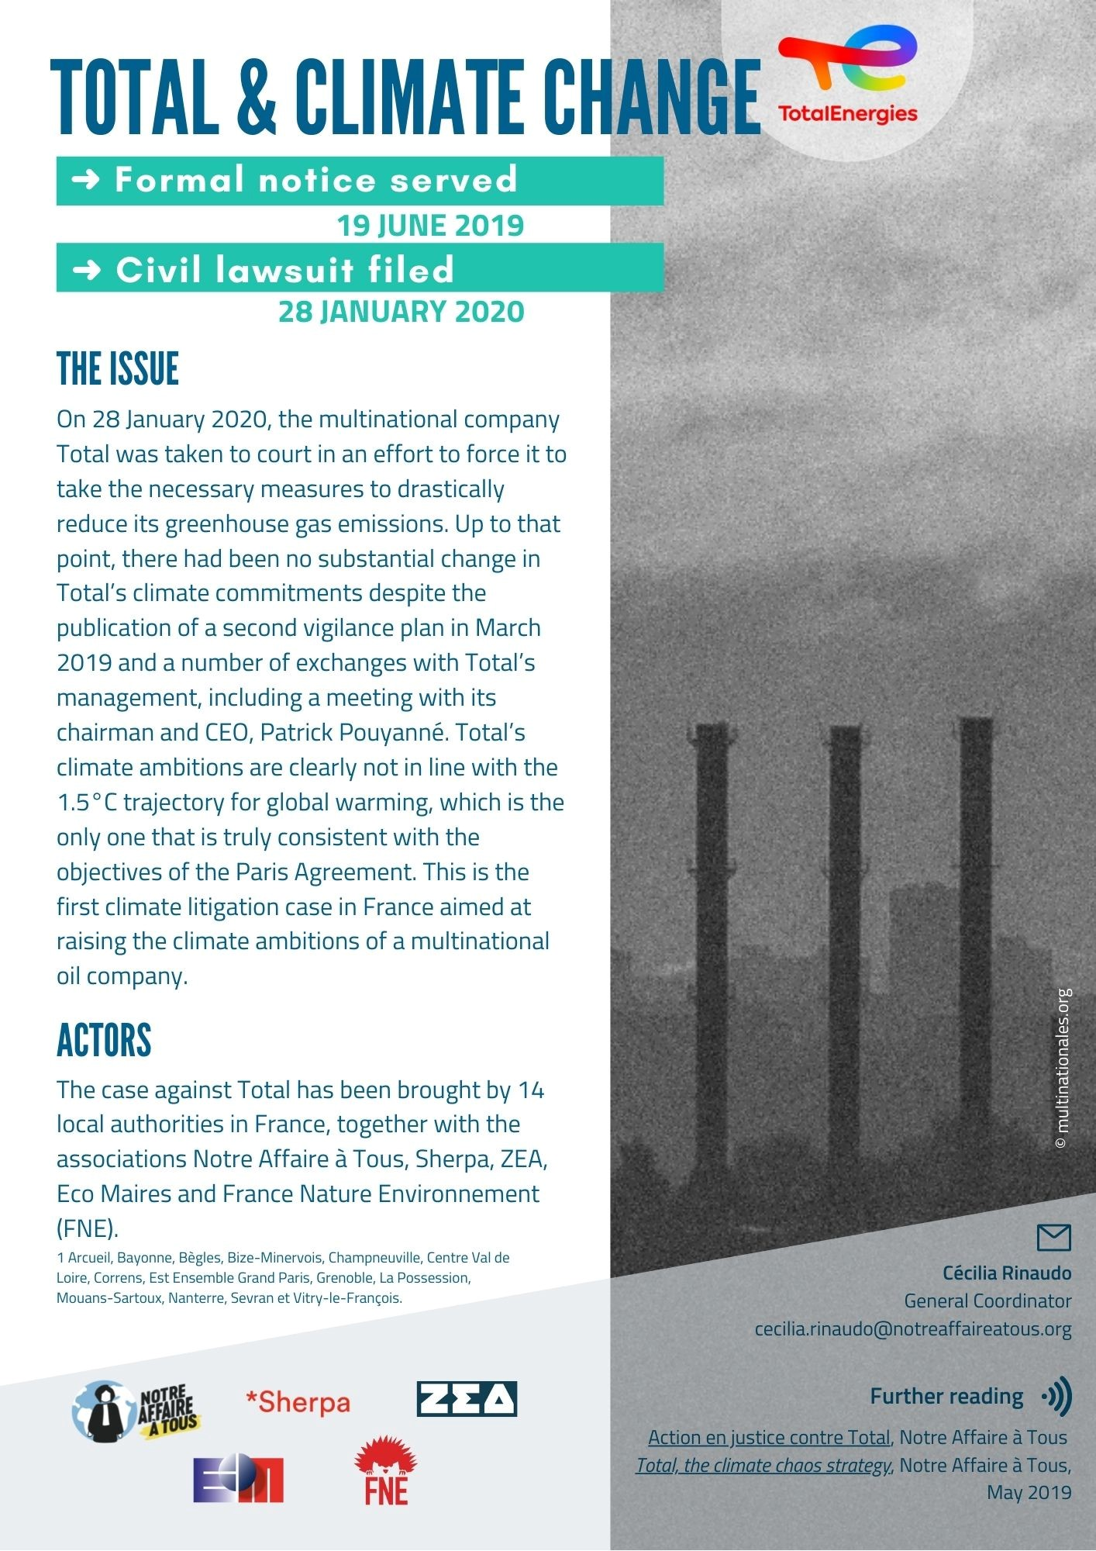

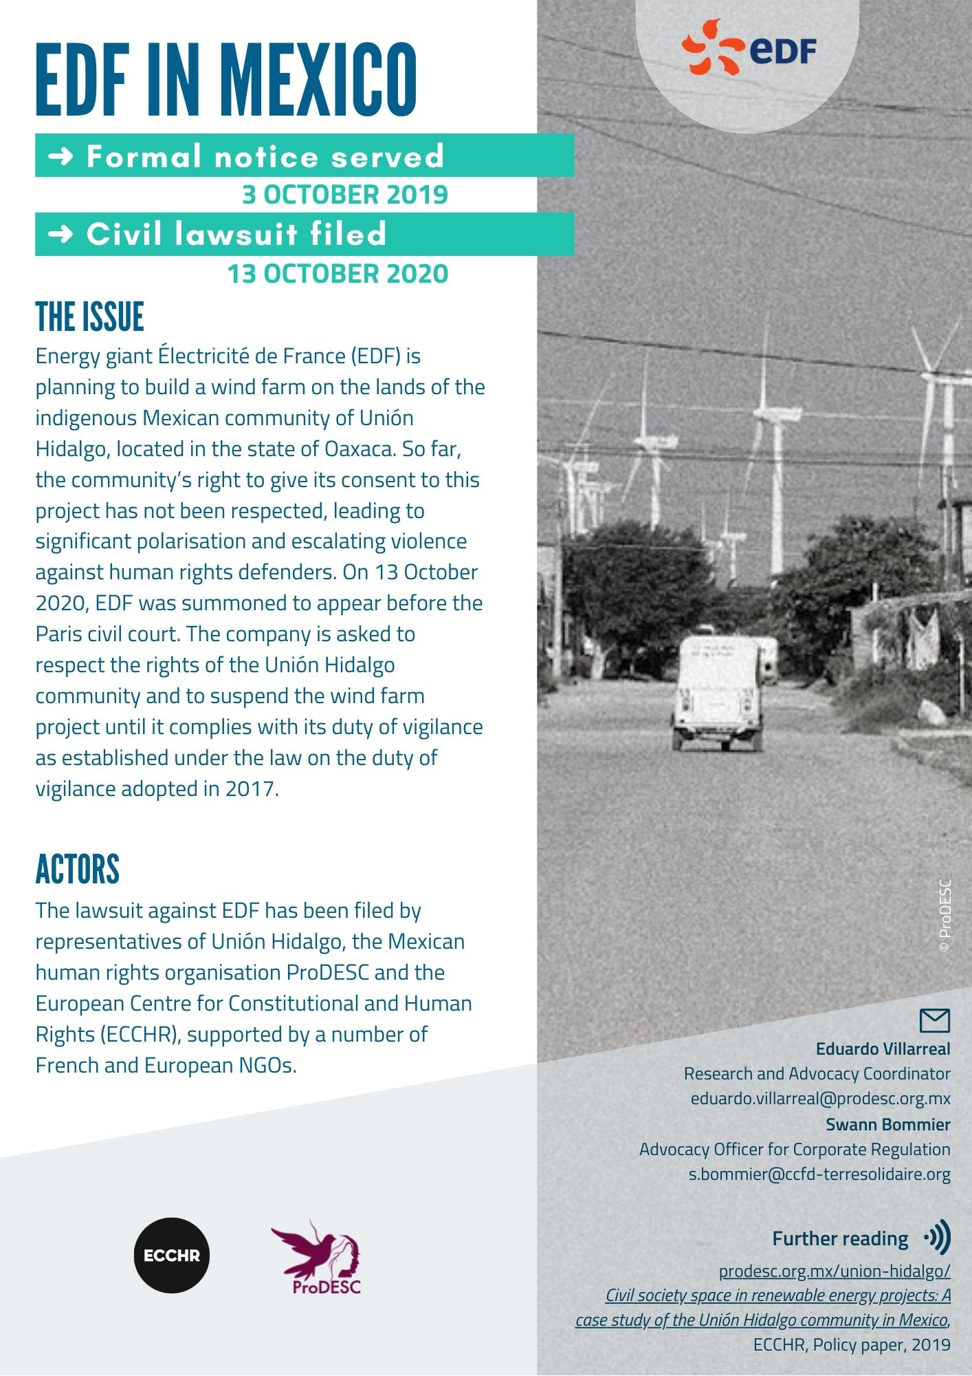
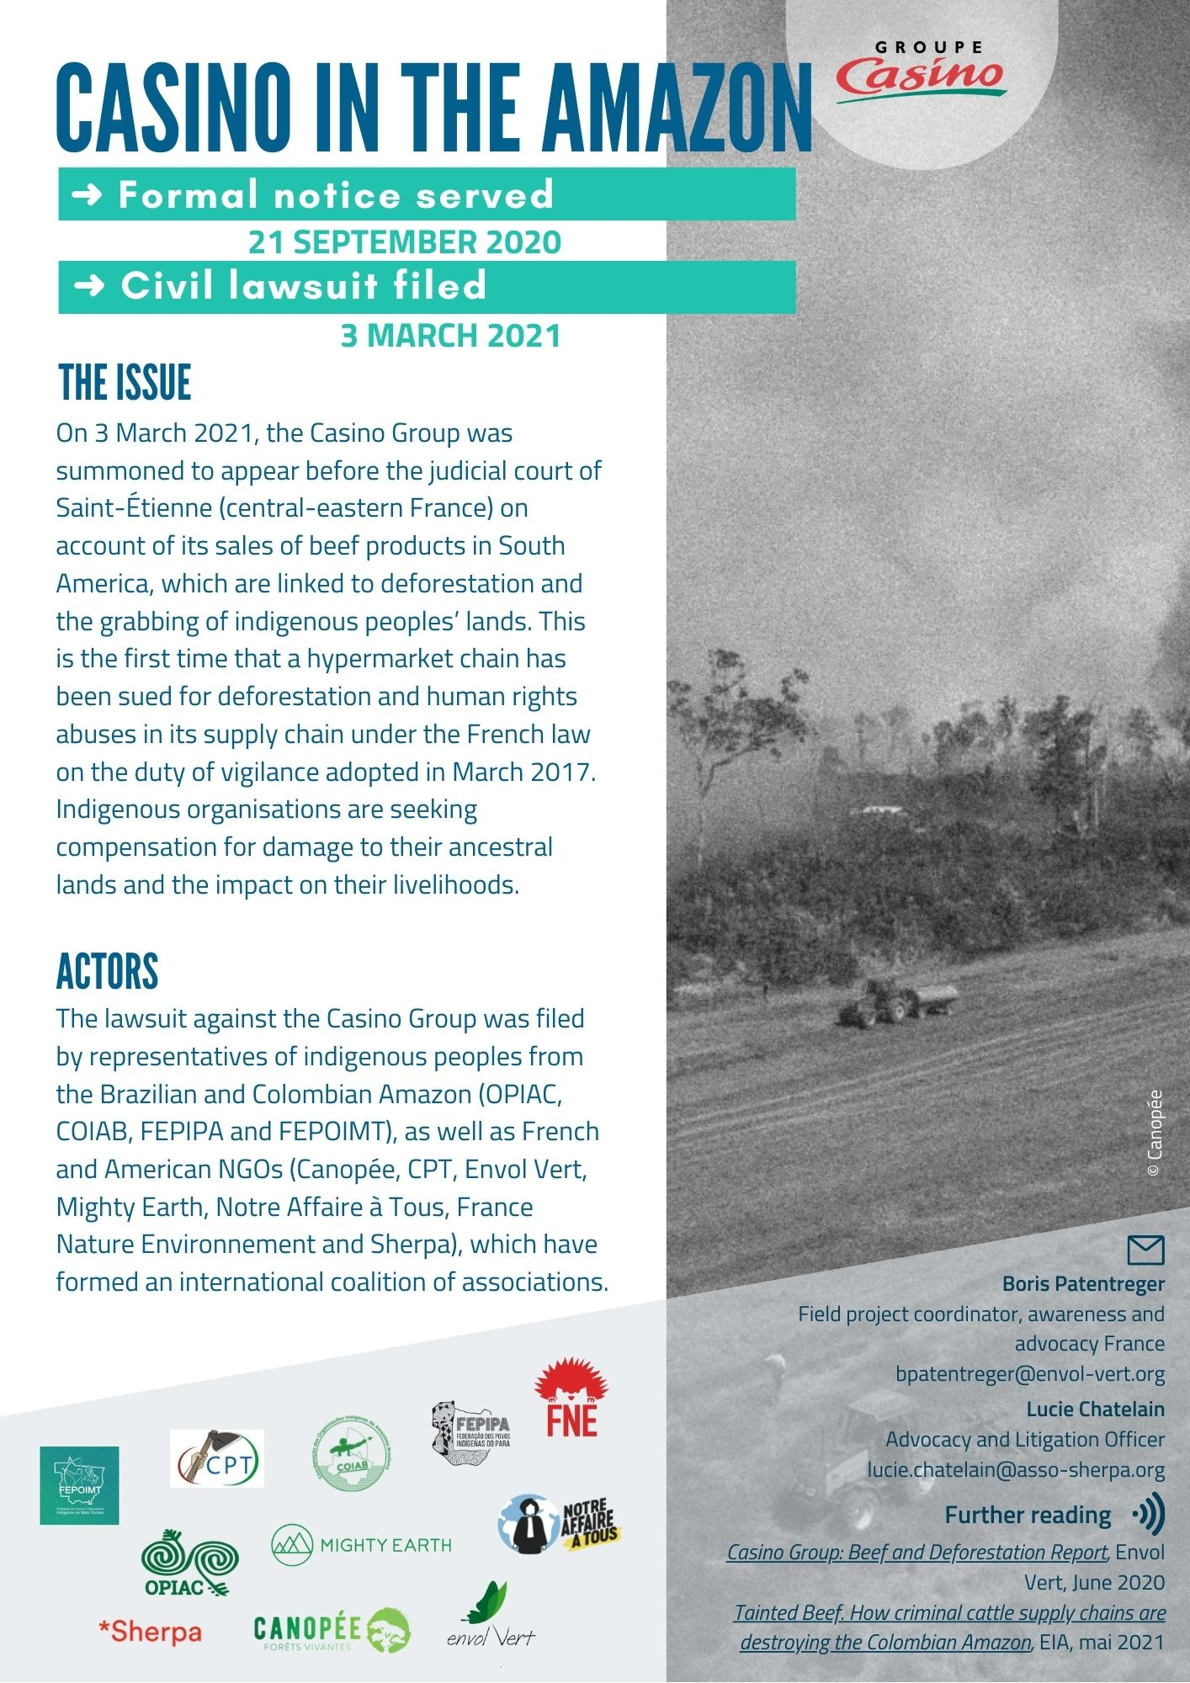
Loi sur le devoir de vigilance – ongoing cases (examples)

Slide 46
Enforcement of the French Law on the Duty of Vigilance – two decisions on the merits
Paris Judicial Court, 5 December 2023 (La Poste)
Paris Judicial Court, 13 February 2025 (SNCF)
Action brought by a trade union against the French State-owned postal company.
The Cour ordered the company to (i) amend its vigilance plan with risk mapping, aimed at identifying, analysing and prioritising risks;
(ii) implement procedures for assessing subcontractors, based on the risks identified, (iii) introduce an alert mechanism, (iv) implement an effective system to monitor the implementation of the vigilance measures.
The Court rejected the request to:
publish an exhaustive list of suppliers and subcontractors,
order specific measures to prevent human rights violations (risks of undeclared work of subcontractors, safety and psycho-social risks),
issue a penalty payment (astreinte).
Action brought by trade unions against the French State-owned railway company.
The Court rejected the request to amend the company’s vigilance plan, notably as the request only generally referred to an ecological risk, without identifying in a specific and concrete matter the damage to the environment, human health or safety to be prevented.

Slide 47
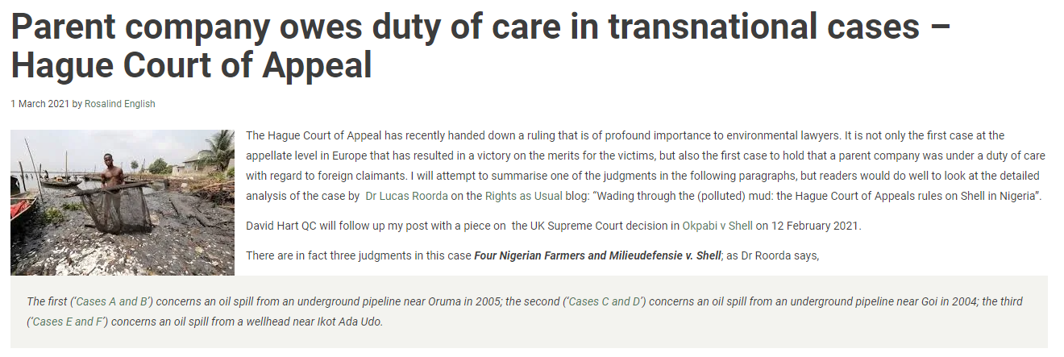
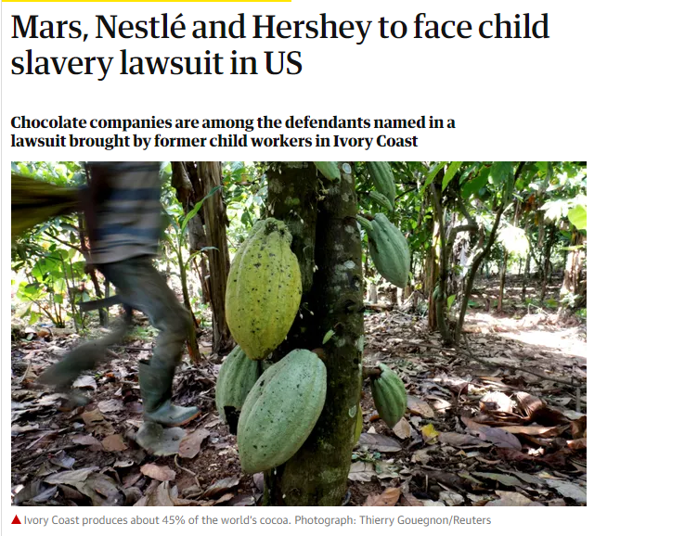
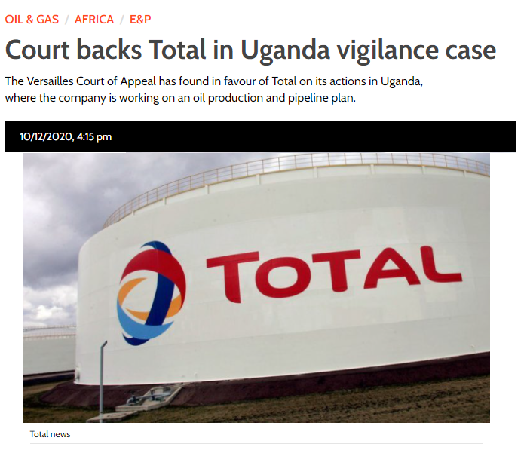

Parent company litigation (out of due diligence regimes)

Slide 48
Okpabi ([2021] UKSC 3) and Vedanta ([2019] UKSC 20) cases
  UK Supreme Court held that parent companies can have liability for the overseas operations of their non-UK subsidiaries
  The two decisions did not decide that a duty of care actually existed, but that it could exist and that the claimants could proceed within the English jurisdiction. The Supreme Court held that, in the context of parent/subsidiary relationships, whether a duty of care arises “depends entirely on the extent to which, and the way in which, the parent availed itself of the opportunity to take over, intervene in, control, supervise or advise the management of the relevant operations (including land use) of the subsidiary” (including by adopting general policies)
  Possible that claims against English parent companies in future may be subjected to the forum non-conveniens hurdle (even where defendant is domiciled in the UK), weakening the position of foreign claimants. The current, decided cases were initiated prior to the end of the UK-EU transition period
  Contrast with:
    Thompson v Renwick Group, where a parent company did not assume a duty of care to employees of its subsidiaries by appointing an individual as a director of the subsidiary with responsibility for health and safety. In running the day-to-day operations of the subsidiary, the director was not acting on behalf of the parent group; he was acting pursuant to his fiduciary duty owed to the subsidiary.
    AAA v Unilever, where it was held that the English-registered parent company owed no duty of care to those affected by the actions or omissions of its Kenyan subsidiary where the subsidiary was responsible for its own decision-making and had not sought advice from the parent company

Slide 49
Hague Court of Appeal – Four Nigerian Farmers and
Milieudefensie v. Shell (29 January 2021)
  First case in which a parent company is held liable for the breach for duty of care for foreign claimants
  Court decided that Shell owed a duty of care to the Nigerian victims affected by an oil spill caused by Nigerian subsidiary
  The court applied Nigerian common law, the law of a state in which a damage occurred, in which English precedent has a persuasive authority (including Vedanta case law, see previous slide).
  Regarding the oil spill, the court decided that Shell cannot be considered to owe a duty of care, since it was caused by sabotage, not by the fault of its Nigerian subsidiary
  However, the Court held Shell liable for its subsidiary's failure to install a LDS (Leak detection system). The Court noted that Shell sets policy and standards, advises, supervises, and is involved in the decision making of the subsidiary. Shell was actively involved in a decision whether oil pipelines in Nigeria should be provided with LDS.

Slide 50
BHP Dam (14 November 2025)
  High Court of England and Wales [2025] EWHC 3001 (TCC) ruled in favour of over 600,000 claimants seeking from BHP compensation for the collapse of the Fundão Dam in Southeast Brazil in 2015
  The court found BHP strictly liable for the disaster under Brazilian law as a result of its ownership and control of the joint venture company which operated the dam. This was because of the Brazilian “polluter law” which provides that a “polluter” is obliged to indemnify or repair damage to the environment regardless of fault. The court found BHP liable under the law because, together with Vale its joint venture partner, it was the controlling shareholder and directing mind of the joint venture company
  In addition, the court found that BHP’s control of the joint venture company and management of the dam gave rise to a Brazilian law duty to take positive action to remedy defects in it. As well as being strictly liable, the court found that BHP would also have been liable under one of the Brazilian fault-based liability regimes relied on by the claimants
  The judgment has decided, at first instance, the key issues of liability in the case but has not determined any issues relating to the claimants’ losses

Slide 51

Contractual disputes

Slide 52

Relevance for contractual disputes
Commercial contracts and supply chain
Post-M&A claims
Significant use of ESG warranties across different size organisations and
sectors.
Proliferation of ESG specific requirements.
Corporate disputes
Debates on fiduciary duties and corporate strategy (see above).
Arbitration
In case of arbitration clause.
Increased pressure on arbitration practitioners themselves.
Investor disputes
Increased disclosure obligations (see above).

Slide 53
Contractual assurances in value chain
OECD Guidelines: “Enterprises can use or increase leverage in a number of ways to influence entities with which it has business relationships, for example, through building expectations around responsible business conduct and due diligence specifically into commercial contracts”
German Supply Chain Due Diligence Act, Art. 6(4): “the enterprise must lay down appropriate preventive measures vis-à-vis a direct supplier, in particular:
1. the consideration of human rights-related and environment-related expectations when selecting a direct supplier,
2. contractual assurances from a direct supplier that it will comply with the human rights-related and environment-related expectations required by the enterprise’s senior management and appropriately address them along the supply chain,
3. the implementation of initial and further training mechanisms to implement the contractual assurances made by the direct supplier according to number 2,
4. agreeing on appropriate contractual control mechanisms and their risk-based implementation to verify compliance with the human rights strategy at the direct supplier.”
CSDDD Commission Proposal, Art. 7(2)(b) “Companies shall be required to take the following actions, where relevant: […] (b) seek contractual assurances from a business partner with whom it has a direct business relationship that it will ensure compliance with the company’s code of conduct and, as necessary, a prevention action plan, including by seeking corresponding contractual assurances from its partners, to the extent that their activities are part of the company’s value chain (contractual cascading)”

Slide 54

Contractual assurances in value chain
CSDDD Commission Proposal, recital 15:
“This Directive should not require companies to guarantee, in all circumstances, that adverse impacts will never occur or that they will be stopped […]. The company should take the appropriate measures which can reasonably be expected to result in prevention or minimisation of the adverse impact under the circumstances of the specific case. Account should be taken of the specificities of the company’s value chain, sector or geographical area in which its value chain partners operate, the company’s power to influence its direct and indirect business relationship, and whether the company could increase its power of influence.”

Slide 55
ESG model clauses
ABA Model Clauses (American Bar Association Business Law Section Working Group) – U.S. law and CISG
  2018 Model Contractual Clauses (MCCs 1.0): representations and warranties
  2021 Model Contractual Clauses (MCCs 2.0): shared responsibility
  2023 Supplier Model Contract Clauses (SMCs 1.0) (Responsible Contracting Project)
The Chancery Lane Project – English law
  “Using climate contracting to deliver fast and fair decarbonisation”
  Collaborative initiative: 3600 professionals, 350 organisations, 113 countries
  160 model contractual clauses
European Model Clauses Project – EU law
  European Working Group: academics and legal practitioners
  Based on ABA MCCs 2.0

Slide 56
ESG model clauses – purposes
Avoiding and minimising ESG adverse impact
Assigning liability risks
  Representations and warranties / indemnity
  Allocate time and cost risks of ESG-related delay and disruption (new legislation, customs seizure, investigation or enforcement action by local authorities, remediation efforts, legal proceedings, etc.)
Compliance with legal obligations
There is also a momentum, particularly among larger corporates, to impose detailed climate change or other ESG-specific requirements on suppliers due to the expectations of external stakeholders, such as investors, who seek to identify ESG risks and issues within businesses, especially across its supply chain.
– IBA Report on use of ESG contractual obligations and related disputes (2023), p. 21

Slide 57


Example of clause on ESG regulatory change
Increasingly ESG due diligence is a major factor on transactions
Pressure to tighten ESG covenant packages is mounting
We are
starting to see ESG dilemmas crystallise at credit committee level
‘Green’ and ‘sustainable’ financial products are on the rise
Financiers are keen to invest in ‘green’ (especially Taxonomy-aligned) businesses
Some asset classes (e.g. coal) are extremely difficult to
finance

Slide 58


Example of requested ESG covenant for an industrial project
Increasingly ESG due diligence is a major factor on transactions
Pressure to tighten ESG covenant packages is mounting
We are
starting to see ESG dilemmas crystallise at credit committee level
‘Green’ and ‘sustainable’ financial products are on the rise
Financiers are keen to invest in ‘green’ (especially Taxonomy-aligned) businesses
Some asset classes (e.g. coal) are extremely difficult to
finance

Slide 59
M&A context
Due diligence, where applicable, can be geared towards identifying, managing and allocating ESG-related risks – ESG-specific due diligence is increasingly more common-place. Indemnities will often track the findings (or lack thereof) of the due diligence process
The usual representation and warranties sought in M&A transactions (assets of the business are in good repair; the business operates in compliance with all applicable laws) remains relevant as a result of the ESG dimension of the transaction
However, in light of the ESG dimension, buyers may additionally seek to tailor representations and warranties to pin-point key ESG issues, such as compliance with particular environmental laws or reporting regimes (such as gender pay gap or modern slavery reporting)
Example: MDW Holdings Ltd v Norvill [2022] EWCA (Civ) 883: It transpired that the Sellers had been operating the purchased company in breach of applicable environmental regulations and had misled regulators. The Buyer brought a claim for damages in deceit and for breach of warranty against the Sellers, relying inter alia on ESG focussed warranties, including: “29.2 The Company and the Subsidiary have at all relevant times obtained and complied in all material respects [with] all EHS Permits. All EHS Permits currently held by the Company and the Subsidiary are in full force and effect, and, so far as the Sellers are aware, there are no facts or circumstances in existence as at Completion that are likely to result in the revocation, suspension, variation or non-renewal of any EHS Permits.”
Increasingly ESG due diligence is a major factor on transactions
Pressure to tighten ESG covenant packages is mounting
We are
starting to see ESG dilemmas crystallise at credit committee level
‘Green’ and ‘sustainable’ financial products are on the rise
Financiers are keen to invest in ‘green’ (especially Taxonomy-aligned) businesses
Some asset classes (e.g. coal) are extremely difficult to
finance

Slide 60
M&A context – example with respect to transition plan
1. The Company [and Seller each] represent(s), warrant(s) and covenant(s) that full and complete details of each of the following have been disclosed to Buyer in the Disclosure Documents:
  1.1. How climate change issues are considered in the Company’s corporate strategy and long and short-term business plans;
  1.2. The Company’s Net Zero Target and Net Zero Transition Plan, if any;
  […]
  1.5. Whether the Company has made any public or employee-directed statements regarding its Net Zero Target, Carbon Budget or other sustainability or climate change-related plans [in the previous [5] years];
  1.6. Whether the Company’s Net Zero Target has been approved by the Science Based Targets initiative;
  1.7. If and how the Company assesses and discloses climate risks and opportunities with regard to the recommendations of the Task Force on Climate-related Financial Disclosures;”
Increasingly ESG due diligence is a major factor on transactions
Pressure to tighten ESG covenant packages is mounting
We are
starting to see ESG dilemmas crystallise at credit committee level
‘Green’ and ‘sustainable’ financial products are on the rise
Financiers are keen to invest in ‘green’ (especially Taxonomy-aligned) businesses
Some asset classes (e.g. coal) are extremely difficult to
finance

Slide 61

Questions?

