Slide 1

Specific regimes and practical questions
ULB, 2 December 2024

Slide 2

Focus on the E

Slide 3
Emission trading systems (ETS and ETS2)
Directive 2003/87/EC establishing a scheme for greenhouse gas emission allowance trading within the Community (“ETS Directive”)
Aim of reducing greenhouse gas emissions from most emitting sectors by transforming the possibility to emit greenhouse gases into a scarce commodity that must be purchased in the form of so-called “EU allowances”
Revised ETS entered into force on 5 June 2023; target is to achieve a 62% reduction in carbon emissions from the sectors covered by it by 2030 (up from the 41% reduction that has been achieved since introduction in 2005)
  In phase 3 (2013-2020), yearly reduction of allowances of 1.74%. In phase 4 (2021-2030), 2.2%
Currently: around 10,000 in-scope installations (exceptions for small operators):
  Electricity and heat generation
  Energy-intensive industry sectors, including oil refineries, steel works, and production of iron, aluminium, metals, cement, lime, glass, ceramics, pulp, paper, cardboard, acids and bulk organic chemicals
  Aviation within the European Economic Area and departing flights to Switzerland and the United Kingdom
  Maritime transport (50% of emissions from voyages starting or ending outside of the EU and 100% of emissions from voyages between two EU ports and when ships are within EU ports)
ETS2 (operational in 2027): to cover emissions from buildings, road transport and additional sectors (small industry not yet covered). Social Climate Fund created to address the social impact. Aim is to mobilise EUR 86.7 billion from the ETS2 revenue for 2026-2032

Slide 4
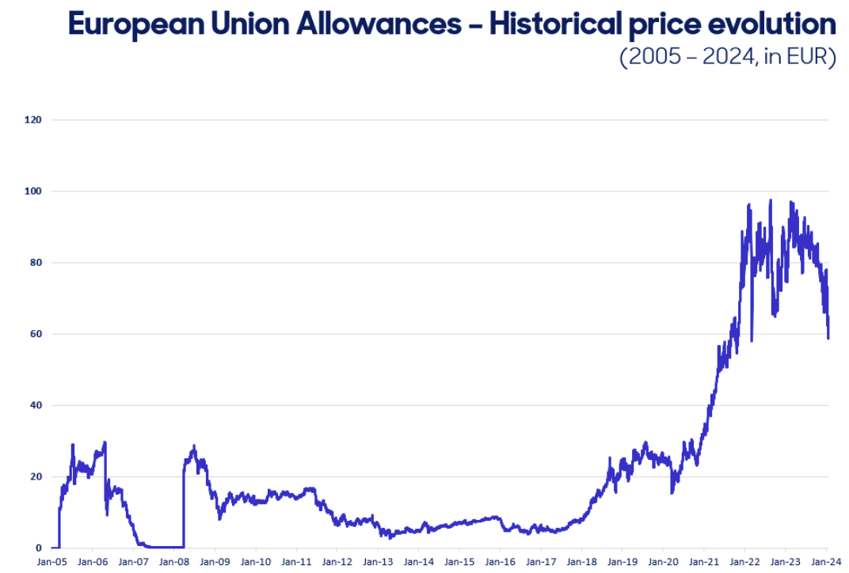
ETS – in figures
57% of the total amount of allowances were auctioned (rest granted free of charge)
The total revenues generated by Member States, the UK and EEA countries from the auctions since 2013 exceeds EUR 175 billion
The ETS Directive provides that Member States should use at least 50% of auctioning revenues or the equivalent in financial value for climate and energy-related purposes (in practice 78% of revenues in 2013-2019)

Slide 5
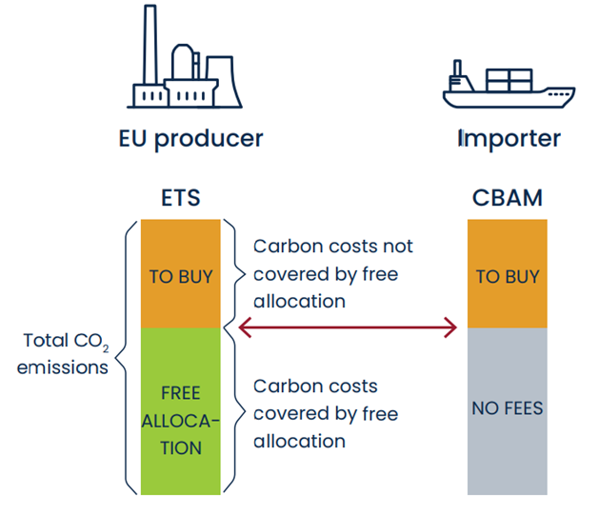
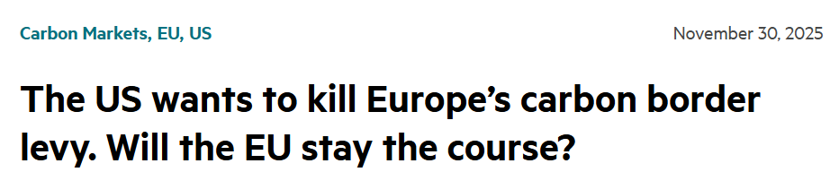
Carbon border adjustment mechanism (CBAM)
Entered into force on 17 May 2023
CBAM applies to goods imported into the EU to prevent “carbon-leakage”, i.e. relocation of energy intensive production from the EU to countries with lower levels of regulation of GHG emission
Covers iron and steel, cement, aluminium, fertilisers and electricity, as well as hydrogen, indirect emissions under certain conditions, certain precursors and certain downstream products (such as screws and bolts and similar articles of iron or steel)
The European Commission will assess whether it should be extended to organic chemicals and polymers (plastics) by 2026
By 2030, CBAM will cover all goods covered by the ETS

Slide 6
New focus on biodiversity and nature
Globally, momentum is building to address biodiversity loss and the associated risks issues via policy and regulation. Market sentiment is also shifting
Whilst data and methodologies remain challenging, significant progress is being made to collate data and make it more accessible as well as to develop methodologies and metrics
These trends highlight the physical/transition and systemic risks (including litigation risks) to corporations. In addition, the regulatory policy and market sentiment trends give rise to additional transition risks
Disclosures
Assessing own operations
Governance
Regulatory expectations
Assessing impacts, risks & opportunities
Labelling and investments
“While climate-related concerns have long dominated the environmental pillar of ESG investing, increasing attention is now being paid to biodiversity risks and the importance of the ecosystem to the global economy.”
- ESMA TRV Risk Monitor No. 2, 2023
Developing and updating policies
Risk assessment and appetite
Transition Plans
“As alarm at the decline in nature and biodiversity grows – with some considering that humanity has become a weapon of mass extinction – we can expect litigants to turn to the courts, drawing inspiration from their successes in the area of climate.”
- Frank Elderson, Member of the ECB’s Executive Board

Slide 7
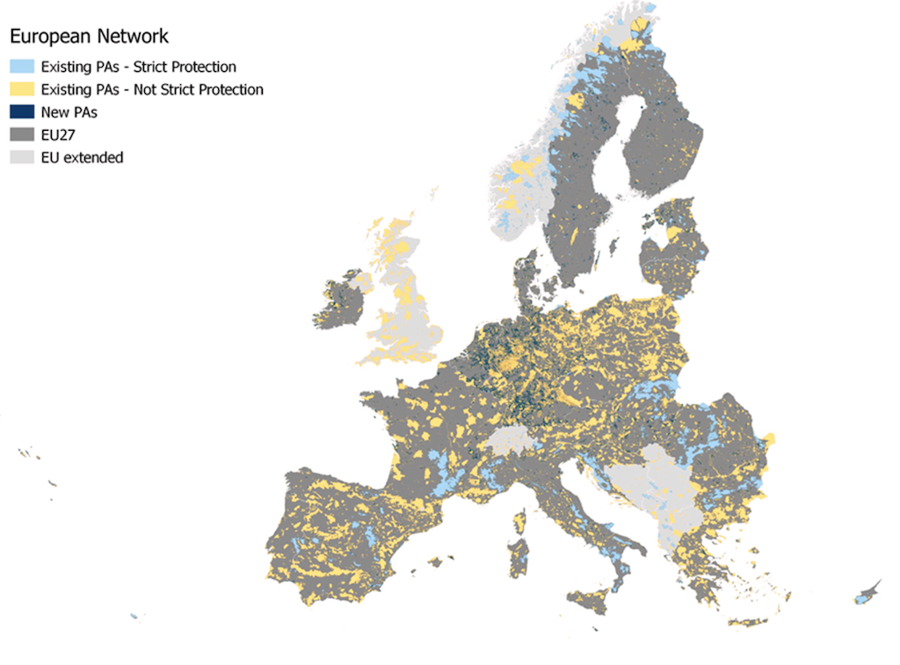
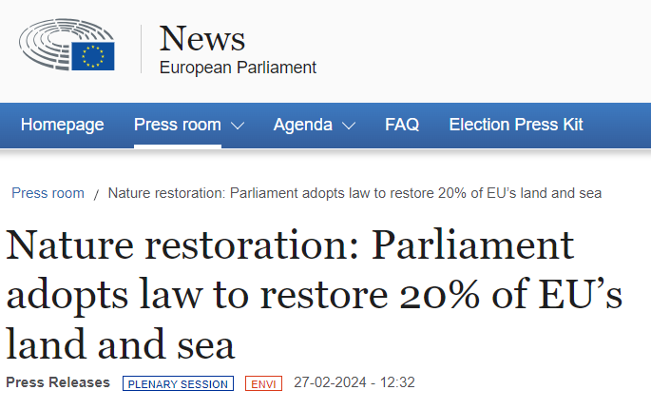
EU Nature Restoration Law
EU countries must restore at least 30% of protected habitats in poor condition by 2030, 60% by 2040, and 90% by 2050
EU countries would need to submit national restoration plans to the Commission to show how they plan to deliver on key targets, with requirements for monitoring and reporting on their progress towards those goals
Passed through a final vote in the European Parliament on 27 February 2024, with 329 votes in favour, 275 against and 24 abstentions
Intended to work alongside other environmental policies on a range of issues, including birds, habitats, water and invasive alien species. Its goals also align with the new EU 2030 forest strategy, which intends to protect and restore forests across the bloc

Slide 8
Biodiversity: existing regulatory landscape
Local and National Laws
UN Global Biodiversity Framework (GBF) (2022)
Disclosure Requirements
Other
Planning laws / variety of environmental (land use, fisheries, pollution, marine and water) regulations
All 196 contracting parties committed to setting national targets to implement the GBF
Target 15: measures to be taken to encourage large companies and FIs to regularly monitor, assess and disclose risks, dependencies and impacts on biodiversity, including along their value chain and portfolios
Sets the stage for mandatory corporate reporting and due diligence
Bank-led working group formed by the UN in May 2023 aimed at aligning industry guidance with the GBF
UNEP FI, PRI and Finance for Biodiversity Foundation published guidance on the implications of the GBF for responsible investors in April 2023
Corporate Sustainability Reporting Directive (CSRD): sustainability reporting
Biodiversity and ecosystems standard (ESRS E4) as well as standards on climate change, pollution, water and marine resources, resource use and circular economy
IFRS S1 General Requirements for Disclosure of Sustainability-related Financial Information (ISSB S1)
Pillar 3 (ESG risks): disclosures by certain listed FIs
Corporate Sustainability Due Diligence Directive (CSDDD): due diligence obligations
EU Taxonomy
SFDR (sustainable investments, PAIs)
UK Sustainability Disclosure Requirements (SDR) (draft)
Taskforce on Nature-related Financial Disclosures (TNFD) (18 September 2023)
GRI 304 on Biodiversity (Q4 2023)
Deforestation regulations

Slide 9
Recast EU Environmental Crime Directive
Directive on the protection of the environment through criminal law, replacing the existing Environmental Crime Directive (Directive 2008/99/EC)
Provides for tougher penalties and increases the list of environmental crimes at the EU level, from 9 to 18, including timber trafficking, illegal collection, transport and treatment of waste, pollution caused by ships, the use of mercury and fluorinated greenhouse gases, the import of invasive species, the illegal depletion of water resources, as well as serious breaches of legislation on chemicals (connection with AML)
“Qualified offence” (= ecocide): offence committed intentionally that causes destruction or “irreversible, widespread and substantial damage” or “long-lasting, widespread and substantial damage” to an ecosystem of considerable size or environmental value, or to a natural habitat within a protected site, or to the quality of air, soil or water
National provisions may go further – e.g. France:
  Ecocide covered by Article L. 231-3 of the French Environment Code
  Erika oil spill case (French Supreme Court; Cass. crim., 25 September 2012, No. 10-82.938): creates notion of “ecological damage” (now covered by Article 1247 of the French Civil Code)
  On 22 September 2023 four environmental NGOs filed a criminal complaint against TotalEnergies based on alleged “failure to combat a disaster likely to endanger the safety of people”, “unintentional injury”, “destruction, degradation or deterioration of property belonging to others likely to create a danger to people”, and “manslaughter”. The non-public criminal complaint is reported to generally criticise the company’s impact on the environment over the past years

Slide 10
EU Deforestation Regulation (EUDR): in a nutshell
Who?
Specific regimes for SME operators and for SME traders
Rule?
Deforestation-free;
Produced in accordance with the relevant legislation of the country of production; and
The operator/trader has filed a due diligence statement.
How?
When?
30 December 2025 (but 30 June 2026 for SMEs)
Specific transitory regime for wood and wood products covered by previous EU Timber Regulation
Enforcement?
National Competent Authorities to undertake minimum annual checks (9% for high-risk, 3% for medium risk, 1% for low-risk)
Maximum amount of fines shall be at least 4% of the infringer’s total annual EU-wide turnover
Other legal risks in case of non-compliance with any contractual undertakings a company has given
Covered commodities (cattle, cocoa, coffee, oil palm, rubber, soya and wood) and products (e.g., chocolate, leather or wood furniture)
Operators (first placing on the market) and traders (making available the product on the market further down the supply chain)
Prohibition of placing and making available listed products on the EU market (and of exporting therefrom) unless:
Three-step due diligence: (i) Information requirements, (ii) Risk assessment, and (iii) Mitigation measures
What?

Slide 11
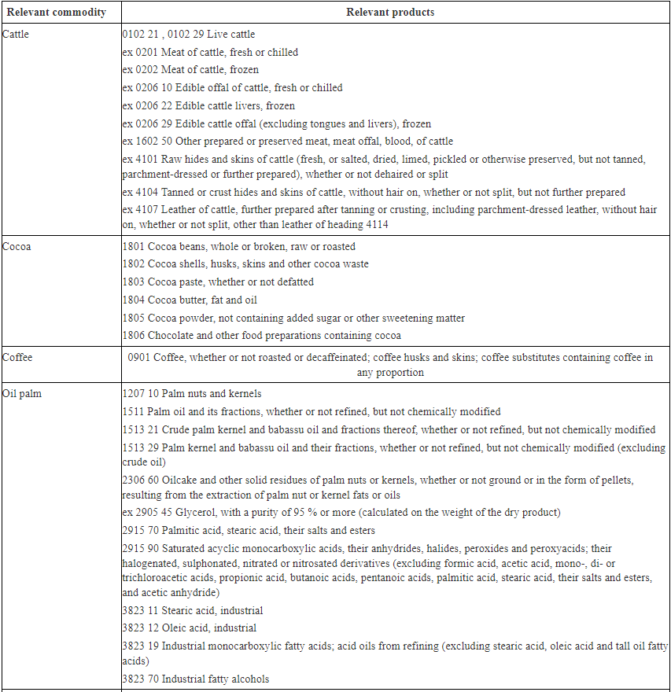
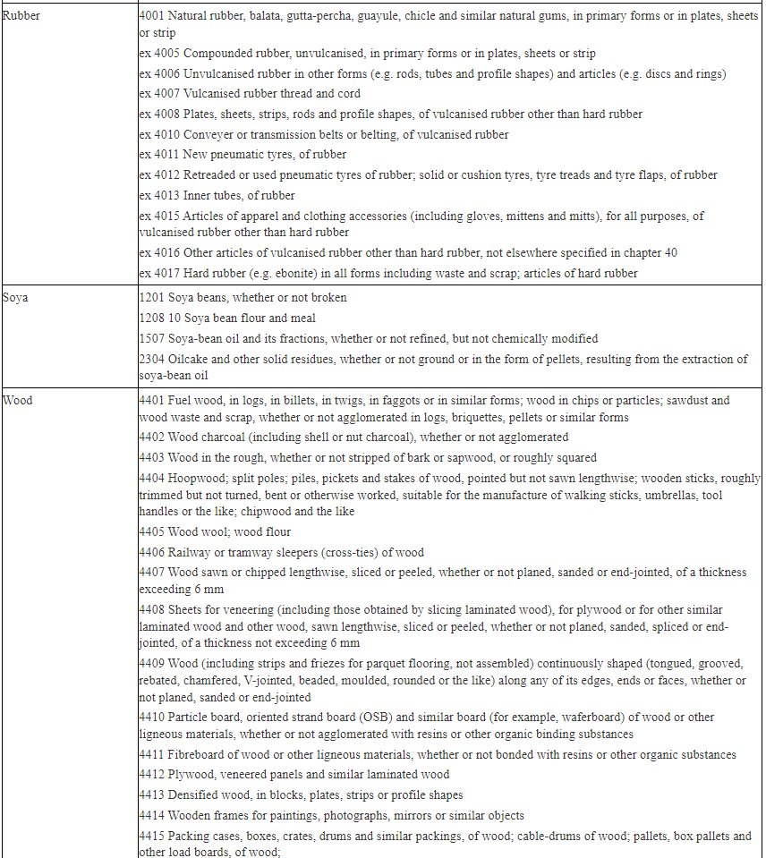
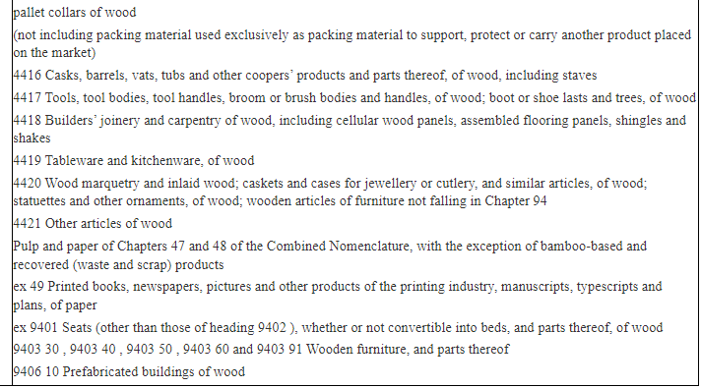
EUDR: Annex I

Slide 12
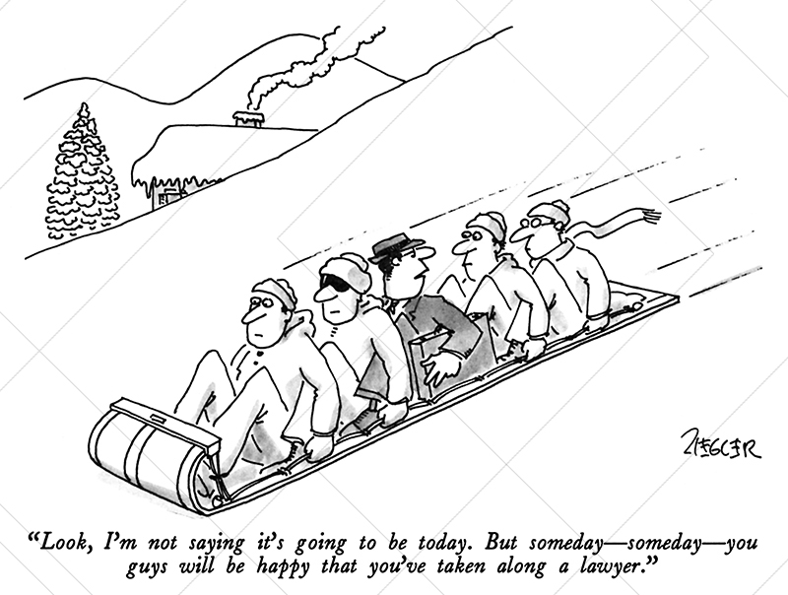
EUDR in practice – what are businesses asking their lawyers?
Temporal application (especially for wood products – transition from EU Timber Regulation)
Scope of application – how far does it go?
Enforcement risks
Review of implementation plan
Specific interpretation queries
Uncertainties on postponement
Adaptation of contracts: information requirements; assurances; who has to bear the costs of compliance; termination rights
Etc.

Slide 13
When does the EUDR apply (timing)?
Key:
=
Timber product produced within this date range
=
Timber product placed on the EU market within this date range
EUTR applies
Scenario 1
❒
EUTR applies
Scenario 2
❒
EUDR applies
✓
Scenario 3
EUDR applies
✓
Scenario 4
29 June 2023
30 December 2024
31 December 2027

Slide 14


EUDR in practice – Scope of application – how far does it go?
“(18) ‘making available on the market’ means any supply of a relevant product for distribution, consumption or use on the Union market in the course of a commercial activity, whether in return for payment or free of charge;
(19) ‘in the course of a commercial activity’ means for the purpose of processing, for distribution to commercial or non-commercial consumers, or for use in the business of the operator or trader itself”
Company A, manufacturer of trucks (non in-scope products), acquire in-scope products (e.g. tyres) from EU operators (acting as importers of record)
Company A provides maintenance services, including replacement of tyres
Company A also sell coffees to clients visiting its workshops
Is company A trader of tyres and coffees? If so, does it need to file a due diligence statement before each “sale”?

Slide 15
Circular economy
Circular Economy Act – ongoing consultation; expected for 2026
Packaging and Packaging Waste Regulation (PPWR)
  Various measures aimed at reducing packaging, limiting specific types, and banning the use of harmful chemicals in food packaging
Right to Repair Directive
  Amend the legal warranty rules laid down in the Sale of Goods Directive and introduce new rights and obligations for the time after the legal warranty period has elapsed for certain in-scope products
  Further tools to make repair more attractive to consumers include a European repair information form and a European online platform for repair

Slide 16





In practice – PPWR
According to article 10 PPWR, which includes the requirement of packaging minimisation:
There is an obligation for the manufacturer/importer to ensure that packaging placed on the market is designed in a way so that the weight and volume of the packaging is reduced to the minimum necessary “for its function” (article 10 (1) PPWR));
Furthermore, there is a prohibition for the manufacturer/importer to place on the market (article 10 (2) PPWR):
  Packaging that does not comply with the performance criteria set out in Annex IV PPWR; and
  Packaging only aimed to increase the perceived volume of the product

Slide 17

Focus on the S
Notes:
GILLY

Slide 18



EU Pillar of Social Rights Action Plan
As we overcome the pandemic, as we prepare necessary reforms and as we speed up the twin green and digital transitions, I believe it is time to also adapt the social rulebook. A rulebook which ensures solidarity between generations. A rulebook that rewards entrepreneurs who take care of their employees. Which focuses on jobs and opens up opportunities. Which puts skills, innovation and social protection on an equal footing.
Commission President von der Leyen, 20 January 2021
More and better jobs
Social protection and inclusion
Skills and equality

Slide 19
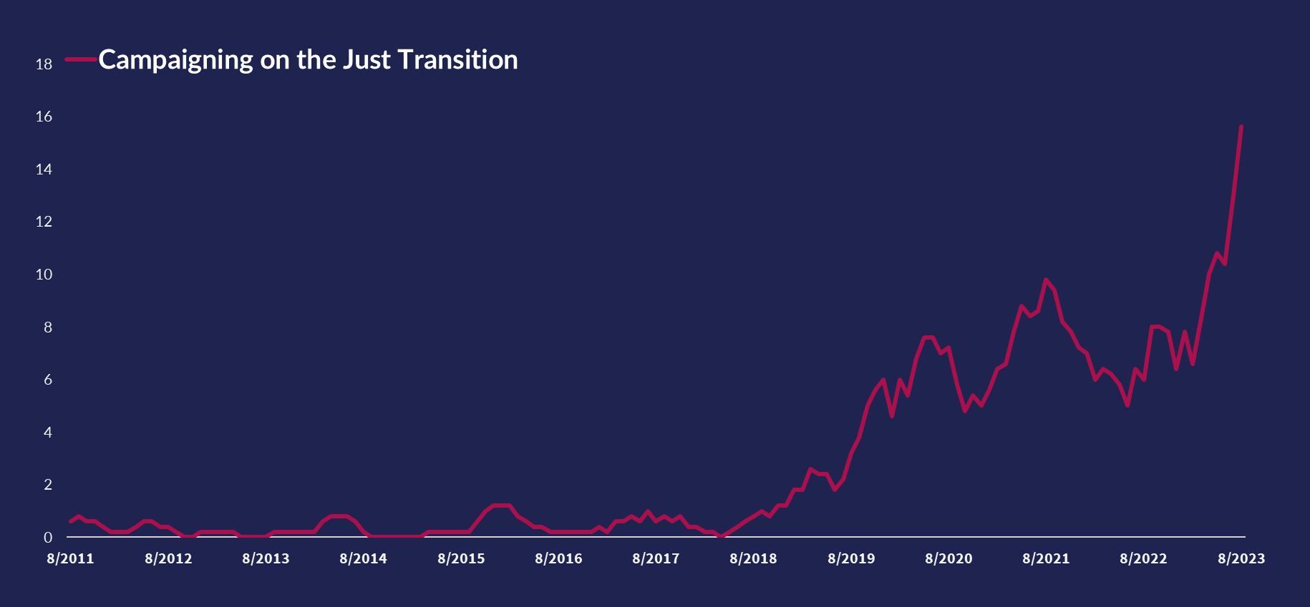

Just transition – NGO campaigns

Slide 20

‘S’ Regulatory landscape
Forced Labour Ban Regulation
Platform Work Directive
​[Social Taxonomy]
Pay Transparency Directive
​Implementation Minimum Wages Directive
Implementation Women on Boards Directive
Work-life Balance Directive
  > Minimum Safeguards Taxonomy / SFDR
    Disclosure & reporting of the social landscape – CSRD

Slide 21
Women on Boards Directive
  Directive (EU) 2022/2381 of the European Parliament and of the Council of 23 November 2022 on improving the gender balance among directors of listed companies and related measures
  Large listed EU companies that do not meet the target of 40 % among non-executive board members or 33% among all directors of the under-represented sex by 30 June 2026 have to ensure fair and transparent selection procedures for the selection of candidates for board positions. Such companies will be required to make appointments on the basis of a comparative analysis of the qualification of candidates by applying clear, gender-neutral and unambiguous criteria and to ensure that applicants are assessed objectively based on their individual merits, irrespective of gender
  Large-listed EU companies also have to undertake individual commitments to reach gender balance among their executive board members.
  Companies that fail to meet the objective of the directive must report the reasons and the measures they are taking to address this shortcoming
  Member States can foresee penalties for companies that fail to comply with selection and reporting obligations
  The directive is meant to be temporary and is set to expire on 31 December 2038.
  Many Member States go further already

Slide 22
Platform Work Directive
  “Employment in which organisations or individuals use an online platform to access other organisations or individuals to solve specific problems,​ or to provide specific services in exchange for payment”
  Over 28 million people in the EU work through one (or more) of these digital labour platforms in 2023.​ In 2025,​ that number is expected to reach 43 million people
  Workers legally presumed to be employees of a digital platform (as opposed to self-employed) if their relationship with the platform fulfils at least two out of five indicators:
    upper limits on the amount of money workers can receive
    supervision of their performance, including by electronic means
    control over the distribution or allocation of tasks
    control over working conditions and restrictions on choosing working hours
    restrictions on their freedom to organise their work and rules on their appearance or conduct
  Workers will have to be informed about the use of automated monitoring and decision-making systems. these systems need to be monitored by qualified staff, who enjoy special protection from adverse treatment. Human oversight is also guaranteed for significant decisions such as the suspension of accounts

Slide 23
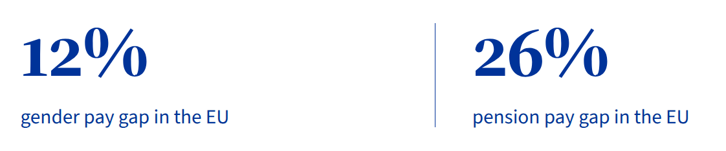
Pay Transparency Directive
  > Entry into force in 2026
Far-reaching
information rights
on (average) salary
and criteria
for progression
Gender pay gap (GPG)
reporting for companies
> 250 employees
If GPG + 5%
→
Action plan (“joint pay
Assessment”)
Sanctions and
enforcement
Mechanisms in case of
gender pay
discrimination
Job applicants
Employees
Definitions “same work” and “work of equal value”
Align with CSRD?
Review of pay structures with employee representatives
Collective actions, reversal of burden of proof, etc.
Penalties based on gross annual turnover or payroll cost

Slide 24
EU Whistleblowing Directive
  Directive (EU) 2019/1937 of the European Parliament and of the council of 23 October 2019 on the protection of persons who report breaches of Union law (EU Whistleblowing Directive)
Who?
Legal entities in the financial services sector (subject to EU financial services legislation)
Every ‘legal entity’ with 50 or more workers (as defined under local law)
What?
Reports of violations of listed European legislation (e.g. data privacy, consumer protection, protection of the environment, public procurement, etc.)
Enabling reporting by (ex-/future) employees, self-employed contractors, volunteers, trainees, shareholders, members of supervisory bodies
Cannot rely on group-wide channels and procedures or those operated by another entity within the corporate group
Resource sharing permitted between legal entities with 50 – 249 employees
Ensure that workers understand how channels work and are incentivised to use internal channels at first instance

Slide 25

EU Whistleblowing Directive – reporting channels: key features
  Prohibition of “retaliation” against whistleblower (very broadly defined: any (i) direct or indirect act or omission which occurs in a (ii) work-related context, prompted by (iii) internal or external reporting or by public disclosure, and (iv) which causes or may cause unjustified detriment to the reporting person)
  Measures for protection against retaliation: shift of burden of proof and immunity from liability
Follow-up by designated person or department
Confidentiality
Depends on size and resources of the company
external channels
After consultation and agreement with social partners
Specific timeframe to acknowledge / give feedback
In person or not, orally or in writing
public disclosure
internal channels

Slide 26

Focus on the G

Slide 27
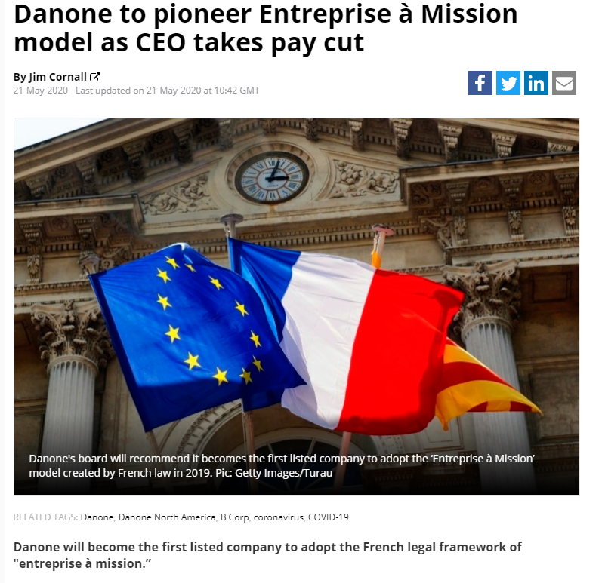
Corporate purpose – France
Loi pacte du 22 mai 2019 relative à la croissance et la transformation des entreprises
Introduced the company with a mission (“société à mission”)
  Its articles of association must state one or more social or environmental goals that it will pursue in the course of its business
  French law requires a double control of the execution of these goals :
    internal control, by a “mission committee", which is separate from the management bodies and includes at least one employee
    external control, by an independent third party
Around 1,000 companies

Slide 28
Corporate purpose – Belgium
Article 1:1 of the new Code of Companies and Associations
  “One of the goals” of a company is to distribute profits to its shareholders
  This is a way of inviting companies to envisage goals going beyond the sole distribution of profits
    No specific status or regime as in France
    Impact on the corporate purpose clause (in the articles of association)
    In any case, profits must remain one of the goals of any company
  What about the corporate interest, for a company which would not chose to include any social or environmental goals in its corporate purpose clause?
    Court of Cassation (Belgian Supreme Court), 28 November 2013: “the company's interest is determined by the collective profit goal of the present and future shareholders of the company”
    This remains a controversial topic
    New Art. 1:1 to impact the case law?

Slide 29

Corporate purpose – B Corporation
  Main sustainability-oriented corporate certification scheme, B Corp (“B” stands for the “absence of Planet B”) that a business “is meeting high standards of verified performance, accountability, and transparency on factors from employee benefits and charitable giving to supply chain practices and input materials”
  In order to achieve certification, a company must:
    “Demonstrate high social and environmental performance by achieving a B Impact Assessment score of 80 or above and passing our risk review. Multinational corporations must also meet baseline requirement standards.
    Make a legal commitment by changing their corporate governance structure to be accountable to all stakeholders, not just shareholders, and achieve benefit corporation status if available in their jurisdiction.
    Exhibit transparency by allowing information about their performance measured against B Lab’s standards to be publicly available on their B Corp profile on B Lab’s website”
  Many B Corp certified companies are small and midsize companies, with a few exceptions in the consumer goods sector, such as Nespresso (part of Nestlé group), Ben & Jerry’s (part of Unilever group) and Patagonia

Slide 30
Corporate duty of care – The Netherlands
The responsibility of business enterprises to respect human rights, as formulated in the UNGP, is a global standard of expected conduct for all business enterprises wherever they operate. It exists independently of States’ abilities and/or willingness to fulfil their own human rights obligations and does not diminish those obligations. And it exists over and above compliance with national laws and regulations protecting human rights. Therefore, it is not enough for companies to monitor developments and follow the measures states take; they have an individual responsibility. It can be deduced from the UNGP and other soft law instruments that it is universally endorsed that companies must respect human rights.
– Shell judgement
  Broadly confirmed on appeal
  Extension to directors’ fiduciary duties?

Slide 31
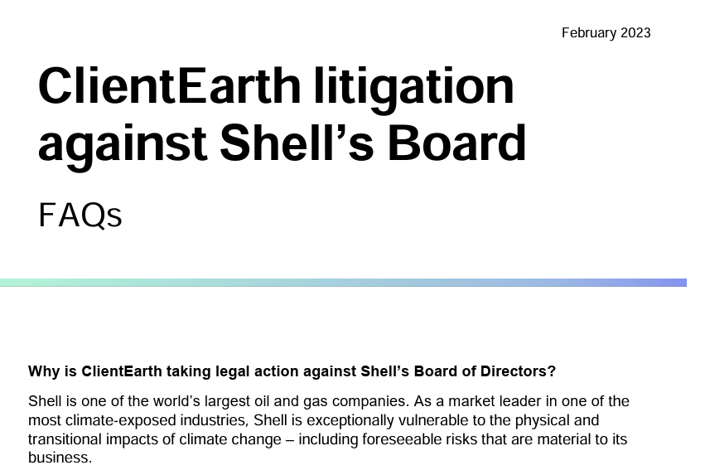
Directors’ duties – UK
    Section 172 Companies Act 2006 – Duty to promote the success of the company
      A director of a company must act in the way he considers, in good faith, would be most likely to promote the success of the company for the benefit of its members as a whole, and in doing so have regard (amongst other matters) to
      (a) the likely consequences of any decision in the long term,
      (b) the interests of the company’s employees,
      (c) the need to foster the company’s business relationships with suppliers, customers and others,
      (d) the impact of the company’s operations on the community and the environment,
      (e) the desirability of the company maintaining a reputation for high standards of business conduct,
      (f) the need to act fairly as between members of the company.
    Section 174 Companies Act 2006 – Duty to exercise reasonable care, skill and diligence

Slide 32
EU second shareholders’ rights directive (2017/828/EU; SRD II)
    Main objectives
      Further increase the long-term engagement of shareholders in listed companies
      Further increase the transparency by listed companies and certain other stakeholders
      Overarching objective: Achieve the long-term sustainability of listed companies
      Areas covered by SRD II
        Right of identification of shareholders by listed companies
        New rules regarding the communication between the company, the intermediaries and the shareholders
        Confirmation of votes at shareholders’ meetings
        New obligations for institutional investors and asset managers in relation to investments in listed companies
        New obligations for proxy advisors
        New rules regarding the remuneration policy and the remuneration report
        New rules on related party transactions

Slide 33

Remuneration disclosure – Scope of application
  Listed companies only
  Persons within the scope of application:
    the members of the board of directors (in a one-tier structure) or the members of the supervisory board and the management board (in a two-tier structure;
    the person or persons in charge of the daily management; and
    all other persons who are members of any committee where the general management of the company is discussed and which is not a management board, i.e., the “other executives”

Slide 34
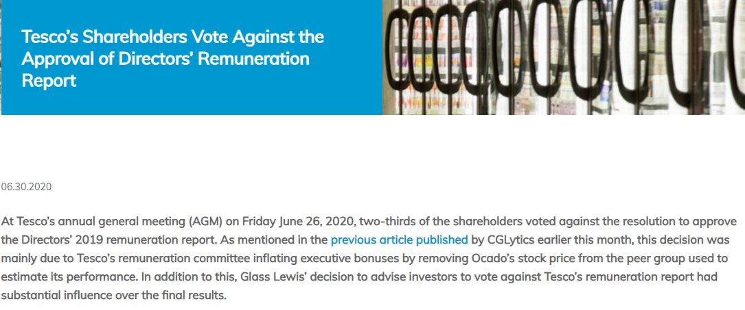
Two separate remuneration documents subject to SM approval
  Remuneration policy
  Providing for detailed rules applicable to the remuneration framework
  To be submitted to the binding vote of the shareholders’ meeting at least every four years and whenever there is a substantial change to the policy
    Where the shareholders’ meeting rejects the proposed policy:
      the remuneration may continue to be paid as before (i.e., the proposed
      new or modified items of the policy are not applied);
      the company must submit a revised policy for approval
      at the following shareholders’ meeting
      Remuneration report
  Reporting on the past financial year
  To be submitted every year to the advisory vote of the SM
  Requirement to explain how the vote on the previous report
  was taken into account

Slide 35
Engagement of institutional investors and asset managers
  Key assumptions of the EU legislator
    a greater involvement of shareholders in corporate governance can help improve the financial and non-financial performance of companies, including as regards ESG factors, in particular as referred to in the UN Principles for Responsible Investment
    such greater involvement may counter-balance the short-term pressure exercised by the financial markets
  Scope of application
    Institutional investors, to the extent that they invest directly or through an asset manager in shares traded on a regulated market
    Asset managers, to the extent that they invest in shares traded on a regulated market on behalf of investors

Slide 36
Engagement policy
  Institutional investors and asset managers have to develop and disclose a policy on shareholder engagement or explain in detail why they have chosen not to do so (comply or explain)
  Contents of the engagement policy:
    How institutional investors and asset managers integrate shareholder engagement in their investment strategy and which engagement activities they carry out
    Policies to manage actual or potential conflicts of interests
  Annual reporting:
    Information on the implementation of the policy
    In particular, information on how voting rights have been exercised
    However, votes considered to be insignificant due to the subject matter of the vote or to the size of the holding in the company do not need to be disclosed

Slide 37

Questions?

