Slide 1

“Backlash” and “recalibration”
ULB, 9 December 2025

Slide 2
Exam – practicalities
  Written exam – 20 January, 2:45pm (3h in total for both corporate governance and ESG)
  “Practical” case: “you have recently been appointed ESG legal counsel at multinational company X. The board of directors request your urgent high-level advice on the following queries: […]”.
  Core materials:
    Slide decks
    Further readings
    No expectation for you to know the detailed content of regimes discussed – relevant legislative texts will be available during the exam (which is, however, closed book for the rest)
Questions ahead of the exam? guillaume.croisant@linklaters.com

Slide 3
Agenda for today
1
ESG “backlash” – general context
2
From the Green Deal to the Clean Industrial Act: EU new focus on competitiveness
3
Main proposed changes to key ESG instruments
4
Future perspectives

Slide 4

ESG “backlash” – general context
A45554948
Notes:
GILLY

Slide 5
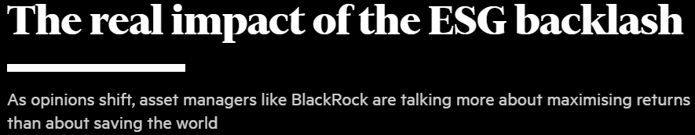
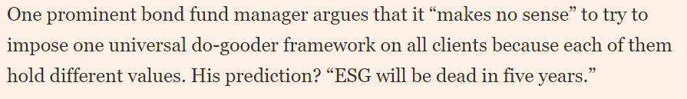
Backlash
  EU and U.S. politics (see next slides)
  Numerous regimes, difficult to read and loosely compatible (evolving political consensus), rather than actionable coherent set of rules
  Recent poor performance of ESG funds: they historically have been overexposed to tech in view of its relatively low carbon footprint. Higher interest rates have driven down the valuations of growth companies)
  Impact of Russian invasion of Ukraine and the ensuing energy and inflation crisis
    In support of ESG critics, this crisis shed light on the importance of the military industry and the necessity to be able to count on polluting energy, such as coal, in times of necessity. It also increased the focus on just/fair transition, and the protection of industry/competitiveness
    Conversely, this crisis highlighted Europe’s geopolitical exposure towards Russia, that could accelerate European countries investing in alternative energy sources and focus on energy efficiency and insulation

Slide 6
Impact of EU elections
  EPP’s manifesto (similar trends for liberals)
    Near absence of environmental policy. The word appears only four times in the 14-page document, and when it does, it is framed in the context of Europe’s economic rivalry with competitors like China and the US.
    “Economic prosperity, ambitious environmental protection and social peace can only succeed in Europe if our economy is also successful worldwide. This is why competitiveness is so crucial,”
    Climate change as the top green priority, with refocus on economic competitiveness and Europe’s re-industrialisation: “Without climate protection, our economy cannot remain competitive in the long term, but without a competitive economy, there can be no sustainable climate protection either”, calling for “less bureaucracy” in the EU’s green policymaking
  S&D’s and Greens’ manifestos reject a “regulatory” pause on green policies
  Nationalist and far right: pressure to give back control of EU policies to the national level, including on energy and environment.

Slide 7
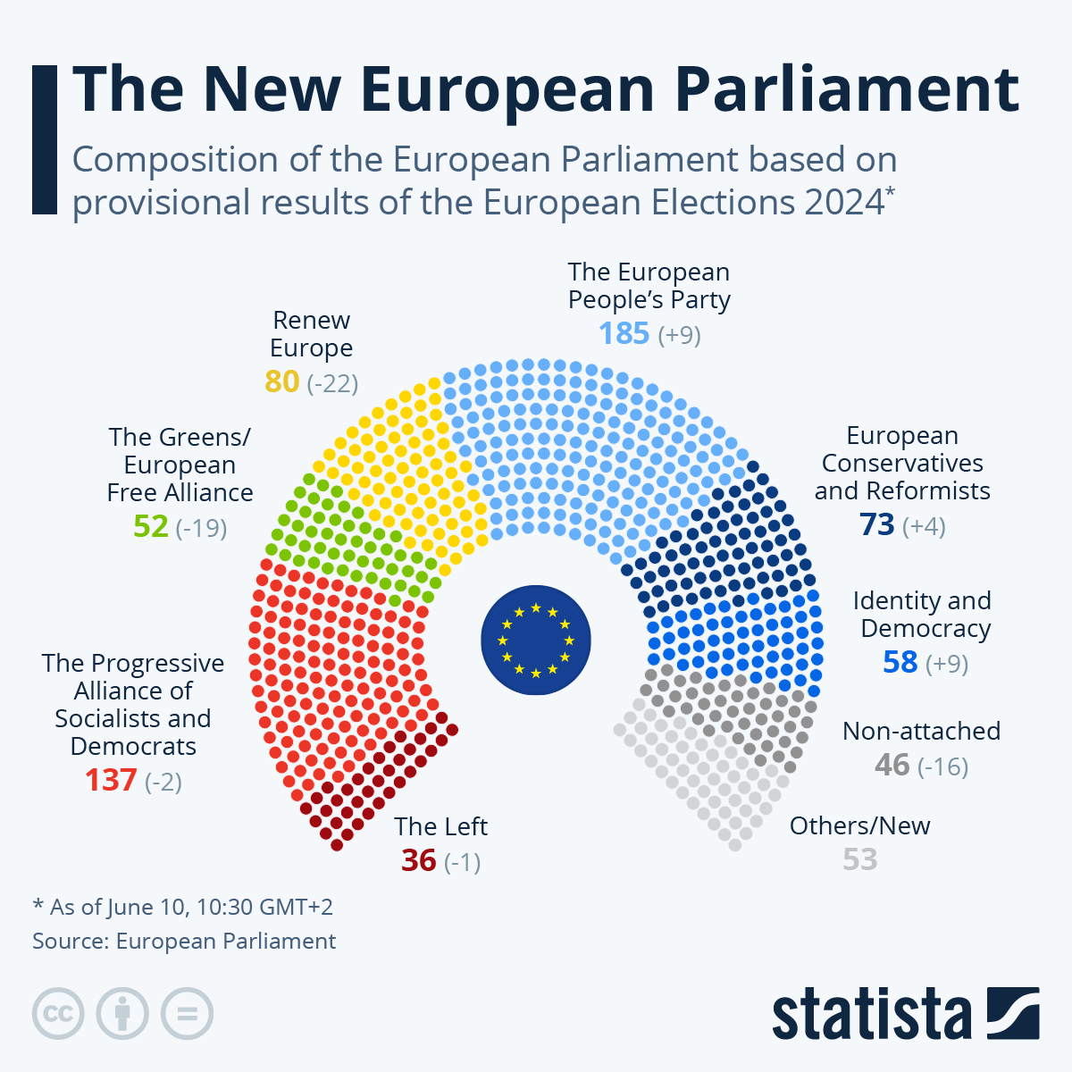
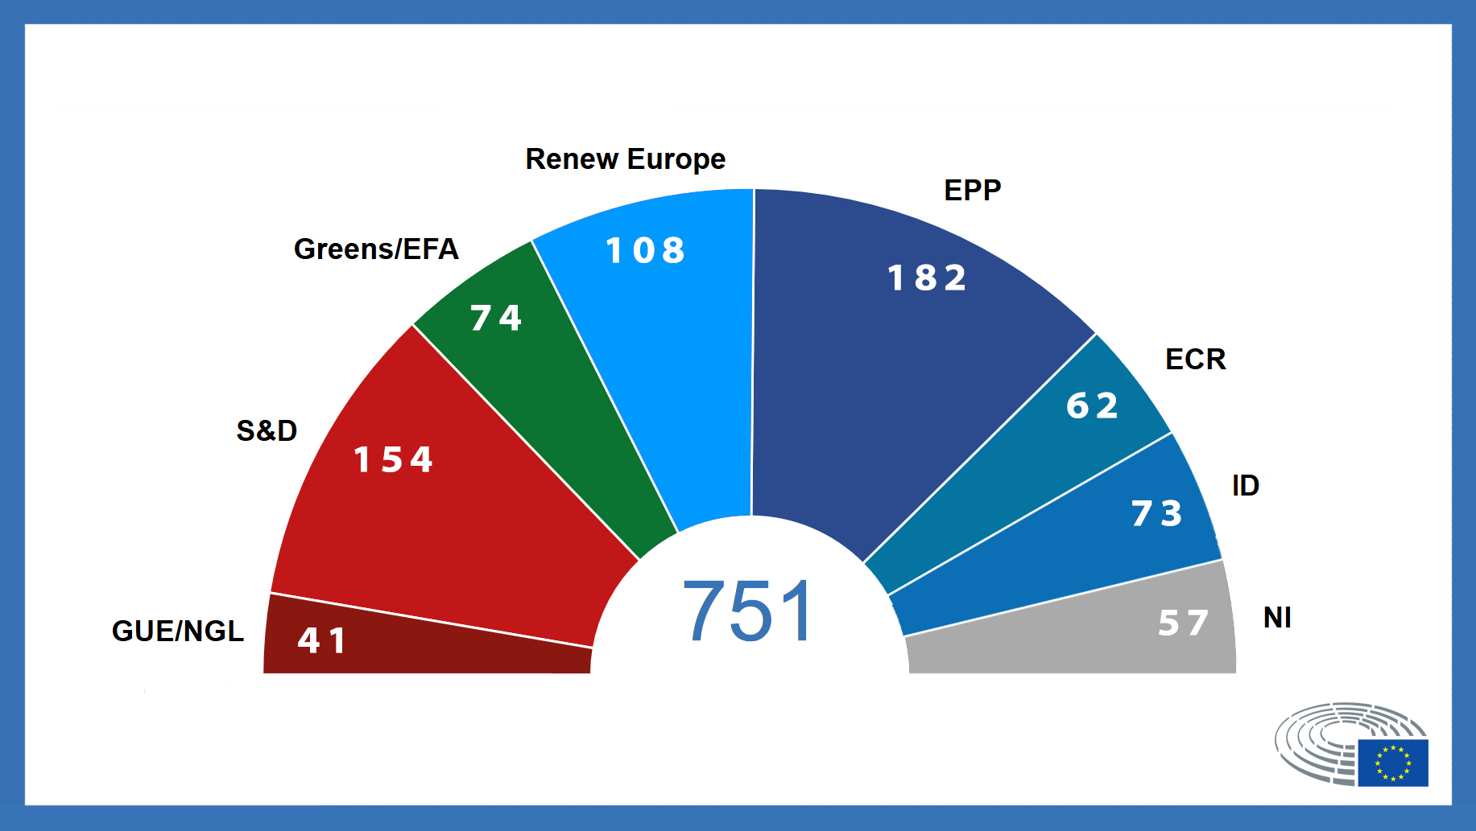
Impact of EU elections
2019 results

Slide 8
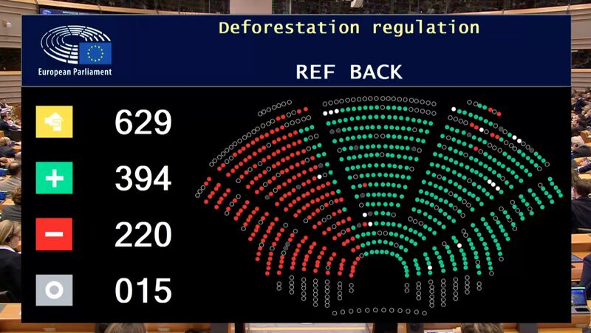
Impact of EU elections – postponement of EUDR and introducing of “no risk” category (December 2024)

Slide 9
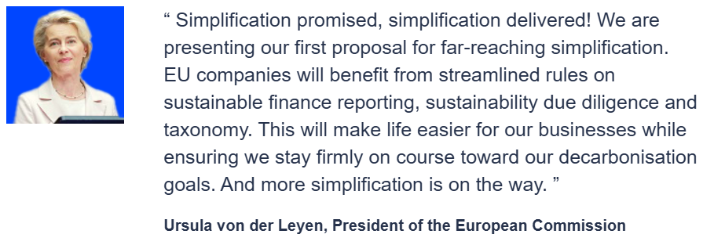
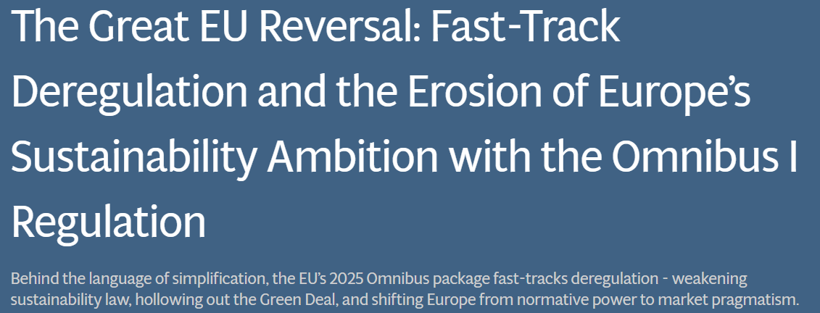
Impact of EU elections – “omnibus simplification package” (see infra)

Slide 10
U.S. Perspective – before Trump administration
  Even before Trump (see next slides):
  conservative politicians, lawmakers and claimants have argued that responsible investment imposes unnecessary constraints on corporations and undermine financial returns. E.g.:
    After having introduced ESG criteria in its investment policies, BlackRock was targeted by Republican states, who withdrew billions of dollars from its funds
    In March 2023, Joe Biden vetoed a Republican-led initiative to prevent pension fund managers from basing investment decisions on ESG criteria
  Reached the courtroom, e.g.:
  Challenges in Texas and Wisconsin against the U.S. Department of Labor “Investment Duties” regulation, which clarified that employee benefit plan fiduciaries may consider ESG factors in risk and return analyses for investment decisions
  In April 2023, the federal Ninth Circuit Court of Appeals held that federal law preempted a City of Berkeley, California ordinance banning natural gas infrastructure in new buildings. In October, a lawsuit was filed in federal court in New York asserting that federal law preempts New York laws that ban natural gas appliances and infrastructure in certain new buildings
  Lawsuit filed in May 2023 challenges New York City pension plans’ plans to divest from fossil fuels

Slide 11
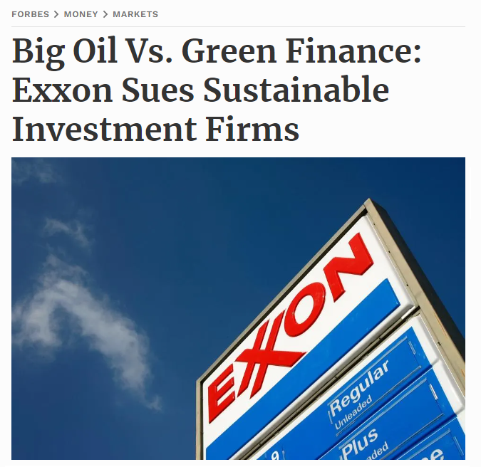

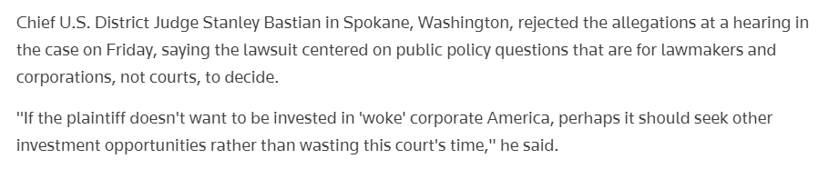
U.S. perspective: court challenges extending to corporates
In August 2023, a plaintiff shareholder filed a lawsuit in Florida against Target and its executives of “failing to oversee the risks of its adoption of ESG and DEI mandates (and misleading investors both as to their failure and to the risks of those mandates”. Target’s LGBT-Pride campaign would have led to an “immense customer backlash resulting in a $10 billion loss in market valuation.”
In April 2023, Disney started legal proceedings against the governor of Florida, containing that he retaliated against the company for its opposition to a state law which broadly prohibits classroom instruction of sexual orientation or gender identity

Slide 12
EU “SLAPP” Directive
Directive 2024/1069 of 11 April 2024 on protecting persons who engage in public participation from manifestly unfounded or abusive court proceedings (so-called “strategic lawsuits against public participation directive” or “SLAPP Directive”), To be transposed by 7 May 2026
Scope of application
  civil court proceedings
  with cross-border implications
  started against public participation: any statement/activity (including preparatory, supportive or assisting action) by a natural or legal person in the exercise of fundamental rights such as freedom of expression and information, freedom of the arts and sciences, or freedom of assembly and association, and concerning a matter of current or future public interest
  related to matters of public interest: issue that affects the public to a degree that justifies public engagement, in areas such as fundamental rights, the environment, public law and democracy, etc.

Slide 13
EU “SLAPP” Directive – procedural safeguards
  The court may order the claimant to provide security to cover the estimated costs of the proceedings
  Courts may dismiss, after a proper examination, claims against public participation as manifestly unfounded at the earliest possible stage of the proceedings, in accordance with national law. The burden of proving that the claim is well-founded rests with the claimant
  If the court identified the proceedings as abusive, it may include all types of costs that can be awarded under national law in the remedy, encompassing the full costs of legal representation incurred by the defendant unless deemed excessive. If national law does not allow for the full reimbursement of legal representation costs beyond statutory fee scales, Member States should ensure the claimant fully bears such (non-excessive) costs through other means available under national law
  Courts may permit associations, organisations, trade unions and other entities which have a legitimate interest in protecting or promoting the rights of those engaging in public participation, to (i) provide information in the proceedings and (ii) with the defendant approval, support them
  EU courts must refuse to recognise and enforce a judgement from a non-EU country in court proceedings against public participation by an EU resident if those proceedings are considered manifestly unfounded or abusive. Affected person may seek compensation for the damage and costs related to foreign proceedings in the courts of their home Member State

Slide 14
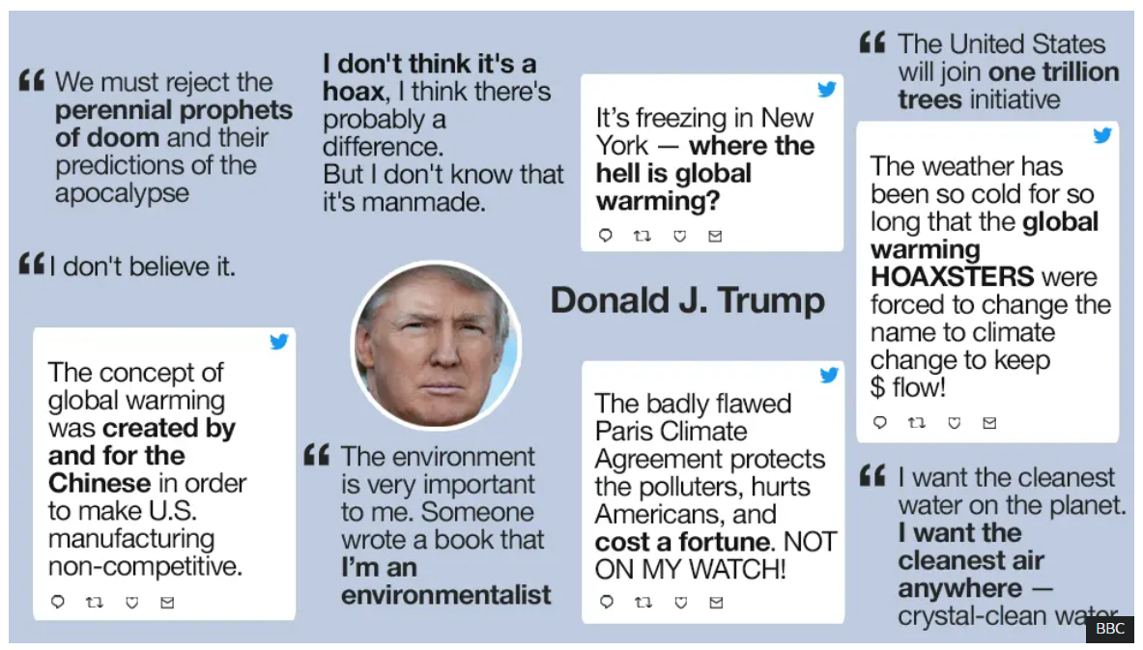
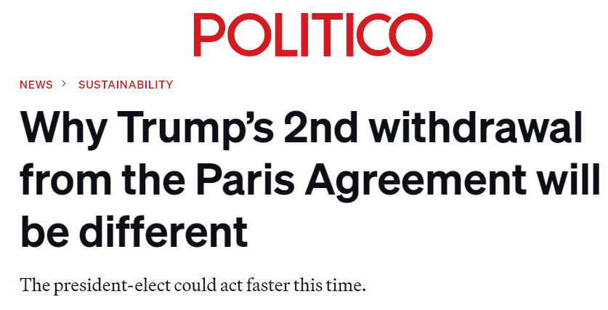
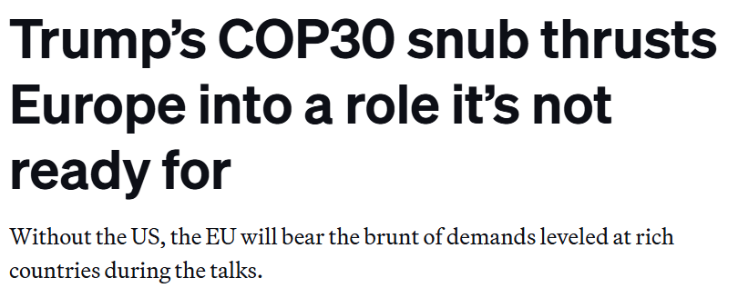
Impact of U.S. elections

Slide 15
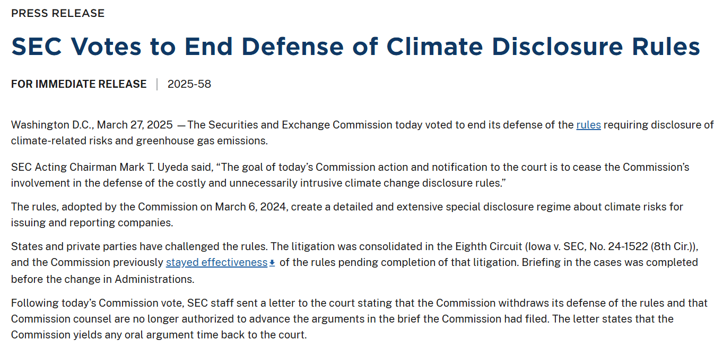
Change at SEC level
ESG enforcement taskforce abandoned
  started in 2021 with more than 20 members
  In charge of enforcement against misleading ESG disclosures
  Progressively shut down in the second half of 2023
Fifth Circuit Court of Appeals court has thrown out
(9-8 majority) rules requiring Nasdaq-listed companies to have board members meeting certain racial or gender diversity criteria or explain why they did not. The appeals court’s majority found that Nasdaq’s diversity rules, which were approved by the SEC, could not be squared with the legal framework under which the securities regulator operates

Slide 16
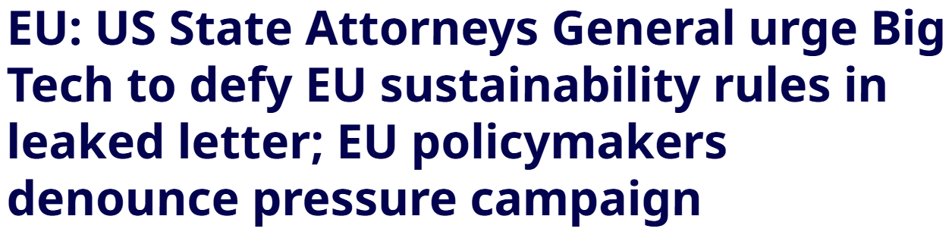

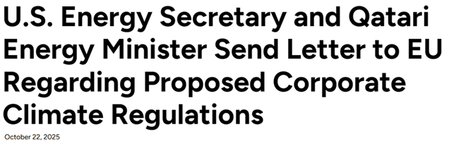

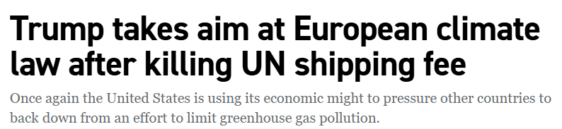
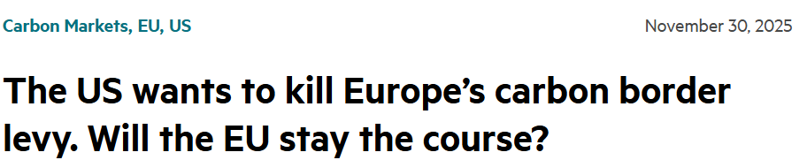
Pressure on EU

Slide 17

Von der Leyen Commission II’s shift on competitiveness

Slide 18
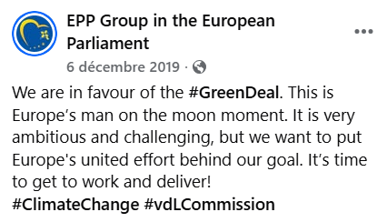
Recap: European Green Deal
  EU’s ambition to become the first climate-neutral continent by 2050 was
  heralded as "Europe's man on the moon moment" at the start of the
  Von der Leyen Commission I term (2019-2024)
  Led to the adoption of the European Climate Law, which makes reaching the EU’s climate goal of reducing EU emissions by at least 55% by 2030 (compared to 1990 levels), and climate neutrality 2050, a legal obligation for the EU and its Member States
  Entailed the adoption of a broad legislative agenda, in particular the “European Green Deal” and the “fit for 55” package (i.e. fit tor the 55% carbon emission reduction by 2030), a set of proposals to revise and update EU legislation and to put in place new initiatives with the aim of ensuring that the policies of the EU and its Member States are in line with the EU’s climate goal
    Taxonomy
    SFDR and CSRD
    CSDDD and sector specific value chain due diligence instruments
    ETS and CBAM
    Circular economy (PPWR, Right to Repair Directive, etc.)
    ...

Slide 19
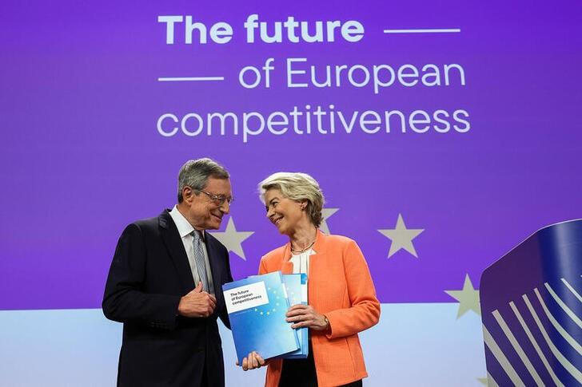
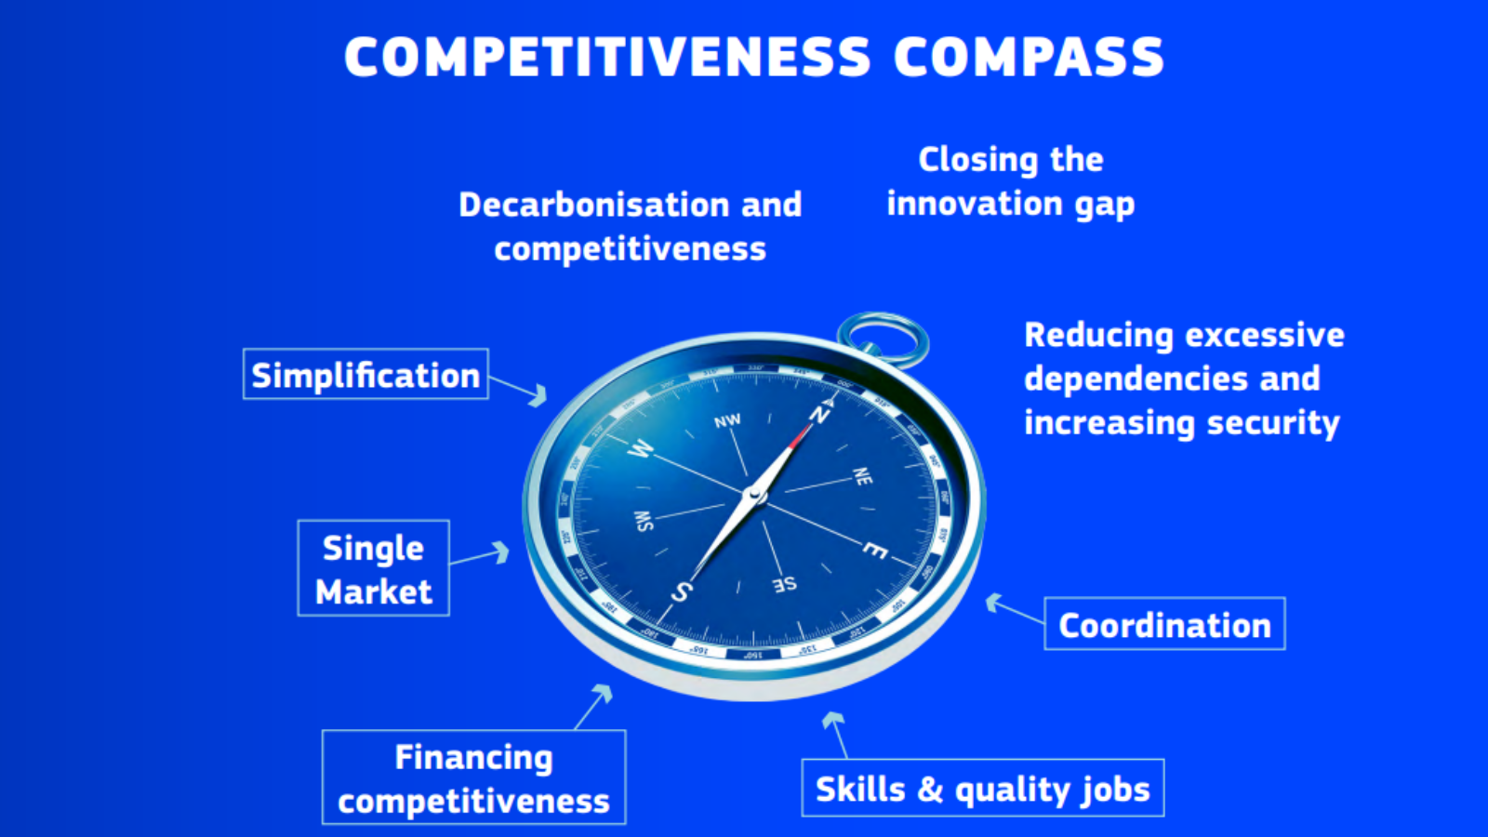
From the Green Deal to the Clean Industrial Deal
  Draghi Report (9 September 2024): report by former European Central Bank President Mario Draghi on the future of European competitiveness to the President of the European Commission. Calls for a “new industrial strategy for Europe” and raises concerns that the EU’s sustainability reporting and due diligence framework is a major source of regulatory burden, magnified by a lack of guidance and lack of clarity surrounding its interaction with other legislative acts, and that this entails a major compliance cost for companies in the EU
  Competitiveness Compass (29 January 2025): blueprint to guide the work of the new Commission during the second term of the VDL presidency; provides a roadmap to how the Commission intends to take forward the recommendations in the Draghi report on the future of EU competitiveness.
    Sets out three core areas for action: (i) innovation, (ii) decarbonisation, and (iii) security
    Complemented by five “horizontal enablers”: (i) simplification, (ii) lowering barriers to the Single Market, (iii) financing competitiveness, (iv) promoting skills and quality jobs, and (v) better coordination of policies at EU and national level.
    Targets of cutting the administrative burden by at least 25% for all companies and by at least 35% for SMEs

Slide 20
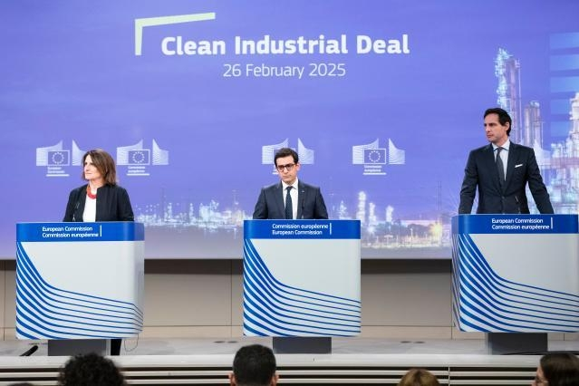
From the Green Deal to the Clean Industrial Deal (cont’d)
  “Clean Industrial Deal: a joint roadmap for competitiveness and decarbonisation” (26 February 2025):
    New roadmap after the Green Deal
    Focus on energy-intensive industries and the clean-tech sector. Circularity is also put at the centre of the CID with the aim to maximise the EU’s limited resources and reduce overdependencies on third country suppliers for raw materials.
    Serve as a framework for dialogue with industries to develop sectoral transition pathways (e.g. Industrial action plan for the European automotive sector published on 5 March 2025)

Slide 21
Omnibus I simplification package
  "Stop-the-Clock" Directive (published in the OJ on 16 April 2025): delays the entry into application of the CSRD requirements for large companies that have not yet started reporting, as well as listed SMEs, by two years and the transposition deadline and the first phase of the application (covering the largest companies) of the CSDDD by one year (i.e. to 26 July 2028)
  “Requirements” proposal: still under discussion in so-called trilogues at EU level, making more substantial changes to the reporting and due diligence requirements in the CSRD and CSDDD.
  EFRAG released on 3 December 2025 its finalised proposed revision of the European Sustainability Reporting Standards (ESRS)
  The Commission adopted, on 4 July 2025, a Delegated Act to simplify requirements under the Taxonomy Regulation, most notably by introducing a financial materiality threshold and reducing reported data points by around 70%;
  The Commission proposed a number of changes to the existing CBAM Regulation, including a new de minimis mass threshold of 50 tonnes which would exempt 90% of importers from the CBAM while still covering 99% of CO2 emissions from in-scope CBAM emissions. The European Parliament and Council reached political agreement on 18 June 2025;
  While those are not technically part of Omnibus packages, (i) a political agreement was reached by the Council and Parliament on 3 December to postpone and simplify the Deforestation Regulation and (ii) on 20 November 2025 the Commission published a proposal to simplify the SFDR.

Slide 22

Further Omnibus simplification packages
  Digital omnibus
  Optimisation of support programmes
  Common Agricultural Policy
  Small mid-caps
  Defence
  Chemicals sector
  Environment
  Food and feed safety

Slide 23

Proposed changes to key ESG instruments

Slide 24
Taxonomy
  On 4 July, the European Commission adopted a delegated act aimed at simplifying the application of the EU Taxonomy. It applies as from 1 January 2026
  Exempt non-financial and financial undertakings from assessing Taxonomy eligibility and alignment for economic activities that are not financially material for their business
    For non-financial undertakings, activities are considered non-material if they account for less than 10% of total turnover, CapEx or OpEx)
    For financial undertakings, activities will be deemed non-material where they account for less than 10% of loans and investments financing specific economic activities whose use of proceeds is known

Slide 25
SFDR “2.0”
  On 20 November 2025, the European Commission adopted its final proposal for a set of amendments to overhaul the Sustainable Finance Disclosure Regulation (“SFDR 2.0”). Earliest effective date is likely to be around early to mid-2028 (depending on political discussions).
  Key changes:
    New product categorisation regime for financial products making ESG claims, to replace the existing Article 8 and Article 9 disclosure regime. Strict eligibility criteria are proposed for each of the three new categories: ‘sustainable’, ‘transition’ and ‘ESG basics’
    Imposing very strict limitations regarding ESG marketing and disclosures for uncategorised products
    Streamlining the disclosure and reporting obligations – detailed website disclosures will no longer be required, and the pre-contractual / periodic reports will have a 2-page limit. However, clients and investors will be able to request more information upon request
    More limited mandatory Taxonomy-related disclosures

Slide 26
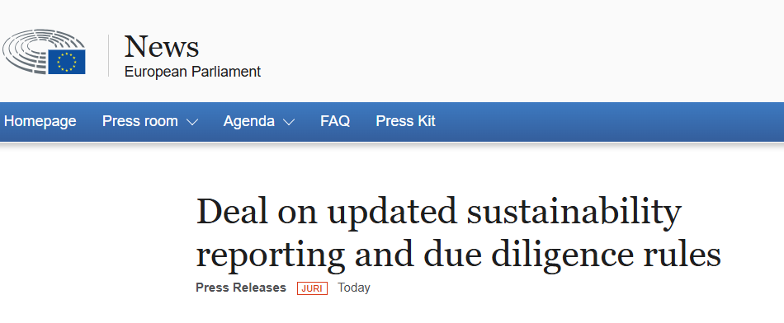
CSRD and CSDDD

Slide 27
Deal on CSRD
  Previous scope
    EU companies that exceed two of these three criteria (i) turnover exceeding €50 million per year; (ii) a balance sheet total of more than €25 million and (iii) more than 250 employees (averaged over a year)
    Non-EU companies with annual EU-generated revenues in excess of €150 million and which also have either a large or listed EU subsidiary or a significant EU branch (generating €40 million in revenues).
  New scope:
    EU companies with more than 1,000 employees and annual turnover higher than €450 million
    Non-EU companies: €450 million turnover generated in the EU + EU subsidiary/branch generating turnover of €200 million
    Financial holding undertakings are exempt from the CSRD’s scope
  Transition exemption is agreed for companies that had to start reporting from financial year 2024 (the so-called “wave one” companies) falling out of scope for 2025 and 2026

Slide 28
CSRD: EFRAG submits revised ESRS to the Commission
  On 3 December 2025, EFRAG submitted its technical advice on the revised European Sustainability Reporting Standards (ESRS) under the Corporate Sustainability Reporting Directive (CSRD)
  Key simplifications
    Claim of 61% reduction of mandatory data points
    Using “usefulness of information” as a general filter with an emphasis on fair presentation
    Simplification of the double materiality assessment requirements through the provision of clearer guidance, reduced documentation, and better alignment with audit needs
    Elimination of the preference for direct data in the value chain thereby reducing the pressure for data collection
    Additional provisions to alleviate reporting burden through reliefs (e.g., specific reliefs for metrics), proportionality mechanisms (i.e., limiting information to that which is “reasonable and supportable information that is available without undue cost or effort”), and phase-ins for certain challenging disclosures (e.g., quantitative information about financial effects)
    Simplifying the structure to make the ESRS shorter, clearer, easier to understand and to implement

Slide 29
Deal on CSDDD
  Previous scope:
    EU companies reaching 1,000 employees on average and a worldwide turnover of EUR 450 million
    Non EU companies with EU turnover of EUR 450 million (no employee threshold)
  New scope:
    EU companies with more than 5,000 employees and annual turnover higher than over €1.5 billion
    Non-EU companies with annual (EU? Not clear yet) turnover higher than over €1.5 billion (no employee threshold)
  End of transition plan requirement
  Enforcement: end of harmonised civil liability regime; fines of up to 3% of the company’s net worldwide turnover, the guidance on which will be provided by the Commission and member states.
  The provisional agreement postpones the CS3D’s transposition deadline by another year, to 26 July 2028. Companies will have to comply with the new measures by July 2029

Slide 30
Deal on EU Deforestation Regulation (EUDR)
  On 4 December 2025, the Council and the European Parliament reached a provisional political agreement on a one-year postponement and targeted revision. Agreement must be formally adopted and published before the end of the year since initial entry into application is 30 December 2025
  Key changes:
    The EUDR would be postponed by one year, i.e. would apply from 30 December 2026 for medium and large operators, and from 30 June 2027 for micro and small operators.
    Limitation of the requirement to submit due diligence statements only to operators first placing products on the market. Downstream operators and traders would be relieved from submitting separate due diligence statements
    Reduction of the obligations on micro and small primary operators, which will now only have to submit a one-off simplified declaration
    Removal of products from scope of application: products falling under Chapter 49 of the Combined Nomenclature including printed books, newspapers, pictures and other products of the printing industry, manuscripts, typescripts and plans, of paper
  Commission to conduct a simplification review and to present a report by 30 April 2026. The report should evaluate the impact and administrative burden of the EUDR, particularly for smaller operators, and indicate ways to address the identified issues, including through guidelines and improvements to the information system

Slide 31

Future perspectives

Slide 32

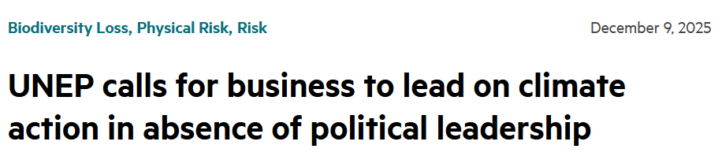
Future perspectives
  Despite the legislative “recalibration”:
    Other drivers for “sustainability shift” remain
    Main obligations remain imposed on biggest companies (sustainability
    reporting; value chain due diligence; avoidance of greenwashing; sectorial rules)
    Except for climate transition planning, which has disappeared
      How to apply CSDDD provision was very difficult to understand in practice,
      Future EU instruments may be adopted.
      Member States remain free to adopt national legislation (e.g. Spain has done it)
    Likely increased court litigation (including on the basis of general duties; see next slide)
      Civil law tradition against societal changes led by courts (Cf. Montesquieu: “[courts should be] no more than the mouth that pronounces the words of the law, mere passive beings, incapable of moderating either its force or rigour”)
      Sufficient expertise/means?
      Discriminatory against the few companies ordered changes of policies/to pay damages?
    Must the solution come from the UN? The strenghtening of voluntary standards/a coalition of the willing?

Slide 33
Corporate purpose – Belgium
Article 1:1 of the new Code of Companies and Associations
  “One of the goals” of a company is to distribute profits to its shareholders
  This is a way of inviting companies to envisage goals going beyond the sole distribution of profits
    No specific regime as in France (“société à mission”)
    Impact on the corporate purpose clause (in the articles of association) (see B Corp scheme – next slide)
    In any case, profits must remain one of the goals of any company
  What about the corporate interest, for a company which would not choose to include any social or environmental goals in its corporate purpose clause?
    Court of Cassation (Belgian Supreme Court), 28 November 2013: “the company's interest is determined by the collective profit goal of the present and future shareholders of the company”
    This remains a controversial topic
    New Art. 1:1 to impact the case law?

Slide 34

Corporate purpose – B Corporation
  Main sustainability-oriented corporate certification scheme, B Corp (“B” stands for the “absence of Planet B”) that a business “is meeting high standards of verified performance, accountability, and transparency on factors from employee benefits and charitable giving to supply chain practices and input materials”
  In order to achieve certification, a company must:
    “Demonstrate high social and environmental performance by achieving a B Impact Assessment score of 80 or above and passing our risk review. Multinational corporations must also meet baseline requirement standards.
    Make a legal commitment by changing their corporate governance structure to be accountable to all stakeholders, not just shareholders, and achieve benefit corporation status if available in their jurisdiction.
    Exhibit transparency by allowing information about their performance measured against B Lab’s standards to be publicly available on their B Corp profile on B Lab’s website”
  Many B Corp certified companies are small and midsize companies, with a few exceptions in the consumer goods sector, such as Nespresso (part of Nestlé group), Ben & Jerry’s (part of Unilever group) and Patagonia

Slide 35
Corporate duty of care – The Netherlands
The responsibility of business enterprises to respect human rights, as formulated in the UNGP, is a global standard of expected conduct for all business enterprises wherever they operate. It exists independently of States’ abilities and/or willingness to fulfil their own human rights obligations and does not diminish those obligations. And it exists over and above compliance with national laws and regulations protecting human rights. Therefore, it is not enough for companies to monitor developments and follow the measures states take; they have an individual responsibility. It can be deduced from the UNGP and other soft law instruments that it is universally endorsed that companies must respect human rights.
– Shell judgement
  Broadly confirmed on appeal
  Extension to directors’ fiduciary duties?

Slide 36
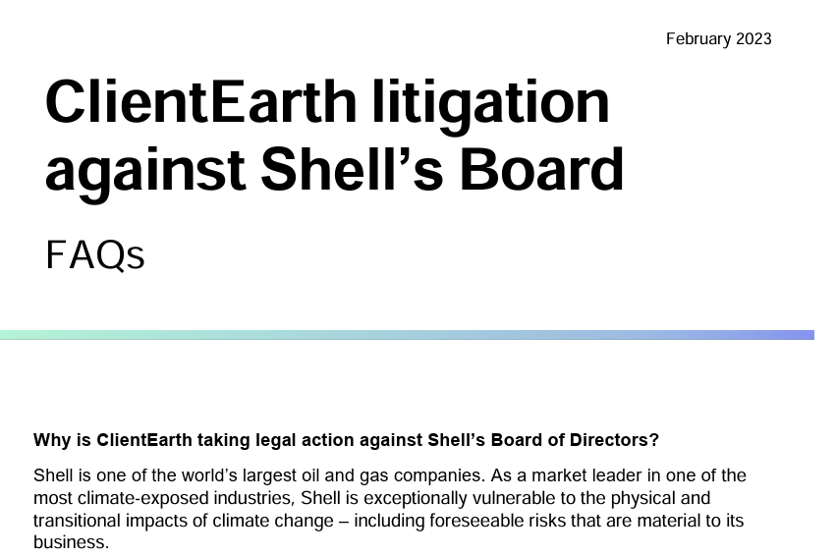
Directors’ duties – UK
    Section 172 Companies Act 2006 – Duty to promote the success of the company
      A director of a company must act in the way he considers, in good faith, would be most likely to promote the success of the company for the benefit of its members as a whole, and in doing so have regard (amongst other matters) to
      (a) the likely consequences of any decision in the long term,
      (b) the interests of the company’s employees,
      (c) the need to foster the company’s business relationships with suppliers, customers and others,
      (d) the impact of the company’s operations on the community and the environment,
      (e) the desirability of the company maintaining a reputation for high standards of business conduct,
      (f) the need to act fairly as between members of the company.
    Section 174 Companies Act 2006 – Duty to exercise reasonable care, skill and diligence

Slide 37
Parent company litigation in the UK: Vedanta (2019) and
Okpabi (2021)
  In Vedanta ([2019] UKSC 20), then Okpabi ([2021] UKSC 3), the UK Supreme Court held that parent companies can have liability for the overseas operations of their non-UK subsidiaries
  The two decisions did not decide that a duty of care actually existed, but that it could exist and that the claimants could proceed within the English jurisdiction. The Supreme Court held that, in the context of parent/subsidiary relationships, whether a duty of care arises “depends entirely on the extent to which, and the way in which, the parent availed itself of the opportunity to take over, intervene in, control, supervise or advise the management of the relevant operations (including land use) of the subsidiary” (including by adopting general policies)
  Possible that claims against English parent companies in future may be subjected to the forum non-conveniens hurdle (even where defendant is domiciled in the UK), weakening the position of foreign claimants. The current, decided cases were initiated prior to the end of the UK-EU transition period
  Contrast with:
    Thompson v Renwick Group, where a parent company did not assume a duty of care to employees of its subsidiaries by appointing an individual as a director of the subsidiary with responsibility for health and safety. In running the day-to-day operations of the subsidiary, the director was not acting on behalf of the parent group; he was acting pursuant to his fiduciary duty owed to the subsidiary.
    AAA v Unilever, where it was held that the English-registered parent company owed no duty of care to those affected by the actions or omissions of its Kenyan subsidiary where the subsidiary was responsible for its own decision-making and had not sought advice from the parent company

Slide 38
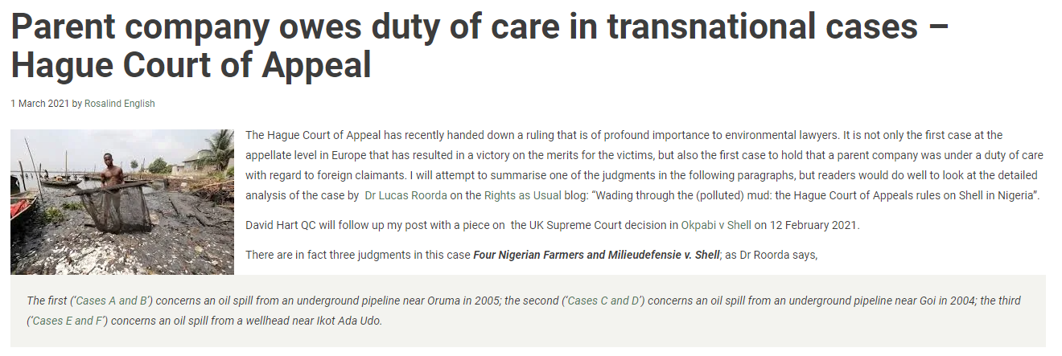
Hague Court of Appeal – Four Nigerian Farmers and
Milieudefensie v. Shell (2021)
  First case in which a parent company is held liable for the breach for duty of care for foreign claimants
  Court decided that Shell owed a duty of care to the Nigerian victims affected by an oil spill caused by Nigerian subsidiary
  The court applied Nigerian common law, the law of a state in which a damage occurred, in which English precedent has a persuasive authority (including Vedanta case law, see previous slide).
  Regarding the oil spill, the court decided that Shell cannot be considered to owe a duty of care, since it was caused by sabotage, not by the fault of its Nigerian subsidiary
  However, the Court held Shell liable for its subsidiary's failure to install a LDS (Leak detection system). The Court noted that Shell sets policy and standards, advises,
  supervises, and is involved in the decision
  making of the subsidiary. Shell was actively
  involved in a decision whether oil pipelines
  in Nigeria should be provided with LDS.

Slide 39

Questions?

