Slide 1

ARE THE ATP RULES COMPATIBLE WITH ARTICLE 102 TFEU?
MARKET ACCESS, FORECLOSURE AND THE ROLE OF RANKING POINTS.
LL.M. PAPER DEFENSE
Supervisor: David Hull
Author: Chloé Van Den Spiegel

Slide 2
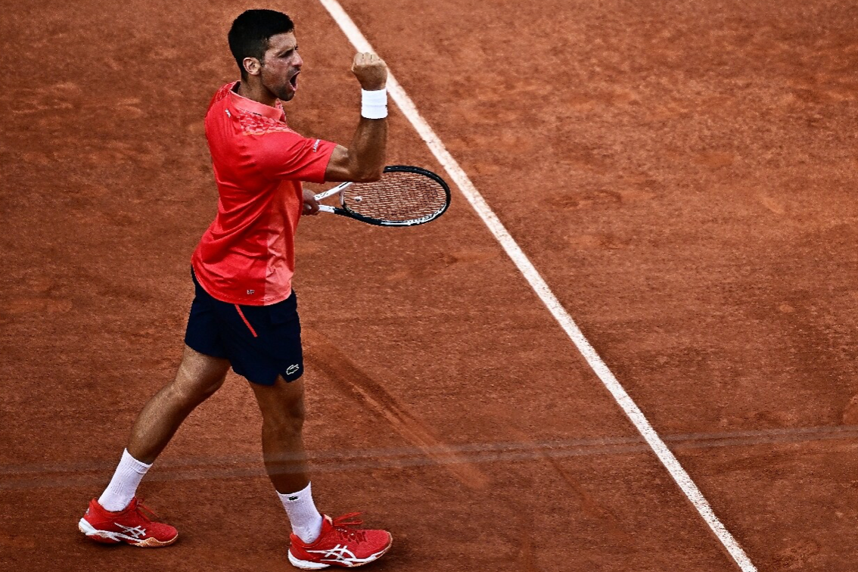
PTPA COMPLAINT
  What is the PTPA?
    Independent association representing male and female professional players
    Novak Djokovic & Vasek Pospisil
    Not recognised as an official union
    Player rights, welfare, transparency, bargaining power
  What triggered the complaint?
    PTPA filed an antitrust complaint before the European Commission
    Parallel legal actions in the US and UK
    ATP, WTA, ITF, ITIA
  Core allegation
    = ATP and tournament organisers engage in a range of anti‐competitive or abusive practices

Slide 3
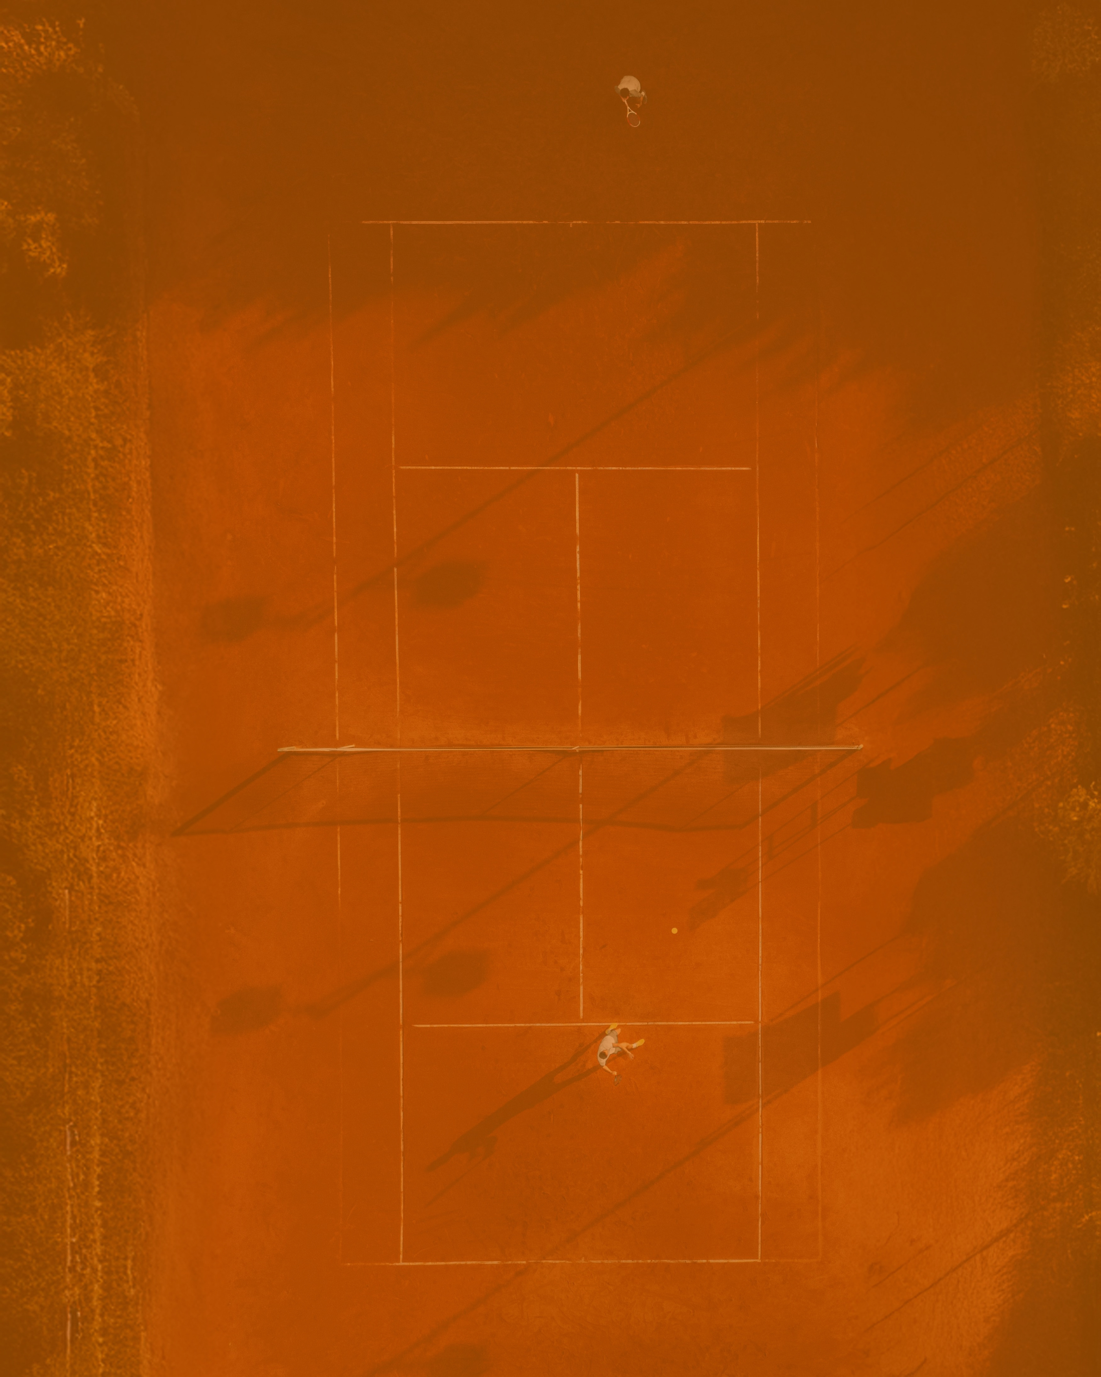
SPORT GOVERNING BODIES: A STRUCTURAL TENSION
REGULATORY FUNCTIONS
(public‑interest role)
COMMERCIAL FUNCTIONS
(market‑participant role)
  Rules of the game
  Eligibility criteria
  Calendar setting
  Disciplinary powers
  Organise competitions
  Sell media rights
  Negotiate sponsorships
  Profit from events
2026

Slide 4
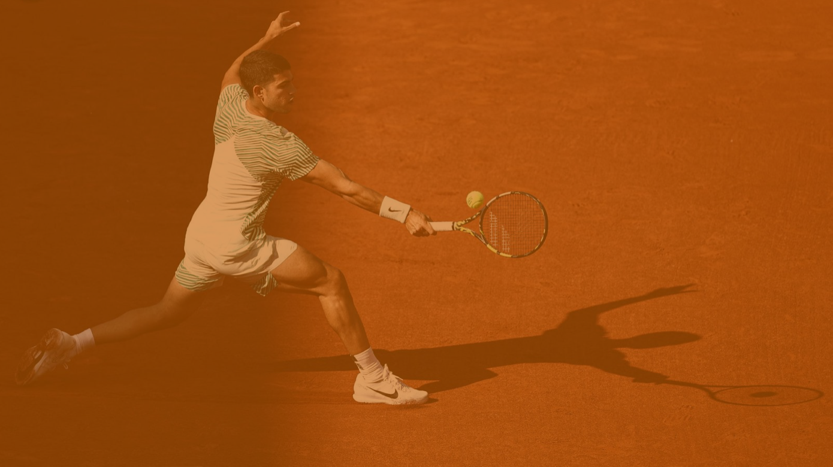

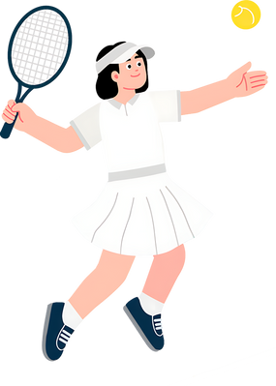

DIFFERENT PLAYERS
ATP
WTA
ITF
  Operates the men’s professional tour
  Controls the ATP ranking system
  Sets tournament categories and participation rules
  Both a regulator and a commercial organiser
  Parallel structure for women
  Controls the WTA ranking system
  Operates the women’s professional tour
  Sets the Rules of Tennis
  Coordinates global governance
  Also organises and profits from international events
Cooperation on:
Calendar - Entry rules - Integrity rules - Ranking coordination - Player eligibility

Slide 5

EU COMPETITION LAW & SPORT
Meca‐Medina
MOTOE
  No general sporting exemption
  Functional approach: rules fall under EU law if economic
  Justification only if inherent and proportionate
  Regulator + operator = structural conflict of interest
  Market access must rely on objective, transparent, reviewable criteria
ESL & ISU
  Prior authorisation + sanctions = risk of foreclosure
  Criteria must be transparent, objective, precise, non‑discriminatory
  Sanctions = restrictions “by their nature”
  Gatekeeping allowed only with safeguards

Slide 6
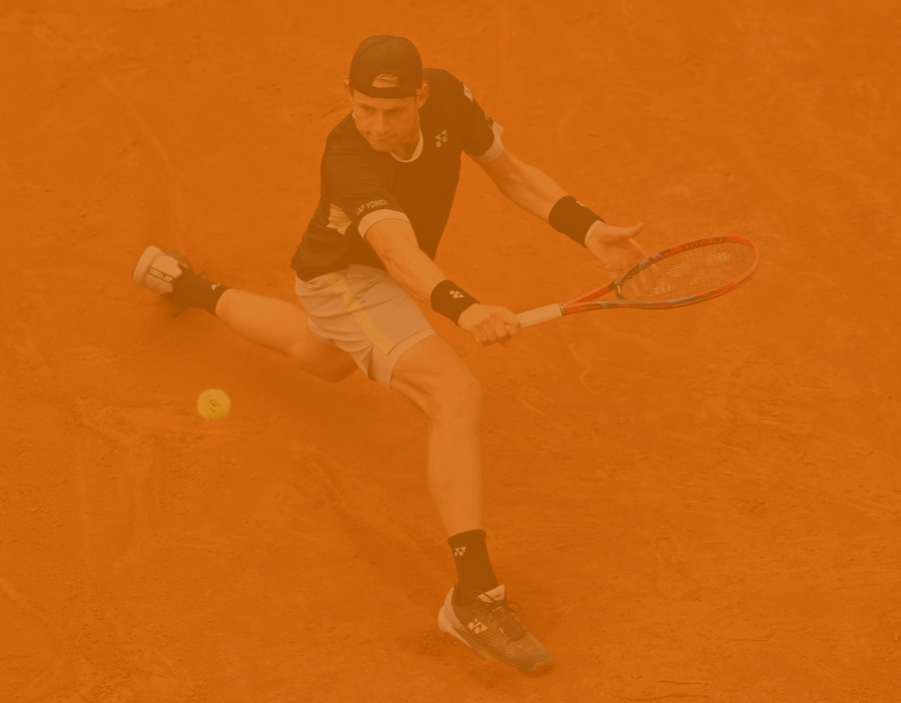
FORECLOSURE OF THE MARKET FOR RIVAL TENNIS TOURS
1. ATP’s exclusive power to sanction tournaments
2. Mandatory participation and sanctions for playing rival tournaments
  ATP sanctioned events are not awarded through transparent, objective and non‐discriminatory criteria
    Ex: Masters 1000 event in Saudi Arabia
    Independent format
  Mandatory participation and sanctions restrict player freedom, deter independent events, reinforce foreclosure.
  Opaque exemptions and disproportionate penalties exceed legitimate sporting aims, raise Article 102 concerns.
3. The specific nature of ranking points
  Ranking-point exclusivity operates as the foreclosure mechanism
  Only recognised pathway through which players can maintain or improve their professional standing
  Current system goes beyond what is necessary to ensure comparability of results and the integrity of competition

Slide 7
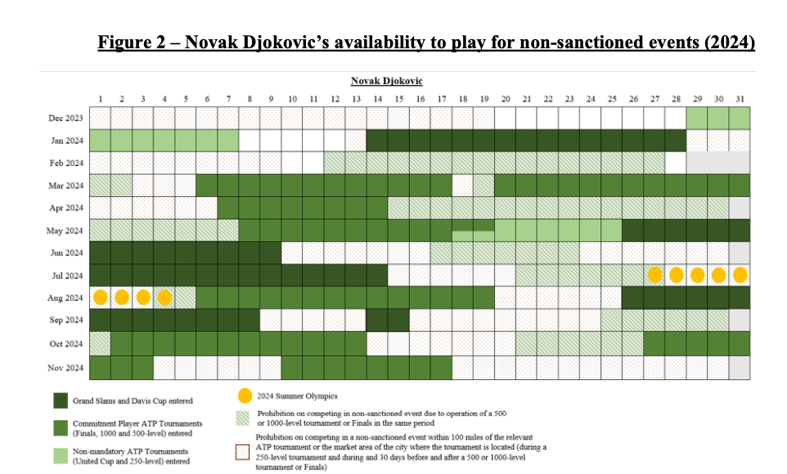

Slide 8
FORECLOSURE OF THE MARKET FOR RIVAL TENNIS TOURS
1. ATP’s exclusive power to sanction tournaments
2. Mandatory participation and sanctions for playing rival tournaments
  ATP sanctioned events are not awarded through transparent, objective and non‐discriminatory criteria
    Ex: Masters 1000 event in Saudi Arabia
    Independent format
  Mandatory participation and sanctions restrict player freedom, deter independent events, reinforce foreclosure.
  Opaque exemptions and disproportionate penalties exceed legitimate sporting aims, raise Article 102 concerns.
3. The specific nature of ranking points
  Ranking-point exclusivity operates as the foreclosure mechanism
  Only recognised pathway through which players can maintain or improve their professional standing
  Current system goes beyond what is necessary to ensure comparability of results and the integrity of competition

Slide 9
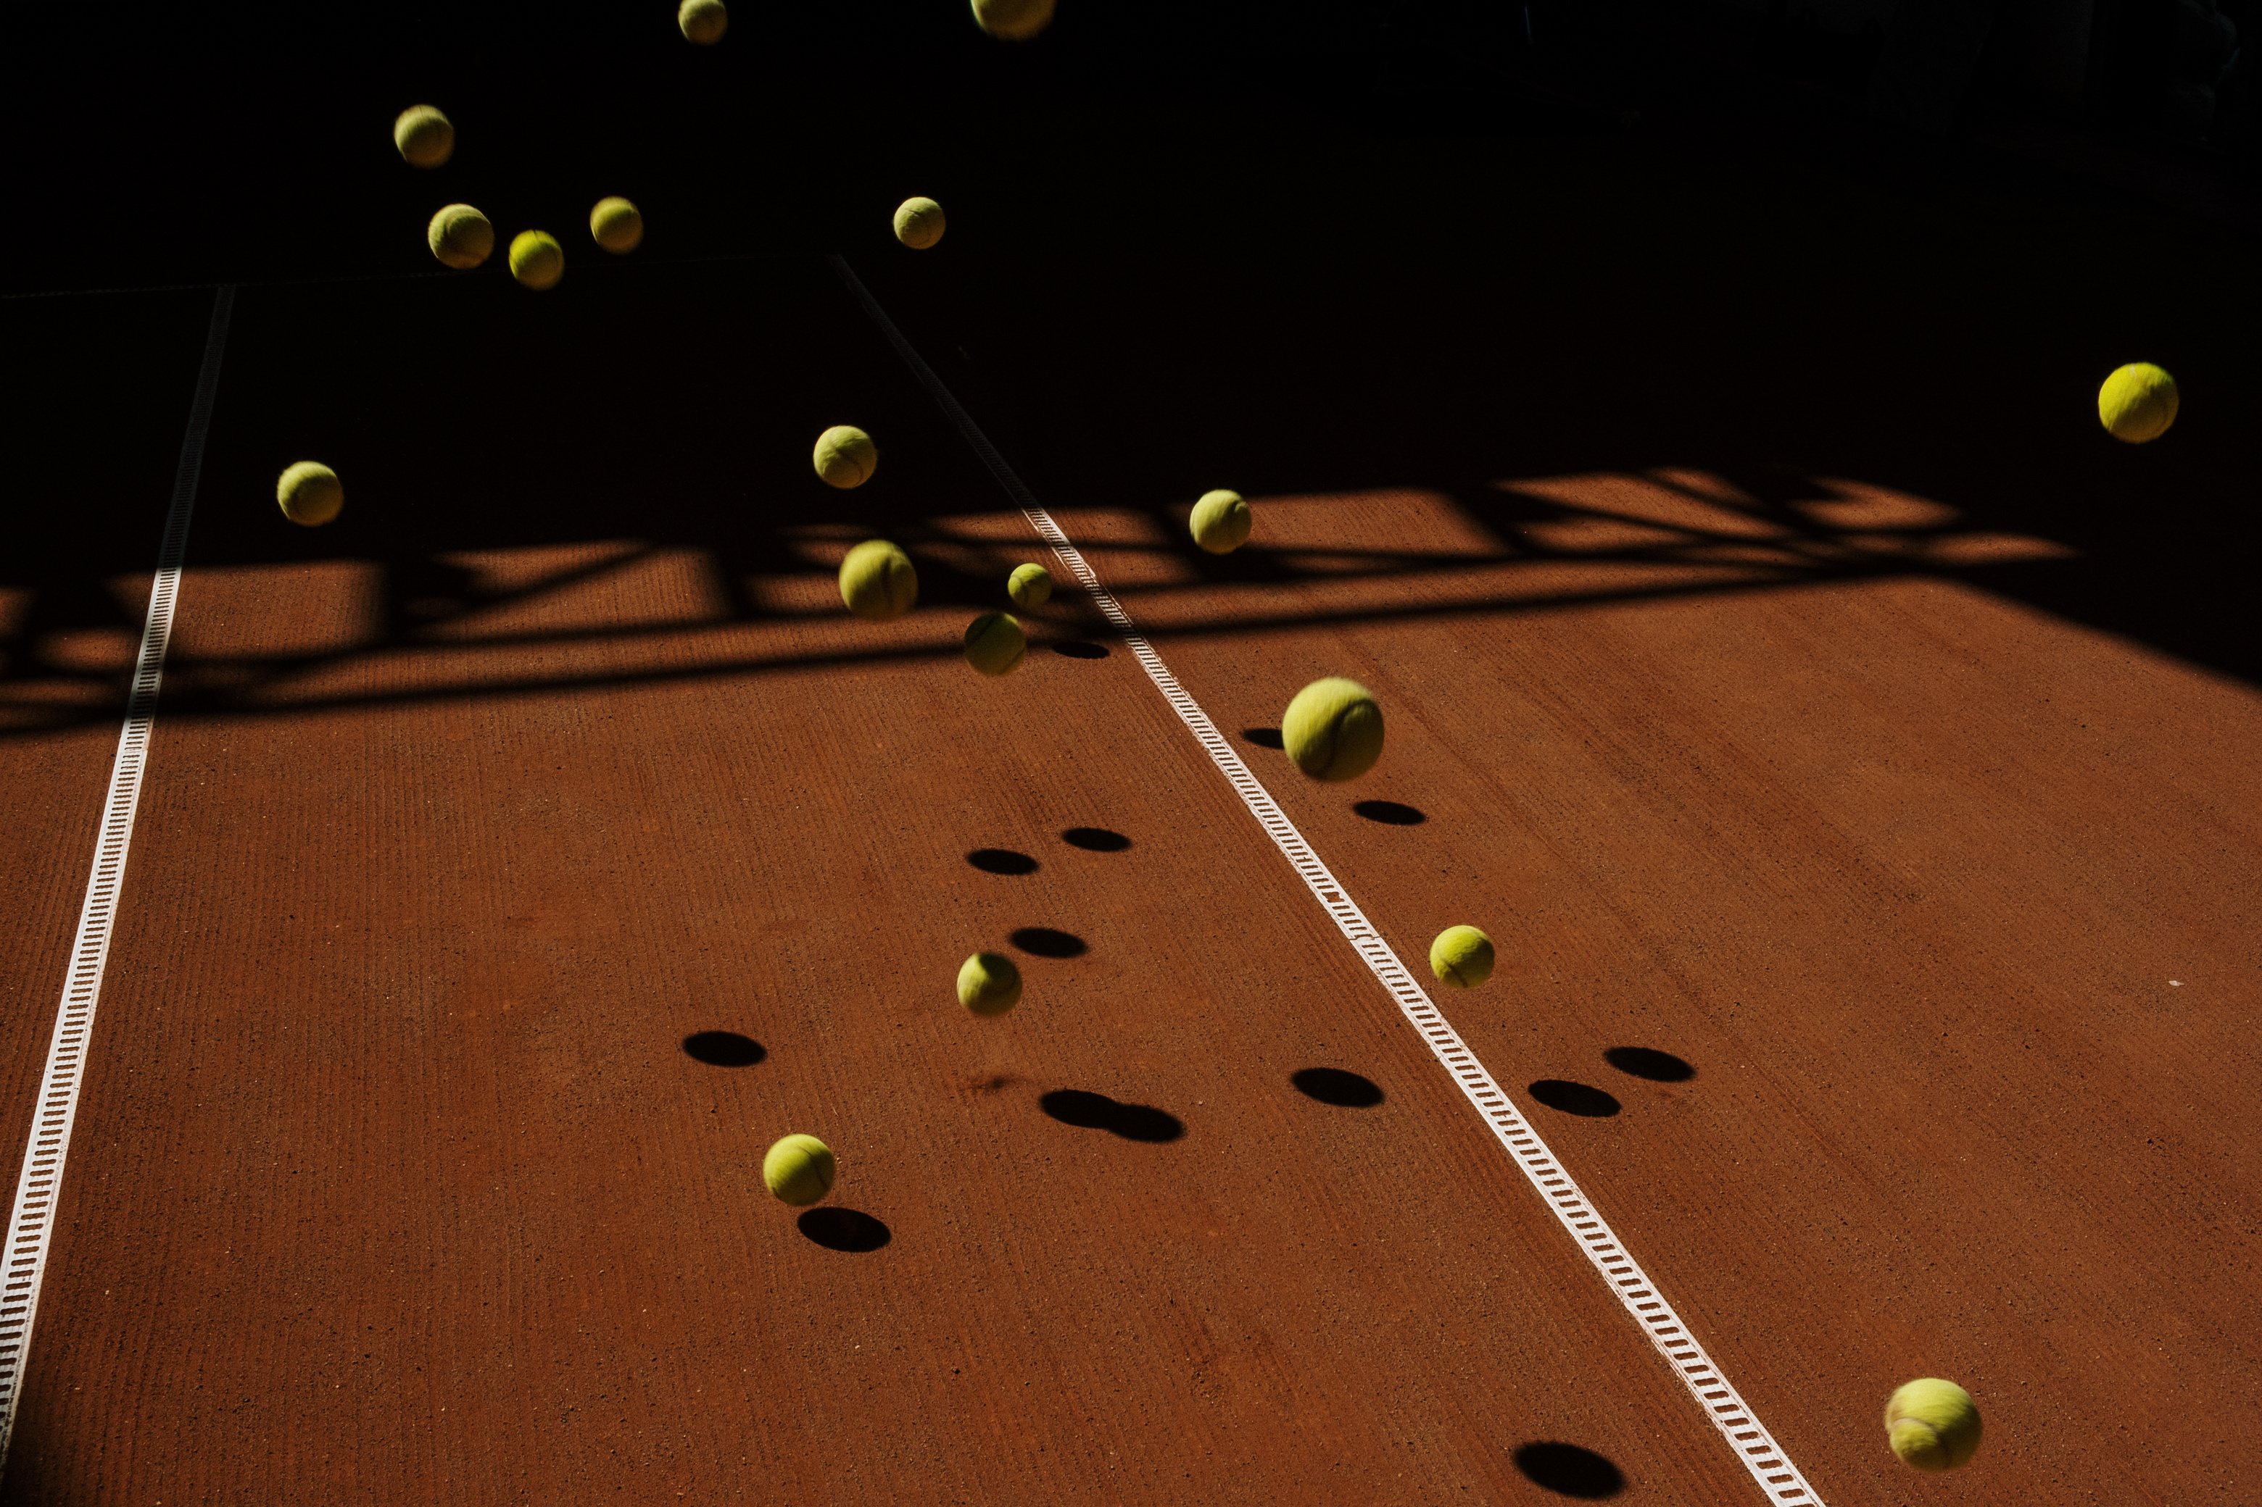
THANK YOU
FOR YOUR ATTENTION

