Slide 1

Can Arbitration under Article 25 DSU Replace the WTO Appellate Body?
Giulio Sironi · Supervisor: Professor David Luff · Academic Year 2025/2026

Slide 2
The Main Issue
Since December 2019, the WTO Appellate Body has been paralyzed, unable to hear appeals due to blocked U.S. appointments. Appealed panel reports are left in a legal limbo, a phenomenon known as "appeal into the void."

Slide 3

The Original Two-Tier WTO Dispute Settlement System
Panels
Ad hoc bodies examining factual and legal issues
Appellate Body
Standing 7-members body reviewing issues of law only

Slide 4
Why the Appellate Body Collapsed
Blocked Appointments
Procedural Delays
Judicial Overreach/Activism
The United States systematically blocked the appointment of new AB members, exploiting the consensus requirement under the DSU. By December 2019, the AB fell below the minimum number of members required to function.
Appellate proceedings repeatedly exceeded the 60–90-day deadline under Art. 17.5 DSU, weakening the efficiency and credibility of the system over time.
The U.S. criticized the AB for issuing advisory opinions, expanding its interpretative role beyond the DSU and blurring the line between legal and factual review.

Slide 5
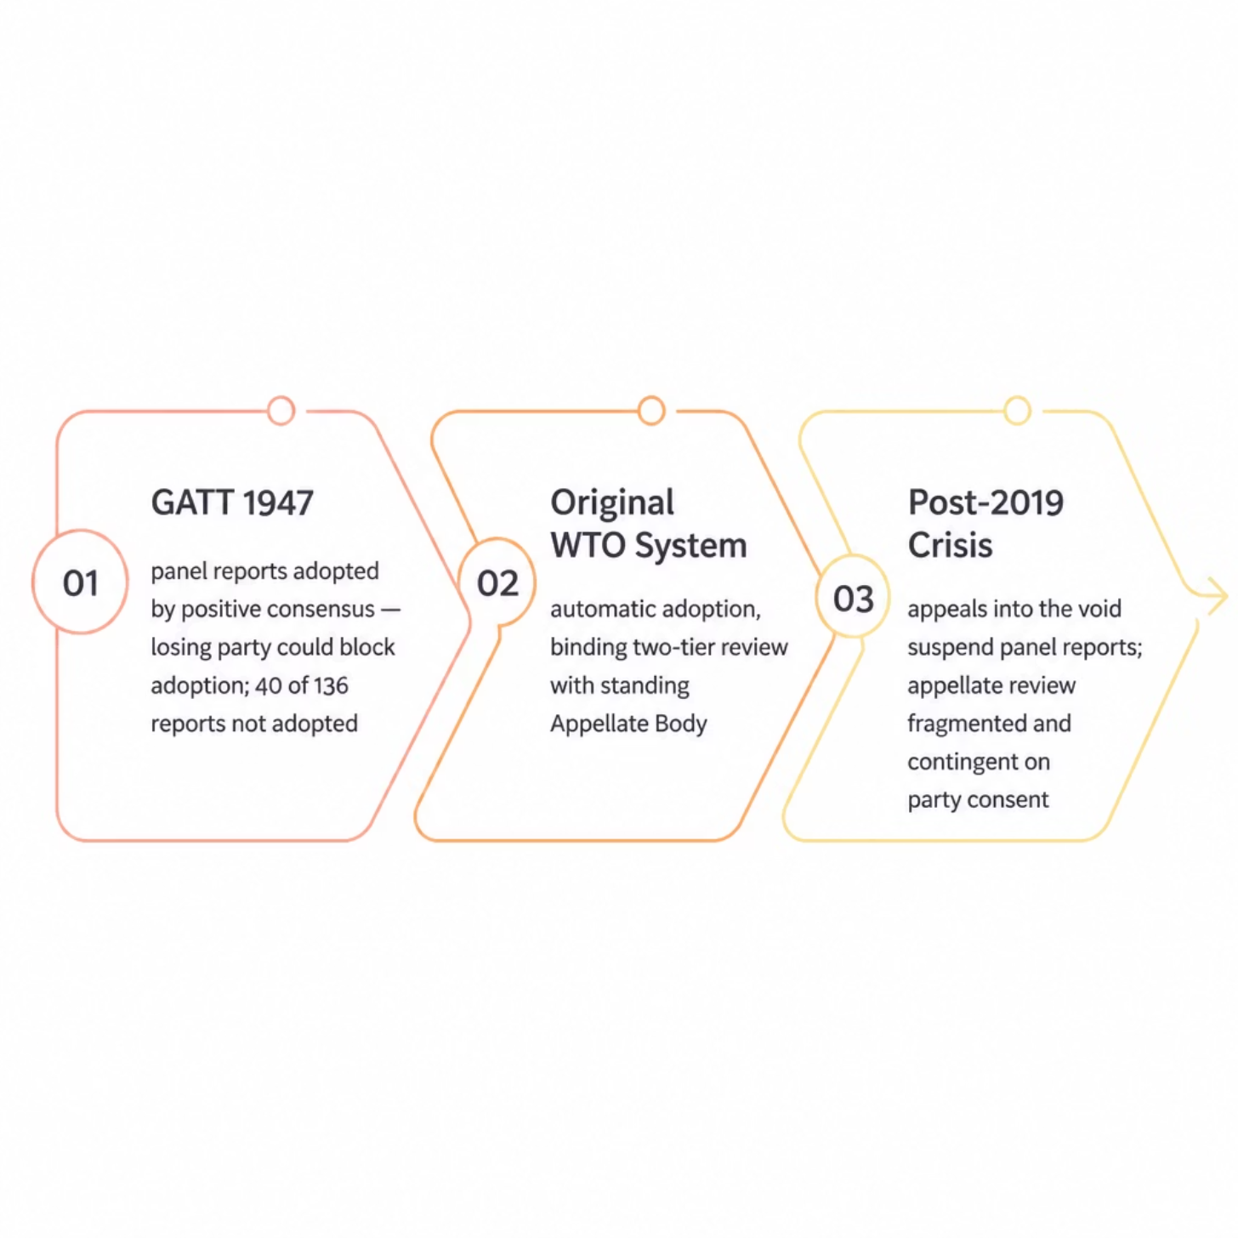
"Appeal into the Void": Legal Consequences
The Mechanism
Under Art. 16.4 DSU, a panel report cannot be adopted if appealed. With no functioning AB, such appeals cannot be completed — leaving reports permanently suspended and complainants without enforceable rulings.
Strategic Incentive
Respondents now have a strong incentive to appeal into the void to avoid compliance obligations — undermining the binding and predictable framework the DSU was designed to provide.

Slide 6

Article 25 DSU: Legal Basis for Appeal Arbitration
Art. 25.1 — Scope
Art. 25.2 — Consent
Expeditious arbitration may facilitate resolution of disputes within the WTO framework.
Recourse requires mutual agreement of the parties, who also define the procedures to be followed.
Art. 25.3 — Binding Award
Art. 25.4 — Enforcement
Parties must abide by the award, which is notified to the DSB, integrating arbitration into the WTO legal order.
Arts. 21 and 22 DSU on implementation and retaliation apply mutatis mutandis, ensuring binding force equivalent to adopted reports.
Originally conceived as a flexible alternative, Art. 25 DSU gained new significance post-2019 as a legal basis for appellate arbitration

Slide 7
The MPIA: A Structured Interim Solution
What Is the MPIA?
Appeal Arbitration in practice
The Multi-Party Interim Appeal Arbitration Arrangement is a pre-committed framework through which participating Members agree to use Art. 25 DSU for appellate review in disputes among themselves, pending the AB's restoration.
DS583 — Turkey–Pharmaceuticals (2022)
First Art. 25 appellate arbitration
DS591 — Colombia–Frozen Fries (2022)
First MPIA-based award
Key Features
DS611 — China–
IP Rights (2025)
Second MPIA-based award
Standardized procedures and 90-day deadline (Annex I)
Pre-established pool of arbitrators (Annex II)
Scope limited to participating Members only

Slide 8

Does the MPIA Address the Criticisms Against the AB?
Procedural Timelines
Scope of Reasoning
Procedural Economy
The MPIA explicitly targets a 90-day deadline for awards, directly responding to the AB's chronic delays under Art. 17.5 DSU.
Arbitrators are encouraged to focus exclusively on issues necessary to resolve the dispute, reducing the risk of advisory or superfluous reasoning.
Page limits, time limits and streamlined hearing rules address concerns about excessive procedural complexity.
Caveat: The small number of concluded proceedings means conclusions remain preliminary.

Slide 9
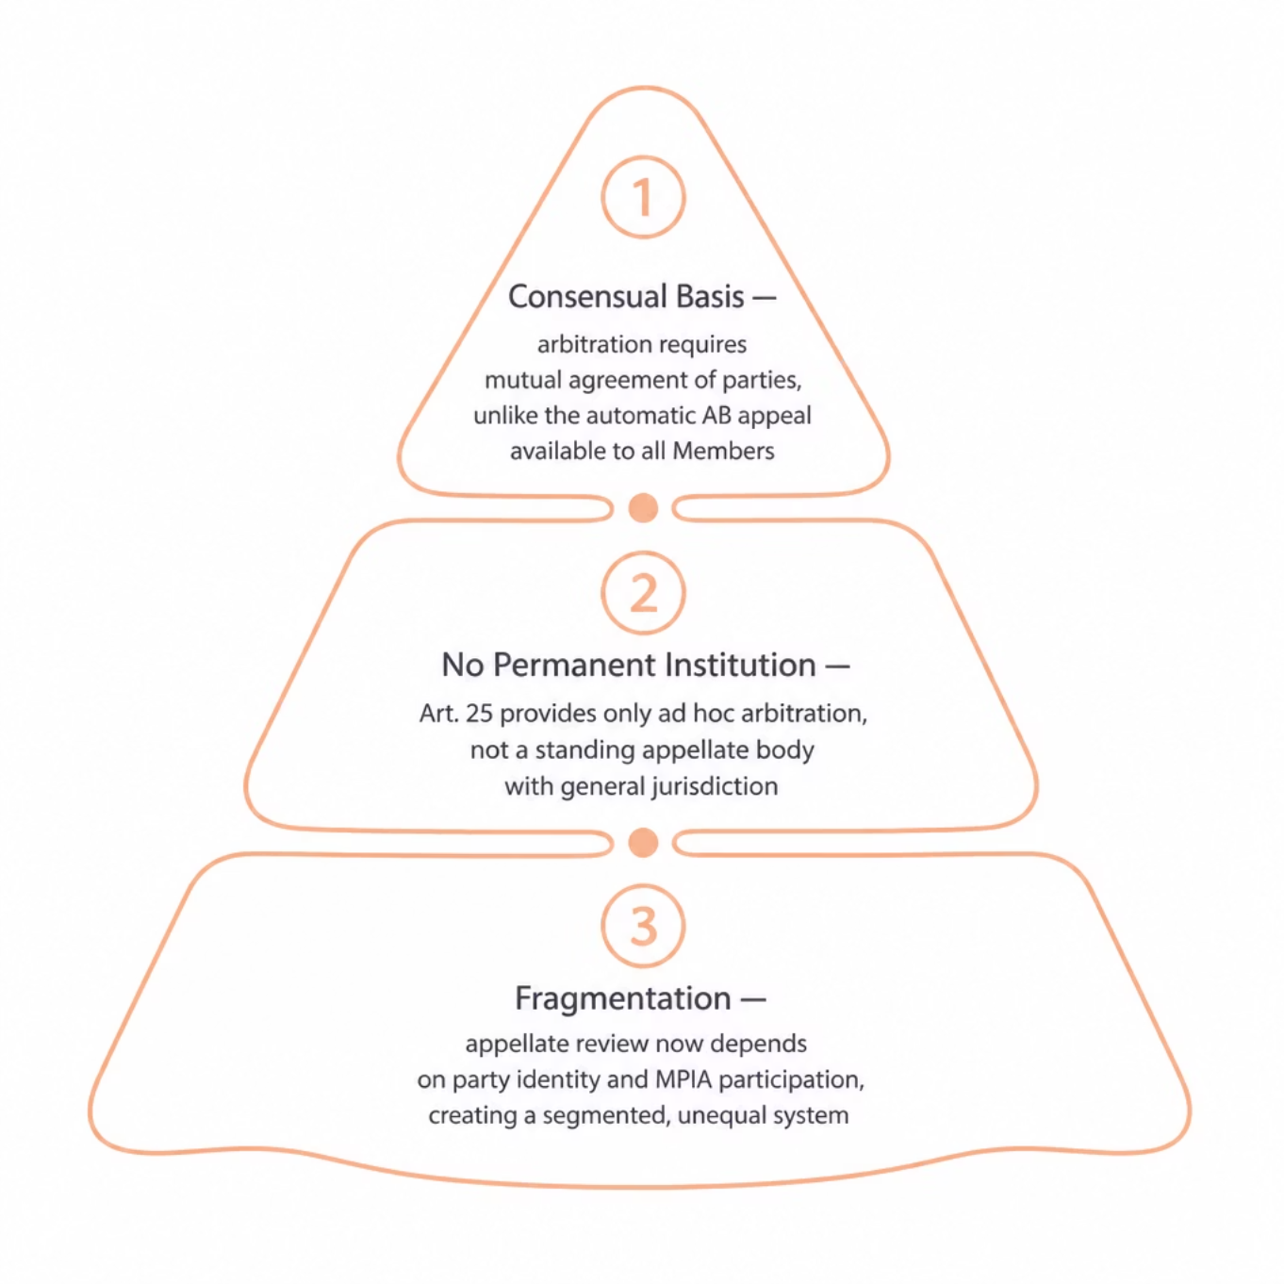
Structural Limits: Why Article 25 and MPIA Cannot Fully Replace the AB
The Core Distinction
Article 25 DSU can replace a function: reviewing legal issues after the panel stage- It cannot restore the institution that originally performed that function.
Fragmentation in Practice
MPIA Members such as China and the EU have simultaneously used appellate arbitration in some disputes while filing appeals into the void in others (e.g., DS558, DS618), depending solely on whether the opposing party participates in the MPIA.
Alternative: Majority Voting
Some scholars propose appointing AB members by majority vote under Art. IX:1 of the Marrakesh Agreement, restoring the permanent institution rather than substituting it with consensual arbitration.

Slide 10
Interim Response, Not Institutional Solution
What Art. 25 and MPIA Achieve
What They Cannot Do
Preserve judicial review beyond the panel stage
Operate within the WTO legal framework
Demonstrate practical feasibility
Address procedural criticisms of the AB
Establish a universal right of appeal
Create a permanent appellate institution
Prevent fragmentation across Members
Eliminate appeals into the void
Article 25 DSU and the MPIA should be understood as a valuable interim responses to the crisis, not as the definitive institutional solution. The long-term resolution lies in reestablishing a truly multilateral and stable appellate adjudication system within the WTO.

