Slide 1

19 june 2024
Emilia de Kerchove

Slide 2


HOW? BUYING OUT

Slide 3
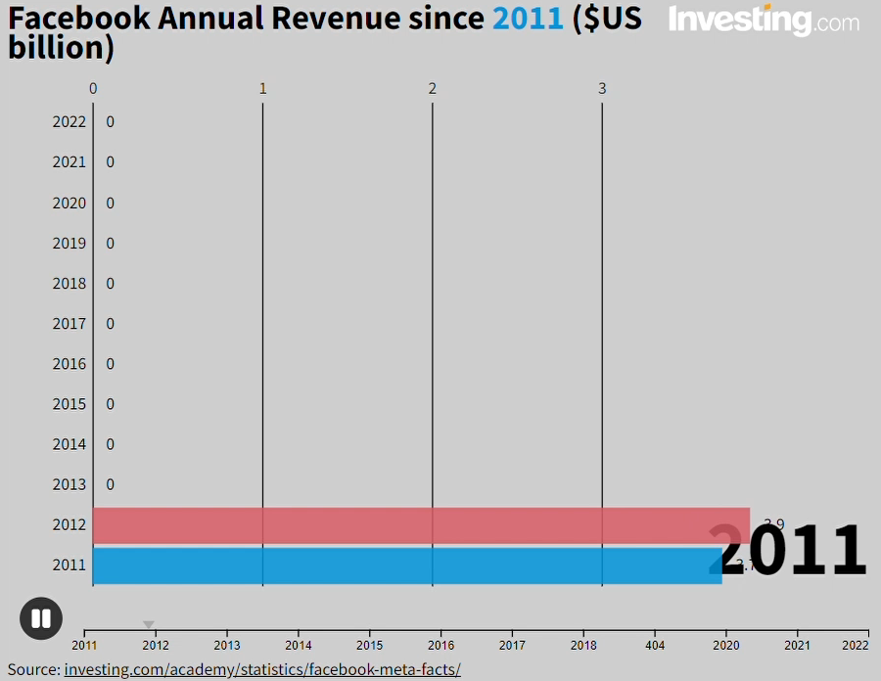



FACEBOOK (ACQUIRING FIRM)
ACQUIRED FIRM
Launched in 2010
Acquired in 2012 – 1billion
NO turnover / 27 MM users
Launched in 2009
Acquired in 2014 – 19billion
10 MM turnover / 600 MM users ww
EU threshold = 5000 MM/2500 MM
combined turnover

Slide 4


EX ANTE
DMA
Merger Control
Referral Policy
Theories of Harm

Slide 5

Strengthen Control of Acquisitions
1st step → Amend procedural net
Complementary notification thresholds in the DMA

Slide 6


THANK YOU
FOR LISTENING

