Slide 1

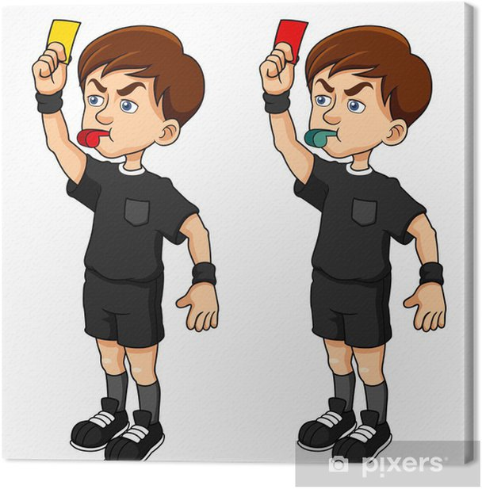
The powers of the Court of Arbitration for Sport
A red card?
June 20, 2024

Slide 2

Today
1) Problem identification
2) Arguments in favor
3) Arguments contra

Slide 3

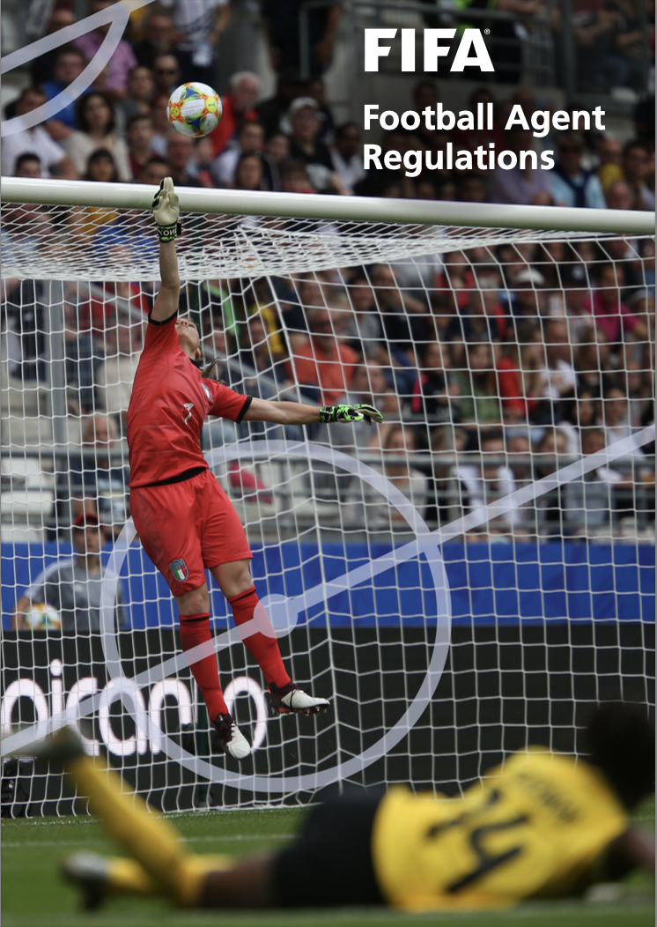
Problem identification

Slide 4


Problem identification
V.

Slide 5
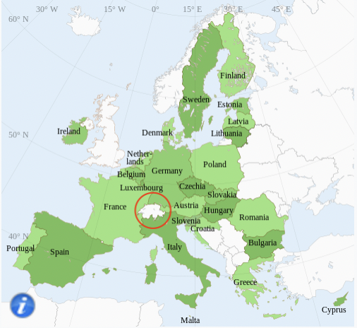
Problem identification

Slide 6
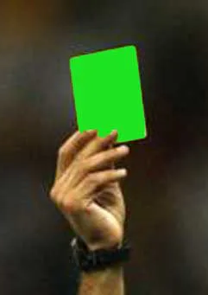
Arguments in favor
1) CAS as the sole instance court
2) Arbitrability of EU Competition Law
3) Obligation for arbitrators to apply EU Competition Law

Slide 7
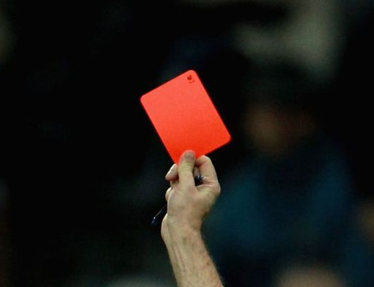
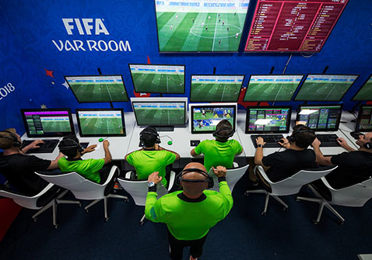
Arguments contra
1) Lack of knowledge
2) No judicial review
3) No public policy

Slide 8
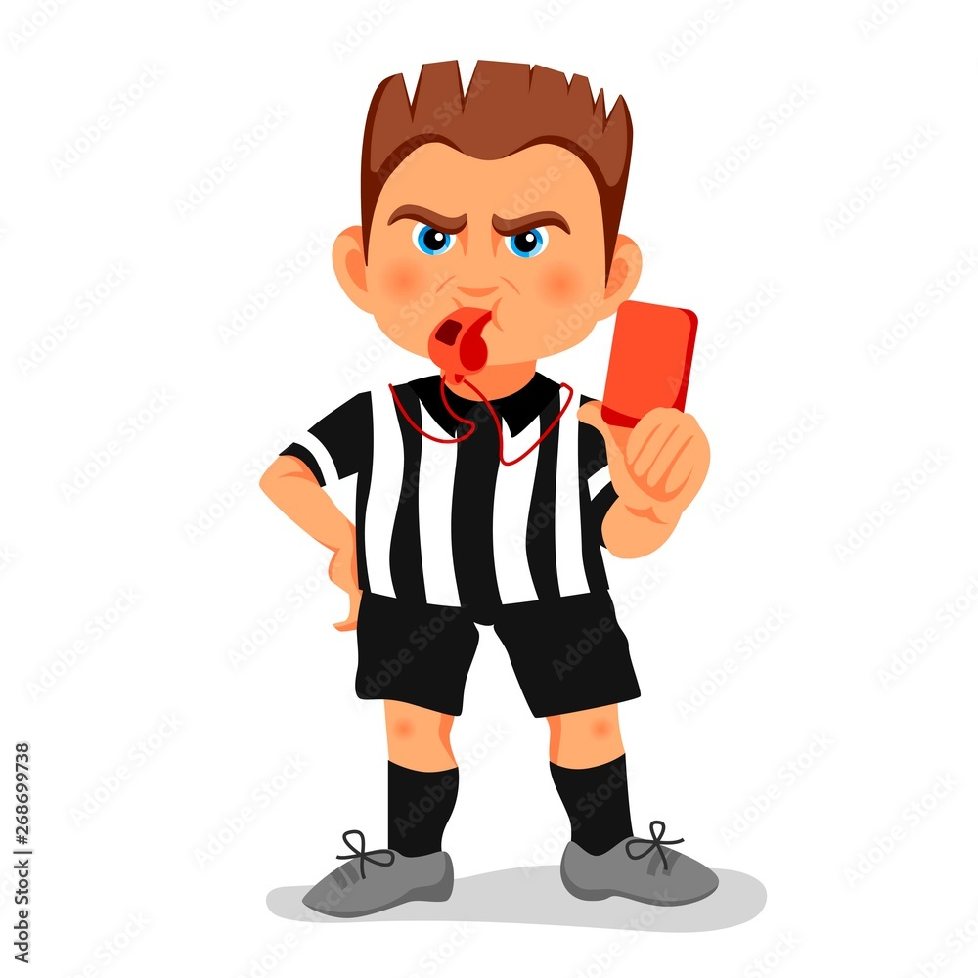
Legal uncertainty

