Slide 1

Your healthcare
in Belgium
A visual guide for international students
Academic year 2026–2027
Notes:
Partner identity: LL.M. in International Business Law at Université libre de Bruxelles. https://www.brusselsllm.com/
Original partner logo: https://www.brusselsllm.com/wp-content/uploads/2023/02/llm_ulb_logo.png

Slide 2

The Belgian healthcare system
Three key players connect healthcare rules to reimbursements.
Social security
It funds a large share of healthcare costs.
INAMI
It sets the rules and reimbursement rates.
Partenamut
It activates your entitlements, reimburses you
and supports you.
2
Notes:
Speaker notes
In Belgium, compulsory healthcare insurance is regulated by INAMI. The reimbursement rules under this compulsory insurance are identical across all health insurance funds. The health insurance fund is the practical point of contact: it checks eligibility, opens entitlements and processes reimbursements.
Clarification
For employees, the ONSS collects social security contributions, among other duties. For students, how entitlements are established depends primarily on their foreign coverage, school enrolment and residence status.
Transition
Let’s see what this coverage changes in everyday life.
[Sources]
- Presentation Expats Partenamut.pptx, slides “How Belgian social security works” and “What your mutuality does for you”.
- INAMI, “Healthcare: costs and reimbursement”: https://www.inami.fgov.be/fr/themes/soins-de-sante-cout-et-remboursement
- Visuals cropped from Presentation Expats Partenamut.pptx.
[/Sources]

Slide 3



Your coverage in everyday life
You may still have to pay part of the costs.
Doctors & specialists
Consultations are partially reimbursed.
Pharmacy
Some medicines are reimbursable.
Hospital
The statutory share is sent to your
health insurance fund.
3
Notes:
Speaker notes
At the doctor’s office, you will often pay for the consultation and then receive a reimbursement based on the applicable rates and the provider’s status. At the pharmacy, third-party payment may allow you to pay only your personal share. At the hospital, the portion covered by compulsory insurance is generally billed directly to the health insurance fund.
Terminology
The amount that remains payable by the patient is called the personal share or co-payment. Additional charges may apply, for example when using a non-contracted provider or staying in a private room.
Transition
The compulsory reimbursement level follows the same rules; what changes first for students is how they establish their entitlements.
[Sources]
- Presentation Expats Partenamut.pptx, slides “Reimbursements in practice” and “Your cover decoded”.
- INAMI, “Healthcare services reimbursed by your health insurance fund”: https://www.inami.fgov.be/fr/themes/soins-de-sante-cout-et-remboursement/les-prestations-de-sante-que-vous-rembourse-votre-mutualite
- Visuals cropped from Presentation Expats Partenamut.pptx.
[/Sources]

Slide 4
01
Find your status
Three routes. The right questions
help you choose quickly.
4
Notes:
Transition
Ask the students to consider three things: the country that insures them, the validity of their EHIC, and whether they are registered with the municipality.
[Sources]
- Partenamut, “Healthcare system in Belgium”: https://www.partenamut.be/fr/assurance-sante-belgique/systeme-sante-belgique
[/Sources]

Slide 5
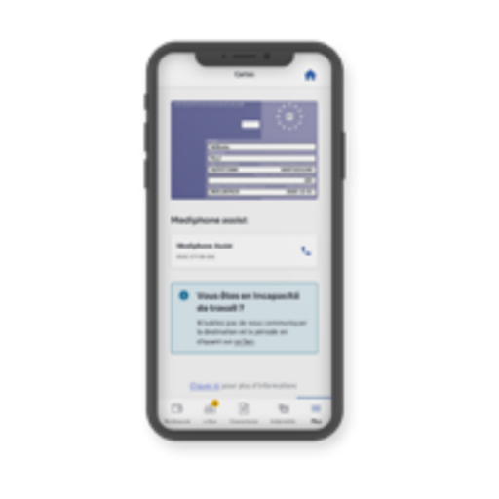

Route 1: EHIC
EU / EEA / Switzerland, with a temporary stay in Belgium
Valid EHIC
Required
Identity card
Required
Registration in Belgium
€0
Registration period
1 year
Renewal
Every year
5
Notes:
Who is this for?
A student insured by an EU or EEA country or Switzerland, with a valid EHIC during their temporary stay.
Documents
- Valid European Health Insurance Card.
- Identity card.
Effect of registration
Partenamut states that registration based on the EHIC is free for one year and renewable. It allows students to request reimbursements directly in Belgium. The EHIC gives access to medically necessary healthcare during the stay; it does not replace comprehensive travel insurance.
Transition
Without an EHIC and without registration with the municipality, the next route is generally student status.
[Sources]
- Partenamut, “Healthcare system in Belgium”, EU students section: https://www.partenamut.be/fr/assurance-sante-belgique/systeme-sante-belgique
- Partenamut, “Health insurance for students in Belgium”, EHIC FAQ: https://www.partenamut.be/fr/assurance-sante-belgique/etudiants
- INAMI, “Studying in another EEA country or Switzerland”: https://www.inami.fgov.be/fr/themes/soins-de-sante-cout-et-remboursement/international/etudier/vous-allez-etudier-dans-un-autre-etat-membre-de-l-espace-economique-europeen-eee-ou-en-suisse
- Visuals cropped from Presentation Expats Partenamut.pptx.
[/Sources]

Slide 6

Route 2: Student
Non-EU student enrolled at a school, without municipal registration
Identity card or passport
School enrolment certificate
Membership form
Statutory contribution in 2026
€78.93
Payment frequency
Quarterly
6
Notes:
Who is this for?
A student arriving from a non-EU country who is enrolled at a school but is not registered with the municipality, under the route described by Partenamut.
Documents and procedure
- Identity card or passport.
- School enrolment certificate.
- Membership form to be completed.
Contribution
INAMI sets the statutory personal contribution for students at €78.93 per quarter from 1 January 2026. Once registration and payment are up to date, entitlement to reimbursement can be activated. Present this amount as the 2026 statutory rate, which may be indexed in the future.
Partenamut clarification
The Partenamut supplementary insurance contribution, shown in internal documents as €14.75 per month per policyholder, is separate from this statutory contribution.
[Sources]
- Partenamut, “Healthcare system in Belgium”, non-EU student section: https://www.partenamut.be/fr/assurance-sante-belgique/systeme-sante-belgique
- INAMI, “Personal contribution required for insurance”: https://www.inami.fgov.be/fr/themes/soins-de-sante-cout-et-remboursement/assurabilite/cotisation-personnelle-pour-etre-assure-si-vous-ne-payez-pas-de-cotisations-sociales
- Présentation RH Expats Payeur.pptx — Partenamut supplementary contribution.
- Visuals cropped from Presentation Expats Partenamut.pptx.
[/Sources]

Slide 7
Route 3: Resident
Non-EU student registered with the municipality
Contribution based on income
Identity card or passport
School enrolment certificate
Household composition certificate
Residence permit
Membership form + declaration
7
Notes:
Who is this for?
A non-EU student who is enrolled at a school and is also registered with the municipality, under the public route described by Partenamut.
Basic documents
- Identity card or passport.
- School enrolment certificate.
- Household composition certificate.
- Residence permit.
- Membership form and declaration on honour.
Contribution
The statutory contribution depends on the household’s annual gross taxable income. For 2026, the official sources consulted indicate a range of €0 to €931.12 per quarter. Partenamut reviews the income and determines the applicable amount.
Internal note
The Partenamut and INAMI webpages give different figures for a reduced intermediate bracket: €468.55 versus €465.55. The presentation therefore does not include this bracket until it has been confirmed.
Timing
Partenamut states that resident membership takes effect on the first day of the quarter in which the membership form was signed, provided the required documents are received within the relevant deadlines.
[Sources]
- Partenamut, “Healthcare system in Belgium”: https://www.partenamut.be/fr/assurance-sante-belgique/systeme-sante-belgique
- Partenamut, “Contributions for residents in Belgium”: https://www.partenamut.be/fr/situations-de-vie/cotisations-residents-belgique
- INAMI, “Personal contribution required for insurance”: https://www.inami.fgov.be/fr/themes/soins-de-sante-cout-et-remboursement/assurabilite/cotisation-personnelle-pour-etre-assure-si-vous-ne-payez-pas-de-cotisations-sociales
- Visuals cropped from Presentation Expats Partenamut.pptx.
[/Sources]

Slide 8
Three students, three routes
Same campus, different procedures.
Lucía, Spain
EHIC route: €0, renewable annually.
Amir, Morocco
No municipal registration.
Student route: €78.93 per quarter in 2026.
Maya, Canada
Registered with the municipality.
Resident route: contribution based on income.
8
Notes:
Scenario
Lucía is insured in Spain and has a valid EHIC, so she follows the EHIC route. Amir is enrolled at a school but is not registered with the municipality, so he follows the student route described by Partenamut. Maya is enrolled at a school and registered with the municipality, so her case follows the resident route.
Key message
Nationality alone is never enough to make the decision. Check the student’s existing coverage, the validity of their EHIC, school enrolment and registration with the municipality. Employment or another European document may change the route.
Contributions to mention verbally
- EHIC: free one-year registration with Partenamut, renewable.
- Student: €78.93 per quarter in 2026.
- Resident: €0 to €931.12 per quarter, depending on income.
Documentation note
The Partenamut webpage shows €468.55 for a reduced intermediate resident bracket, while the 2026 INAMI webpage shows €465.55. To avoid presenting contradictory information, the slide does not show this bracket and recommends an individual assessment.
Practical conclusion
Remember your route and prepare the corresponding documents. Specific situations should be checked with Partenamut.
Transition
Let’s move on to questions.
[Sources]
- Partenamut, “Healthcare system in Belgium”: https://www.partenamut.be/fr/assurance-sante-belgique/systeme-sante-belgique
- INAMI, “Personal contribution required for insurance”: https://www.inami.fgov.be/fr/themes/soins-de-sante-cout-et-remboursement/assurabilite/cotisation-personnelle-pour-etre-assure-si-vous-ne-payez-pas-de-cotisations-sociales
- Présentation RH Expats Payeur.pptx, slide “Why Partenamut immediately engages with an international employee”.
- Visuals cropped from Presentation Expats Partenamut.pptx.
[/Sources]

Slide 9
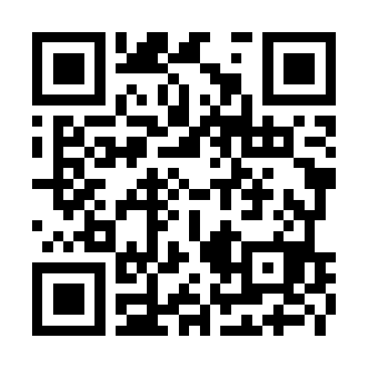
Questions? Let’s make it easy
Book an appointment
appointment.partenamut.be
+32 2 44 44 111
9
Notes:
Closing contact and original QR code taken from the final slide of Partenamut_St_Johns_2026_Visual.pptx. The school-specific DKV contract note is omitted for the Brussels LL.M. audience.

